Slide 1
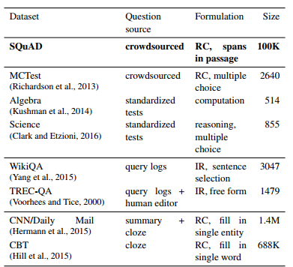
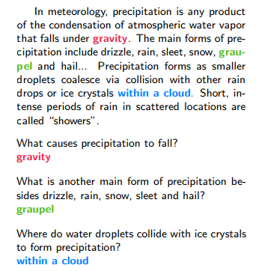
Reading comprehension (RC)
Squad: 100,000+ questions for machine comprehension of text (Rajpurkar acl’2016)

Slide 2
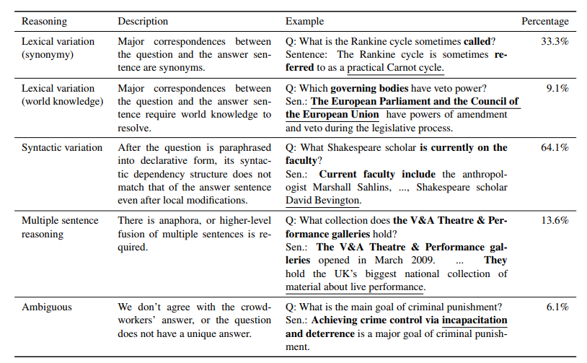
Reading comprehension (RC)
Squad: 100,000+ questions for machine comprehension of text (Rajpurkar acl’2016)

Slide 3
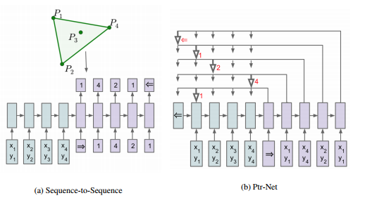

Pointer networks ( Vinyals nips’2015)
Motivation: It deals with the fundamental problem of representing variable length dictionaries by using a softmax probability distribution as a “pointer”.

Slide 4



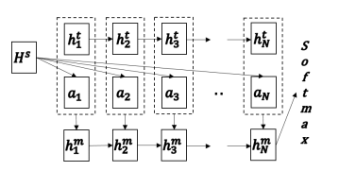

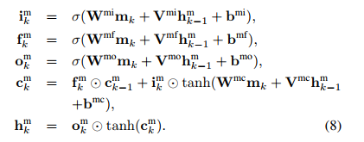
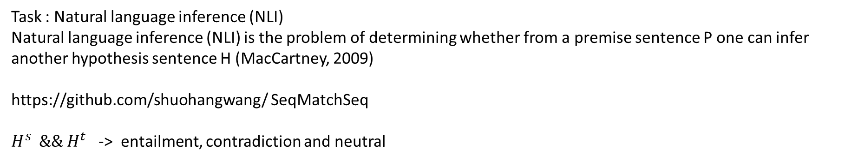
Learning natural language inference with LSTM(Wang NAACL’2016 )
Task : Natural language inference (NLI)
Natural language inference (NLI) is the problem of determining whether from a premise sentence P one can infer another hypothesis sentence H (MacCartney, 2009)
https://github.com/shuohangwang/ SeqMatchSeq
$H^{s } \&\& H^{t}$ -> entailment, contradiction and neutral

Slide 5












MACHINE COMPREHENSION USING MATCH-LSTM AND ANSWER POINTER(wang ICLR’2017)
Task: reading comprehension(RC)

Slide 6
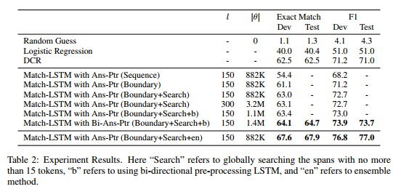
MACHINE COMPREHENSION USING MATCH-LSTM AND ANSWER POINTER(wang ICLR’2017)
Task: reading comprehension(RC)

Slide 7

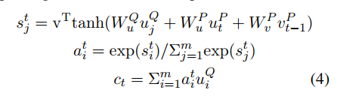


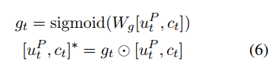
R-net (msra,2017)
Task: reading comprehension(RC)

Slide 8

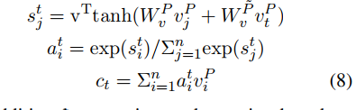


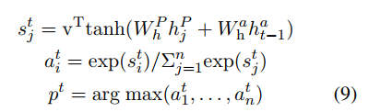


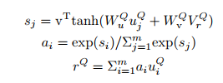
R-net (msra,2017)
Task: reading comprehension(RC)
Output layers initial hidden state

Slide 9
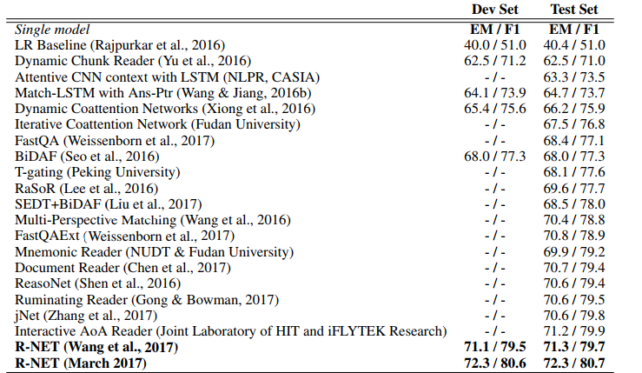
R-net (msra,2017)
Task: reading comprehension(RC)

Slide 10
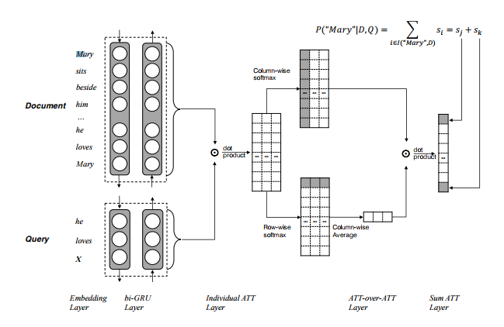
AoA reader (hit,2016)
Task: factoid reading comprehension(RC)

Slide 11
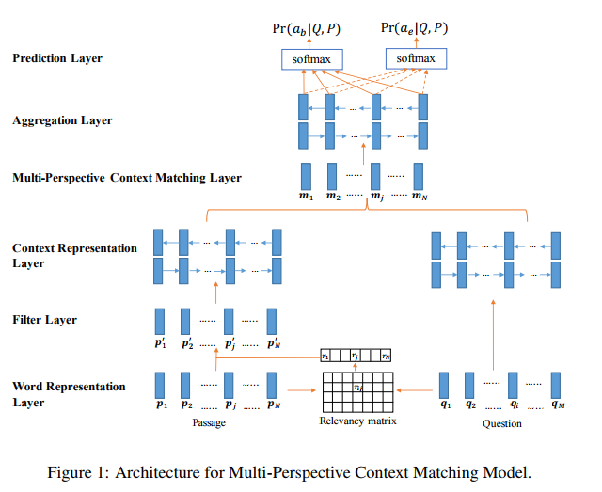





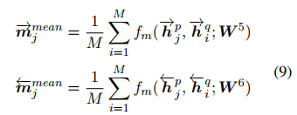
Multiperspective matching (wang,2016)
Task: reading comprehension(RC)

Slide 12













Reading Wikipedia to Answer Open-Domain Questions(chen,ACL’2017)
Task: retrieval and reading comprehension(RC)

Slide 13




Reading Wikipedia to Answer Open-Domain Questions(chen,ACL’2017)
Task: retrieval and reading comprehension(RC)
For Cloze test

Slide 14
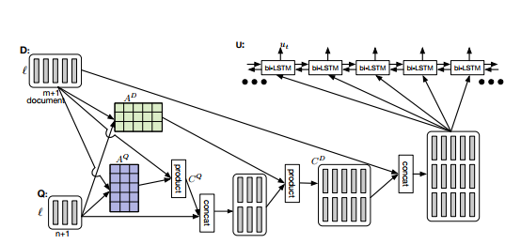




DYNAMIC COATTENTION NETWORKS FOR QUESTION ANSWERING(saleforce,iclr2017)
Task: reading comprehension(RC)

Slide 15

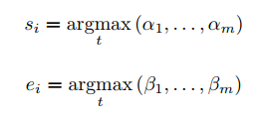
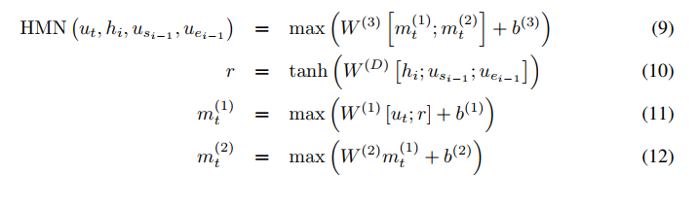

DYNAMIC COATTENTION NETWORKS FOR QUESTION ANSWERING(saleforce,iclr2017)
Task: reading comprehension(RC)

Slide 16
DYNAMIC COATTENTION NETWORKS FOR QUESTION ANSWERING(saleforce,iclr2017)
Task: reading comprehension(RC)

Slide 17
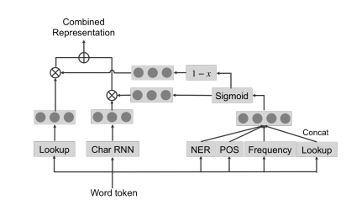
Words or Characters? Fine-grained Gating for Reading Comprehension( 2017’ICLR)
Task: reading comprehension(RC)

