Slide 1
UE24CS352A · MACHINE LEARNING · MINI-PROJECT
Latent Feature Extraction for Musical Genres from Raw Audio
Re-implementing the Stanford CS229 Deep Softmax Autoencoder, testing it honestly, and extending it
Amogh Sharma
PES1UG24CS053
Amartya Sinha
PES1UG24CS051
PES1UG24CS053 · PES1UG24CS051
1
Notes:
Introduce the project, the paper we re-implemented, and ourselves.

Slide 2
What the paper asked
Task Raw audio samples to genre encodings, with no MFCCs, spectrograms or other hand-made features.
The question
1
Can a network learn what makes classical sound classical and metal sound like metal, straight from the sound wave, without anyone telling it which audio properties to measure?
Method A Deep Softmax Autoencoder: 64 numbers that must both rebuild the clip and predict its genre.
2
Evaluation Accuracy, precision, recall and F1, plus PCA pictures of the encodings.
3
Why it matters: a compact style vector is the first step to music style transfer, like neural style transfer for images.
Left open Latent interpolation, an external task for the encodings, more genres, a better autoencoder.
4
PES1UG24CS053 · PES1UG24CS051
2
Notes:
The base paper (Sawhney, Vasavada, Wang; CS229 2018) wants an encoding of musical style for style transfer. Style is undefined for music so they use genre as a stand-in. Their rule: no feature engineering, learn straight from the waveform.

Slide 3
Data: from a song to 500 numbers
30 s song
20,000-sample clip
Average pool, 40
500-dim input
›
›
›
661,500 samples
mono, 22.05 kHz
0.9 s, 20 clips
per song
mean of every 40
neighbouring samples
one scaled vector
per clip
400
8,000
6,000 / 1,000 / 1,000
276 Hz
songs: classical, jazz, metal, pop
clips (400 x 20)
train / dev / test
highest frequency left after pooling
PES1UG24CS053 · PES1UG24CS051
3
Notes:
GTZAN: 1000 songs, 10 genres, we use the same four genres as the paper. A song is 30 s at 22,050 Hz = about 661,500 samples. Clips of 20,000 samples = 0.907 s. Average pooling with window 40 gives 500 numbers. 22,050/40 = 551 values per second so only content under 276 Hz survives - that is the bass, kick drum and loudness. This explains much of what we found later.

Slide 4
Three models from the paper
Two Layer
Neural Network
500
128
4
Vanilla
Autoencoder
500
256
192
128
64
128
192
256
500
Deep Softmax
Autoencoder
500
256
192
128
64
128
192
256
500
plus a classifier on the 64-dim encoding:
64
32
16
4
tanh units everywhere, dropout 0.1 (none in the two-layer net)
PES1UG24CS053 · PES1UG24CS051
4
Notes:
All use tanh units and dropout 0.1 (not in the two-layer net). The Vanilla autoencoder is unsupervised. The DSAE shares the encoder and adds a 64-32-16-4 classifier head on the bottleneck, so the 64 numbers must serve two jobs.

Slide 5
One loss, two jobs for 64 numbers
loss = γ · reconstruction + (1 − γ) · cross-entropy
Training setup (paper)
Optimiser | Adam
Learning rate | 1e-4
Batch size | 512
Epochs | 500
Dropout | 0.1
Activation | tanh
Init (ours) | Xavier
Seed | 229
γ = 0.9: rebuild the clip, but still make the genre readable
Reconstruction: mean squared error between the 500 scaled inputs and the decoder output
Cross-entropy: −log of the probability given to the correct genre (softmax of 4 logits)
Our choice: a mean, not a sum, so both terms share a scale
PES1UG24CS053 · PES1UG24CS051
5
Notes:
Equation 3 of the paper. The classification gradient flows back through the bottleneck into the encoder. Gamma 0.9 weights reconstruction nine times more. NOTE: the paper writes a sum over 500 values; we use a mean because a sum would be about 500 times larger than the cross-entropy and the classifier would not learn.

Slide 6
Reproducing the paper
Ranking holds: the DSAE beats the baseline on both splits
We get 56.3% where the paper reports 65.3%; the paper leaves details open
Holding out whole songs costs the DSAE 4 points and the baseline 6.5
Clips of one song in both train and test inflate the score
PES1UG24CS053 · PES1UG24CS051
6
Notes:
Our DSAE beats the two-layer net on both splits, as in the paper, but we do not reach 65.3 percent. The paper leaves details open (which clips, scaling, epoch). The two-layer net is actually higher than the paper's because their baseline was under-trained. On unseen songs both fall further: the random split leaks.

Slide 7
Three problems we found
96.7% vs 49.2%
62.0%
30 pairs
train vs dev accuracy of the DSAE
from loudness alone
duplicate recordings in GTZAN
The network memorises its 6,000 fixed training clips.
One hand-made number beats the paper-style DSAE (52.2%).
5 of 50 test songs had a copy in training; the DSAE looked 5 points better.
PES1UG24CS053 · PES1UG24CS051
7
Notes:
1) Memorisation: with 20 fixed clips per song the network sees the same 6000 waveforms 500 times. 2) A single hand-made number, log RMS loudness, with logistic regression gets 62 percent on unseen songs, better than the paper-style DSAE. 3) GTZAN holds 30 recordings twice in these genres (13 jazz, 8 metal, 9 pop); some shifted by up to 0.18 s. We detect them by correlating loudness envelopes and keep both copies in training. Before the fix 5 of 50 test songs had a copy in training and the DSAE scored 57.3 instead of 52.2.

Slide 8
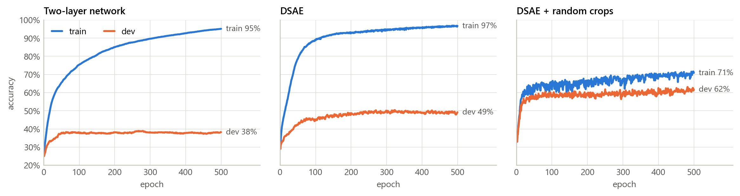
Our fix: random crops
Accuracy during training, unseen-songs split. Left and middle: fixed clips are memorised. Right: random crops.
52.2% → 66.8%
+14.6 pts
same cost
DSAE test accuracy on unseen songs
above the paper's 65.3% on a stricter test
same model, loss, epochs, steps per epoch
PES1UG24CS053 · PES1UG24CS051
8
Notes:
A 30 s song has far more than 20 possible clips. Every epoch our CropSampler cuts 20 new windows from each training song at random positions (multiples of 40 samples so that each song is pooled once). Architecture, loss, epochs and test clips are unchanged. Without memorisation the network tolerates and needs lr 1e-3, chosen on the dev set. Dev accuracy rises from 49 to 62 percent.

Slide 9
Ablation: crops or learning rate?
An honest finding
With random crops the plain two-layer network (66.8%) matches the DSAE (66.9%).
So the DSAE's value is its 64-dim encoding with a decoder, not its accuracy. Both new features use exactly that.
PES1UG24CS053 · PES1UG24CS051
9
Notes:
We changed two things together, so we separated them. With fixed clips a bigger learning rate does not help (the network only memorises faster). With crops the DSAE already gains at 1e-4, the two-layer net needs 1e-3. With crops the plain two-layer network (66.8) equals the DSAE (66.8-66.9): the paper's claim that the hybrid design is needed for accuracy does not survive proper training. The DSAE's value is the encoding with a decoder.

Slide 10
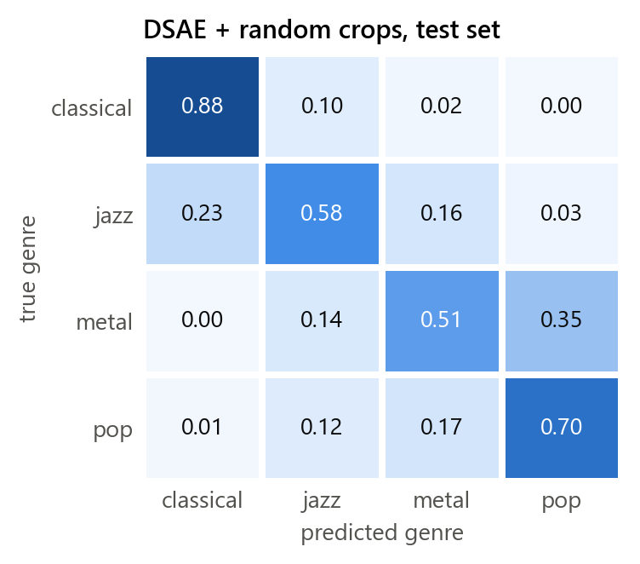
Which genres get confused
Genre | Paper F1 | DSAE | + crops
classical | 0.779 | 0.783 | 0.835
jazz | 0.616 | 0.429 | 0.591
metal | 0.534 | 0.402 | 0.555
pop | 0.638 | 0.440 | 0.665
Classical is easiest, as in the paper
Errors are between genres neighbouring in loudness
Whole-song vote: 70% of 50 unseen songs
PES1UG24CS053 · PES1UG24CS051
10
Notes:
Rows are true genres, columns are predictions, on 1,000 test clips from 50 unseen songs. Classical is easiest as in the paper. Mistakes are between neighbours in loudness: classical-jazz, jazz-metal, metal-pop. Our F1 with crops matches or beats the paper's on classical, metal and pop and is close on jazz, under the stricter protocol.

Slide 11
What do the encodings actually hold?
How to read it
Loudness alone gives 62.0%, more than the paper-style DSAE
The vanilla autoencoder keeps almost no genre: no labels, no reason to
Only the crops-trained DSAE encoding beats loudness (66.2%)
Average clip RMS rises: classical 0.020, jazz 0.053, metal 0.105, pop 0.148
PES1UG24CS053 · PES1UG24CS051
11
Notes:
A linear probe freezes the representation and trains a logistic regression on it: how linearly readable is genre? The vanilla autoencoder keeps almost no genre (37.1 percent) as the paper says. Only the encoding of the DSAE trained with random crops beats the loudness number. The PCA picture shows the DSAE encodings stretched along one dominant direction (84 percent of variance for the crops model) - which is loudness.

Slide 12
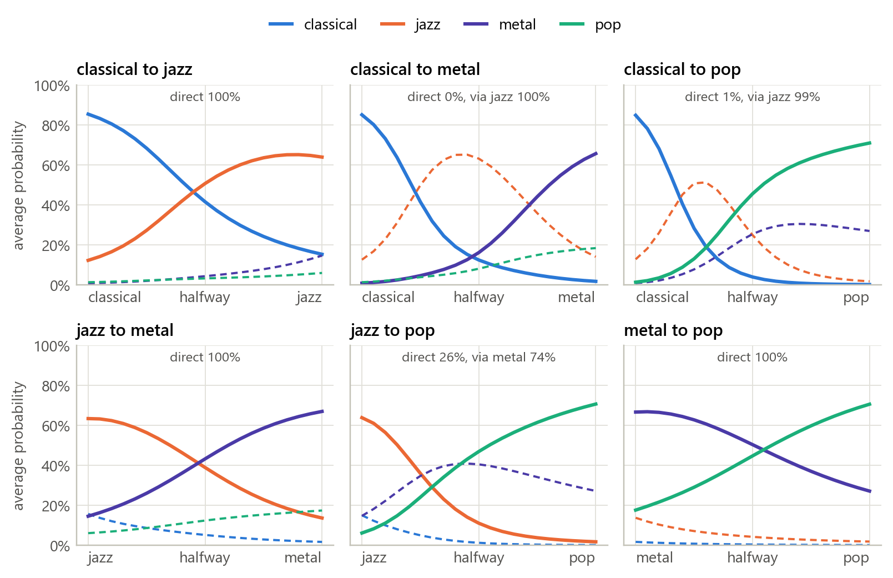
New feature 1: Genre morph
z(t) = (1 − t) · zA + t · zB
Walk a straight line between two 64-dim encodings; classify and decode every step
Genres form a chain: classical, jazz, metal, pop, the order of loudness
Classical to metal passes through jazz on 100% of walks
92%
70%
latent walks steady
audio cross-fades
PES1UG24CS053 · PES1UG24CS051
12
Notes:
The paper lists interpolating in the latent space as future work. z(t) = (1-t) zA + t zB. Every point on the line is a valid 64-dim input for the classifier head and for the decoder, so we can read a genre and draw a waveform at every step. 1,000 walks per genre pair, 21 steps, only between correctly classified clips. Direct = the top genre is only ever A or B. Steady = the target genre's probability never drops by more than one point. Reference: the same walk on the inputs, which is a plain cross-fade of the audio. Result: genres form a chain classical-jazz-metal-pop = order of loudness. 92 percent of latent walks are steady versus 70 percent for cross-fades.

Slide 13
New feature 2: Similar-song search
Fingerprint: mean clip encoding, centred, unit length
Similarity: cosine; library of 300 songs, 100 unseen queries
Nearest song has the right genre 68% of the time
Labels matter: the unsupervised autoencoder is worst (41%)
PES1UG24CS053 · PES1UG24CS051
13
Notes:
The paper plans to evaluate its embeddings in an extrinsic task. A song's fingerprint is the mean of its clip encodings, centred on the library mean and scaled to unit length; similarity is the dot product (cosine). Library: 300 training songs. Queries: the 100 dev and test songs the models never trained on. A hit is a result with the query's genre. Chance is 25 percent. Note MAP is higher for the paper-style DSAE because it memorised training songs so the library is sorted by label.

Slide 14
Experiment: the loss weight γ
γ = 0: only a classifier; γ = 1: only an autoencoder
Accuracy peaks at the paper's γ = 0.9
At 0.99 the classification signal is too weak
Test reconstruction MSE falls from 1.06 (γ=0) to 0.73 (γ=1)
PES1UG24CS053 · PES1UG24CS051
14
Notes:
We trained the paper-style DSAE with five values of gamma on the song split. gamma 1 is a pure autoencoder, the classifier is never trained and stays near guessing (33.2). Reconstruction error falls as gamma rises (1.064 to 0.731). Accuracy peaks at the paper's 0.9 and drops at 0.99. The paper's choice is reasonable.

Slide 15
Live demo and engineering
1
Live demo
2
Genre morph
Engineering
Pick a held-out song or upload one: genre, clip-by-clip vote, position in the latent map, decoder reconstruction, and the pooled audio the network hears.
Choose two songs and drag a slider from A to B: probability curves, path on the latent map, decoded waveform.
PyTorch on a laptop CPU, under 5 minutes per model
Every random choice seeded
20 unit tests, about 15 s
One command rebuilds all tables and figures
Config marks every value: paper or ours
3
Similar songs
4
Project results
The five nearest library songs with players, plus a map of the whole library.
Every table and figure from results/, for both split protocols.
PES1UG24CS053 · PES1UG24CS051
15
Notes:
Run streamlit run app.py in the main folder (needs the audio). Demo order: pick a classical test song, show prediction and clip-by-clip heat map; open 'Hear what the network hears'; Genre morph to pop; Similar songs; Project results. All results regenerate with python -m src.evaluate; 20 pytest tests need neither data nor weights.

Slide 16
Limits we should state
!
Band-limited input
!
Loudness is a big part of it
Pooling leaves only sound below 276 Hz: bass, kick, loudness. We kept it so results stay comparable with the paper.
Loudness depends on mastering as much as composition. The latent chain follows it.
!
Small test set
!
GTZAN faults
1,000 clips from 50 songs, one seed. Gaps of 2 to 3 points are within noise.
We removed duplicate recordings, not same-artist songs or mislabelled ones.
PES1UG24CS053 · PES1UG24CS051
16
Notes:
Be candid with the evaluators: these limits are the honest reading of our own results.

Slide 17
Conclusions
Reproduced, and checked The paper's ranking holds, but its split is optimistic: unseen songs and duplicate removal lower the DSAE from 56.3% to 52.2%.
1
Fixed memorisation Random crops lift unseen-song accuracy to 66.8%, with the same architecture, loss and compute.
2
Value is the encoding A plain two-layer net matches the DSAE once trained properly; the DSAE gives encoding plus decoder.
3
Two new uses Genre morph shows a smooth, loudness-ordered latent chain; similar-song search finds the right genre 68% of the time.
4
PES1UG24CS053 · PES1UG24CS051
17
Notes:
Four take-aways. Then offer the live demo.

Slide 18
Questions
Live demo: streamlit run app.py
Code: github.com/Chunnu-Munnu/ML_Project
Amogh Sharma
PES1UG24CS053
Amartya Sinha
PES1UG24CS051
PES1UG24CS053 · PES1UG24CS051
18
Notes:
Open the demo here.

