Slide 1
Sample problems from Ph 211.

Slide 2
A ball is thrown from the edge of a cliff at a height of h = 11 meters above a canyon floor at an angle of θ = 55° above the horizontal.
a. How far from the cliff does the ball hit the ground?
b. At what velocity does the ball hit the ground?

Slide 3
Given:
m₁ = 2.0 kg
m₂ = 5.0 kg
μ_{s} = 0.4
μ_{k} = 0.1
g = 9.8m/s²
h = 1.1 m
find the speed at which m₂ hits the ground.
m₁
m₂
h

Slide 4
You twirl a mass of m = 500 grams on a string of length L = 2.0 meters around in a horizontal plane at constant speed with a period of τ = 1.2 seconds.
What is the tension in the string?
m

Slide 5
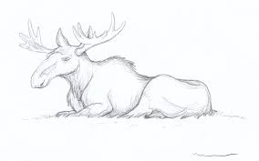
m₁
A frictionless roller-coaster car of mass m₁ = 900 kg slides down a roller coaster ramp from a height of h₁ that makes an angle of θ = 70° with respect to the horizontal. The car then goes around a loop-d-loop of radius R = 10 meters. After going up a distance of h₂ = 3 meters the roller-coaster car reaches a flat spot. A moose of m₂ = 500kg is laying on the tracks. The car runs into the moose moving it a distance of d = 400 meters before coming to a stop. The moose was not hurt.
What was h₁?
h₁
R
Moose friction information:
μ_{s} = 0.55
μ_{k} = 0.15
μ_{r} = unavailable
h₂

Slide 6
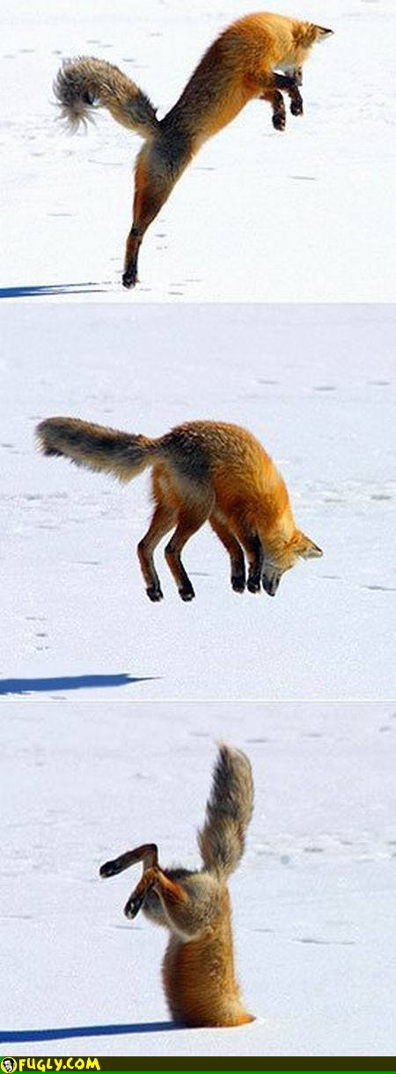
An artic fox will jump up in the air, aiming to hit the snow nose-first so to penetrate into the snow in order to catch rodents running around underneath.
A fox of mass m = 3.0kg will reach a maximum height of h = 95cm in order to end up a depth d = 25cm into the snow.
As the fox burrows through the snow, it experiences a depth dependent force that can be described by the equation F(s) = cs².
What is the value of c?

