Slide 1
Chapter 1 – Concepts of Motion
On your white boards, try creating a way to describe the motion of Mr. Cleese walking.
http://www.youtube.com/watch?v=IqhlQfXUk7w&feature=related
Sect. 1.1

Slide 2

Motion and the Particle Model
Chp 1.2

Slide 3
In groups with your white boards, create a particle motion diagram for:
A dust particle setting to the floor at constant speed.
A ball dropped from the roof of a building.
A descending rocket slowing to make a soft landing on Mars.
1.
2.
3.
Chp 1.2

Slide 4
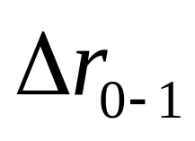
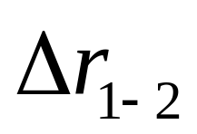

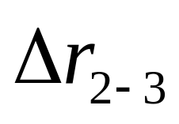


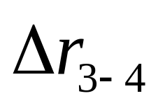

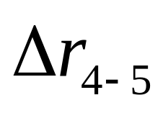

These would be position vectors
Let’s look more closely at the ball being dropped from the roof of a building.
These would be displacement vectors.
Sect. 1.3

Slide 5
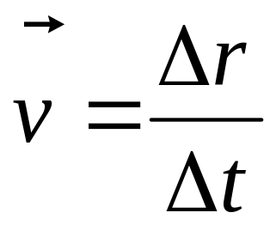
Velocity is thus a “displacement” per “time”.
Sec 1.4

Slide 6
Some definitions:
Speed and Velocity
“I’m travelling 90 kph.” – this is a speed, which is a scalar quantity.
“I’m travelling due North at 90 kph.”—this is a velocity, which is a vector quantity.
Units
Speed and Velocity have the same units. Some typical choices for units are:
miles
km
meters
hour
hour
second
Sec 1.4

Slide 7
Average Velocity vs. Instantaneous Velocity

Slide 8
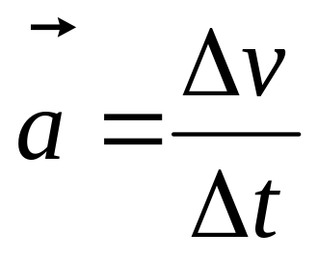
Acceleration
Acceleration is defined as the change in velocity with respect to time.
Chp 1.5

Slide 9

You throw a ball straight up in the air. At the top the acceleration is:
Up
Down
Zero

Slide 10
Acceleration
Let’s take a ball and throw it directly upward into the air.
B.
What does the velocity vector look like at points A., B., and C.?
What does the acceleration vector look like at points A., B., and C?
A.
C.
Chp 1.5

Slide 11
Acceleration
Let’s take a ball and throw it directly upward into the air. What is the acceleration at point A?
B.
A.
C.
Chp 1.5

Slide 12
Motion
John walks forward 20 meters in 2 seconds. He then stands still for 1 second. Next, he walks backwards 30 meters in 2 seconds. He then slowly moves forward 50 meters over 10 seconds.
position
time
velocity
time
Chp 1.6

Slide 13
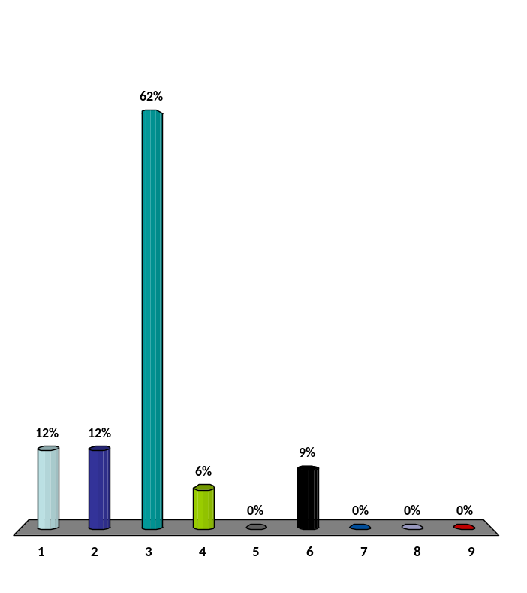
At t=0 the car is s=10meters. Where is the at 6 seconds?
40m
50m
60m
70m
80m
90m
100m
110m
120m
velocity
40m/s
time
3s
6s

Slide 14
Let’s try solving a problem:
m s
Sound travels at 331
If you are a bat, and you bounce a sound wave off a bug 2.0 meters away…
… how long does it take for that sound wave to get back to you from the time that you sent it?

Slide 15
First thing that you do in problem solving is always: Draw a Picture
2 meters
And, write down what you know:
Distance between bat and bug = 2.0 meters
Speed of Sound = 331 m/s

Slide 16
Distance between bat and bug = 2.0 meters
Speed of Sound = 331 m/s
If you don’t know what to do next, try thinking about a similar problem that you do know.
For example: If you are traveling 90kph, and you traveled for 2 hours, how far did you go?
From experience you know that you take 90 km/hr • 2 hours
Let’s put that into word : velocity • time = distance
Or: v • t = s

Slide 17
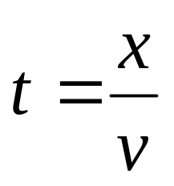
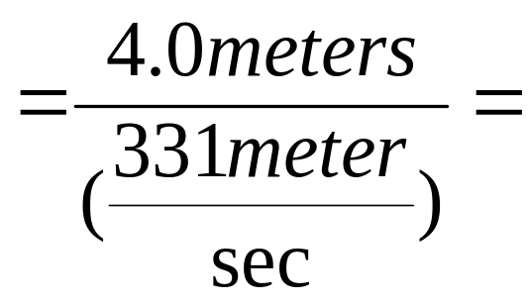
Distance between bat and bug = 2 meters
Speed of Sound = 330 m/s
v • t = s
2 meters
So, in this problem: v = 330 m/s
s = 4.0 meters
and t is the variable we want to solve for.
.0120845921s
=.012 s
Chp 1.9

Slide 18
Rules for significant figures:
Counting Significant Figures
4.322
0.4322
4.3220
400
Scientific Notation
Multiplication of Significant Figures
When multiplying (or dividing) your result should have the same number of significant digits as the measured value with the least number of significant digits. For example: 4.32 * 4.3 =
Addition of Significant Figures
When adding (or subtracting) you keep the largest last significant digit.
Sect 1.7

Slide 19
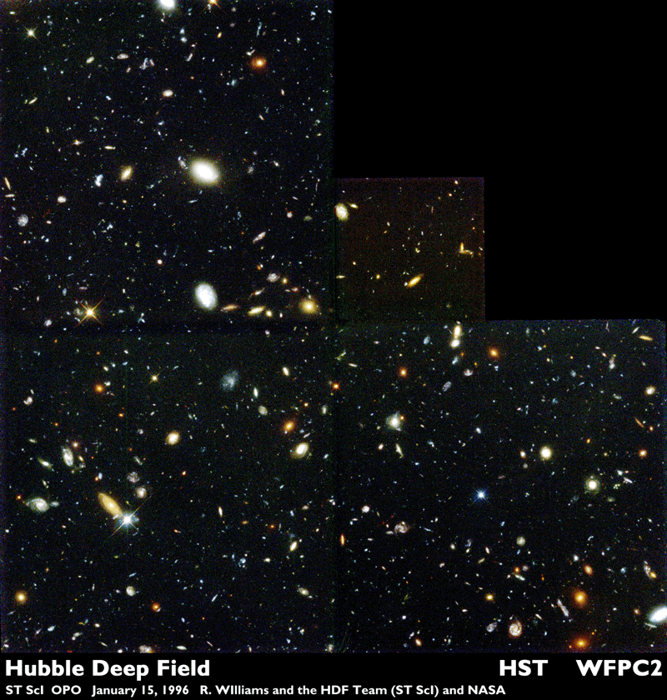
Let’s try an example:
The Hubble Deep Field Image contains 2.1·10³ galaxies and it covers 1/9,891,000th of the entire sky.
Our galaxy contains about 432 billion suns.
With this information, approximate the total number of suns in the Universe.
Sect 1.7

Slide 20
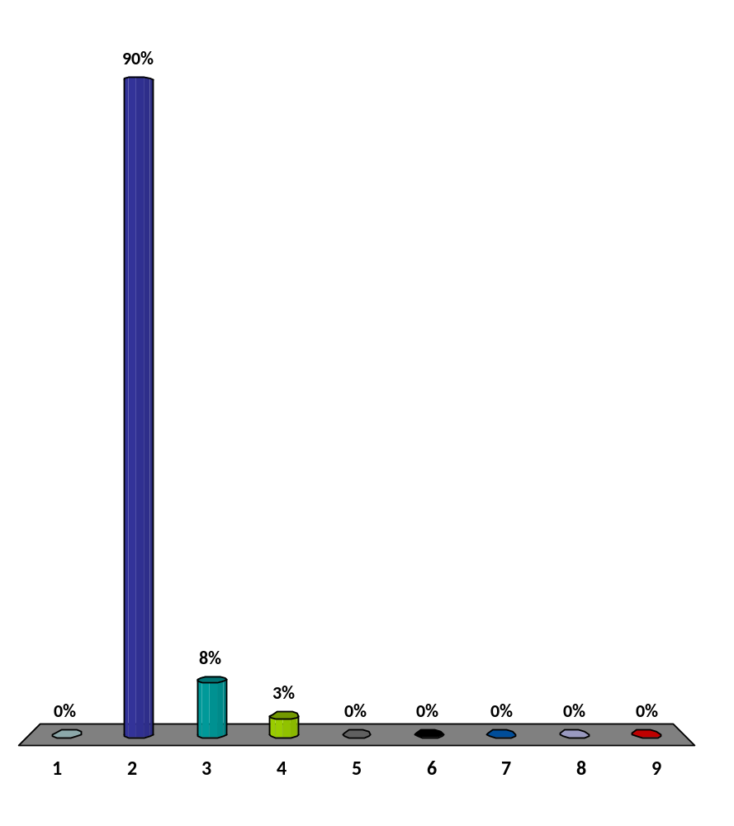

How many sig. figs. did your answer have?
1
2
3
4
5
6
7
8
9
Response Grid

Slide 21
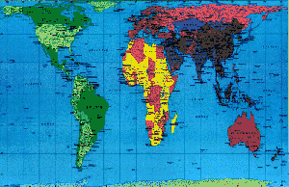
Units of Measurements
95% of the human population uses SI Units.
Only three countries don’t:
U.S. Liberia Sultan of Oman
Sect. 1.8

Slide 22

10¹²
10⁹
10⁶
10³
10⁰
1,000,000,000,000
1,000,000,000
1,000,000
1,000
1
Tera-
Giga-
Mega-
Kilo-
T
G
M
k
Sect. 1.8

Slide 23
10⁰
10⁻¹
10⁻²
10⁻³
10⁻⁶
10⁻⁹
10⁻¹²
1
.1
.01
.001
.000001
.000000001
.000000000001
deci-
centi-
milli-
micro-
nano-
pico-
d
c
m
μ
n
p
Sect. 1.8

Slide 24
Describe the position, velocity, and acceleration profiles for the following case:
Motion Detector
The Cart is given a brief “kick”. It travels up the ramp, momentarily comes to rest at the top of the ramp, and then rolls back down.

Slide 25
Position
time
Velocity
time
Acceleration
time

Slide 26
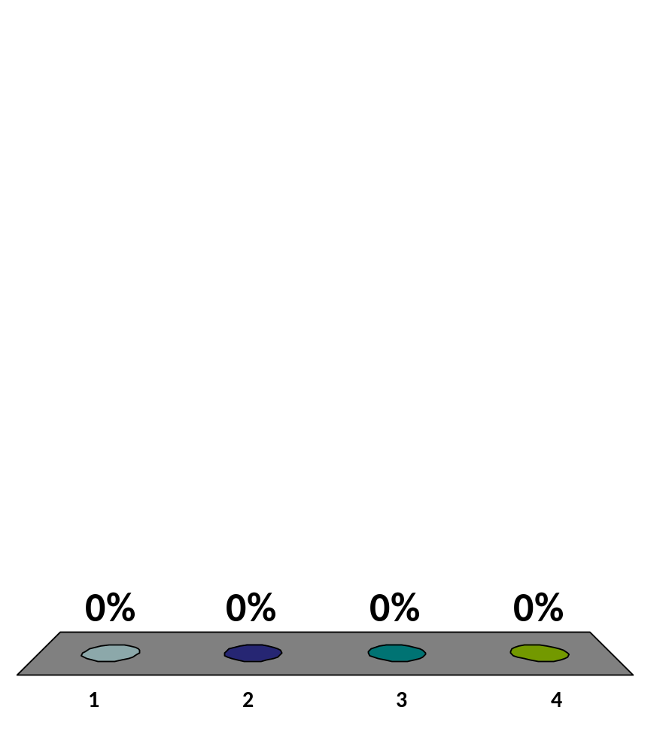
What is the acceleration of the car at the top?
Up
Down
Zero
Something else

Slide 27
Let’s try using graphs to solve question 1.21.
The light turns green and a bicyclist starts forward with a constant acceleration of 1.5 m/s². How far must she travel to reach a speed of 7.8m/s?

Slide 28
Make a prediction of what the position vs. time, velocity vs. time and acceleration vs. time graphs are going to look like for the following cases:
A person walking forward at a constant slow speed for 5 seconds.
s
A person walking forward at a constant fast speed for 5 seconds.
t
A person starting at rest, then walking forward starting out slow and ending up fast while attempting a constant acceleration over a 5 second time period
v
t
A person walking forward at a constant fast speed for 10 meters, quickly turning around and running back to the start all over a 5 second time period.
a
t

Slide 29
From chapter 1 you should be able to:
Describe position, velocity, and acceleration using:
words
pictures (particle models) with vectors
graphs
You should be able to correctly use scientific notation, significant figures, and remember to include proper units and labeling everywhere.

