Slide 1
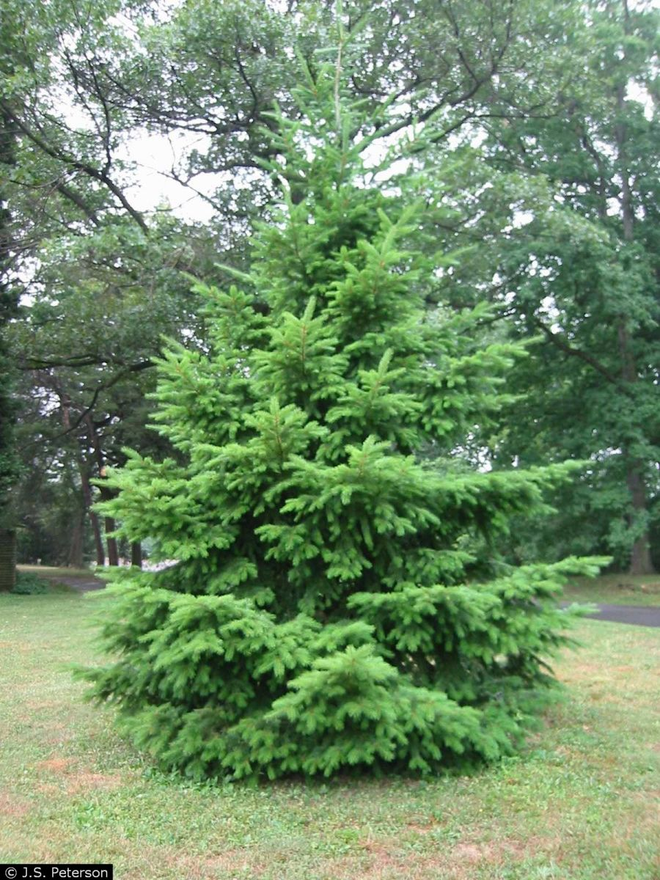
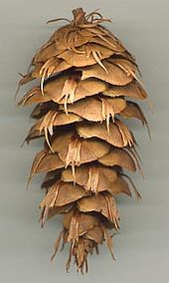
Chapter 11 -- Momentum
Chp 9 in the 3rd ed.
Where does the mass of a tree come from?

Slide 2

Where does the mass of a tree come from?
Soil
Water
Air
Light
Nowhere

Slide 3
Momentum:
Momentum
p ≡ mv
Momentum is a quantity that is conserved.

Slide 4
Motion Detector
Previously in Physics 211…
We gave a cart a “kick” up a hill.
Pos
time
Vel
time
Acc
We told you to ignore the “kick” and the “catch”.

Slide 5
Suppose we “kick” a soccer ball and want to predict its motion.
So far, we have mostly only done problems that had either constant forces or “nice” force vs. time functions.
Now, everything is going to change!!!
F_{foot on ball}
Let’s take a look at the units of the quantity of the area under the graph.
Beginning of collision and compression of object.
End of collision and restitution of object.
Impulse ≡ J
t

Slide 6
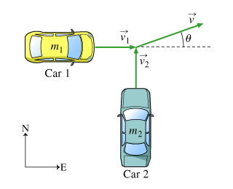
Sample Problem:
In this problem we will consider the collision of two cars initially moving at right angles. We assume that after the collision the cars stick together and travel off as a single unit.
What is neat about momentum, is that we don’t have to worry about the “crumple forces” – all we need to do is look at the collision before and after.
Two cars of masses m₁ and m₂ collide at an intersection. Before the collision, car 1 was traveling eastward at a speed of v₁ , and car 2 was traveling northward at a speed of v₂ . (Intro 1 figure) After the collision, the two cars stick together and travel off in the direction shown. Car 1 is a Hummer of M=7,000kg and Car 2 of m=3,000kg.
At what velocity does the crumpled combined mass travel?
Car 1 and Car 2 are both traveling at 55 mph.

Slide 7
Impulse:
Impulse is defined as the Change in Momentum
The below graph shows the force that a tennis ball exerts upon a wall as it in the process of hitting the wall.
Using a motion detector, you find out that the 60g tennis ball has an initial speed of 32m/s. It collides with the wall and bounces back with the same speed.
Using this information, find the maximum force that the ball exerts upon the wall.
Force (N)
J
Time (ms)
0 2 4 6

Slide 8
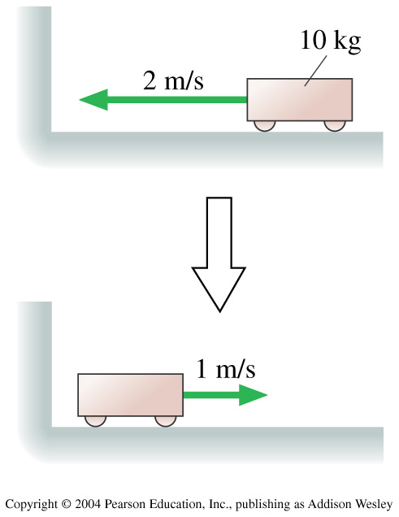
The cart’s change of momentum is
1. –30 kg m/s.
2. –20 kg m/s.
3. –10 kg m/s.
4. 10 kg m/s.
5. 30 kg m/s.
The first thing you do whenever solving a physics problem involving a “conservation law” is: draw a before picture, and an after picture.
Notes:
STT9.1

Slide 9
In lab we (would have) looked at two carts “exploding”
Position
Position
Velocity
Velocity
Acceleration
Acceleration
Cart 1
Cart 2

Slide 10
Momentum and Impulse
Momentum is, like mass, a “Conserved Quantity”.
Other Conserved Quantities that we will meet up through this class will include:
Energy
Angular Momentum (Spin)
Charge

Slide 11
Two cars colliding at 50mph is like one car hitting a wall at 100mph?
True
False

Slide 12
Two ice skaters, with masses of 50kg and 75kg are at the center of a 60-meter diameter circular ice rink.
The skaters push off against each other and glide to opposite edges of the rink. If the heavier skater reaches the edge in 20 sec, how long does the lighter skater take to reach the edge?
Let’s try solving this problem using conservation of momentum.

Slide 13
Cool collision and center of mass webiste:
http://phet.colorado.edu/en/simulation/collision-lab

Slide 14
What did the center of mass do?
Shift Direction
Exactly reflect
Stay the same
Change speed
Change speed and direction

Slide 15
A semi-truck and a geo metro collide. You have an “elasticity” button on your geo metro. Which do you want to have:
A perfectly elastic collision
A perfectly inelastic collision.

Slide 16
Your car is about to run into an unmoveable wall, which do you want?
A perfectly elastic collision
A perfectly inelastic collision.

Slide 17
Which will knock over the block?
A perfectly elastic collision
A perfectly inelastic collision.

Slide 18
V_{ftrain}=20m/s
Beginning Horizontal Momentum
M_{train}v_{train} + m_{rain}v_{rain}
Final Horizontal Momentum
(M_{train}+ m_{rain})v_{total}
=

Slide 19
Momentum is also useful for very small particles:
The carbon isotope Carbon-14 is used for carbon dating of archeological artifacts. ¹⁴C (mass 2.34·10⁻²⁶kg) decays by the process known as beta decay in which the nucleus its an electron (the beta particle) and a subatomic particle called a neutrino. In one such decay, the electron and neutrino are emitted at 60 degrees to each other. The electron has a speed of 5.0*10⁷ m/s and the neutrino has a momentum of 8.0·10⁻²⁴kgm/s. What is the recoil speed of the nucleus? (mass of the electron m_{e}=9.11·10⁻³¹kg)

Slide 20
Two people, m₁ and m₂, are standing stationary on a frictionless ice rink.
Person 1 throws a ball to Person 2 at an angle of θ above the horizontal with a velocity v₀.
Person 2 catches the ball at the same height from which it was thrown.
v₀
θ₀

Slide 21
A 2100 kg truck is traveling east through an intersection at 2.0m/s when it is hit simultaneously from the side and the rear. One car is a 1200kg compact traveling north at 5.0m/s. The other is a 1500 kg midsize traveling east at 10m/s. The three vehicles become entangled and slide as one body. What are their speed and direction just after the collision?

Slide 22
A rocket engine in a model rocket exerts a variable force.
This force is given to us as: F(t) = 0.4t² + 4t for the first 10 seconds.
How fast is the rocket (13grams) going after 10 seconds? (assume massless fuel)

Slide 23
Let’s have two objects of equal mass and equal but opposite velocities collide with one another inelastically.
p₁ = mv
p₂ = m(-v)

Slide 24
Let’s have two objects of equal mass and equal but opposite velocities collide with one another inelastically.
p₁ = mv
p₂ = m(-v)
Before the collision, the total momentum was:
p1 + p2 = mv + m(-v) = 0 kg•m/s
Therefore, after the collision, the momentum of the system must also be = 0kg•m/s

Slide 25
This time, let’s have two objects of equal mass and but with one having twice the velocity of the other colliding inelastically.
p₁ = mv
p₂ = m(-2v)

Slide 26
Let’s have two objects of equal mass and equal but opposite velocities collide with one another inelastically.
p₁ = mv
p₂ = m(-2v)
Before the collision, the total momentum was:
p1 + p2 = mv + m(-2v) = -(mv) kg•m/s
Therefore, after the collision, the momentum of the system must also be = -(mv)kg•m/s

Slide 27
To summarize:
Problems dealing with collisions or explosions are often most easily solved using conservation of momentum concepts.
For problems where there is a clear “before” and “after” state you are most likely going to be looking at p_{before} = mv_{before} and p_{after} = mv_{after}.
For problems where you are more interested in the processes during the collision, you are most likely going to use:

