Slide 1
Chapter 2 –
Kinematics in One Dimension
The light turns green and a bicyclist starts forward with a constant acceleration of 1.5 m/s². How far must she travel to reach a speed of 7.8m/s?

Slide 2
Describe the position, velocity, and acceleration profiles for the following case:
Motion Detector
The Cart is given a brief “kick”. It travels up the ramp, momentarily comes to rest at the top of the ramp, and then rolls back down. We are just interested in the motion from just after it left your hand until just before it was caught.

Slide 3
Position
time
Velocity
time
Acceleration
time

Slide 4

What is the acceleration of the cart at the top?
+
Zero
Negative
Response Grid

Slide 5
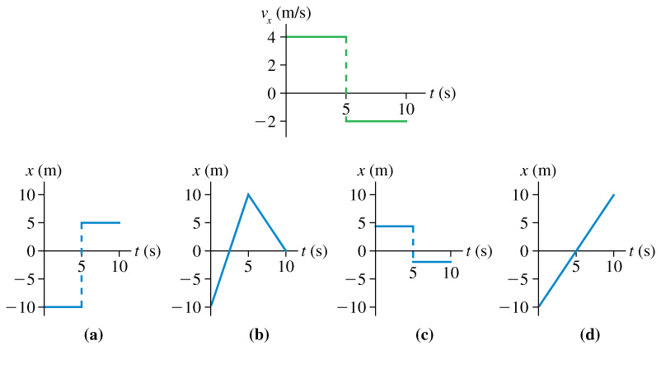

Which position-versus-time graph goes with this velocity-versus-time graph on the left? The particle’s position at t_{i} = 0 s is x_{i} = –10 m .
A
B
C
D

Slide 6
An object is undergoing an constant acceleration that is described by the function a(t) = a.
Correctly and clearly use calculus to find v(t) and s(t) for all times t.
Follow up question: o

Slide 7
On Earth, in Oregon is g always equal to -.9.8m/s²
g is always negative.
g is always positive
g can be either negative or positive

Slide 8

You drop a ball from rest off the 2nd story of ST, the ball starts 5 meters off the ground. How many seconds does it take to reach the ground?
a = g = -9.8 m/s² = -32 ft/s²

Slide 9
If I drop a lead brick and a wood brick off the second floor of ST, which is going to hit the ground first?
The lead brick will hit the ground first.
The wood block will hit first.
They will both hit at the same time.
Neither will ever hit the ground.

Slide 10
Enter question text...
Lead
Wood
Same
neither

Slide 11
Realizing that a(t) = g in this room, create an experiment that will allow you to test your neighbor’s reaction time.
When you get your reaction time, type in your age and reaction time in the spreadsheet.

Slide 12
If I drop a penny and a feather, which will hit bottom first?
1. The penny
2. The feather
Both will hit at the same time
Neither will ever hit

Slide 13

Thus far we have examined motion from several points of view:
We used dots:
We used vectors:
We used graphs:
Position
time
Velocity
time
Acceleration
time

Slide 14
Let’s recall from yesterday how we use calculus to create a method in which we can deal with motion using equations.

Slide 15
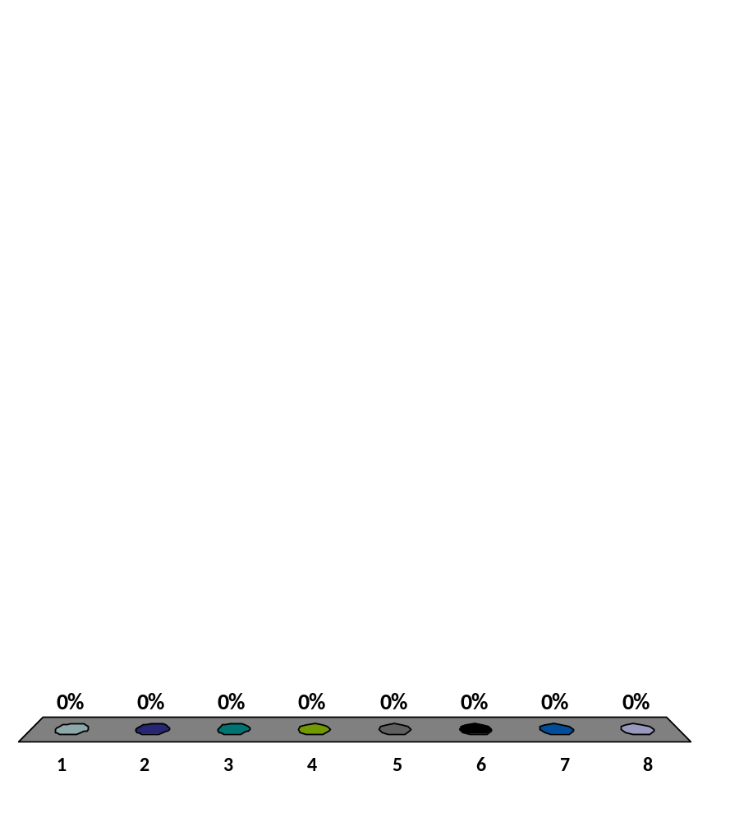
Let’s try playing “Catch the Dot”.
Which of the below describes the motion of the dot?
s_{o} = + v_{o} = + a = +
s_{o} = + v_{o} = + a = -
s_{o} = + v_{o} = - a = +
s_{o} = + v_{o} = - a = -
s_{o} = - v_{o} = + a = +
s_{o} = - v_{o} = + a = -
s_{o} = - v_{o} = - a = +
s_{o} = - v_{o} = - a = -

Slide 16
It’s New Year’s Day 3005, and you wake to discover recollections of the night before are a bit foggy as you drank too much the night before. You discover that you don’t really know just where you are. Matter of fact, it occurs to you, that you are not even sure which planet you are on. You reach over to take a look the alarm clock, but with you being so groggy, you end up knocking the clock off the dresser. Your computer implants inform you that it took 1.03 seconds for the clock to hit the ground, and that the dresser was 200 cm tall.
“Ah-ha!” You proclaim as you realize what planet you are on.
What planet are you on?
Step 1. Draw a picture (with givens)
Step 2. Define a co-ordinate system
Step 3. Derive appropriate equations.
Planet g (m/s²)
1.Mercury 3.77
2.Venus 8.60
3. Earth 9.78
4. Mars 3.72
5. Jupiter 22.9
6. Saturn 9.05
7. Uranus 7.77
8. Neptune 11.0
9. Pluto 0.03
10. Earth's Moon 1.62

Slide 17
You are instead, today, on the surface of a neutron star.
As your clock falls, you discover that the acceleration is not constant. Instead a(t) = 3.0t.
Calculate how far the clock has fallen in 4 seconds. Also: what units does the (3.0) have?

Slide 18
2.19
Ball bearings are made by letting spherical drops of molten metal fall inside a tall tower, called a shot tower, and solidify as they fall.
If a bearing needs 3.50sec to solidify enough for impact, how high must the tower be?
What is the bearing's impact speed?

Slide 19
2.69
David is driving a steady 29.0 m/s when he passes Adira, who is sitting in her car at rest. Adira begins to accelerate at a steady 2.70 m/s² at the instant when David passes.
How far does Adira drive before she passes David?
How fast is Adira driving at the instant she passes David?

Slide 20
A rocket accelerates upward, starting at rest, at 11 m/s². After 10 seconds, a bolt fall off the rocket and falls to the ground.
Create a position vs. time, a velocity vs. time and an acceleration vs. time graph for the motion of the bolt from the time of launch to the time it hits the ground.
Car Bowling http://failblog.org/page/5/

Slide 21
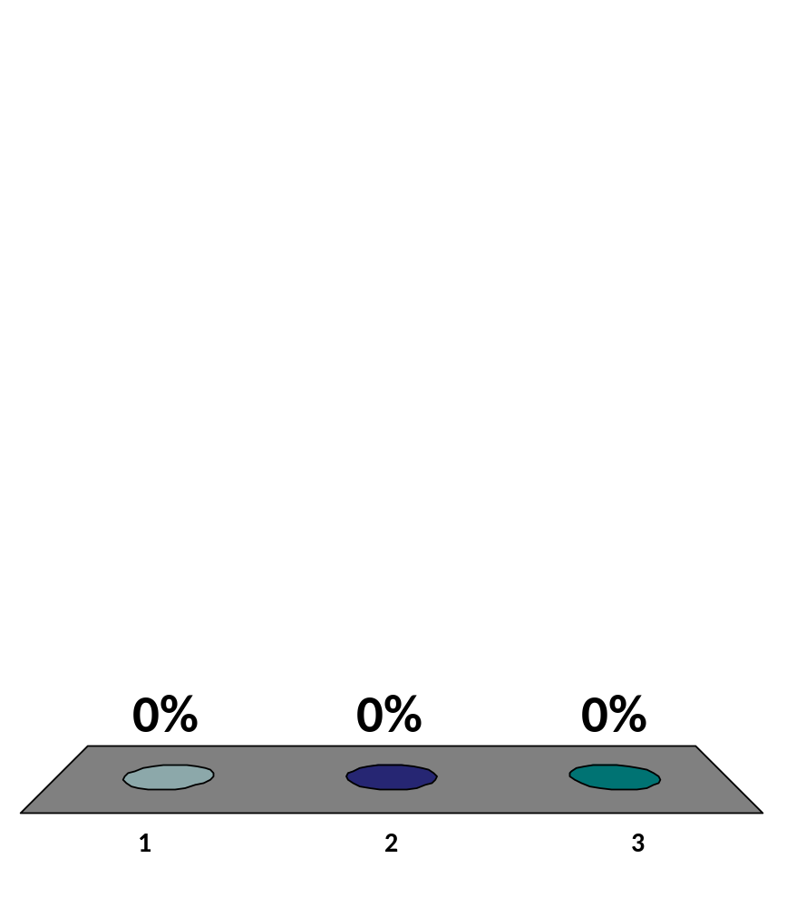
When the bolt drops off it:
It immediately follows the rocket up
It immediately starts falling
Neither of those two, something else happens.

Slide 22
2.55
Santa loses his footing and slides down a frictionless, snowy roof that is tilted at an angle of 25.0 degrees .
If Santa slides 5.00 meters before reaching the edge, what is his speed as he leaves the roof?
6.44m/s

Slide 23
A dropped object passes a window that is 1.35m tall in 0.210s. From what height above the top of the window was the object released?.

Slide 24
Nicole throws a ball straight up. Chad watches the ball from a window 5.20 m above the point where Nicole released it. The ball passes Chad on the way up, and it has a speed of 14.0 m/s as it passes him on the way back down.
How fast did Nicole throw the ball?

Slide 25
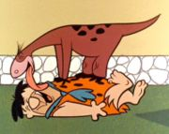
My dog, Yoshi, runs to greet me when I get home.
He starts at rest 3.0*10¹ meters away from me and accelerates at 1.9 m/s² for 5.1 seconds. He then “slams on the breaks” and decelerates at 1.1 m/s².
What speed does he have when he runs into me?

Slide 26
An important thing to remember:
Not all acceleration is constant!
A certain rocket takes a while to warm up. The acceleration vs. time function looks like a(t) = (bt² + c) for the first 5 seconds where b = 2.0m/s⁴ and c = 4m/s².
How far does the rocket travel in these 5 seconds?

Slide 27
Let’s recap what we learned in Chapter 2
We looked again at how position vs time; velocity vs time and acceleration vs time graphs work.
We learned how to use a(t) = a to derive the equations of motion for an object undergoing constant acceleration.
Then, we looked at non-constant acceleration. If you ever see non-constant acceleration you instantly know that you are going to have to integrate and/or differentiate.

