Slide 1
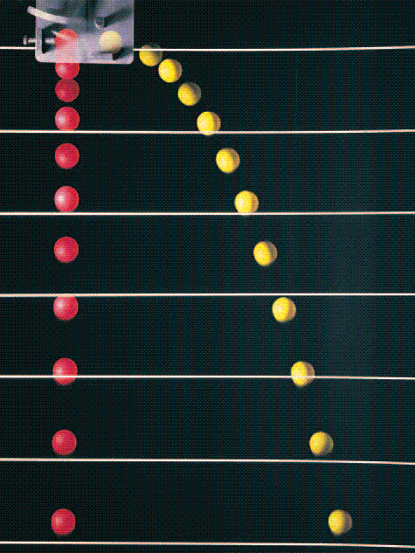
Chapter 4 – Kinematics in Two Dimensions

Slide 2
Exam 1 will cover:
- All of Chapters 1 – 4
- Will be 5 pages long and worth 50 points

Slide 3
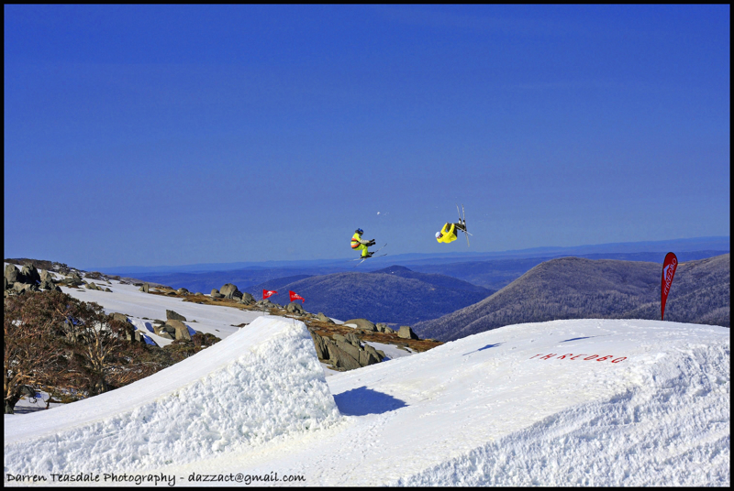
Create position vs. time; velocity vs. time and acceleration vs. time graphs for one of these skiers.

Slide 4
A ball is dropped from rest at the same time a ball is fired perfectly horizontally from the same height. What is going to hit the ground first?
The dropped ball
The ball fired at high speed
Both will hit at the same time
Neither will ever hit the ground

Slide 5
The speed at top of flight is
Greater than
Less than
Equal to
The speed of the skier at the end of ramp?

Slide 6
Parabolic Motion
A baseball player friend of yours wants to determine how fast she can throw a baseball. You have her stand on a ledge and throw the ball horizontally. The ball is released 4m above the ground and it lands 25 meters away. How fast did she throw the ball? How fast did it hit the ground?

Slide 7
Relative Motion

Slide 8
Circular Motion
Your car hits a pothole and is spinning at an angular speed of 4.3rad/sec.
How many full rotations does the car go through after 3 seconds of (frictionless) spinning?

Slide 9
A person kicks a soccer ball at an angle θ with respect to the vertical at speed v_{o}. How far does the soccer ball travel before it hits the ground? (State your final answer in terms of the givens θ, v_{o}, and any relevant physical constants of the universe).
At what angle do you kick the ball so that it goes the maximum distance possible?

