Slide 1
Chapter 5 – Forces and Free Body Diagrams

Slide 2
Newton’s First Law:
An object remains at rest, or in uniform motion in a straight line, unless it is compelled to change by an externally imposed force.
N = Normal Force
W = Weight
f = frictional force
N
f
W
V

Slide 3
Free Body Diagrams
Includes all the forces acting upon the object.
Sizes of arrows indicate magnitude of force.
As forces are vectors, direction of arrow is also important.
N
f
W

Slide 4
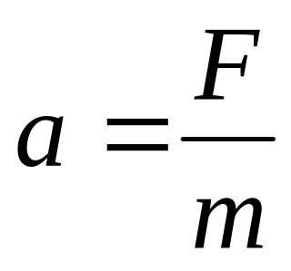
Newton’s Second Law of motion:
The acceleration of an object is directly proportional to the magnitude of the imposed force and inversely proportional to the mass of the object. The acceleration is in the same direction of that imposed force.
In other words:
Or: F = ma

Slide 5
A short catalog of forces:
Weight
Spring Force
Tension
Normal Force
Friction
Drag
Thrust

Slide 6

Stationary Object

Slide 7
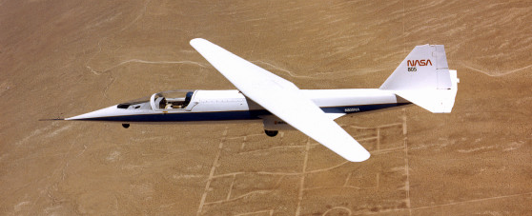
Object Moving w/ Constant Velocity

Slide 8
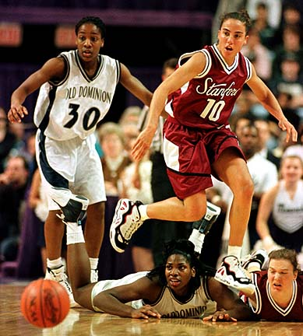
Accelerating Object

Slide 9

Accelerating Object

Slide 10
Velocity is always changing direction.
Acceleration points inward.

Slide 11
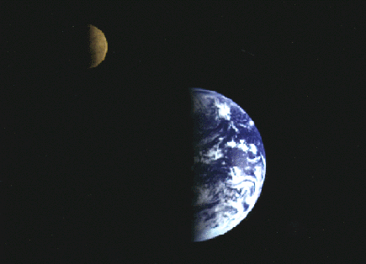
We’ll see Circles more in Chapter 7

Slide 12


A Martian Lander is approaching the surface. It is slowing its descent by firing its rocket motor. Which is the correct free-body diagram for the lander?
A.
B.
C.
D.
E.
Descending
and
Slowing

Slide 13

A car of mass 1530kg is being towed up a 20° slope at a constant velocity.
The tow rope is rated at 5000N maximum tension. Will it break?
+
N
+
T
W
F_{x}
F_{y}
T
0
0
N
-Wsinθ
-Wcosθ
θ=20°
0N
0N

Slide 14
Summary of Chap. 5
When drawing a Free Body Diagram (FBD):
Draw a “dot” to represent the object in question.
Every external force acting upon the object needs to be included in your FBD AND only external forces acting upon the object should be included.
A FBD should have a coordinate system
Forces should be drawn to-scale and in the correct direction.
You should always include a “equal sign” and the direction of the F_{net}.

