Slide 1
Chapter 6 – Forces in Motion

Slide 2
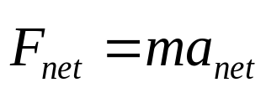
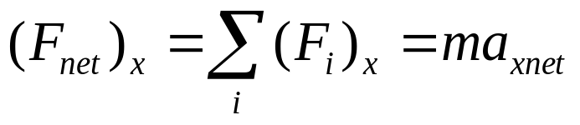
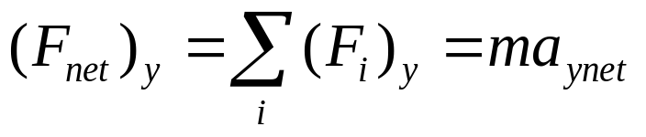
In chapter 5 we examined Forces and Free Body Diagrams. In chapter 6 we’re going to begin to formalize the language:
The Net Force acting upon an object creates a net acceleration on an object.
But, since F is a vector, we really need to break this up into components:
Sect. 6-1

Slide 3

A car of mass 1530kg is being towed up a 20° slope at a constant velocity.
The tow rope is rated at 5000N maximum tension. Will it break?
y+
y+
N
T
F_{net}=0
x+
x+
=
W
F_{x}
F_{y}
T
0
0
N
-mgsinθ
-mgcosθ
θ=20°
0N
0N
Sect. 6-1

Slide 4
A system is said to be in Equilibrium if the Net Force equals zero.
Problem to solve:
Let figure out how strong of a rope is needed to tow a 1530kg car up a 20.0 degree (frictionless) hill at a constant speed.
Note: Static Equilibrium vs. Dynamic Equilibrium
Even though this car is moving, it is still in Equilibrium
Sect. 6-1

Slide 5
A car of mass 1530kg is being towed up a 20° slope at a constant velocity.
How strong must the rope be if you are going to accelerate the car up the hill at 1 m/s²?
Draw a picture.
Draw a FBD.
Derive your equations.
4. Plug ‘n Chug ‘n Solve

Slide 6
+
+
What Tension is required in the rope if we want to initially accelerate the car at 1m/s²?
N
+
+
T
F_{net}
=
W
F_{x}
F_{y}
T
0
0
N
-mgsinθ
-mgcosθ
θ=20°
(ma_{x})_{net}
(ma_{y})_{net}
Sec. 6-2

Slide 7
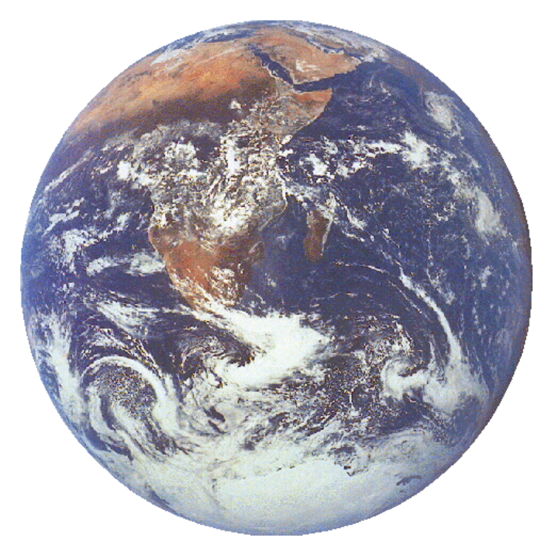
Weight and Apparent Weight
Sec. 6-3

Slide 8

You are riding in an elevator that is going down at 5m/s, but slowing down at 2m/s².
Question 1:
A bathroom scale will read…
Apparent Weight
an apparent weight less than your rest weight
an apparent weight more than your rest weight
an apparent weight the same as your rest weight
Sec. 6.3

Slide 9
You are riding in an elevator that is going up at 5m/s, but slowing down at 2m/s².
Question 2:
If, at rest, the scale measures your weight as 725N, what will is read in the above situation?
Question 3:
The elevator is now going down at 5m/s, but speeding up at 2m/s². Draw the FBD.

Slide 10
Friction:
There are 3 main types of friction we’re going to deal with.
  Static Friction
  Kinetic Friction
  Rolling Friction
Sec. 6-4

Slide 11
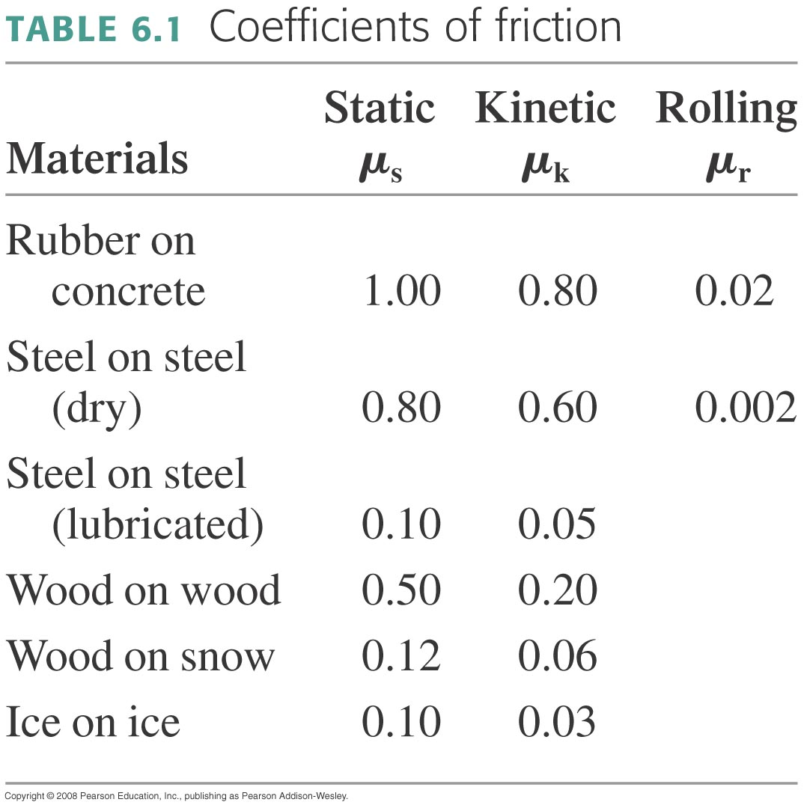
The earliest recorded experiments done on friction (recorded by Leonardo da Vinci) discovered that friction was proportional to the magnitude of the normal force.
f = μN

Slide 12
You are pushing a 1.0kg wood block against a vertical wood wall with a force of 12N at an angle of 30° from the horizontal.
If the block is initially at rest, will it move upward, move downward, or stay at rest?
m
F
θ
Note to self: these numbers are very good as an example. When problem solving: a) first see if it slips using > methods. b) it doesn’t slip, so, instead, split class into two halves as seen below. One comes to a stop, the other doesn’t.
Left Side: An Earthquake has happened – the block is now slipping at 2m/s in the downward direction. What is the acceleration of the block? How far has it slipped after 2 seconds?
Right Side: An Earthquake has happened – the block is now slipping 2m/s in the upward direction. What is the acceleration of the block? How far has it slipped after 2 seconds?

Slide 13
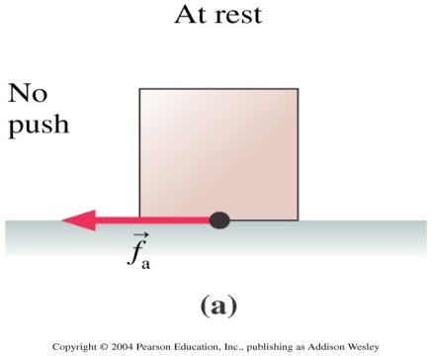
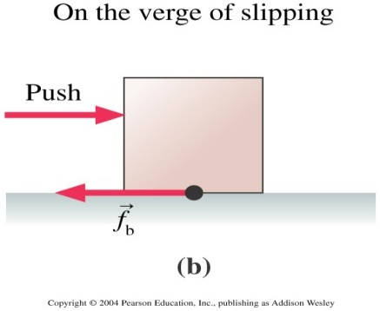
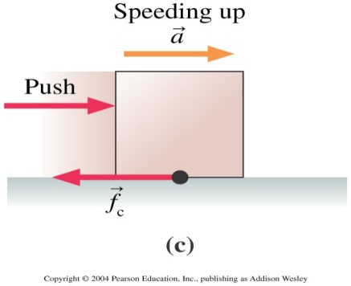
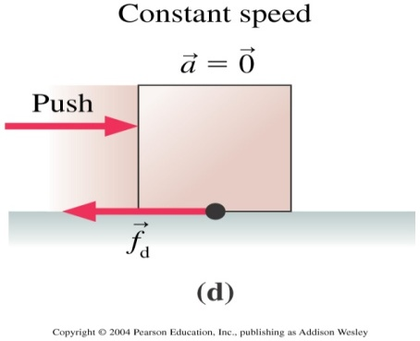
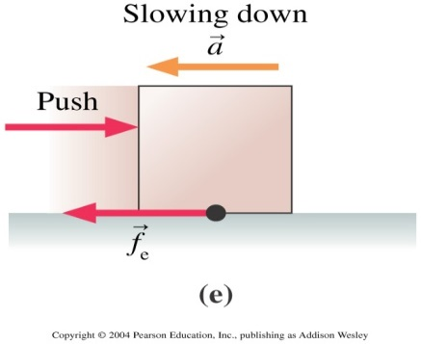
Rank order, from largest to smallest, the size of the frictional forces in these 5 different situations.
f_{c} > f_{d} > f_{e} > f_{b} > f_{a}.
f_{b} > f_{c} > f_{d} > f_{e} > f_{a}.
f_{a} > f_{c} = f_{d} = f_{e} > f_{b}.
f_{a} = f_{b} > f_{c} = f_{d} = f_{e}.
f_{b} > f_{c} = f_{d} = f_{e} > f_{a}.

Slide 14
Let’s try a different type of “friction”.
You throw a styrofoam ball straight downward from the roof of a building that happens to be on the surface of the moon.
Which qualitative velocity graph is most correct for the motion of the ball?
1.
2.
3.
4.
5.
Sec. 6-5

Slide 15
Drag
The Drag experienced by an object moving through a fluid at speed v can be described by:
D = (½ρC_{d})Av²
Where ρ is the density of the fluid and C_{f} is an experimentally determined coefficient between the fluid and the cross-sectional surface of the object in question.

Slide 16
My car is 1.8 meters wide and 1.4 meters tall and has a mass of about 1600kg. At what speed does the magnitude of the drag equal the magnitude of the rolling friction?
μ_{r}=0.020
For my car I get: v_{c}=22 m/s (=79km/hr)

Slide 17
Terminal Velocity
Terminal velocity occurs when D = W.
Find an estimate for your terminal velocity.
D
W

Slide 18
You throw a styrofoam ball straight downward from the roof of the ST building here on Earth. You throw it straight down at a velocity of 30m/s. Terminal velocity for the ball is found to be 15m/s.
Which velocity graph is most correct for describing the motion of the ball?
1.
2.
3.
4.
5.

Slide 19
Sample Problems Follow

Slide 20
Static Equilibrium
5.2 The three ropes in the figure are tied to a small, very light ring. Two of these ropes are anchored to walls at right angles with the tensions shown in the figure. What are the magnitude and direction of the tension T₃ in the third rope?
0.6m
T₂ = 80N
0.8m
T₁ = 50N

Slide 21
Dynamic Equilibrium
In a car experiencing a frictional force, it is discovered that if you pull on a rope with a Force of T with an angle θ, that the car travels at a constant speed.
Do all the forces add up to zero.
Yes they do!
No they don’t!
Not enough information is given to know.

Slide 22
Non Equilibrium
A frictionless car of mass m is being dragged across a floor as shown. You are pulling on rope shown with a tension T at an angle with respect to the floor of θ. In terms of m, T and θ, what is the acceleration of the car?

Slide 23
Let’s try another example:
A 100 kg box is hanging from a rope that is suspended from a hot-air balloon. What is the tension in the rope if:
The box is at rest.
The box moves up at a steady 5.0m/s.
The box is accelerating from rest in an upward direction at 5.0m/s².
The box is moving initially upward at 5.0m/s and is speeding up at 5.0m/s².
The box is moving initially upward at 5.0m/s and slowing down at 5.0m/s².

