Slide 1
Chapter 8 – Dynamics II – Motion in a Plane
- or –
Motion in a Circle

Slide 2
I twirl a rubber stopper in a circle over my head.
Where should I place a razor to cut a string so that the rubber stopper hits the door?
White Board
4.
Per. Table
1.
3.
2.
Sect. 8.1

Slide 3

N
F_{net}
f
=
mg
Accelerating Object
Notes:
3

Slide 4
Whenever an object is moving in a uniform circle, the F_{net} must add up to equal:
We call this sum of force the Centripetal Force.

Slide 6
Warning:
Let’s looks at some words:
Centripetal Force—is the sum of forces that add up to point inward toward the center of the curve you’re traveling on.
Centrifugal Force--
Centrifical Force--

Slide 7
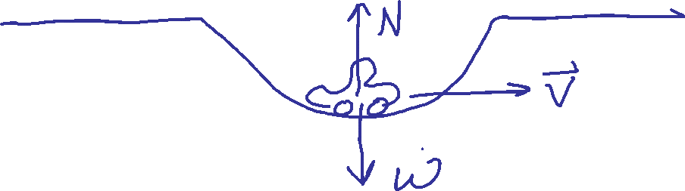
A car is rolling through a dip in the road speed v. At this instant,
1. n > w.
2. n = w.
3. n < w.
4. We can’t tell about n without knowing v.
Notes:
7
STT7.4

Slide 8
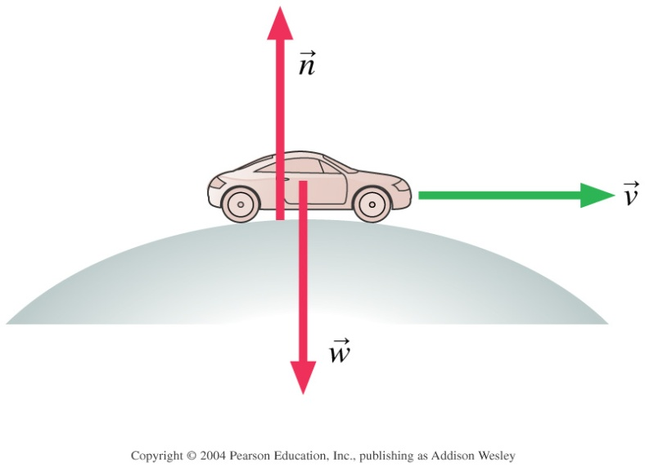

A car is rolling over the top of a hill at speed v. At this instant,
N > W
N = W
N < W
We can’t tell about n without knowing v.

Slide 9
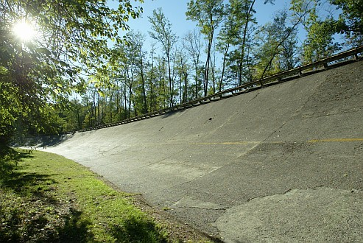
In many icy parts of the world, curves are banked to increase safety while driving in icy conditions.
Let’s find the appropriate banking angle so that a car can make it around a curve of radius R and the speed limit v.

Slide 10
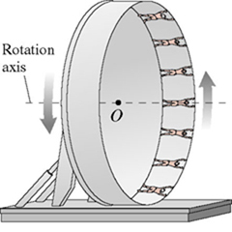
8.41
In an amusement park ride called The Roundup, passengers stand inside a 16.0 m-diameter rotating ring. After the ring has acquired sufficient speed, it tilts into a vertical plane, as shown in the figure .
Suppose the ring rotates once every 4.40s. If a rider's mass is 57.0kg:
a)… with how much force does the ring push on her at the top of the ride?
b)… with how much force does the ring push on her at the bottom of the ride?
c) The tilting mechanism fails, at what rotational speed do people being to fall off?

Slide 11
In Lab -- Let’s try to use Newton’s third law to find the mass of the stopper.

Slide 12
What we have covered since Exam 1:
Chapter 5:
We learned how to draw Free-Body Diagrams. Every FBD should:
include every force acting upon the object AND ONLY those forces acting upon
the object.
include an = F_{net}.
axes, vectors, angles all should be labeled.
Chapter 6:
We learned to turn FBDs into equations and learned F_{net}=ma_{net}.
We did this in terms of Newton’s first two laws:
Newton’s First Law: An object remains or rest or at constant velocity unless acted upon by an external force.
Newton’s Second Law: a_{net}=F_{net}/m
We also learned at a couple of empirically derived equations:
f = μN and D = kAv²
Chapter 7:
We looked at Newton’s Third Law – For every force there is an equal and opposite force.
We learned that when solving problems with multiple bodies we much include a FBD for every body in the problem.
Chapter 8:
When ever something is moving at a constant velocity around a circle, the sum of the forces must add up to mv²/r and point inward to the center of the circle.

