Slide 1
Chapter 9 - Work
Chp 11 in 3rd Ed.
Work has the units of energy.
Just like “Impulse” can be thought of as a change in momentum, “Work” can be thought of as a change in energy.
Fs stands for the Force exerted upon the object in the direction of motion (this can be a negative number).

Slide 2
This “s” is important.
This really turns into:

Slide 3
Chapter 11
http://www.falstad.com/dotproduct/

Slide 4

T
You pull this 5.0kg crate along a carpeted floor (μ_{k} = .80) with a rope of T=75N at an angle of 30.0 degrees above the floor.
What is the speed of the crate after 1.0 meters of pulling?

Slide 5

A block slides down a rough board. What sign convention is correct if the problem is set up as shown?
+++
++-
+-+
-++
--+
-+-
+--
---
±W_{of_friction_on_block} ± W_{gravity_on_block} = ± KE

Slide 6
A block slides down a rough board. What sign convention is correct if the problem is set up as shown?
+++
++-
+-+
-++
--+
-+-
+--
---
± mgh = ± E_{thermal} ± KE

Slide 7
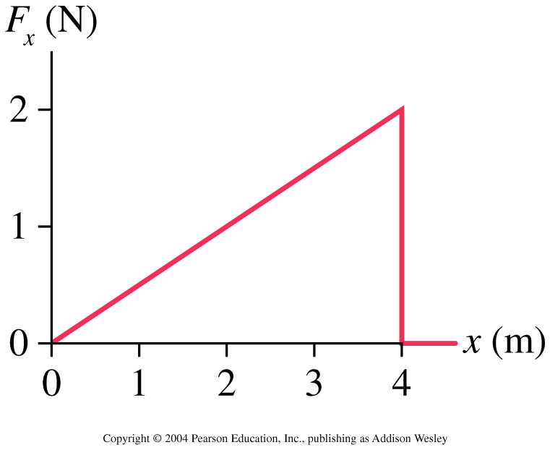
A particle moving along the x-axis experiences the force shown in the graph. If the particle has 2.0 J of kinetic energy as it passes x = 0 m, what is its kinetic energy when it reaches x = 4 m?
-2.0J
0.0J
2.0J
4.0J
6.0J

Slide 8
Using Work to define the Potential Energy of a Spring
Let’s start with the spring compressed and see what work the spring does on the mass by the time the spring reaches it’s equilibrium position.

Slide 9
We can do the same thing for gravity on the surface of Earth:
The “cool” thing about this is it doesn’t matter how you get from point “A” to point “B”.
Forces that are path independent are called “Conservative Forces”

Slide 10
Power Defined
Power = ΔEnergy / Δtime
1 Watt = 1Joule/1sec
Using the following tools, find your maximum power output:
ruler
stopwatch
stairs

Slide 11
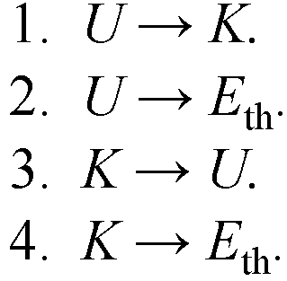
A child slides down a playground slide at constant speed. The energy transformation is
5. There is no transformation because energy is conserved.
Notes:
STT11.1

Slide 12
A particle moving along the x-axis experiences the force shown in the graph. If the particle has 2.0 J of kinetic energy as it passes x = 0 m, what is its kinetic energy when it reaches x = 4 m?
1. – 2.0 J
2. 0.0 J
3. 2.0 J
4. 4.0 J
5. 6.0 J
Notes:
STT11.2

Slide 13
A crane lowers a steel girder into place at a construction site. The girder moves with constant speed. Consider the work W_{g} done by gravity and the work W_{T} done by the tension in the cable. Which of the following is correct?
1. W_{g} is positive and W_{T} is positive.
2. W_{g} is negative and W_{T} is negative.
3. W_{g} is positive and W_{T} is negative.
4. W_{g} and W_{T} are both zero.
5. W_{g} is negative and W_{T} is positive.
Notes:
STT11.3

Slide 14
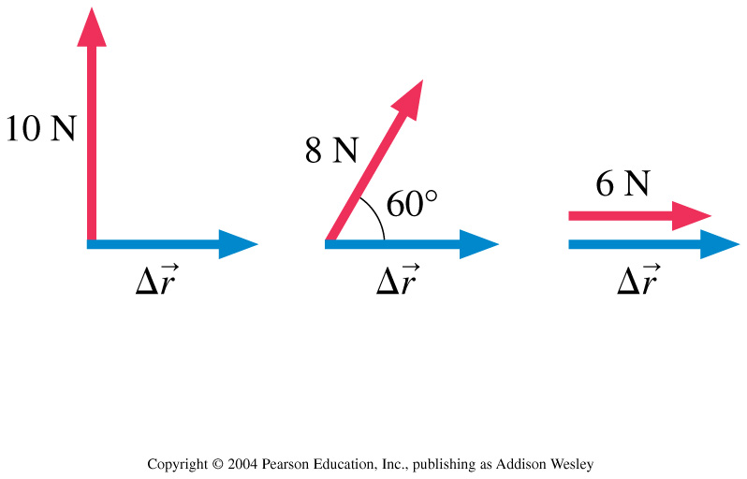
Which force does the most work?
1. The 6 N force.
2. The 8 N force.
3. The 10 N force.
4. They all do the same amount of work.
Notes:
STT11.4

Slide 15
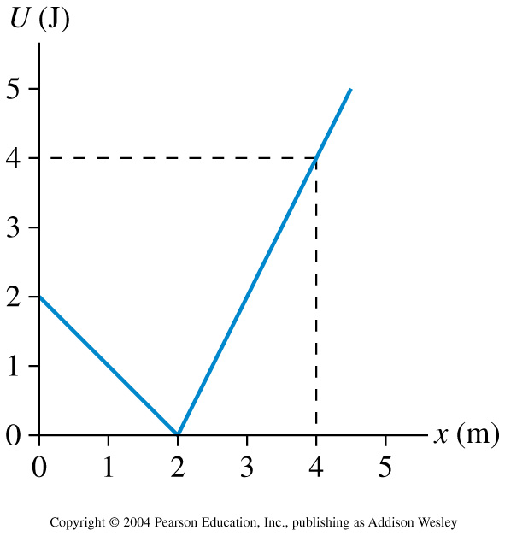
A particle moves along the x-axis with the potential energy shown. The force on the particle when it is at x = 4 m is
1. 4 N.
2. 2 N.
3. 1 N.
4. –1 N.
5. –2 N.
Notes:
STT11.5

Slide 16
A child at the playground slides down a pole at constant speed. This is a situation in which
1. U → Eth. Emech is conserved.
2. U → K. Emech is not conserved but Esys is.
3. K → Eth. Emech is not conserved but Esys is.
4. U → Eth. Emech is not conserved but Esys is.
5. U → Wext. Neither Emech nor Esys are conserved.
Notes:
STT11.6

Slide 17
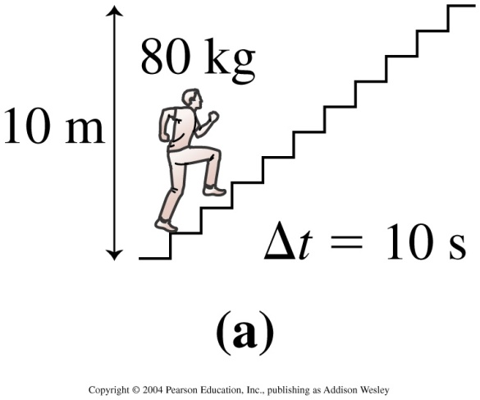
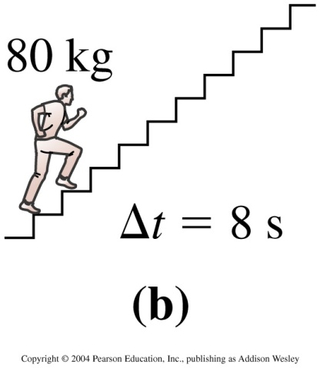
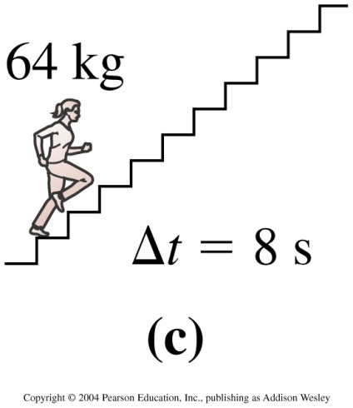
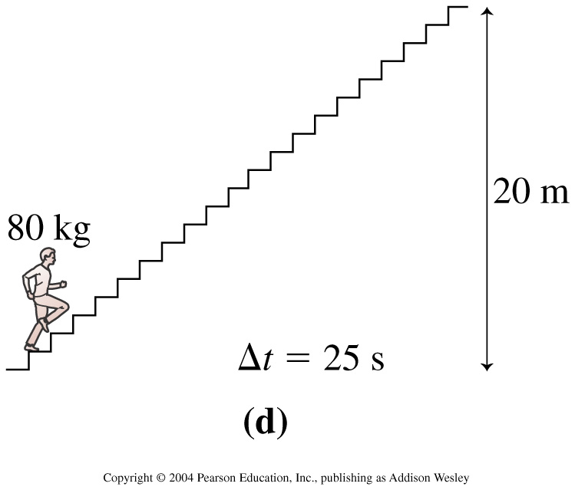
Four students run up the stairs in the time shown. Rank in order, from largest to smallest, their power outputs P_{a} to P_{d}.
1. P_{b} > P_{a} = P_{c} > P_{d}
2. P_{d} > P_{a} = P_{b} > P_{c}
3. P_{d} > P_{b} > P_{a} > P_{c}
4. P_{b} > P_{a} > P_{c} > P_{d}
5. P_{c} > P_{b} = P_{a} > P_{d}
Notes:
STT11.7

Slide 18
What velocity do you need to achieve to burn the energy in 1 eggo if traveling only on horizontal ground?
1 eggo = 1.6 million Joules
How many seconds does it take to achieve this speed if you could burn an eggo at a power of 300Watts?

Slide 19
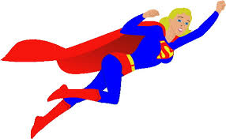
Example 2: A 1000 kg car is rolling slowly across a level surface at 1.0 m/s, heading toward a group of small innocent children. The doors are locked, so you can’t get inside to use the brakes. Instead, Supergril rushes in and pushes on the hood at an angle 30° below horizontal. How hard must she push to stop the car in a distance of 2.0 m?
θ

Slide 20
We could do this problem via the “old way” of using forces and accelerations. But let’s try doing it using Energy and Work.
The car starts out with a K=½mv² of energy.
In order to save the jay-walking family, we need to get rid of all of that Kinetic Energy.
θ

Slide 21
Chapter 11
Reading Quiz

Slide 22
The statement ∆K = W is called the
1. law of conservation of energy.
2. work-kinetic energy theorem.
3. kinetic energy equation.
4. weight-kinetic energy theorem.
Notes:
IG11.2

Slide 23

The statement ∆K = W is called the
1. law of conservation of energy.
2. work-kinetic energy theorem.
3. kinetic energy equation.
4. weight-kinetic energy theorem.
Notes:
IG11.2

Slide 24
The transfer of energy to a system by the application of a force is called
1. Dot product.
2. Power.
3. Work.
4. Watt.
5. Energy transformations.
Notes:
IG11.3

Slide 25
The transfer of energy to a system by the application of a force is called
1. Dot product.
2. Power.
3. Work.
4. Watt.
5. Energy transformations.
Notes:
IG11.3

Slide 26
A child slides down a playground slide at constant speed. The energy transformation is
5. There is no transformation because energy is conserved.
Notes:
STT11.1

Slide 27
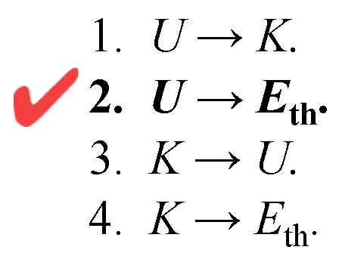
A child slides down a playground slide at constant speed. The energy transformation is
5. There is no transformation because energy is conserved.
Notes:
STT11.1

Slide 28
A particle moving along the x-axis experiences the force shown in the graph. If the particle has 2.0 J of kinetic energy as it passes x = 0 m, what is its kinetic energy when it reaches x = 4 m?
1. – 2.0 J
2. 0.0 J
3. 2.0 J
4. 4.0 J
5. 6.0 J
Notes:
STT11.2

Slide 29
A particle moving along the x-axis experiences the force shown in the graph. If the particle has 2.0 J of kinetic energy as it passes x = 0 m, what is its kinetic energy when it reaches x = 4 m?
1. – 2.0 J
2. 0.0 J
3. 2.0 J
4. 4.0 J
5. 6.0 J
Notes:
STT11.2

Slide 30
A crane lowers a steel girder into place at a construction site. The girder moves with constant speed. Consider the work W_{g} done by gravity and the work W_{T} done by the tension in the cable. Which of the following is correct?
1. W_{g} is positive and W_{T} is positive.
2. W_{g} is negative and W_{T} is negative.
3. W_{g} is positive and W_{T} is negative.
4. W_{g} and W_{T} are both zero.
5. W_{g} is negative and W_{T} is positive.
Notes:
STT11.3

Slide 31
A crane lowers a steel girder into place at a construction site. The girder moves with constant speed. Consider the work W_{g} done by gravity and the work W_{T} done by the tension in the cable. Which of the following is correct?
1. W_{g} is positive and W_{T} is positive.
2. W_{g} is negative and W_{T} is negative.
3. W_{g} is positive and W_{T} is negative.
4. W_{g} and W_{T} are both zero.
5. W_{g} is negative and W_{T} is positive.
Notes:
STT11.3

Slide 32
Which force does the most work?
1. The 6 N force.
2. The 8 N force.
3. The 10 N force.
4. They all do the same amount of work.
Notes:
STT11.4

Slide 33
Which force does the most work?
1. The 6 N force.
2. The 8 N force.
3. The 10 N force.
4. They all do the same amount of work.
Notes:
STT11.4

Slide 34
A particle moves along the x-axis with the potential energy shown. The force on the particle when it is at x = 4 m is
1. 4 N.
2. 2 N.
3. 1 N.
4. –1 N.
5. –2 N.
Notes:
STT11.5

Slide 35
A particle moves along the x-axis with the potential energy shown. The force on the particle when it is at x = 4 m is
1. 4 N.
2. 2 N.
3. 1 N.
4. –1 N.
5. –2 N.
Notes:
STT11.5

Slide 36
A child at the playground slides down a pole at constant speed. This is a situation in which
1. U → Eth. Emech is conserved.
2. U → K. Emech is not conserved but Esys is.
3. K → Eth. Emech is not conserved but Esys is.
4. U → Eth. Emech is not conserved but Esys is.
5. U → Wext. Neither Emech nor Esys are conserved.
Notes:
STT11.6

Slide 37
A child at the playground slides down a pole at constant speed. This is a situation in which
1. U → Eth. Emech is conserved.
2. U → K. Emech is not conserved but Esys is.
3. K → Eth. Emech is not conserved but Esys is.
4. U → Eth. Emech is not conserved but Esys is.
5. U → Wext. Neither Emech nor Esys are conserved.
Notes:
STT11.6

Slide 38
Four students run up the stairs in the time shown. Rank in order, from largest to smallest, their power outputs P_{a} to P_{d}.
1. P_{b} > P_{a} = P_{c} > P_{d}
2. P_{d} > P_{a} = P_{b} > P_{c}
3. P_{d} > P_{b} > P_{a} > P_{c}
4. P_{b} > P_{a} > P_{c} > P_{d}
5. P_{c} > P_{b} = P_{a} > P_{d}
Notes:
STT11.7

Slide 39
Four students run up the stairs in the time shown. Rank in order, from largest to smallest, their power outputs P_{a} to P_{d}.
1. P_{b} > P_{a} = P_{c} > P_{d}
2. P_{d} > P_{a} = P_{b} > P_{c}
3. P_{d} > P_{b} > P_{a} > P_{c}
4. P_{b} > P_{a} > P_{c} > P_{d}
5. P_{c} > P_{b} = P_{a} > P_{d}
Notes:
STT11.7

Slide 40
Example 3: A 1.0 kg block moves along the x-axis. It passes x = 0 m with velocity vx = 2.0 m/s. It is then subjected to the force shown in the graph.
Which of the following is true:
The block gets to x = 5 m with a speed greater than 2.0 m/s,
the block gets to x = 5 m with a speed of exactly 2.0 m/s,
the block gets to x = 5 m with a speed of less than 2.0 m/s,
or the block never gets to x = 5 m?

Slide 41
A balloon of mass m is filled with flour. Attached to a string it is released from height h and swings to hit a box of mass M (similar to lab 6). The box then slides a distance d before coming to rest. What is the coefficient of kinetic friction between the box and the table upon which it slides?

