Slide 1
Chapter 10 -- Energy
Also Chp 10 in 3rd edition

Slide 2
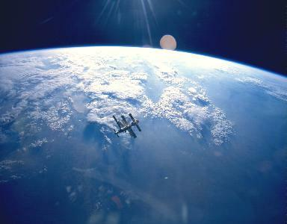
Some “types” of energy:
Kinetic Energy
Potential Energy
Gravitational
Mechanical
Heat
Work
Chemical
Nuclear
M

Slide 3
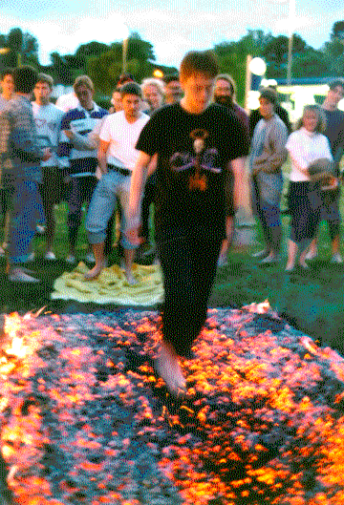
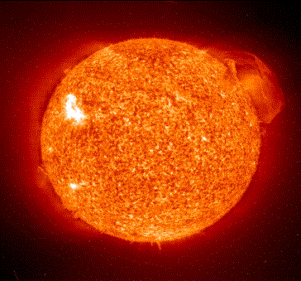
Some “types” of energy:
Kinetic Energy
Potential Energy
Gravitational
Mechanical
Heat
Work
Chemical
Nuclear
T
f
C₆H₁₂O₆ + 6O₂
6CO₂ +6H₂0 + energy

Slide 4
Some “Types” of Energy
Kinetic Energy KE = ½ mv²
Potential Energy
Gravitational PE_{grav} = mgh at Earth Surface or U_{grav} = GmM/r in orbit
Mechanical PE_{spring}= ½ kx²
Heat U = kRT
Work W = F•d
Nuclear E = mc²

Slide 5

Enter question text...
Vector
Scalar

Slide 6

What was found out early on was that all these types of energies could be translated into one-another.
For example, consider a roller coaster. How would we calculate the speed of the car at
various places along the track?
“Tractor-Man the Ride” Roller-Coaster Ride Opening--TBA

Slide 7
Well, if we knew the slope of the roller-coaster track at various places along the track, we could calculate the the acceleration, and then calculate the speed. However, since the slope changes often, we would have many different accelerations, and the calculation would become very difficult.
“Tractor-Man the Ride” Roller-Coaster Ride Opening--TBA

Slide 8
Fortunately, there is an easier way:
Energy Is Conserved.
Def: The total amount of energy in a closed system remain constant no matter what type of physical interactions go on within the system.

Slide 9
Here’s how it would work for a Roller-Coaster
Starts from rest
KE₁ = ½mv₁² = 0
PE₁=mgh₁=max
KE₄ = ½mv₄² =max
PE₄ = mgh₄ = 0
KE₂ = ½mv₂²
PE₂=mgh₂
h₁
h₃
h₂

Slide 10
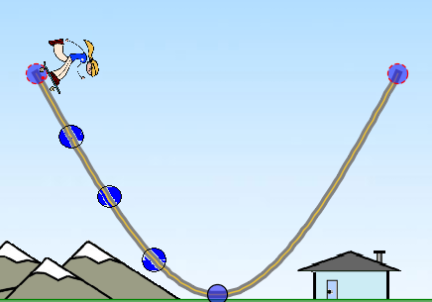
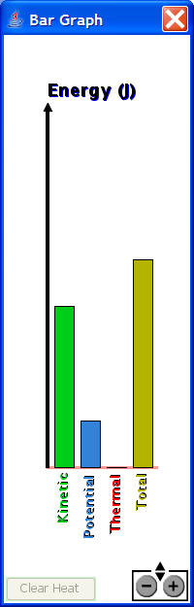
The bar graph shows the energy of the Skater, where could she be on the track?
A
B
C
D
E
There’s not enough information.
A
B
C
D
E

Slide 11
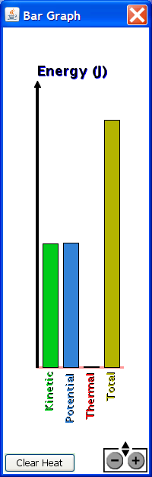
The Energy chart of a boy skating looks like this
He is at his maximum speed
He is stopped
He is going his average speed
He is going slow
He is going fast

Slide 12
K=0
P=mgh
h₁
K=½mv²
P=0
h₂
Given h₁ and h₂, tell me the distance d from the table to place an “x” so that the ball hits it.

Slide 13
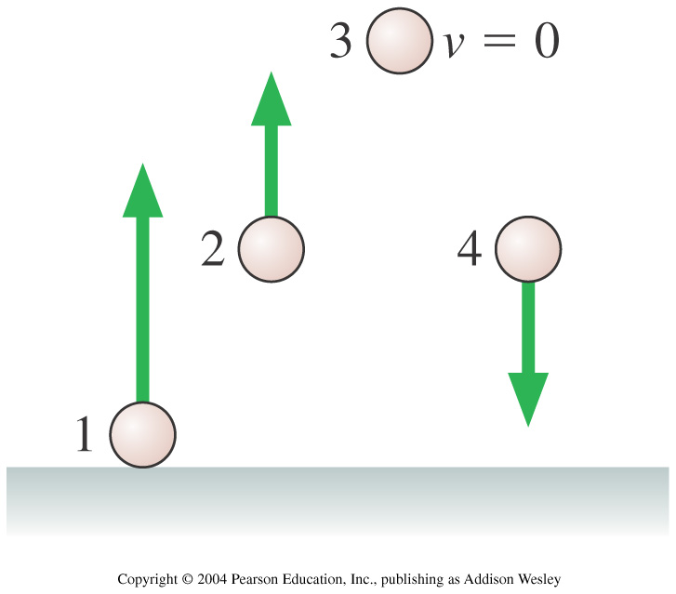
Rank in order, from largest to smallest, the following energies of balls 1 to 4.
1. (Ug)₁ > (Ug)₂ > (Ug)₃ > (Ug)₄
2. (Ug)₄ > (Ug)₃ > (Ug)₂ > (Ug)₁
3. (Ug)₁ > (Ug)₂ = (Ug)₄ > (Ug)₃
4. (Ug)₃ > (Ug)₂ = (Ug)₄ > (Ug)₁
5. (Ug)₄ = (Ug)₂ > (Ug)₃ > (Ug)₁
Notes:
STT10.1

Slide 14
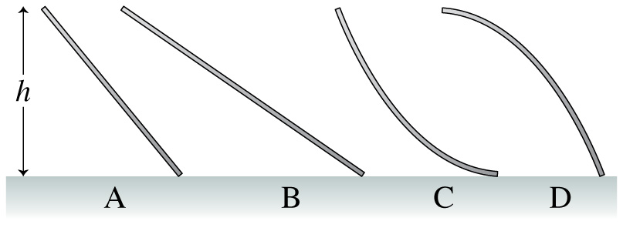
A small child slides down the four frictionless slides A–D. Each has the same height. Rank in order, from largest to smallest, her speeds v_{A} to v_{D} at the bottom.
1. v_{A} = v_{B} = v_{C} = v_{D}
2. v_{D} > v_{A} = v_{B} > v_{C}
3. v_{D} > v_{A} > v_{B} > v_{C}
4. v_{C} > v_{A} = v_{B} > v_{D}
5. v_{C} > v_{B} > v_{A} > v_{D}

Slide 15
Let’s look at the forces and energies involved in a spring:
Hooke’s Law: F = -kΔs
Some things to note about springs:
The spring exerts a force when it is compresses as well as when it is stretched.
The force is always opposed to the direction of stretching or compressing.
M
M
M

Slide 16
We’re going to study Hooke’s Law in more detail in the next chapter. For now, we are going to simply state that:
Energy Stored in a Spring is:
U = ½ k(Δs)²

Slide 17
It turns out that the energy stored in a spring is given by
U = ½ k(ΔS)².
M

Slide 18
Potential Energy
Energy
Total Energy
It turns out that the energy stored in a spring is given by
U = ½ k(ΔS)².
s_{c}
s_{rest}
s_{s}
distance

Slide 19
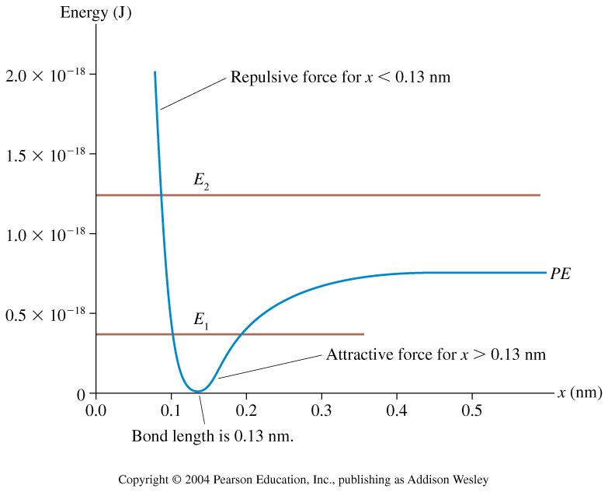

Slide 20
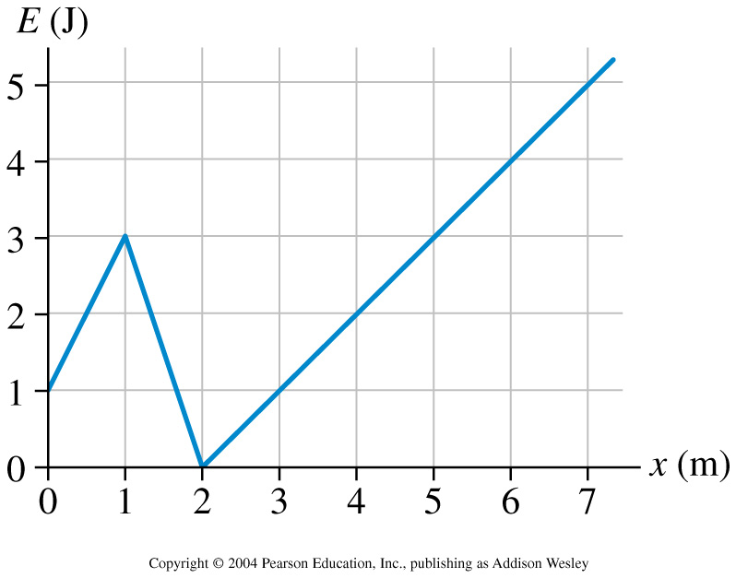
A particle with the potential energy shown in the graph is moving to the right. It has 1 J of kinetic energy at x = 1 m. Where is the particle’s turning point?
1m
2m
3m
4m
5m
6m
7m

Slide 21
Potential Energy
Energy
Total Energy
Unstable Equilibrium
Stable Equibrium

Slide 22
Exercise 1
When a spring attached to a mass is left at rest, we measure the mass to be 20cm away from the wall.
When we pull on the mass with a force of 100N, the spring stretches to become 22cm long.
What is the spring constant?
M

Slide 23
Exercise 2: How much energy is stored in the spring in the previous problem after it has been stretched to 22 cm?

Slide 24
Chapter 10 Summary:
Energy is a conserved quantity.
Energy is a scalar.
The Kinetic Energy of an object is given by K = ½ mv².
The gravitational potential energy of an object near the surface of a planet is given by U_{grav}=mgh.
The potential energy stored in a spring is given Uspring = ½k(Δs)².
In the two types of collision, momentum is always conserved. But in an inelastic collision “Mechanical Energy” is NOT conserved. (Mechanical Energy is defined as Kinetic Energy + Potential Energy).
We also learned to analyze energy vs. position graphs.

