Slide 1
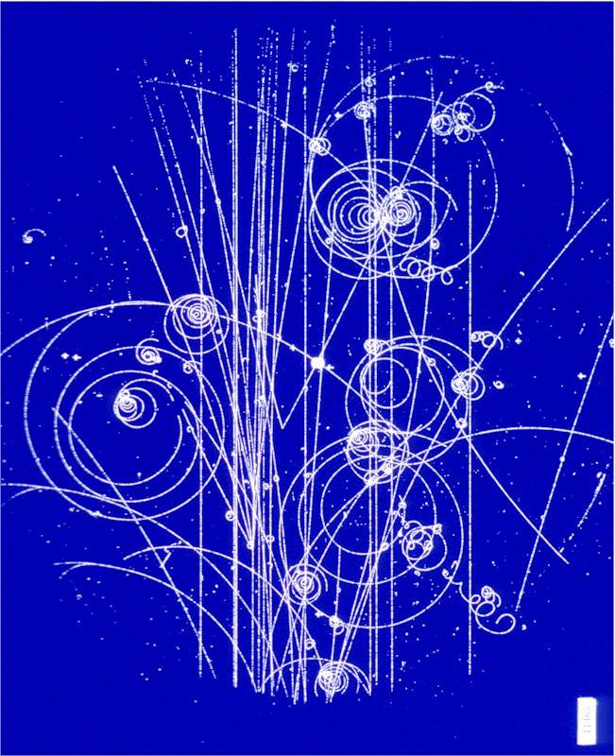
Chapter 25
Electric Charges and Forces

Slide 2
Next Tuesday (9.April) at noon
Dr. Henri Janssen from OSU will be here to talk about Jobs and Life with a Physics Degree.
For $2 lunch will be provided.

Slide 3
Coulomb’s Law
The Force between two charges has been measured to be:
Where ε₀ = 8.85·10⁻¹² C²/Nm²
or 1/4πε₀ = 8.99·10⁹ Nm²/C²
ε₀ -- permittivity of free space

Slide 4

Let’s try In-Class Activity 2
Part 1: Find the net charge on each 2.5g balloon.
Part 2: How many excess electrons is this?
Q_{e} = 1.6*10⁻¹⁹C
Things we have with which to measure:
A ruler, a protractor and a string.
Where ε₀ = 8.85·10⁻¹² C²/Nm²
or 1/4πε₀ = 8.99·10⁹ Nm²/C²

Slide 5
Charge is a fundamental quantity in the universe.
In S.I. Units we use the “Coulomb” as the unit of Charge.
Fundamental particles and their charge:
Electrons: -1.6·10⁻¹⁹ C
Protons: +1.6·10⁻¹⁹ C
Neutrons: 0 C
Up Quark: + (2/3)e
Down Quark: - (1/3)e
Positron: +1.6·10⁻¹⁹ C

Slide 6
Sample Question:
If electrons and protons truly behaved as particles, how fast would an electron be orbiting a Hydrogen nucleus. Take the size of a Hydrogen atom to be S_{H}=1.0Å.

Slide 7
In Class Activity 3 – Let’s use Vpython to solve this one.
We have three 0.5gram Styrofoam peanuts each with a charge of +3nC each separated by 0.1 meters. A 4th peanut is placed 20 cm above the right hand side peanut—it has a charge of -5nC. What is the initial acceleration of the 4th peanut?

Slide 8
from visual import *
myscene = display(x=0,y=0, width = 600, height = 600,
range = vector(.5,.5,.5))
m = .5*10**-3 #kg
M = .5*10**-3 #kg
q = +3*10**-09 #C
Q = -5*10**-09 #C
k = 8.99*10**9 #Nm^2/C^2
s1 = vector(
s2 = vector(
s3 = vector(0.1,0.0,0.0) #m
s4 = vector
F1on4 = k*q*Q/mag(s4-s1)**2*norm(s4-s1)
F2on4 = k*q*Q/mag(s4-s2)**2*norm(s4-s2)
F3on4 = k*q*Q/mag(s4-s3)**2*norm(s4-s3)
Fnet = F1on4+F2on4+F3on4
a = Fnet/M

Slide 9
The Electric Field
When the human race first started in earnest exploring electric forces, many were concerned about these “action at a distance” forces.
The Electric Field Model was created to describe this phenomena.
An Electric Field Vector at a point in space…:
1) … points in the direction a hypothetical infinitesimal positive charge would accelerate if placed there
2)… has a magnitude proportional to the magnitude of the force that positive charge would feel there.

Slide 10
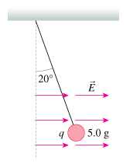
Let’s looks at a simulated Electric Field
http://phet.colorado.edu/simulations/sims.php?sim=Electric_Field_Hockey
Here is a problem we might be asked to solve:
This styrofoam sphere is hanging from from a string while in an electric field of E = 100 000 N/C as shown.
What is the charge on the sphere?

Slide 11
Remember Coulomb’s Law
With your neighbors, answer: “Why does the Force equation have two charges in it, whereas the Electric Field equation has just one charge?”
This gives us the force between two point charges.
Now, we define the E-field from a single point charge to be:

Slide 12
Vector Notation

Slide 13
Chapter 25 Summary:
The force between two point charges has been empirically found to be:
The ultimate “carriers” of charge are fundamental particles such as quarks and electrons. 1e ≡ 1.6∙10⁻¹⁹C
The Electric Field is a mathematical representation that describes the force exerted upon a hypothetical infinitesimal positive point charge placed anywhere in space. The E-Field has the units of N/C.
The Force felt by a real charge q that is placed inside an E-Field is given by:
The electric field of a point charge, in vector notation can be written as:
Or:

