Slide 1
Things left to do in Ph 213:
- Understand light and E, B and S.
Understand the concept of light polarization angles
Find the resonance frequency of LRC circuits.
Next week:
Monday: Chapter 34
Tuesday: Concept Test
Wednesday: Review Part 1
Wed/Thurs Lab: Complete Finals
Friday: Review Part 2
Saturday: Study Jam

Slide 2
Chapter 35
In this chapter, we’re going to try to pull together everything we know about E and B fields.
B
E
Let’s have a proton moving through space experiencing both an E-field and a B-field.
v₀
+
F = qE + qv x B
Lorentz Force Law

Slide 3
35.3 An electron travels with v = 5·10⁶î m/s in a space where E = <2.0·10⁵î,-2.0·10⁵ĵ>V/m and B = -0.10k-hat T. What is the net force on the electron?

Slide 4
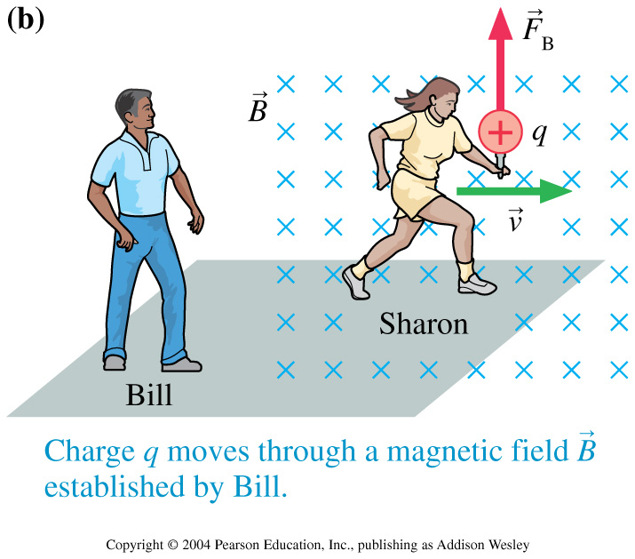
To B or not to B?
It all depends upon your frame of reference.
Bill is creating a magnetic field stationary to himself.
Sharon is running with a charge stationary to herself.

Slide 5
E’ = E + v x B

Slide 6
What we’ve done so far:
Relates net electric flux to net charge enclosed
Gauss’ Law
Relates net magnetic flux to net “magnetic charge” enclosed
Gauss’ Law
A changing magnetic flux induces an electric field
Faraday’s Law
Ampere-Maxwell Law
A changing electric flux induces a magnetic field (as does an electric current)

Slide 7
Let’s try messing around a bit with Faraday’s Law
dx
y
x
h
Let’s calculate the left had side of this equation.
z

Slide 8
Let’s try messing around a bit with Faraday’s Law
dx
y
Now, let’s work on the right side of the equation.
x
h
z

Slide 10
So, Faraday’s Law gives us this:
Doing a similar thing to Ampere’s Law gives us:

Slide 11
Take the derivative w.r.t. x on this…
Then substitute this in…
Ah-ha!
It’s a wave Equation!

Slide 12
Ah-ha!
It’s a wave Equation!
Thus you know:
E = E_{o}cos(kx-ωt)
You also know that the speed of the wave is:
All in mks units

Slide 13
You can do the same thing for the B-field and find out the the same thing happens.
Thus you know:
E = E_{o}cos(kx-ωt) B = B_{o}cos(kx-ωt)
You also know that the speed of the wave is:
c = 3·10⁸ m/s

Slide 14
Let’s try to visualize this:
http://phet.colorado.edu

Slide 15
Thus you know:
E = E_{o}cos(kx-ωt) B = B_{o}cos(kx-ωt)
How are the amplitude of E and B related?
E_{o}=cB_{o}

Slide 16
Maxwell thus showed us that:
E-fields and B-fields behave like self-perpetuating waves.
These electromagnetic waves can travel through empty space.
The speed of EM waves is
Corollary:
E and B fields are perpendicular to each other and mutually perpendicular to the direction of travel.
E = cB (in empty space)
Like all waves, EM waves obey superposition rules.

Slide 17
A story problem to solve:
T.V. Signals from the Earth have now reached the nearest 400 suns. “Survivor” first aired 4 years ago. Has the “Survivor” show reached Alpha-Centauri yet? The Centauri system is 4·10¹³ km away.
The E-field at a TV broadcasting dish is measured to be 250V/m. Assuming a perfectly collimated beam, what would the B-field be at Alpha-Centauri?
The broadcast is sent at a frequency of 4·10⁹Hz. What is the wavelength of the TV wave?
Let’s say that a space probe at Alpha-Centauri is moving away from the Earth at speed of 1·10⁸m/s. What frequency would “Survivor” be found on on TV on the Centauri probe?

Slide 18
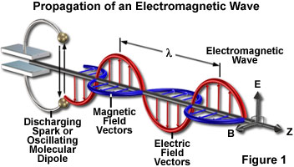
Polarization
http://micro.magnet.fsu.edu/primer/java/polarizedlight/emwave/

Slide 19
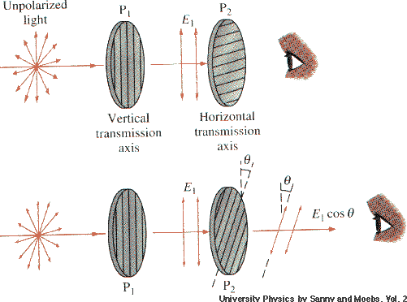
Polarization
The plane in which the E-field is “waving” is called the “Plane of Polarization”
We can test the polarization of a wave by using a Polarizer and Malus’ Law.
I_{transmitted} = I_{o}cos²θ

