Slide 1
Chapter 26 -- The Electric Field
By the end of this chapter should be able to:
Discuss a formal definition of the E-Field
Calculate the E-Field of a variety of situations
a point charge
a dipole
an infinite line of charge
a ring of charge
a disk of charge
an infinite plane of charge
a parallel plate capacitor
Discuss and calculate what happens to a charge or dipole acted upon by an external E-field.

Slide 2
The E-Field from a point charge:
Remember, from last chapter, the E-Field Vector at a point is defined as the direction a positive charge will feel force at that point.

Slide 3
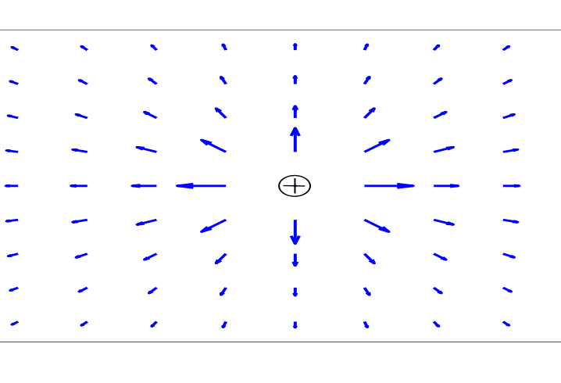
The E-Field from a point charge:
Remember, from last chapter, the E-Field Vector at a point is defined as the direction a positive charge will feel force at that point.
Two different ways to represent the E-Field.
http://phet.colorado.edu/new/simulations/sims.php?sim=Electric_Field_Hockey

Slide 4
The E-Field from a point charge:
Since:
The E-field is:
Note the notation.
To find the force on a charge placed in an external E-Field, we find that F = QE.

Slide 5
The E-field is a vector field. This means that the E-field from multiple point charges add together.
Notes:
STT26.1

Slide 6
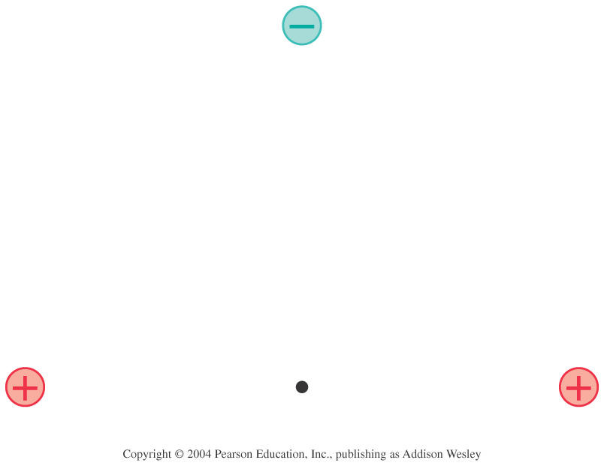

At the position of the dot, the electric field points:
1. Left.
2. Down.
3. Right.
4. Up.
5. The electric field is zero.

Slide 7
Note the direction of the E-field for negative charges.
-
http://phet.colorado.edu/new/simulations/sims.php?sim=Electric_Field_Hockey

Slide 8
Dipoles:
If we put a negative and positive “close” together, we get a dipole.
Sample Question:
Let’s find the E field on the “y-axis” shown here.
₊
-
By definition, the positive charge and negative charge are equal in magnitude AND the dipole is “small”. “small” means small compared to the distance you are away from the dipole.

Slide 9
On Wednesday we discovered that E-field on the vertical axis of a dipole is:
This however, is not too elucidating. Let’s try looking at a limiting case.

Slide 10
Let’s try finding the E-field a distance R from the mid-point of a line of charge of length L and charge Q.

Slide 11
After some work we found that:
Then, after a trig-substitution integral we found that:

Slide 12
Let’s take a look at some “limiting cases” to see if this “not-so-pretty” result makes sense:

Slide 13
R
M
L
Find the E-Field at the dot.

Slide 14
λ(x) = λ_{o}+ bx
R
M
L
Find the E-Field at the dot.
Qtot = same
Does E at R get larger, smaller or the stay same.

Slide 15
R
M
L
R
Find the E-Field at the dot.
For one rod, yesterday, we found that:
L

Slide 16
Let’s now try to find the E-Field on the z-axis of a “ring” of charge with radius R and charge Q.

Slide 17
If we were to try to find the E-field off the axis of the ring, we would discover that this would be very hard to do analytically.
We could, however, do this computationally.

Slide 18
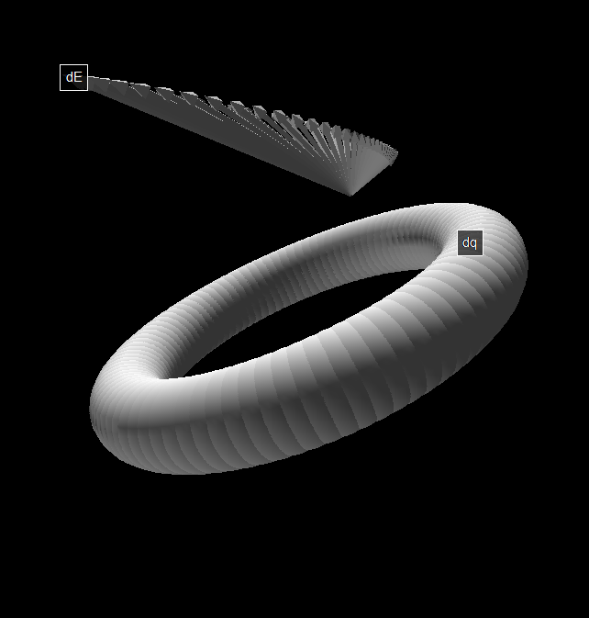
from visual import *
myscene=display(range=vector(.10,.10,.10))
Q = 50*10^-9 # C
R=0.05 #m
k=8.99*10**9
print pi
Lambda = Q/(2*pi*R) # linear charge density
theta = 0
s=vector(R*cos(theta),R*sin(theta),0.0)
dtheta = 2*pi/100
E = vector(0.0,0.0,0.0) # We start our Riemann sum at zero N/C.
p = vector(0.025,0.00,0.025)
ds = R*dtheta
dq = Lambda * ds
dE=vector(0.0,0.0,0.0)
dElabel=label(pos=p+dE,text='dE')
dqlabel=label(pos=dE,text='dq')
while theta < 2*pi:
rate(10)
dE=k*dq/(mag(s-p))**2*norm(s-p)
E=E+dE # this makes the Riemann sum happen
theta = theta + dtheta
s=vector(R*cos(theta),R*sin(theta),0.0)
dot = sphere(pos=s,radius=.01)
print dE
dEvector=arrow(pos=p,axis=dE/5/10**14,shaftwidth=.001)
dElabel.pos=p+dE/5/10**14
dqlabel.pos=s
print 'E=',E,'N/C'

Slide 19
You have a negatively charged ring and a positively charged ring a distance s apart. They share the same z-axis. The rings are of radius R and magnitude charge Q.
What is the E-Field on the z-axis directly between the two rings?

Slide 20
As always, let’s try looking at a limiting case and see if it makes sense.

Slide 21
Now, let’s try a disk.
Find the E-field on the z-axis a distance ‘z’ above a disk of total charge Q and radius R.

Slide 23
Step 1:
We drew a picture. This picture included:
a) Everything given.
b) It included a “dq” – the “dq” is usually best placed NOT at an end or midpoint.
c) Using the definitions of either “linear charge density” or “surface charge density” we turned the dq into something we could integrate over. (for example a dx, or a dxdy, or a ρdρdθ)
d) Set up your integral and…
e) make sure that your ρ, θ, x, r, etc…. aren’t every “double used”
Step 2:
Do your EFD with a clear E-net.
Step 3:
Plug and chug
Step 4:
Analyze your result.

Slide 24
With a little bit of work, we can turn a turn a disk into an infinite plane.

Slide 25
The Parallel Plate Capacitor -- The plates are assumed to be very large.
A.
B.
Which direction does the E-field point at C?
Up
Down
Left
Right
Zero
C.

Slide 26
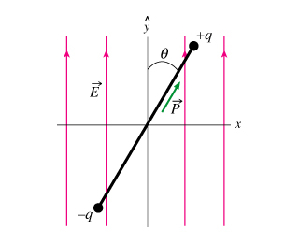
Let’s try putting a dipole in an Electric Field
Let’s find the period of oscillation of HydroFluoric Acid.

