Slide 1
Chp 27 Goals
Understand the concept of Electric Field Flux
View charges as “sinks” and “sources” of Electric Field
Understand “Gauss’ Law”
Go to: http://www.aw-bc.com/knight

Slide 2
Chp 27 -- Gauss’ Law
We’ve already discussed how charge can be thought of as a “source” or a “sink” of E-field line.
It turns out that Electric Fields need to be symmetric around all spatial reflections for Gauss’s
Law to be super useful.
+++++++++++++++++++
Let’s see if this distribution of charge + hypothetical E-Field is symmetric in all dimensions.
+++++++++++++++++++

Slide 3
The Flux of the E-field through a defined surface is:

Slide 4

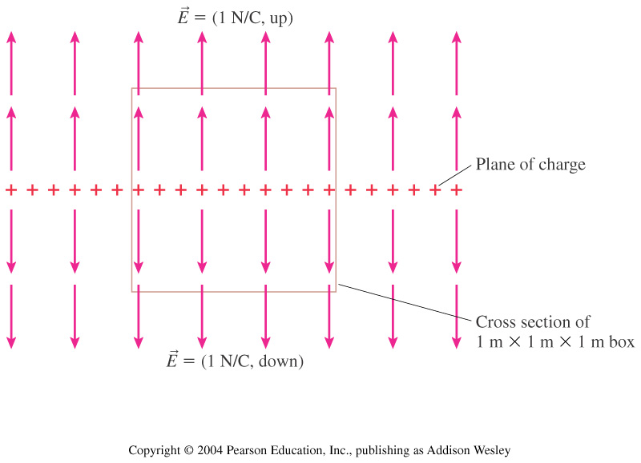
The total electric flux through this box is
6 Nm²/C.
4 Nm²/C.
2 Nm²/C.
1 Nm²/C.
0 Nm²/C.
Notes:
STT27.3
Answer: C

Slide 5
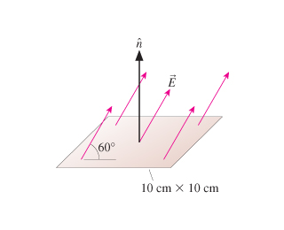
Sample Problem:
Find the E-field flux through this square. E= 20N/C

Slide 6
Sample Problem:
Find the E-field flux through a 2-meter by 2-meter square where the E-field is given by the following equation. The square is located with one corner at the origin in the x-y plane.

Slide 7
Remember that charges can be thought of as “sources” and “sinks” of E-field.
Let’s find the amount of E-field Flux “coming out of” a positive point charge.

Slide 8
Thus, the amount of flux created by a charge can be given as:
When we combine the two ways we can think about flux we get “Gauss’ Law”:

Slide 9
Let’s use Gauss’ Law to find the E-field of an (infinitely) long straight wire.

Slide 10
Chapter 28 Summary
Flux is defined as the normal component of E-field “poking” out of a defined surface.
Gauss’ Law: The amount of E-field fluxing through a closed surface is equal to q_{enclosed.}

Slide 11
You have a long straight wire that is charged up with a linear charge density of +λ.
You then have a conducting cylinder of inner radius R_{in} and outer radius R_{out}.
What is the E-field at: r<R_{in}, R_{out}>r>R_{in}, r>R_{out}?
Also: what is the linear charge density on the inside surface and outside surface of the cylinder.

Slide 12
You have a hollow conductive sphere that is charged up to +5Q. Inside at the middle of the shell you place a metal sphere of charge of -2Q. Find the E-field everywhere.

Slide 13
Gauss’ Law ALWAYS works because it is a fundamental rule of the universe.
HOWEVER, when trying to solve analytically you must have impressive symmetry for it to be useful.
The three shapes of Gaussian surfaces that are “easy”:
Cubes Spheres Cylinders
These three shapes can help us solve problems that include: wires, spheres, very long cylinders, very large planes, point charge.
If you don’t have a probably with appropriate symmetry, then you can use computational means when using Gauss’ Law

Slide 14
Chapter 25:
Coulomb’s Law –
The types of problems we could solve involved FBDs, a_{net}, and other concepts that we discovered in Ph 211 and Ph 212.
Also in Chp 25, we introduced the concept of an E-field.
Chapter 26: We deeply investigated the definition of the E-field. We solved several examples where we had to find the E-field for a finite number of charges (such as a dipole) and/or a continuous distribution of charge.
Chapter 27: We learned how to use Gauss’ Law
To use this we first had to understand the concept of flux.

Slide 15
Find the E-field of a very large plate (l=w=2meters) charged to 5C. Find out to what charge you need to charge a frog in order to levitate above the plate.

