Slide 1
Chapter 28
Think back to Ph 211. One of the things we discovered what that many physics problems are much easier if we think in terms of Energy.
Consider a Parallel Plate Capacitor
E = η/ε₀
Let’s use the definition of Work to analyze this situation.

Slide 2
Potential Across a Parallel Plate Capacitor
Potential Graph

Slide 3
Potential Across a Parallel Plate Capacitor
Potential Graph
Elevation Graph
Contour Map
Equipotential Surfaces

Slide 4
Let’s see if we can find the potential energy of a point charge.

Slide 5

If a system contains more than one charge, then the EPE of the system is the sum or the Electric PE of each pair of charge. The Box is 10 Angstroms on edges and the charges are a fundamental unit.
PE_{electric} = k Σq_{i}q_{j}/r_{ij}
Find the PE of this system of 4 charges arranged in a “box” of sizes l and w.:
For +3 Exam extra credit points:
Create a program that shows the motion of these four charges once you let go of them.

Slide 6
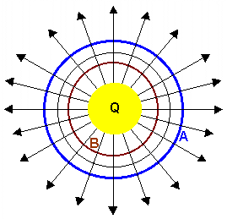
Electric Potential Energy
Consider a spherical conductor with a charge of Q=10 µC.
What would the Electric Potential be at points A and B in the diagram here where r_{b}=1 meter and r_{a}=3meters.
Surface A (r_{A} = 3 meters) the potential equals: V_{A} = kQ/r = (9 x 10⁹)(10 x 10⁻⁶)/3 = 3 x 10⁴ volts Surface B (r_{B} = 1 meter) the potential equals: V_{B} = kQ/r = (9 x 10⁹)(10 x 10⁻⁶)/1 = 9 x 10⁴ volts
dev.physicslab.org

Slide 7
If a 2 nC charge were to be brought in from infinity and placed on surface A shown above, the amount of work done on the 2 nC charge would equal
W = qΔV = | 2 x 10⁻⁹(ΔV)
 | 2 x 10⁻⁹(V_{A} - V∞)
 | 2 x 10⁻⁹(3 x 10⁴ - 0)
 | 6 x 10⁻⁵ J
We say that the 2 nC charge has gained an electric potential energy of
EPE_{A} = 6 x 10⁻⁵ J.
By definition, the absolute potential at a position infinitely far from a point charge is defined to be zero. Similarly, the amount of work done on the 2 nC charge to bring it in from infinity and place it on surface B would equal
W = qΔV = | 2 x 10⁻⁹(ΔV)
 | 2 x 10⁻⁹(V_{B} - V∞)
 | 2 x 10⁻⁹(9 x 10⁴ - 0)
 | 1.8 x 10⁻⁴ J
We say that the 2 nC charge has gained an electric potential energy of
EPE_{B} = 1.8 x 10⁻⁴ J.

Slide 8
If a system contains more than one charge, then the EPE of the system is the sum or the Electric PE of each pair of charge.
Let the “size” of this molecule be 10 angstroms and have each charge be a fundamental unit of charge.
Find the PE of this system.:

Slide 9
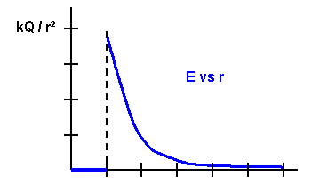
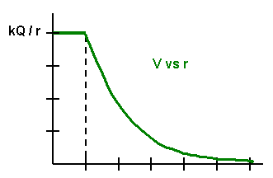
What would the E vs. r and V vs. R graphs look like for this case?

Slide 10
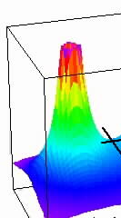
We could also create a 3-D potential map of the system.
Volts
S_{y}
S_{x}

Slide 11
Or, we could create an “equipotential” map.

Slide 12
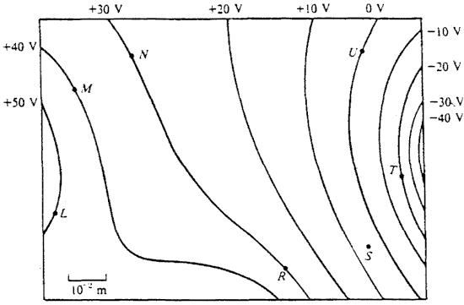
Where is the electric field strongest? L, M, N, R, S, T, U
Where is the electric field weakest? L, M, N, R, S, T, U
What is the direction of the electric field at R?
How much work would it take an external agent to move a charge from R to N?
What does the negative sign mean in the previous answer?

Slide 13
With your neighbor complete the following questions?

Slide 14
Does it take more work to move a 2 µC charge from R to L and then to T compared to going directly to T?
How much Potential Energy did the 2 µC charge have while it was at rest at position R?
What is the 2 µC charge’s EPE at point T?
How much work was required to move the 2 µC charge from R to T?

Slide 15
Q
You place q a distance R away from Q. What speed does q have when it gets really far away from Q. (q has a mass of m) Q has a length of L.
q

Slide 16
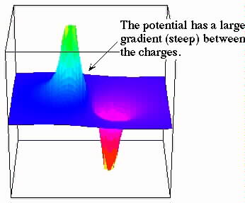

Slide 17
29.56 A Uranium nucleus decays via an alpha decay. How fast is a detected alpha particle traveling from a decayed Uranium nucleus?
29.62 Two spherical drops of mercury each have a charge of 0.10 nC and a potential at the surface of 300 Volts.
The two drops merge to form a single drop.
What is the potential at the surface of the new drop?

Slide 18
