Slide 1
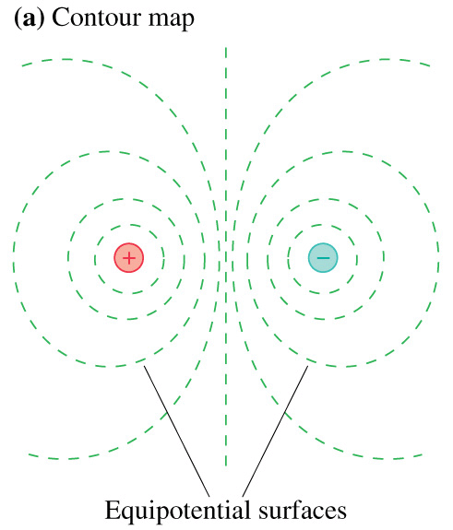
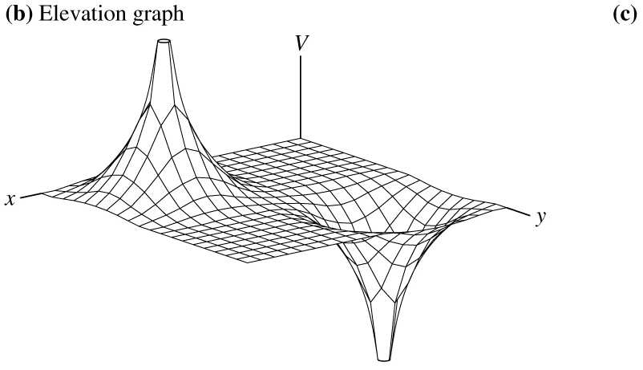
Chapter 29 – Connecting Potential and Field

Slide 2
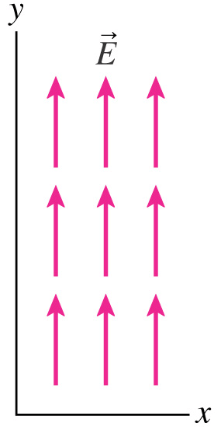
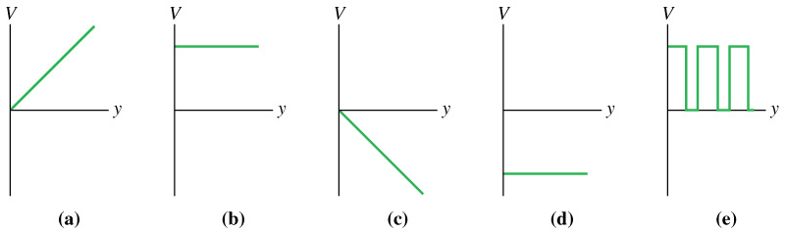
Remember the definition of an E-Field: An E-Field vector field shows at every point the acceleration a positive charge would experience at any given point.
Which graph of the electric potential V describes the electric field shown?

Slide 3
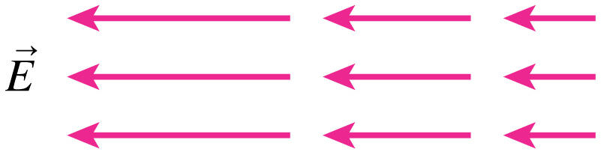
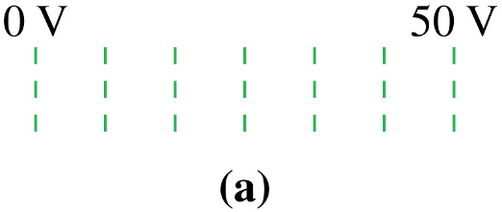
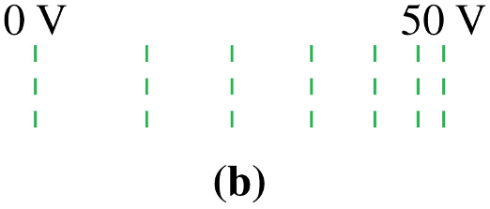
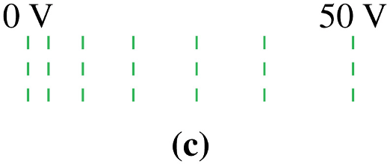
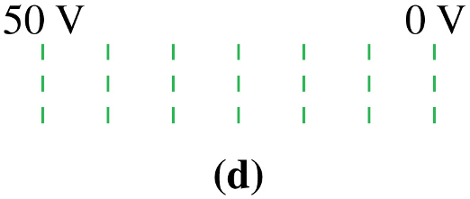
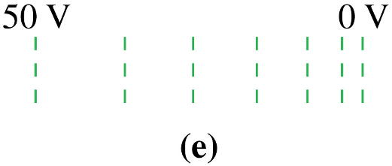
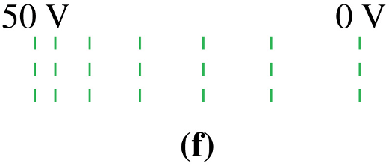
Which set of equipotential contours describes the electric field shown?

Slide 4
Let’s compare energy and voltage in a parallel plate capacitor.

Slide 5
Looking at it in “reverse” we get that:

Slide 6
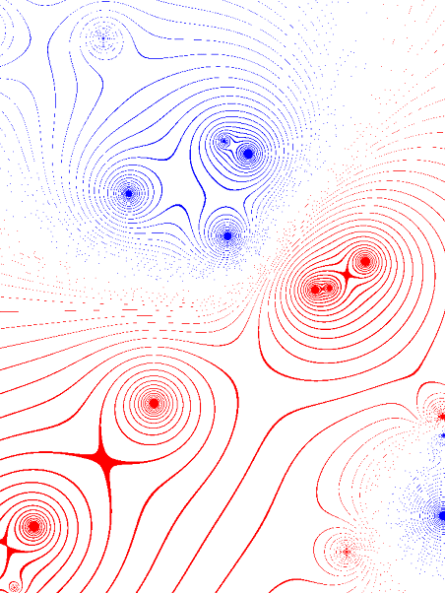
The E-field and Potential Field are related through the gradient:
Sample Problem:
Let’s say that we had some sort of crazy potential field such that: V(x,y,z) = 3xy² + 5y³ + 5z + 12
What E-field would create this potential?

Slide 7
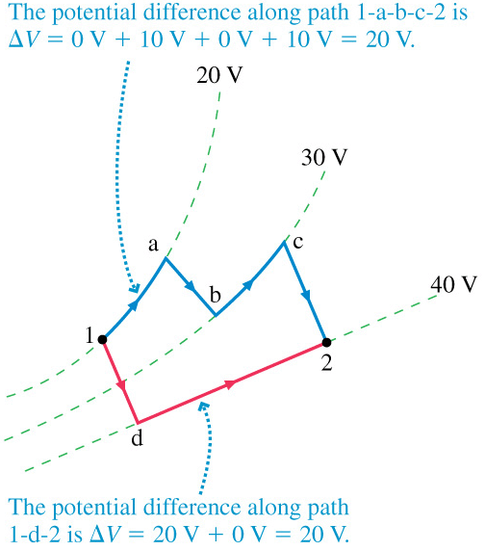
Kirchhoff’s Loop Law
Since the electric field is conservative, any path between points 1 and 2 finds the same potential difference. Any path can be approximated by segments parallel and perpendicular to equipotential surfaces, and the perpendicular segments must cross the same equipotentials.
Since a closed loop starts and ends at the same point, the potential around the loop must be zero. This is Kirchhoff’s Loop Law, which we will use later.

Slide 8
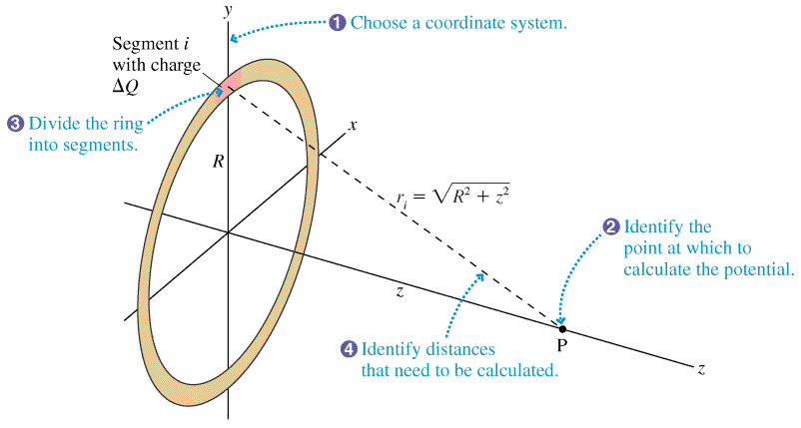
Example: The Potential of a Ring of Charge
Find the potential of a thin uniformly charged ring of radius R and charge Q at point P on the z axis?

Slide 9
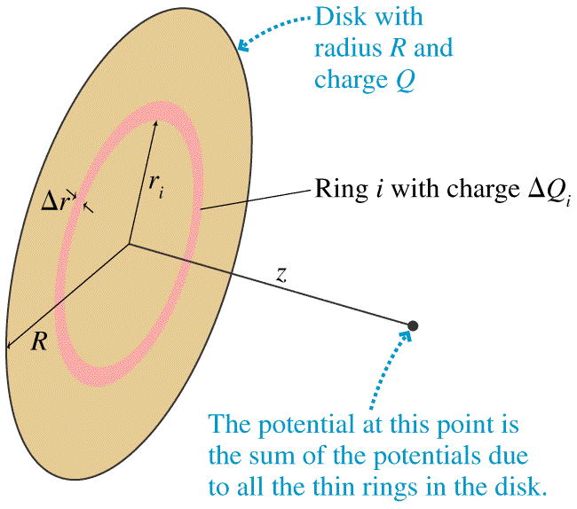
Example: The Potential of a Disk of Charge
Find the potential of a uniformly charged disk of radius R and charge Q at point P on the z axis?
P
Then, use the relationship between V and E to find the E-field on the z-axis.

Slide 10
Go to http://phet.colorado.edu click into “Physics” and then click into “Electricity, Magnets and Circuits”. Run “Circuit Construction Kit (AC +DC).
Step 1: Make a circuit consisting of one battery and one capacitor. What happens?
Step 2: Take a closer look by using the “Current Chart”.
Step 3: Slow things down by making a circuit consisting of a battery, a capacitor and a resistor. What does the current vs. time graph look like this time?
Step 4: What happens if you create an RC circuit with two capacitors in parallel?
Step 5: What happens if you create an RC circuit with two capacitors in series?
Step 6: Play around with the Voltmeter.

Slide 11
Why should the very first equation-like thing that you write be V = integral of dV?

Slide 12
Remember that the E-field between two parallel plates is:
… and remember that the electric potential between two points inside a parallel plate is:
Combining these:
We’re going to define Capacitance as:

Slide 13
We’re going to define Capacitance as:

Slide 14
Let’s look at how much energy is stored in a capacitor.
You can find the energy in a capacitor by integrating:

Slide 15
Let’s find the Effective Capacitance of two capacitors in parallel:

Slide 16
Let’s find the Effective Capacitance of two capacitors in series:

Slide 17
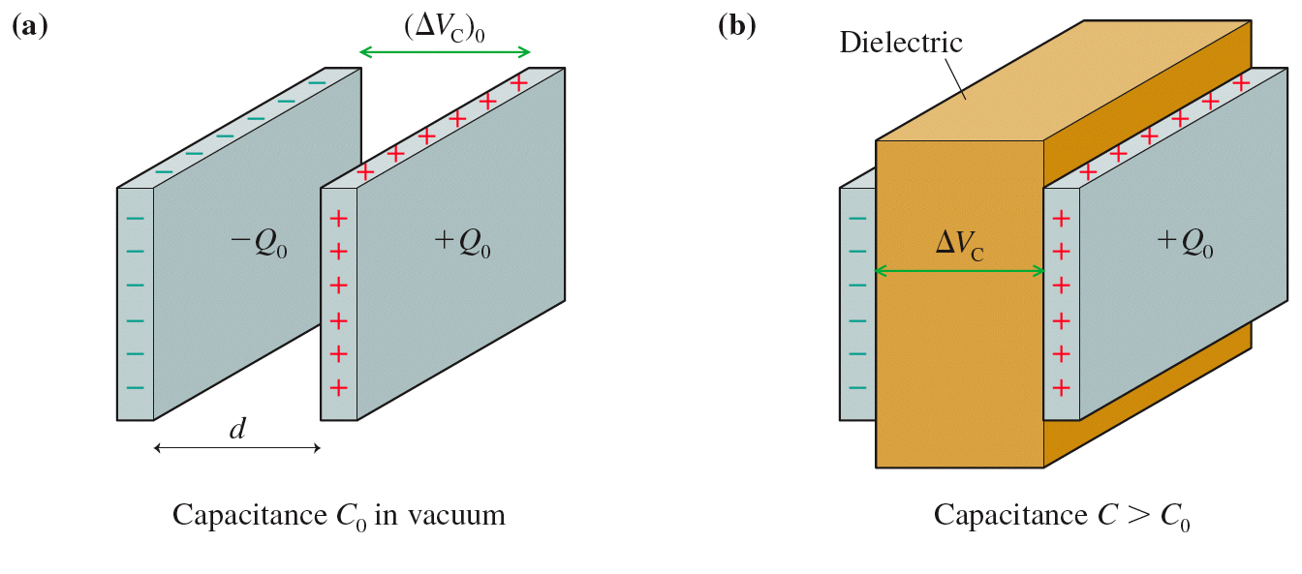
Dielectrics

Slide 18
Summary of Chapter 30:
You should realize how electric potential and electric fields are related to each other.
If you have calculated an E-Field for a configuration, you should be able to find a potential and visa-versa.
You should be able to qualitatively discuss what a capacitor is and does.
You should be able to find the capacitance of a situation.
You should be able to find the effective capacitance of a circuit in parallel and in series.
Energy conservation mandates that the ΔV around a closed loop always be zero.

Slide 19
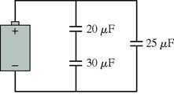
Sample Problem:
a. Find the Effective Capacitance of this Circuit
b. For a 12V battery, what would the voltage be across each capacitor?

Slide 20
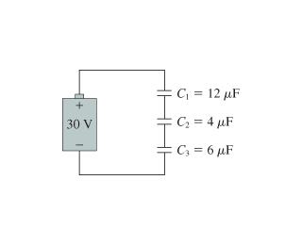
Sample Problem:
Find the Effective Capacitance of this Circuit.
b. Find the charge on each capacitor.
c. What would the voltage be across each capacitor?

