Slide 1
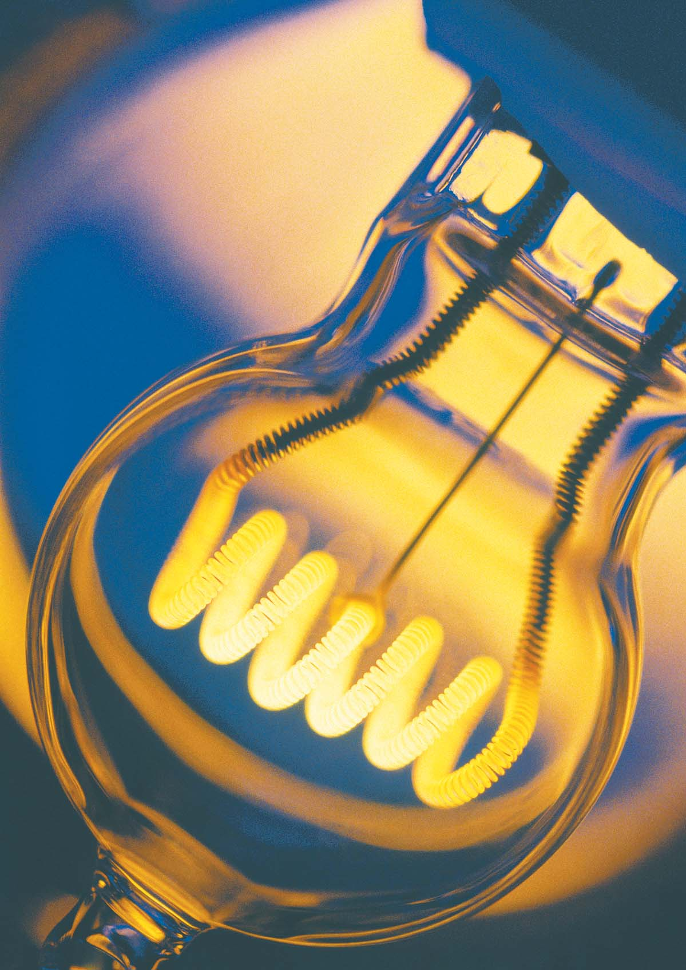
Chapter 30. Current and Resistance
Chapter Goals:
To learn how and why charges moves through a wire.
To define “Current”.
To understand Ohm’s Law
Discuss the differences and similarities between conductors, semi-conductors, super conductors.

Slide 2
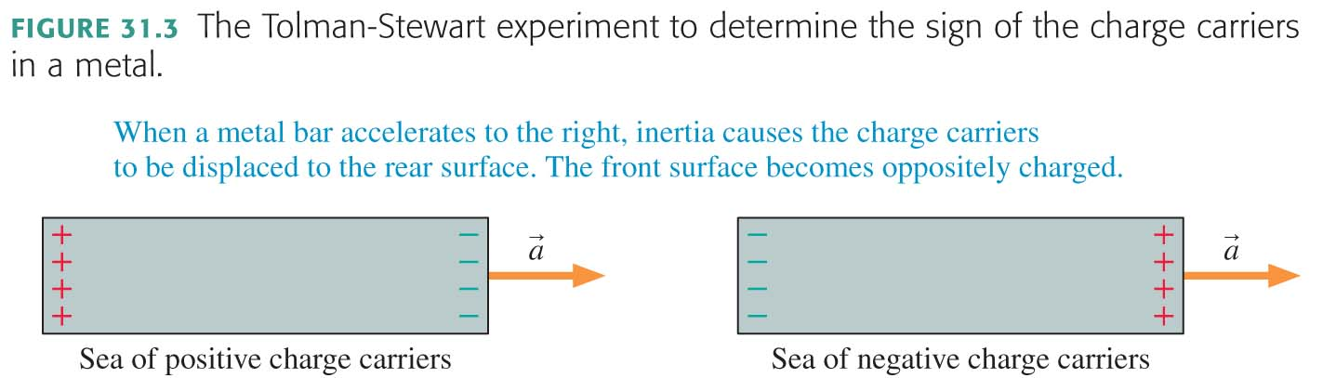
Even through Benjamin Franklin was experimenting with electric in the mid 1700’s and even through electricity was being introduced in households in the late 1800’s, we still didn’t know if it was the positive charges or negative charges moving through the wire.
In 1916 the Tolman-Stewart Experiment finally determines the sign of charge carriers in a metal.

Slide 3
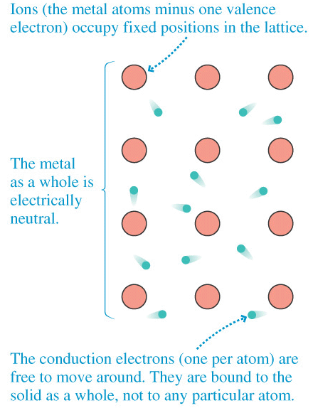
After the 1916 experiment, this is the model we had for a conductive substance.
+
+
+
-
-
-
+
+
+
-
-
-
+
-
+
+
-
-
-
+
+
+
-
-

Slide 4
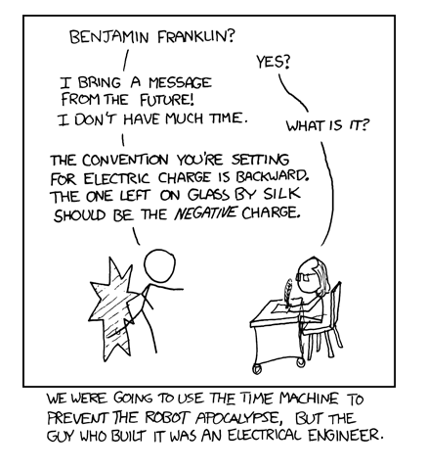

Slide 5
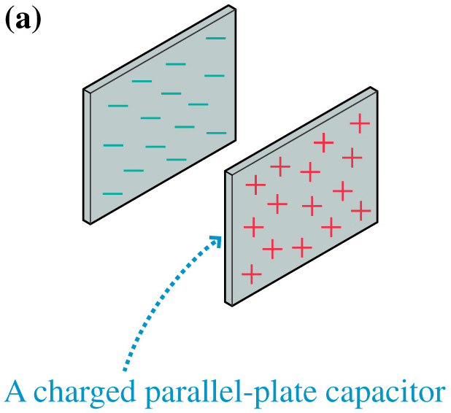
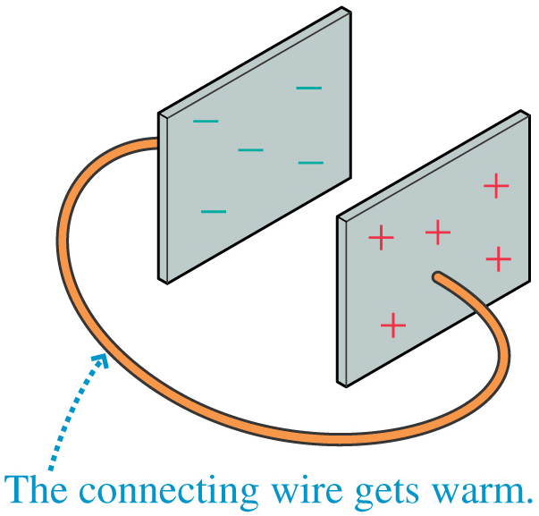
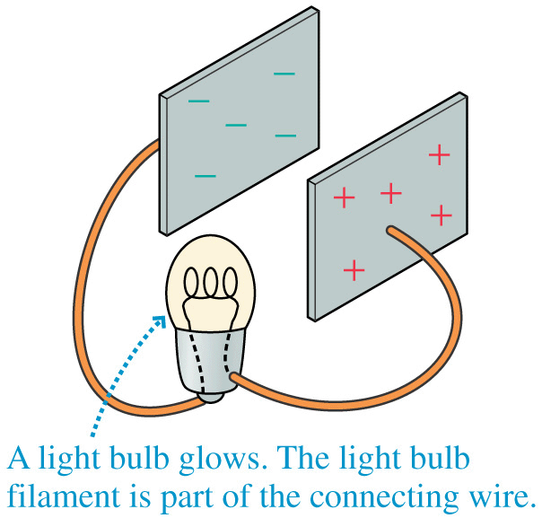
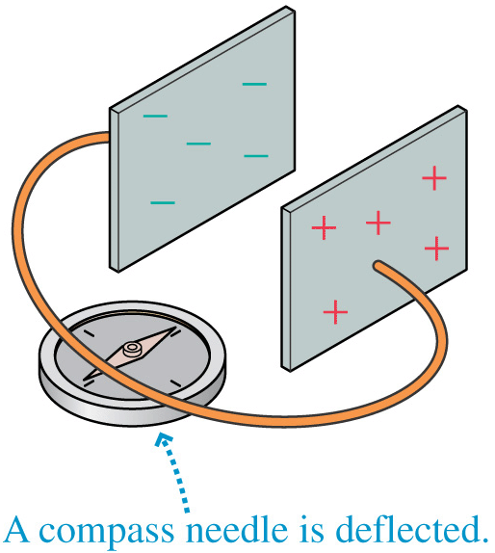
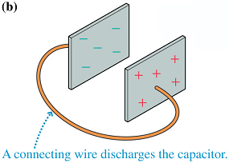
The Electron Current
5

Slide 6
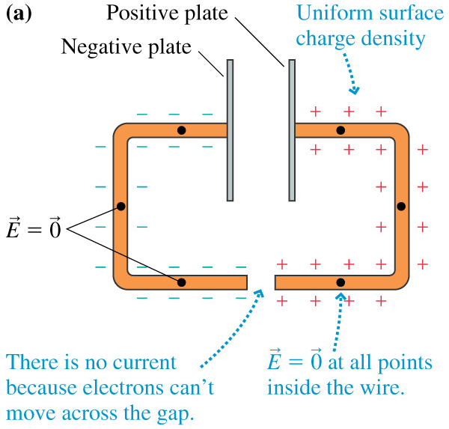
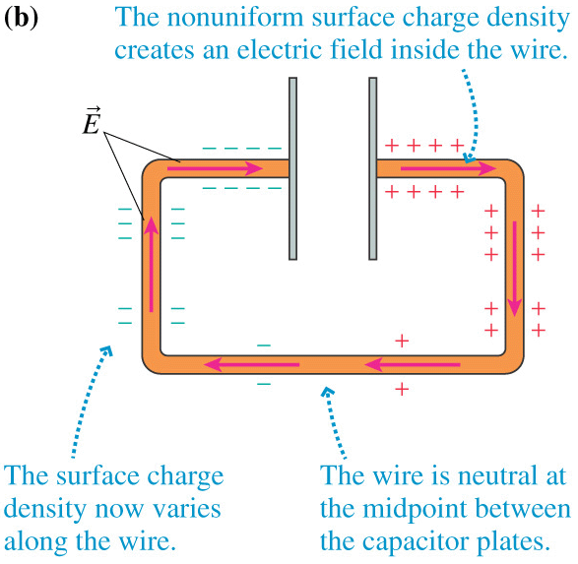
Establishing the Electric Field in a Wire (1)
The figure shows two metal wires attached to the plates of a parallel plate capacitor, with their ends close together but not touching. The wires are conductors, so some of the charge from the capacitor plates spreads out along the wires as surface charge. E=0 inside all conductors.
Now we connect the wires. What happens? The surface electrons can move, and do so. In ~10⁻⁹ s the sea of electrons shifts slightly, and the surface charges are rearranged into a non-uniform distribution of charges, as shown. Surface charges near the + and – plates reflect this charges, but surface charges become near-neutral half-way along the wire
6

Slide 7
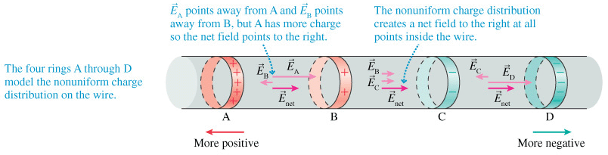
Establishing the Electric Field in a Wire (2)
The non-uniform charge distribution creates an E field inside the wire. This pushes the electron current through the wire
7

Slide 8
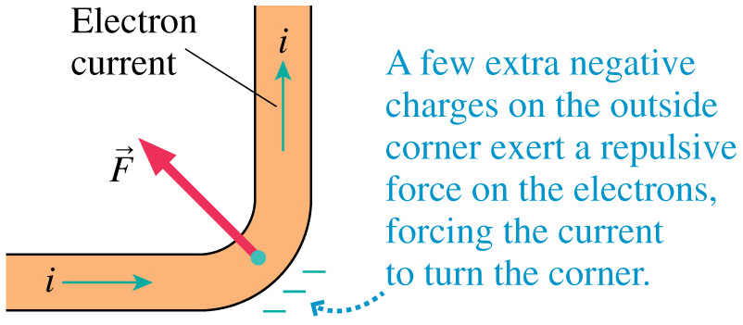
Turning the Corner
8

Slide 9
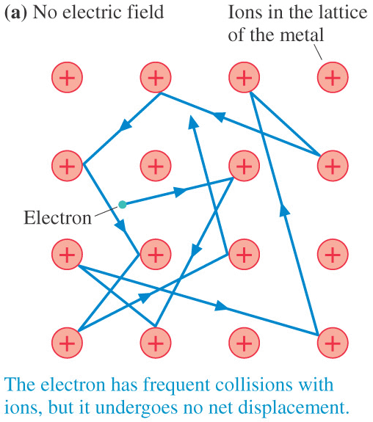
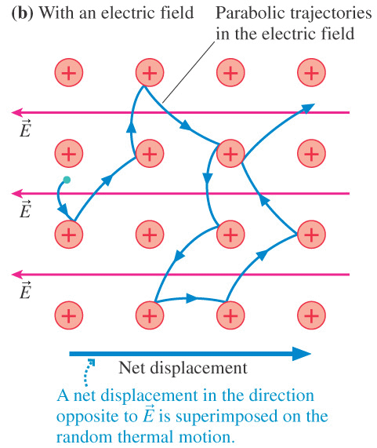
A Model of Conduction (1)
With no applied E-field, the electrons move around due to thermal energy, but, they have no net drift.
Now turn on an E field. The straight-line trajectories become parabolic, and because of the curvature, the electrons begin to drift in the direction opposite E, i.e., “downhill”.
a_{x}=F/m=eE/m
thus v_{x}=v_{ix}+ a_{x}t = v_{ix}+ (eE/m)t
This acceleration increases the electron more kinetic energy until the next collision, a “friction” that heats the wire.
January 24, 2007
9

Slide 10
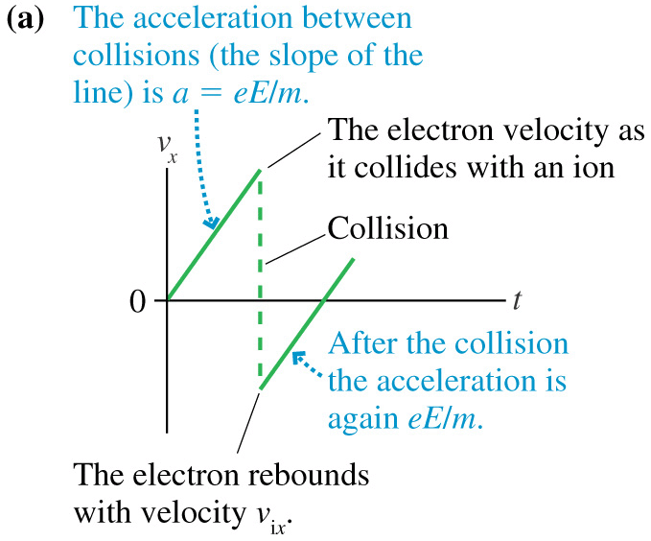
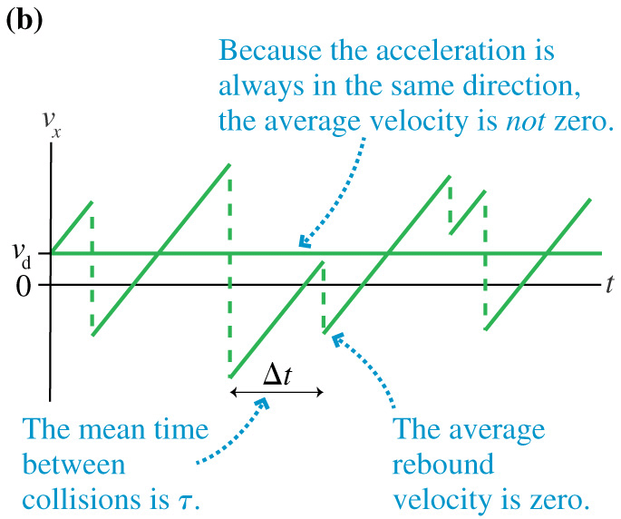
A Model of Conduction (2)
10

Slide 11
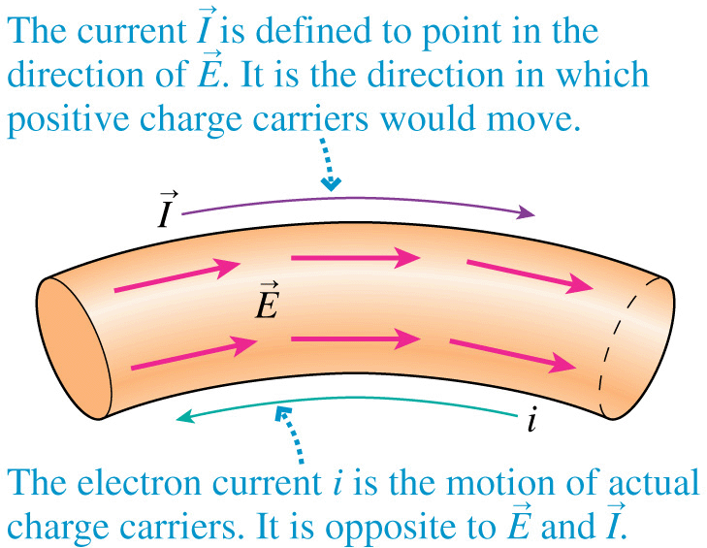
Current and Electrons
11

Slide 12
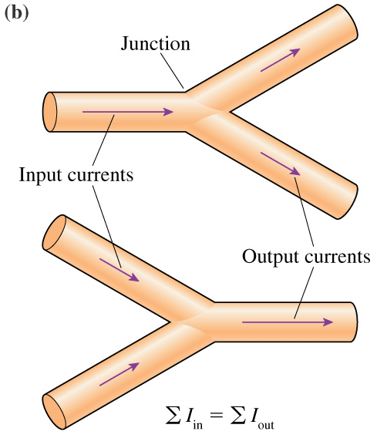
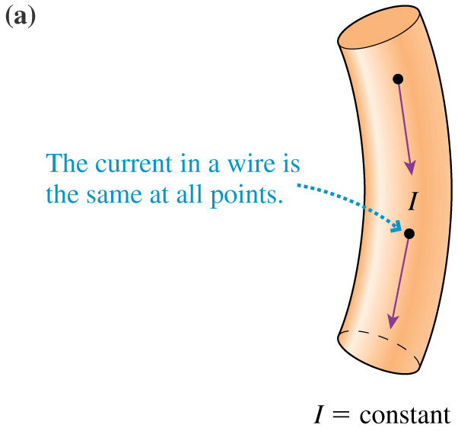
Kirchhoff’s Junction Law
12

Slide 13
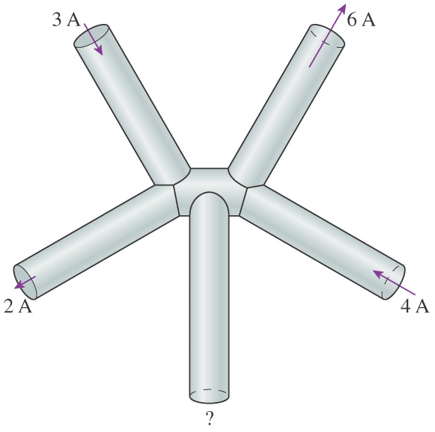
Quick Question 3
What is the current at the bottom wire?
(a) 0 A (b) 1 A in (c) 1 A out (d) 2 A in (e) 2 A out
January 24, 2007
13

Slide 14
Cu
1s² 2s² 2p⁶ 3s² 3p⁶ 4s² 3d⁹
January 24, 2007
14

Slide 15
3d⁹
3d⁹
3d⁹
3d⁹
3d⁹
3d⁹
3d⁹
3d⁹
3d⁹
3d⁹
3d⁹
3d⁹
3d⁹
3d⁹
3d⁹
15

Slide 16
Orbitals only partially filled.
Orbital Band Structure of a Conductor
January 24, 2007
16

Slide 17
Temperature response of a conductor:
The warmer a conductor is, generally the worse its ability to conduct electricity.
17

Slide 18
Conduction Zone
Forbidden Ζονε−−Νο Electrons Allowed
Filled Orbitals
Semi-Conductor Orbital Band Structure
January 24, 2007
18

Slide 19
Temperature response of a semi-conductor:
The warmer a semi-conductor is, the more conductive it gets.
January 24, 2007
19

Slide 20
A super-conductor conducts electricity with zero resistance.
The valence model of electrons doesn’t fully explain superconductivity--for this, we have to turn to quantum mechanics.
January 24, 2007
20

Slide 21
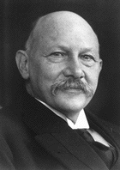
Superconductivity
The “classical” physics we are studying is an approximation to quantum mechanics. In the quantum domain, under certain circumstances (low temperature, electron pairing) , there may be minimum amount of energy that an electron can lose in a collision. If the probable energy loss falls below that minimum, the system may become a “superconductor”, a material in which the electrical resistance of the material vanishes. Superconductivity was discovered in 1911 by the Dutch physicist Heike Kamerlingh Onnes.
Heike Kamerlingh Onnes
(1853-1926)
Most superconductors exist at only very low temperatures (<20 K), but in 1986 a new class of “warm” superconductors was discovered that maintain their superconducting properties up to 125 K. A current initiated in such a material persists, because there is no electrical resistance to dissipate the energy.
January 24, 2007
21

Slide 22
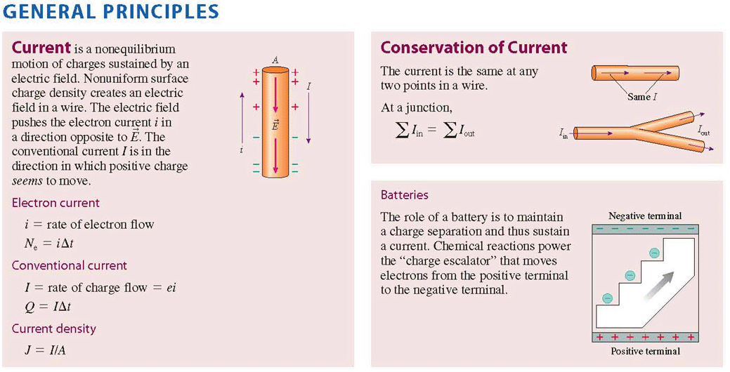
Summary: Chapter 30 (1)
January 24, 2007
22

Slide 23
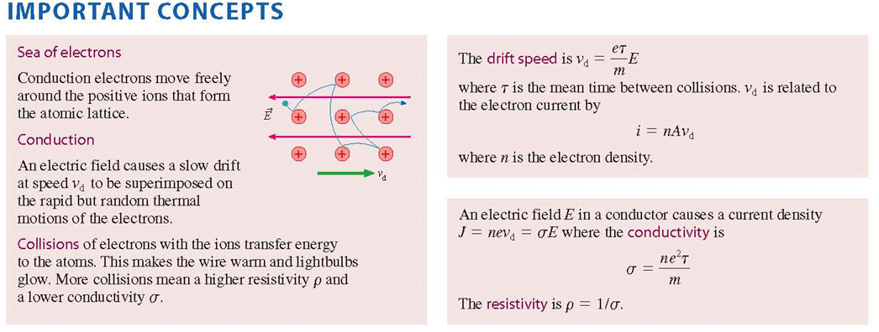
Summary: Chapter 30 (2)
Rearranging all the above terms we’re going to define Resistance ρL/A and discover that:
Ohm’s Law
January 24, 2007
23

Slide 24
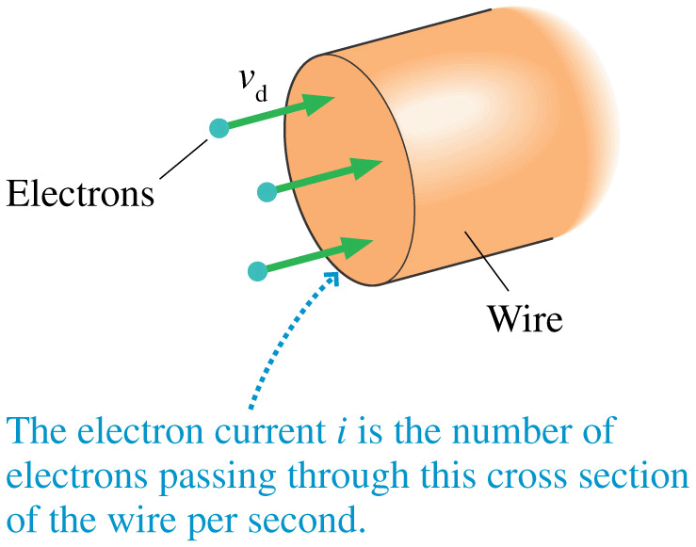
The Electron Current
-
In a metallic conductor in electrostatic equilibrium, the conduction electrons move around quite rapidly, but there is no net movement of charge.
This can be changed by “pushing” on the sea of electrons with an electric field, thereby causing the entire sea of electrons to move in a particular direction, like a gas or liquid flowing through a pipe.
The net motion, the “drift speed” v_{d}, is superimposed on the random thermal motions of the individual electrons, and it is very slow, typically around 10⁻⁴ m/s.
-
-
We define the electron current i as the number of electrons N_{e} that pass through a cross section of wire or other conductor in a time interval Dt. In other words: N_{e}=iDt.
January 24, 2007
24

Slide 25
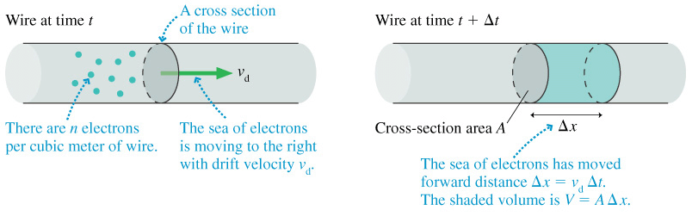
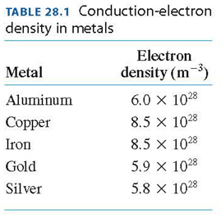
Current and Drift Velocity
If the electrons have an average drift speed v_{d}, then on the average in a time interval Dt they would travel a distance Dx in the wire, where Dx = v_{d} Dt. If the wire has cross sectional area A and there are n electrons per unit volume in the wire, then the number of electrons moving through the cross sectional area in time Dt is N_{e} = nA Dx = nAv_{d}Dt.
Therefore,
This table gives n for various metals.
January 24, 2007
25

Slide 26
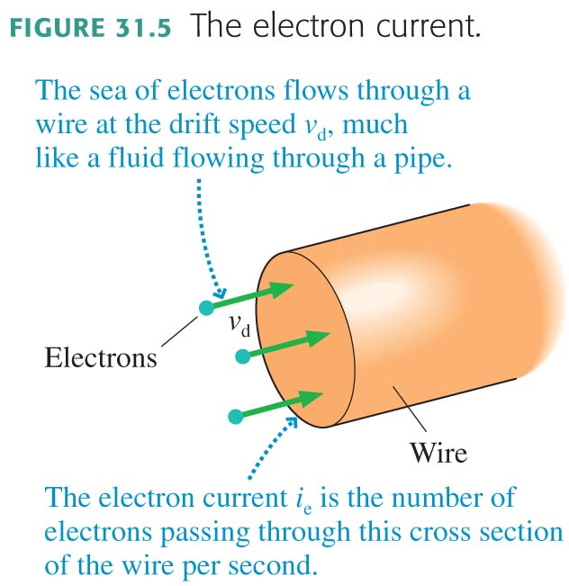

Slide 27

The Electron Current
Pushing on the sea of electrons with an electric field causes the entire sea of electrons to move in one direction like a gas or liquid flowing through a pipe.
This net motion, which takes place at the drift speed v_{d}, is superimposed on top of the random thermal motions of the individual electrons.
The electron current is the number of electrons per second that pass through a cross section of a wire or other conductor. n_{e} is the number density of electrons.
The electron current in a wire of cross-sectional area A is

Slide 28
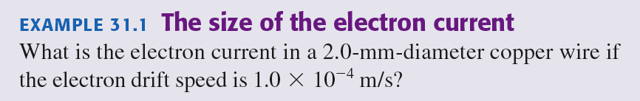
EXAMPLE 31.1 The size of the electron current
QUESTION:

Slide 29
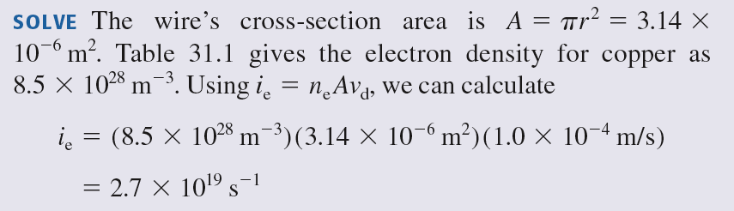
EXAMPLE 31.1 The size of the electron current

Slide 30
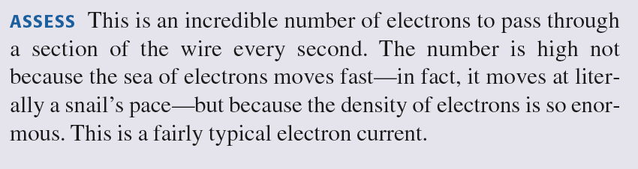
EXAMPLE 31.1 The size of the electron current

Slide 31
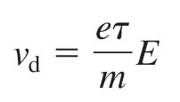
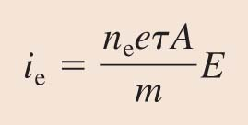
Creating a Current
The average speed at which the electrons are pushed along by an electric field is
Where τ is the mean time between collisions, and m is the mass of the electron.
The electron current is then

Slide 32
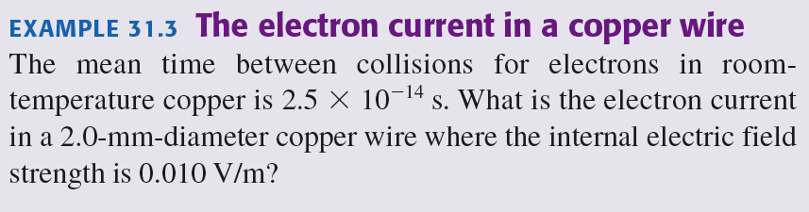
EXAMPLE 31.3 The electron current in a copper wire
QUESTION:

Slide 33
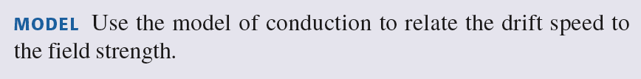
EXAMPLE 31.3 The electron current in a copper wire

Slide 34
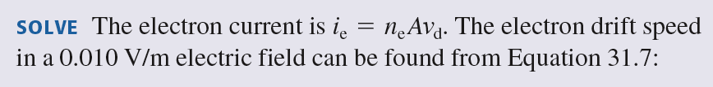
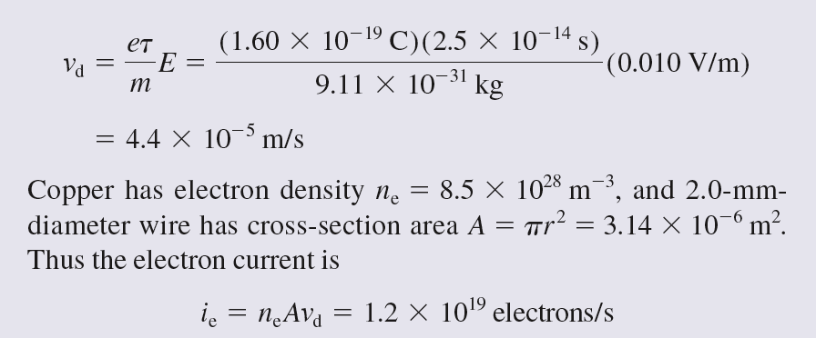
EXAMPLE 31.3 The electron current in a copper wire

Slide 35
EXAMPLE 31.3 The electron current in a copper wire

Slide 36
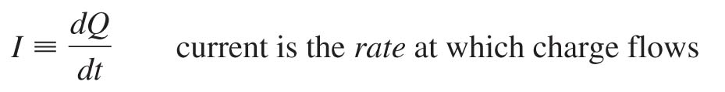
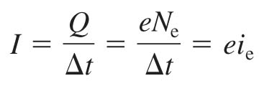
Current
If Q is the total amount of charge that has moved past a point in a wire, we define the current I in the wire to be the rate of charge flow:
The SI unit for current is the coulomb per second, which is called the ampere. 1 ampere = 1 A = 1 C/s.
The conventional current I and the electron current i_{e} are related by

Slide 37
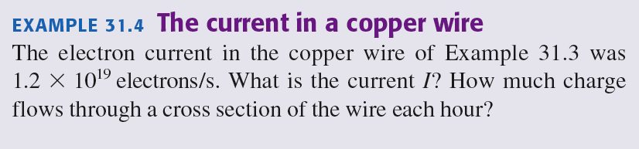
EXAMPLE 31.4 The current in a copper wire
QUESTION:

Slide 38
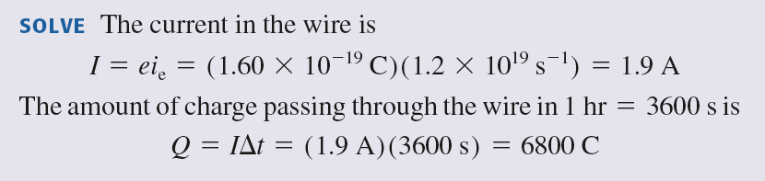
EXAMPLE 31.4 The current in a copper wire

Slide 39
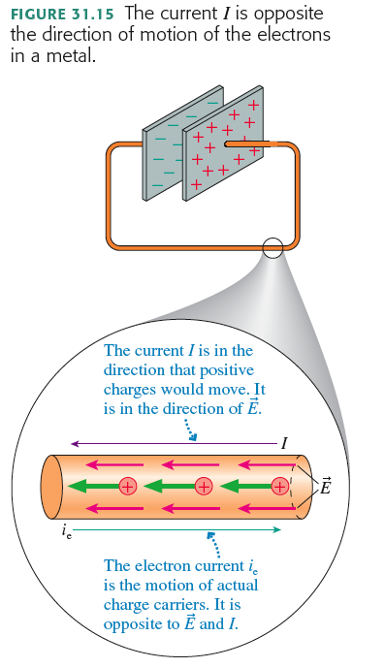

Slide 40
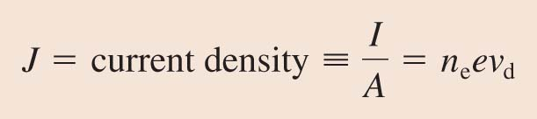
The Current Density in a Wire
The current density J in a wire is the current per square meter of cross section:
The current density has units of A/m².

Slide 41
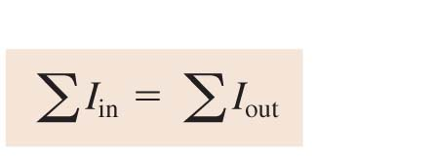
Kirchhoff’s Junction Law
For a junction, the law of conservation of current requires that
where the Σ symbol means summation.
This basic conservation statement – that the sum of the currents into a junction equals the sum of the currents leaving – is called Kirchhoff’s junction law.

Slide 42
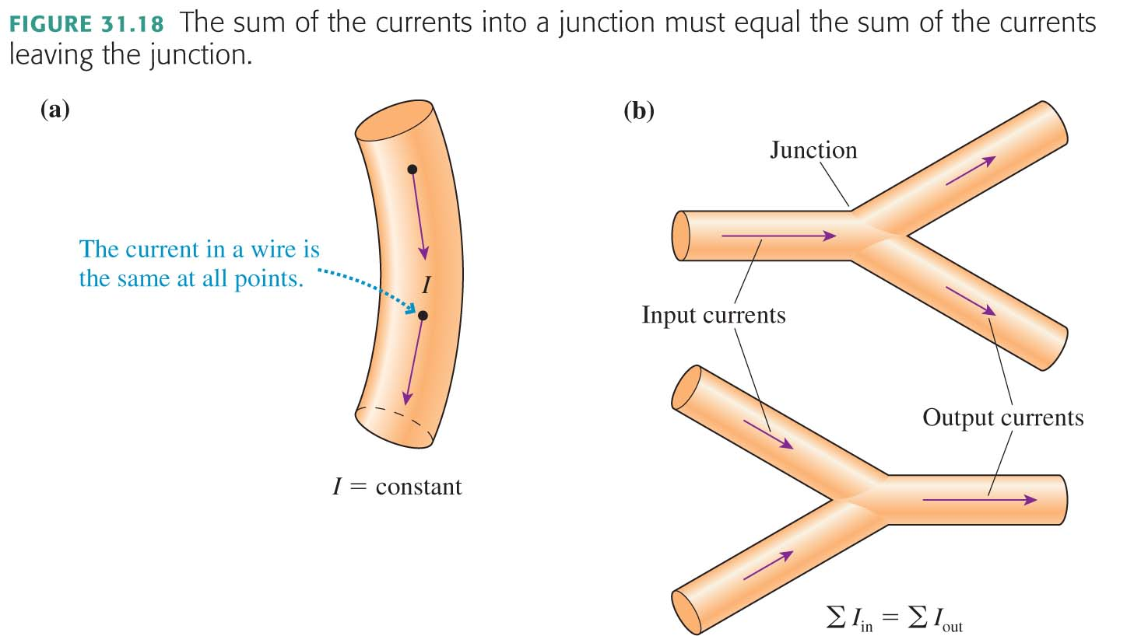

Slide 43
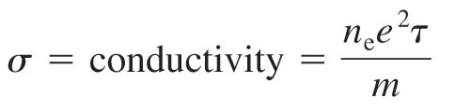

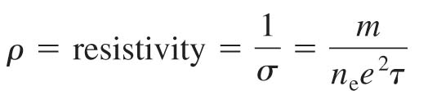
Conductivity and Resistivity
The conductivity of a material is
Conductivity, like density, characterizes a material as a whole.
The current density J is related to the electric field E by:
The resistivity tells us how reluctantly the electrons move in response to an electric field:

Slide 44
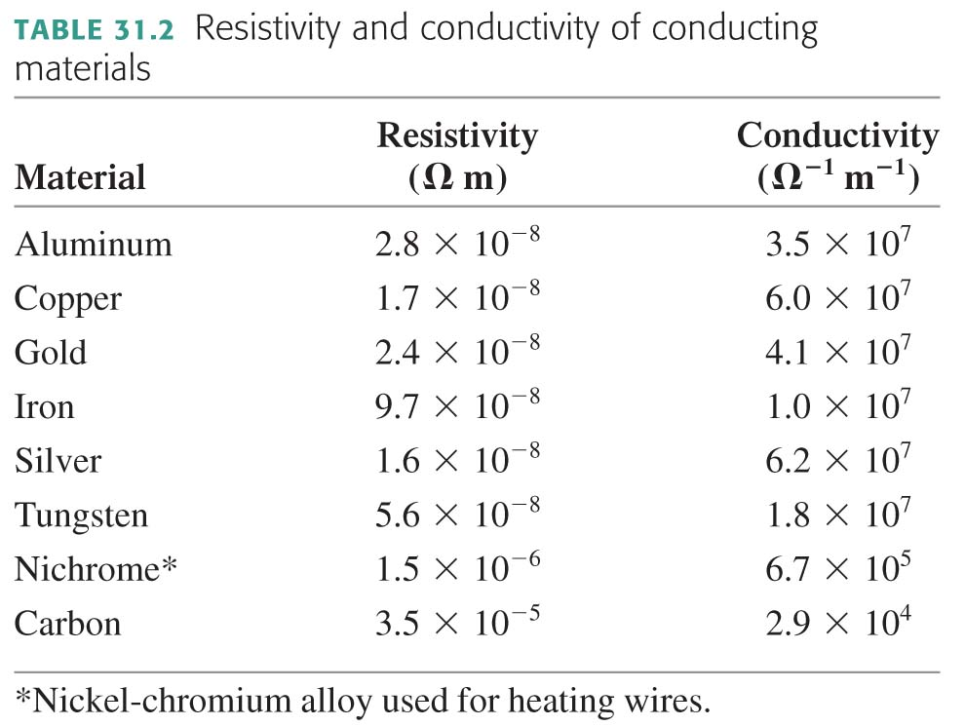

Slide 45
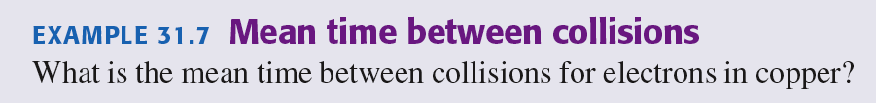
EXAMPLE 31.7 Mean time between collisions
QUESTION:

Slide 46
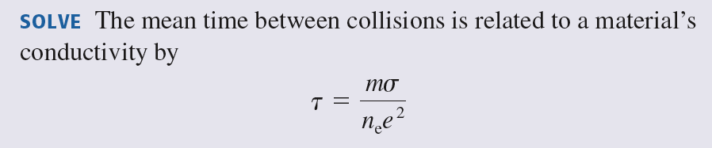

EXAMPLE 31.7 Mean time between collisions

Slide 47


Slide 48


Resistance and Ohm’s Law
The resistance of a long, thin conductor of length L and cross=sectional area A is
The SI unit of resistance is the ohm. 1 ohm = 1 Ω = 1 V/A.
The current through a conductor is determined by the potential difference ΔV along its length:

Slide 49

EXAMPLE 31.8 The current in a nichrome wire
QUESTION:

Slide 50

EXAMPLE 31.8 The current in a nichrome wire

Slide 51


EXAMPLE 31.8 The current in a nichrome wire

Slide 52
Ohm’s Law
Ohm’s law is limited to those materials whose resistance R remains constant—or very nearly so—during use.
The materials to which Ohm’s law applies are called ohmic.
The current through an ohmic material is directly proportional to the potential difference. Doubling the potential difference doubles the current.
Metal and other conductors are ohmic devices.

Slide 53


Slide 54

EXAMPLE 31.9 A battery and a resistor
QUESTION:

Slide 55

EXAMPLE 31.9 A battery and a resistor

Slide 56
Chapter 31. Summary Slides

Slide 57








Review

Slide 58
General Principles

Slide 60
Important Concepts

Slide 61
Important Concepts

Slide 62
Important Concepts

Slide 63
Chapter 31. Clicker Questions

Slide 64

These four wires are made of the same metal. Rank in order, from largest to smallest, the electron currents i_{a} to i_{d}.
i_{d} > i_{a} > i_{b} > i_{c}
i_{b} = i_{d} > i_{a} = i_{c}
i_{c} > i_{b} > i_{a} > i_{d}
i_{c} > i_{a} = i_{b} > i_{d}
i_{b} = i_{c} > i_{a} = i_{d}
Notes:
STT28.1
Answer: C

Slide 65

These four wires are made of the same metal. Rank in order, from largest to smallest, the electron currents i_{a} to i_{d}.
i_{d} > i_{a} > i_{b} > i_{c}
i_{b} = i_{d} > i_{a} = i_{c}
i_{c} > i_{b} > i_{a} > i_{d}
i_{c} > i_{a} = i_{b} > i_{d}
i_{b} = i_{c} > i_{a} = i_{d}
Notes:
STT28.1

Slide 66
Why does the light in a room come on instantly when you flip a switch several meters away?
Electrons travel at the speed of light through the wire.
Because the wire between the switch and the bulb is already full of electrons, a flow of electrons from the switch into the wire immediately causes electrons to flow from the other end of the wire into the lightbulb.
The switch sends a radio signal which is received by a receiver in the light which tells it to turn on.
Optical fibers connect the switch with the light, so the signal travels from switch to the light at the speed of light in an optical fiber.
Notes:
STT28.4
Answer: B

Slide 67
Why does the light in a room come on instantly when you flip a switch several meters away?
Electrons travel at the speed of light through the wire.
Because the wire between the switch and the bulb is already full of electrons, a flow of electrons from the switch into the wire immediately causes electrons to flow from the other end of the wire into the lightbulb.
The switch sends a radio signal which is received by a receiver in the light which tells it to turn on.
Optical fibers connect the switch with the light, so the signal travels from switch to the light at the speed of light in an optical fiber.
Notes:
STT28.4

Slide 68





The two charged rings are a model of the surface charge distribution along a wire. Rank in order, from largest to smallest, the electron currents E_{a} to E_{e} at the midpoint between the rings.
E_{c} > E_{e} > E_{a} > E_{b} = E_{d}
E_{d} > E_{b} > E_{e} > E_{a} = E_{c}
E_{c} = E_{d} > E_{e} > E_{a} = E_{b}
E_{b} = E_{d} > E_{a} = E_{c} = E_{e}
E_{a} = E_{b} > E_{e} > E_{c} = E_{d}
Notes:
STT28.3
Answer: B

Slide 69
The two charged rings are a model of the surface charge distribution along a wire. Rank in order, from largest to smallest, the electron currents E_{a} to E_{e} at the midpoint between the rings.
E_{c} > E_{e} > E_{a} > E_{b} = E_{d}
E_{d} > E_{b} > E_{e} > E_{a} = E_{c}
E_{c} = E_{d} > E_{e} > E_{a} = E_{b}
E_{b} = E_{d} > E_{a} = E_{c} = E_{e}
E_{a} = E_{b} > E_{e} > E_{c} = E_{d}
Notes:
STT28.3

Slide 70

What are the magnitude and the direction of the current in the fifth wire?
15 A into the junction
15 A out of the junction
1 A into the junction
1 A out of the junction
Not enough data to determine
Notes:
STT28.4
Answer: C

Slide 71
What are the magnitude and the direction of the current in the fifth wire?
15 A into the junction
15 A out of the junction
1 A into the junction
1 A out of the junction
Not enough data to determine
Notes:
STT28.4

Slide 72

Rank in order, from largest to smallest, the current densities J_{a} to J_{d} in these four wires.
J_{c} > J_{b} > J_{a} > J_{d}
J_{b} > J_{a} = J_{d} > J_{c}
J_{b} > J_{a} > J_{c} > J_{d}
J_{c} > J_{b} > J_{a} = J_{d}
J_{b} = J_{d} > J_{a} > J_{c}
Notes:
STT28.5
Answer: B

Slide 73
Rank in order, from largest to smallest, the current densities J_{a} to J_{d} in these four wires.
J_{c} > J_{b} > J_{a} > J_{d}
J_{b} > J_{a} = J_{d} > J_{c}
J_{b} > J_{a} > J_{c} > J_{d}
J_{c} > J_{b} > J_{a} = J_{d}
J_{b} = J_{d} > J_{a} > J_{c}
Notes:
STT28.5

Slide 74

A wire connects the positive and negative terminals of a battery. Two identical wires connect the positive and negative terminals of an identical battery. Rank in order, from largest to smallest, the currents I_{a} to I_{d} at points a to d.
I_{c} = I_{d} > I_{a} > I_{b}
I_{a} = I_{b} > I_{c} = I_{d}
I_{c} = I_{d} > I_{a} = I_{b}
I_{a} = I_{b} = I_{c} = I_{d}
I_{a} > I_{b} > I_{c} = I_{d}
Notes:
STT30.4
Answer: D

Slide 75
A wire connects the positive and negative terminals of a battery. Two identical wires connect the positive and negative terminals of an identical battery. Rank in order, from largest to smallest, the currents I_{a} to I_{d} at points a to d.
I_{c} = I_{d} > I_{a} > I_{b}
I_{a} = I_{b} > I_{c} = I_{d}
I_{c} = I_{d} > I_{a} = I_{b}
I_{a} = I_{b} = I_{c} = I_{d}
I_{a} > I_{b} > I_{c} = I_{d}
Notes:
STT30.4

