Slide 1
Chapter 28 – Some Basics of Circuits
The Basic things to know:
Kirchhoff’s Loop Law
ε ≡ emf
Power = IV
Resistors in series and parallel
RC Circuit

Slide 2
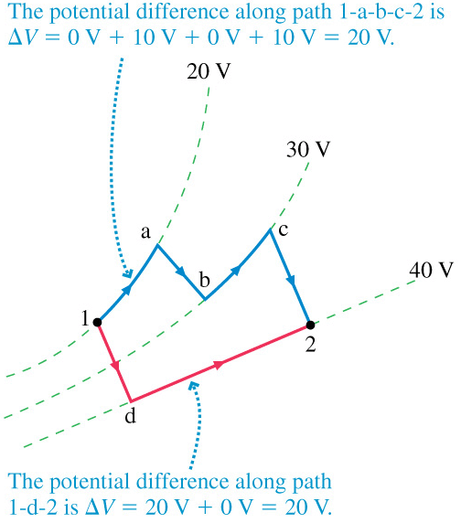
Kirchhoff’s Loop Law
Back in Chapter 30 we discussed the conservative nature of the Electric Field and Potential.
As it is electric fields that make electrons move through circuits, Kirchhoff’s Loop Law holds in a circuit too.

Slide 3
Let’s look at 1000 Ohm and 2000 Ohm light bulb in series and parallel and look at the voltage drops across each.
Kirchhoff’s Loop Law
B_{1s}
ε=12V
B_{2s}
Question: List in order of brightness the brightness of each bulb in the two cases B_{1p}, B_{2p}, B_{1s}, B_{2s}.
Rules:
ΔV_{bat} is positive when “walking” in the negative to positive direction.
ΔV_{R} = -IR

Slide 4
Let’s look at 1000 Ohm and 2000 Ohm light bulb in series and parallel and look at the voltage drops across each.
Power:
Power = IΔV
ε=12V
ε=12V
Note that on your “power” bill, you are charged in units of kWh.

Slide 5
Effective Resistance:
12V
12V
I₂
I₁
I₃
I₁ > I₂
2) I₁ < I₂
3) I₁ = I₂
I₄
I₅
0V
I₆
0V

Slide 6
RC Circuits:
We will cover RC circuits in lab this week.

