Slide 1
Chapter 32 – The “M” Word
In the first half of this class we discovered that the Electric Field behaves in such a way that it speeds up or slows down any charged particle under its influence. The Electric Field thus can give or take energy from a charged particle.
A Magnetic Field is a slightly different creature.

Slide 2
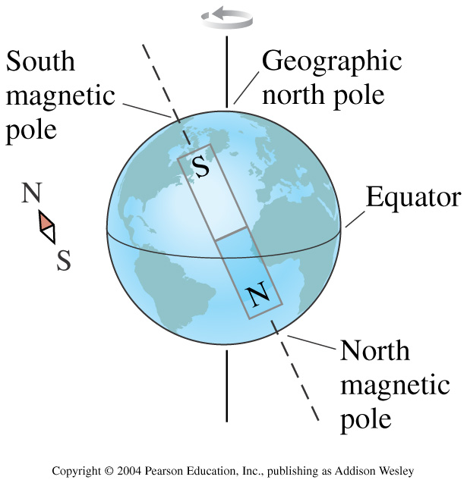
For many thousands of years, magnets were a bit of an enigma. The Chinese learned early on that the Earth itself was a magnet, and by floating a needle shaped magnet in a cup of water, you could build a devise that would always point South.
S
N

Slide 3
One day, in Denmark, a Community College Professor named Hans Christian Oersted was having problems with a lecture demo. His compass wasn’t behaving properly. After the lecture, he examined the compass closer and noticed that whenever a near-by wire was carrying a current in it, the compass would behave not as expected.

Slide 4
Let’s look at the magnetic field of a long straight wire.
www.aw-bc.com/knight

Slide 5
To figure out where the Magnetic Field lines are, we do the right hand rule.
Point your thumb in the direction of the current and wrap your right hand around the wire.
Your fingers then point in the direction of the induced magnetic field.
Warning: B.Franklin got it backwards. What we call the current actually points the opposite direction from what the electrons are actually moving.

Slide 6
Let’s find the magnitude of the B-field from a long straight wire.
The magnetic field of a moving point charge is described by the Biot-Savart Law.
The Biot-Savart Law works for any moving charge, but, in general, it is a bit of a pain to actually use.

Slide 7
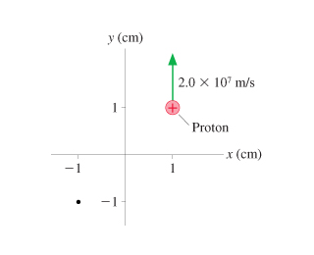
What is the magnetic field direction at the dot in the figure?

Slide 8
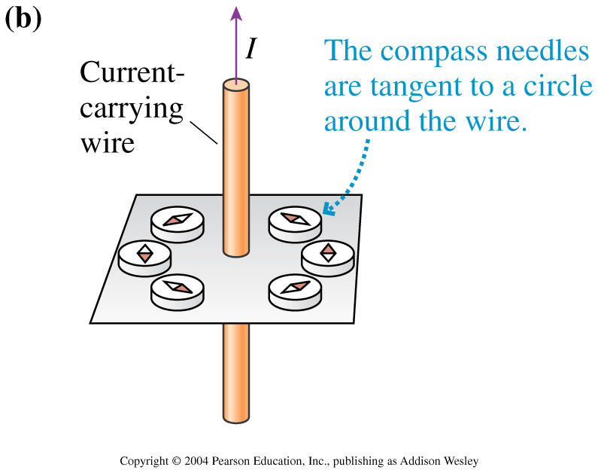

Slide 9
If you want to use the Biot-Savart Law to calculate the B-field of a long straight wire, go to page 1005 in your text.
We’re going to use an easier way:
Ampere's Law
It relates the tangential component of B summed around a closed curve (C) to the current (I) which passes through the curve.

Slide 10
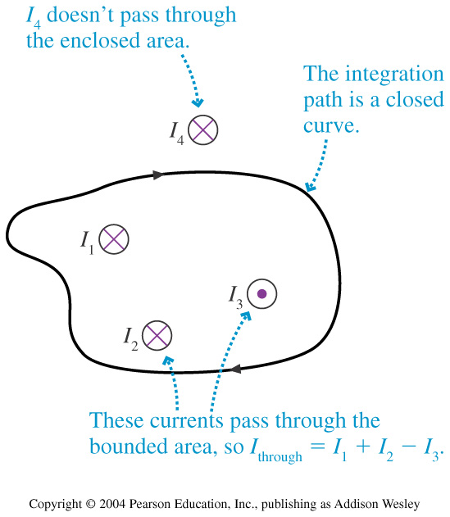
Ampere’s Law looks a lot like Gauss’ Law

Slide 11
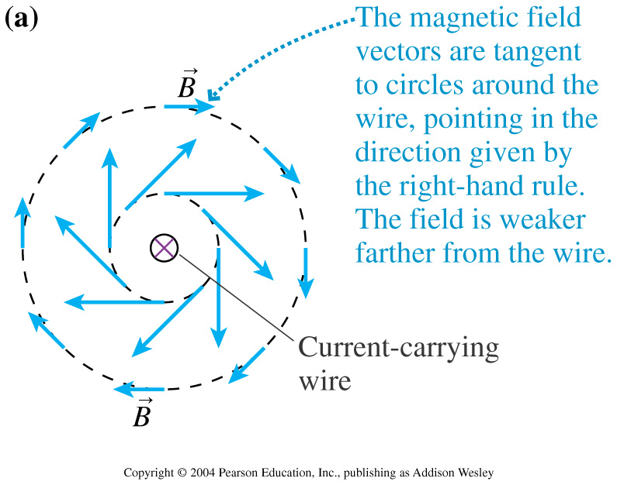
Let’s try using Ampere’s Law to calculate the B-field of a long-straight current-carrying wire.

Slide 12
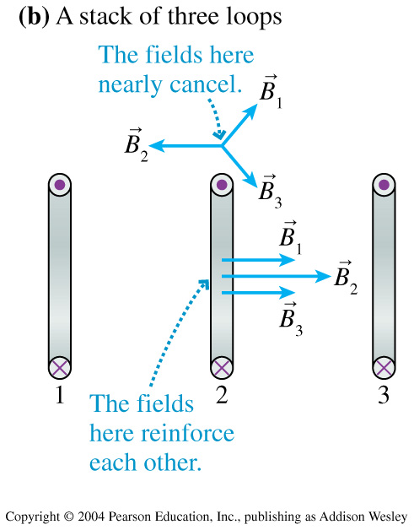

Slide 13
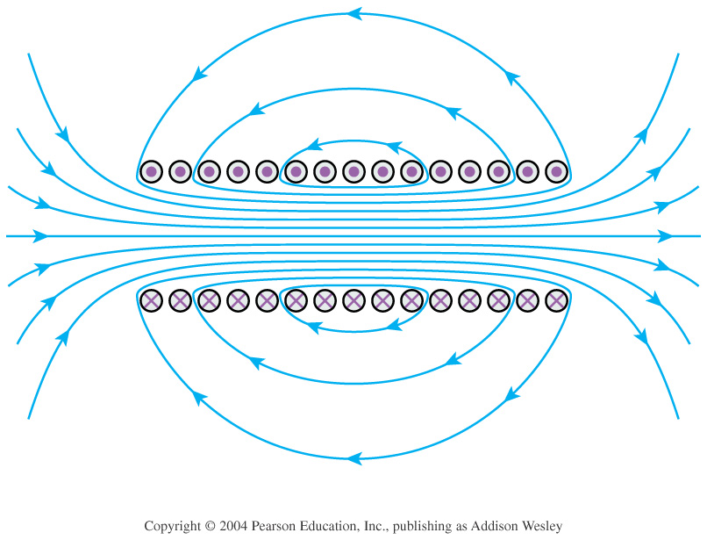

Slide 14
Magnetic Field of a Disk Magnet

Slide 15
Positively Charged particle traveling through a magnetic field that points into the page.
+
+
+
+
+
+
+
+
+

Slide 16
Given that the charge of an electron is q=-1.6∙10⁻¹⁹C and the measurements you can read on the e/m apparatus, calculate the mass of an electron.
How the machine works:
A tungsten filament is heated and creates a cloud of electrons.
A parallel plate accelerates the electrons to create an electron beam. V = 360 Volts
Two coils create a magnetic field through which the electrons travel. R_{coil}=15cm; I=2.1Ams; R_{beam}=5cm.

Slide 17
So, where an electric field can add or subtract from the magnitude of the velocity of a charged particle, a magnet can only change the direction of the velocity of a charged particle.
Electric Field -- changes magnitude of velocity vector
Magnetic Field -- changes direction of velocity vector

Slide 18
Things covered to remember from Chapter 33:
Magnetic fields are created by moving particles.
The tangential component of B summed around a closed curve (C) is proportional to the current (I) which passes through the curve.
Electric Fields accelerate and input energy into a charged particle. Magnetic Fields accelerate but don’t input energy into a charged particle.
Charged particles only experience a force due to a magnetic field when moving through a magnetic field.
Let’s try some sample problems: 32.66; 32.71

Slide 19
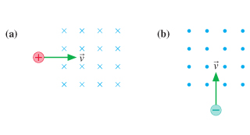
What is the initial direction of deflection for the charged particle entering the above magnetic fields?

Slide 20
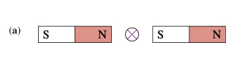
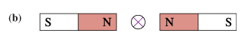
Each figure below shows two bar magnets with a current carrying wire set between them.
For each, is there a force on the wire? If so, in what direction?

Slide 21
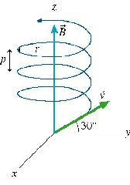
32.66 The uniform 35.0 mT magnetic field in the figure points in the positive z-direction. An electron enters the region of magnetic field with a speed of 5.50 · 10⁶ m/s and at an angle of 30 degress above the xy-plane.
What is the radius of the path and what is the pitch?

Slide 22
Let’s try 33.36.

