Slide 1
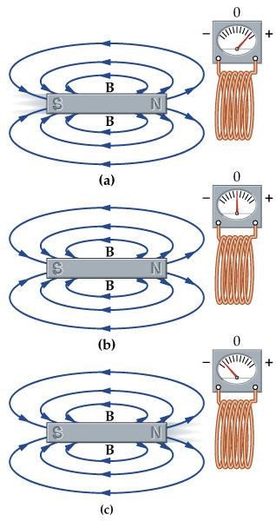
Faraday’s Law of E&M Induction
How can one produce el. current - I?
Observations:
A magnet is pulled toward/away from the coil
A coil moves toward/away from the magnet
The coil changes its area (magnet is stationary)
The coil is spinning (magnet is stationary)
All of the above at the same time

Slide 2
⁻⁻⁻
·
·
·
·
·
·
·
·
·
·
·
·
·
·
·
·
·
·
·
·
·
·
·
·
·
·
·
·
·
·
·
·
·
·
·
·
v
·
·
·
·
·
·
·
·
·
·
·
·
·
·
·
·
·
·
·
·
·
·
·
·
·
·
·
·
·
·
·
·
·
·
·
·
⁺⁺⁺
Let’s pull the above wire through a B-field with a constant velocity as shown.
As we do this, using F=qvxB we find that the positive charges will be pushed down the wire and negative charges will be pushed up the wire.

Slide 3
---
FBD of a single + charge
·
·
·
·
·
·
·
·
·
·
·
·
qE
·
·
·
·
·
·
·
·
·
·
·
·
·
·
·
·
·
·
·
·
·
·
·
·
v
·
·
·
·
·
·
·
·
·
·
·
·
+
·
·
·
·
·
·
·
·
·
·
·
·
·
·
·
·
·
·
·
·
·
·
·
·
+++
qvB
Let’s take a look at the + charges.
The Forces on a + charge above will be:
F_{mag} = qvB
F_{electric} = qE
The balance happens when E = vB.

Slide 4
The Voltage across the top of the wire and the bottom of the wire will be:
ΔV_{wire} = EL_{wire}
FBD of a single + charge
qE
+
qvB
The balance happens when E = vB.
Thus: ΔV = vLB

Slide 5
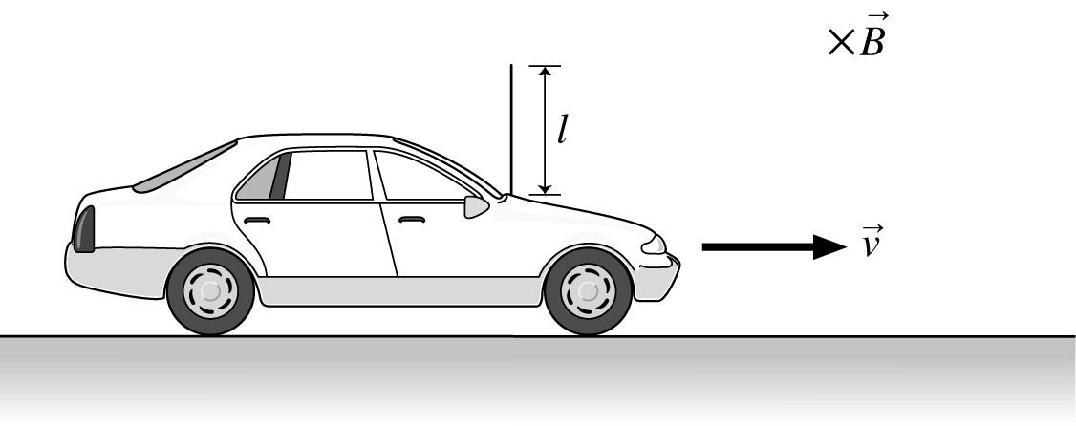
33.2
The Earth’s Magnetic field strength is 50 μT. How fast would you have to drive your car to create a 1.0V motional emf along your 1.0m long radio antenna? (You can assume that the motion to the antenna is perpendicular to B.)
ΔV = vLB

Slide 6
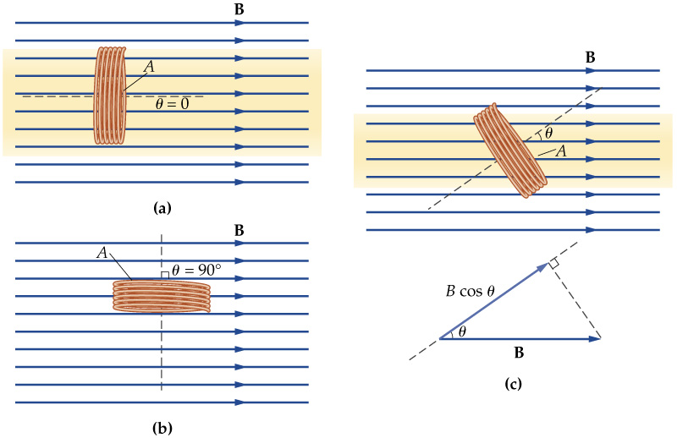
Magnetic Flux
In order to describe our model we need to introduce the concept of MAGNETIC FLUX
Magnetic flux represents the number of magnetic field lines going through the loop. The Unit of Φ_{Β} is Tm² (Weber =1Tx1m²).

Slide 7
·
·
·
·
·
·
·
·
·
·
·
·
·
·
·
·
·
·
·
·
·
·
·
·
A
B
C
·
·
·
·
·
·
·
·
·
·
·
·
·
·
·
·
·
·
·
·
·
·
·
·
·
·
·
·
·
·
·
·
·
·
·
·
·
·
·
·
·
·
·
·
·
·
·
·
Each of these three loops is moving with a constant velocity to the right. What can you tell me about the current in each loop?

Slide 8

Which direction does the current travel?
·
·
·
·
·
·
·
·
·
·
·
·
·
·
·
·
·
·
·
·
·
·
·
·
A
B
C
·
·
·
·
·
·
·
·
·
·
·
·
·
·
·
·
·
·
·
·
·
·
·
·
·
·
·
·
·
·
·
·
·
·
·
·
·
·
·
·
·
·
·
·
·
·
·
·
Clockwise
Counter-Clockwise
There is no current.

Slide 9

Finger PRS: Magnetic Flux
You measure the magnetic flux through the surface of a closed loop to be zero (Φ_{B}=0), then you conclude that:
There is no magnetic field in space.
Magnetic field lines are perpendicular to the surface of the loop.
Magnetic field lines are parallel to the surface of the loop.
The effective area of the loop is zero.
Statements 1,3,4 can be true.
Statements 1,2, 3,4 can be true.

Slide 10
Faraday’s Law of EM Induction
Induced EMF (ε) is proportional to the rate of change of the magnetic flux through the coil and to the number of loops in the coil. The minus sign means that the induced EMF opposes to the change of the magnetic flux.
This law has been tested over and over again in the labs and at your homes… It has more applications that you might think of…

Slide 11
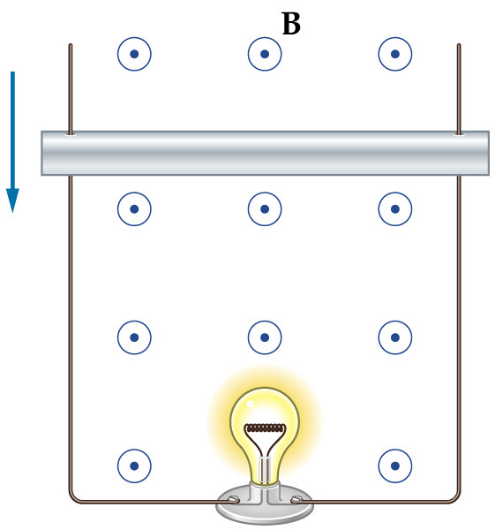
Faraday’s Law of EM Induction: Testing
Moving conducting rod changes the effective area of the loop and consequently changes the magnetic flux. As the result the induced EMF will be created which will be indicated by the bulb!

Slide 12
B
·
·
·
·
·
·
·
·
·
·
·
·
V_{a} = 2cm/s
V_{b} = 4cm/s
V_{c} = 2cm/s
V_{d} = 2cm/s
A
F
·
·
H
·
·
·
·
·
·
·
·
·
·
·
·
·
·
·
·
·
E
·
·
·
·
·
·
·
·
·
·
·
·
·
·
·
·
·
C
D
G
·
·
·
·
·
·
·
·
·
·
·
·
·
·
·
·
·
·
·
·
·
·
·
·
Each loop of conductive wire is moving to the right at the constant velocity listed.
Each loop is either 25%, 50%, 75% or 100% inside the indicated B-field.
Loop H is half of the size of the others.
Rank in order in the induced current in each of the loops at the time and position indicated.
V_{e} = 0cm/s
V_{f} = 2cm/s
V_{g} = 4cm/s
V_{h} = 4cm/s

Slide 13
What best describes the magnitude of the induced currents in loop H and D?
·
·
·
·
·
·
·
·
·
·
·
·
·
·
H
·
·
·
·
·
·
·
·
·
·
·
·
·
·
·
·
·
·
·
·
·
·
·
·
·
·
·
·
·
·
·
·
·
·
D
·
·
·
·
·
·
·
·
·
·
·
·
·
·
·
·
·
·
·
·
·
·
·
·
Each loop is moving to the right with:
I_{H} > I_{D}
I_{H} < I_{D}
I_{H} = I_{D}
V_{d} = 2cm/s
V_{h} = 4cm/s

Slide 14
Enter question text...
Enter answer text...

Slide 15
V_{a} = 2cm/s
V_{b} = 4cm/s
V_{c} = 2cm/s
V_{d} = 2cm/s
·
·
·
·
·
·
·
·
·
·
·
·
·
·
H
·
·
·
·
·
·
·
·
·
·
·
·
·
·
·
·
·
·
·
·
·
·
·
·
·
·
·
·
·
·
·
·
·
·
D
·
·
·
·
·
·
·
·
·
·
·
·
·
·
·
·
·
·
·
·
·
·
·
·
V_{e} = 0cm/s
V_{f} = 2cm/s
V_{g} = 4cm/s
V_{h} = 4cm/s
I_{H} > I_{D}
I_{H} < I_{D}
I_{H} = I_{D}

Slide 16
B
V_{a} = 2cm/s
V_{b} = 4cm/s
V_{c} = 2cm/s
V_{d} = 2cm/s
·
·
·
·
·
·
·
·
·
·
·
·
A
F
·
·
H
·
·
·
·
·
·
·
·
·
·
·
·
·
·
·
·
·
E
·
·
·
·
·
·
·
·
·
·
·
·
·
·
·
·
·
C
D
G
·
·
·
·
·
·
·
·
·
·
·
·
·
·
·
·
·
·
·
·
·
·
·
·
V_{e} = 0cm/s
V_{f} = 2cm/s
V_{g} = 4cm/s
V_{h} = 4cm/s
Each loop of conductive wire is moving to the right at the constant velocity listed below.
Each loop is either 25%, 50%, 75% or 100% inside the indicated B-field.
Loop H is half of the size of the others.
Rank in order in the induced current in each of the loops at the time and position indicated.

Slide 17
33.41 A small, 1.50-mm-diameter circular loop with R = 1.40×10⁻² Ohms is at the center of a large 120-mm-diameter circular loop. Both loops lie in the same plane. The current in the outer loop changes from +1A to -1A in 9.00×10⁻² sec .
What is the induced current in the inner loop?
Which way does I induced go?
What about after the 90 ms?
Do we use A or a in this problem?
Remember: B_{coilcenter} = μ_{o}I/(2R)

Slide 18
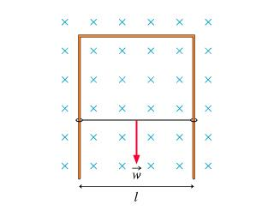
33.49 The figure shows a U-shaped conducting rail that is oriented vertically in a horizontal magnetic field. The rail has no electric resistance and does not move. A slide wire with mass m and resistance R can slide up and down without friction while maintaining electrical contact with the rail. The slide wire is released from rest.
Determine the value of a terminal velocity if
l = 21.0cm , m = 7.00 g,
R = 8.00×10⁻² Ohms, and B = 0.540 T .

Slide 19
Some good sample problems:
34.51
34.52

Slide 20
Initially, in which direction does the current flow through the light bulb?
To the right
To the left
There is no current.

Slide 21
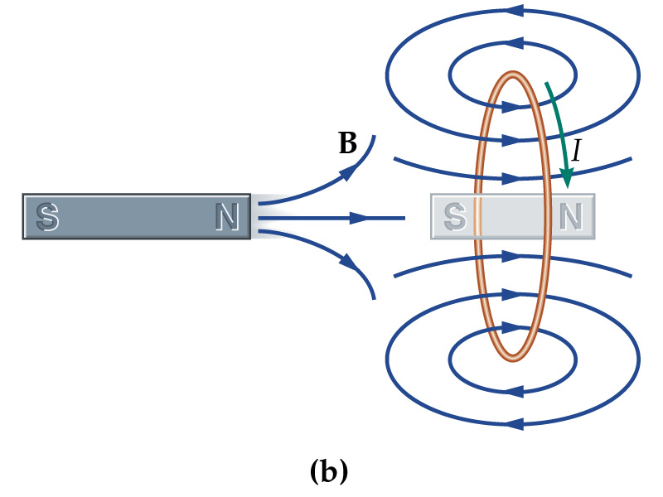
Lenz’s Law (an application of a Faraday’s Law of EM induction)
An induced current always flows in a direction that opposes the change that causes it!
The magnet is pulled away from the ring!

Slide 22
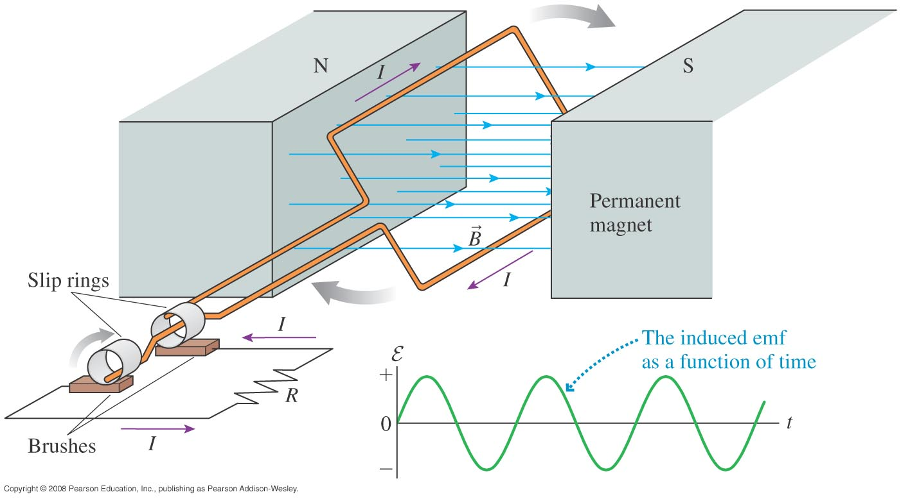
Some Applications of Induced Currents:
Generators:

Slide 23
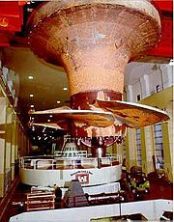
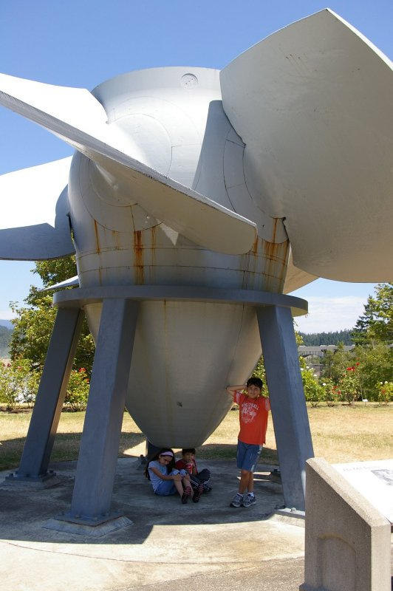
Generators:

Slide 24
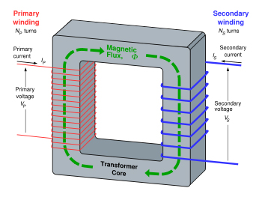
Some Applications of Induced Currents:
Transformers

Slide 25
Some Applications of Induced Currents:
Electronics -- Inductors
A coil of wire is going to have a self-inductance. This self-inductance is defined as:
As in a capacitor, L is dependent upon the geometry and construction of the coil of wire.

Slide 26
Going back to Faraday’s Law:
and since:
we get:
Or, as part of a circuit

Slide 27
The three main topics covered in this chapter are:
We observed that moving magnets create currents in loops of wire.
We calculated that a long straight wire traveling (perpendicular) through a magnetic field has an induced voltage from the “top” to the “bottom” of the wire.
We found that for loops of wire:
+ LC Circuits

