Slide 1
The Complete
Ph 213
10 chapter/10 problem
The Term in Review
Our goal today is to use everything we learned in PH213 (and 211 and 212 of course) in order to create a device capable of nuclear fusion.

Slide 2
In Chapter 22 we learned:
The force between two charges obeys Coulomb’s Law
We defined the “Electric Field” as a field of vectors that would describe the direction a positive electric charge would accelerate if placed at that each point in the field.

Slide 3
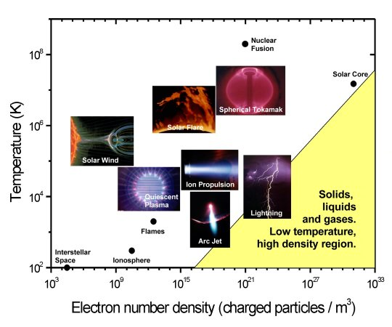
Question 1 (Chapter 22)
First, you need to make a plasma.
A hydrogen atom is 24 nm in diameter.
a. How strongly is the nucleus holding onto the electron?
b. How much energy does it take to ionize the atom?

Slide 4
In Chapter 23 we learned:
We looked at the E-Field of collections of charges.
To find the E-field of a continuous distribution of charges we usually had to integrate. Sometimes we had to look at “approximations”.
Things we looked at:
A line of charge A sphere
A dipole A parallel plate capacitor
An infinite plane of charge A ring and a disk of charge

Slide 5
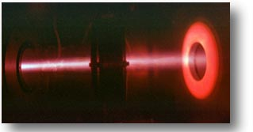
Question 2 (Chapter 23):
You now create an electric field of strength E = 120,000 N/C
a. If you consider just one electron and one proton. How far apart will the electron and proton be after 23ns?
b. How fast will the protons be moving at this time?

Slide 6


In Chapter 24 we:
Introduced the concept of “Electric Field Flux”.
Discovered that “Gauss’ Law” helps make problems with sufficient symmetry a lot easier.
$$Φ_{E}≡\oint{\vec{E}⋅d\vec{A}}$$
$$\oint{\vec{E}⋅d\vec{A}}=\frac{q_{enc}}{ε_{o}}$$

Slide 7
Question 3 (Chapter 24):
When you look closer at the E-field going through the tube, you find that the equation that the E-field strength looks like the below figure and follows the general function
E(x,y) = E_{o}(b²-x²)
What is the E-field flux through a cross-section of a square tube if the tube is 2b tall and a wide?
x
z
y

Slide 8
Chapter 28 -- I’m going to jump out of order a bit here.
We skimmed through Chapter 28. The high points were:
It is E-Field created in wires that cause electrons to flow through a wire.
The electrons come to a “terminal velocity” because they bump into atoms as they travel through a conductor.
Due to a historical error, the quantity we call “electrical current” points in the opposite direction as the “electron current”.

Slide 9
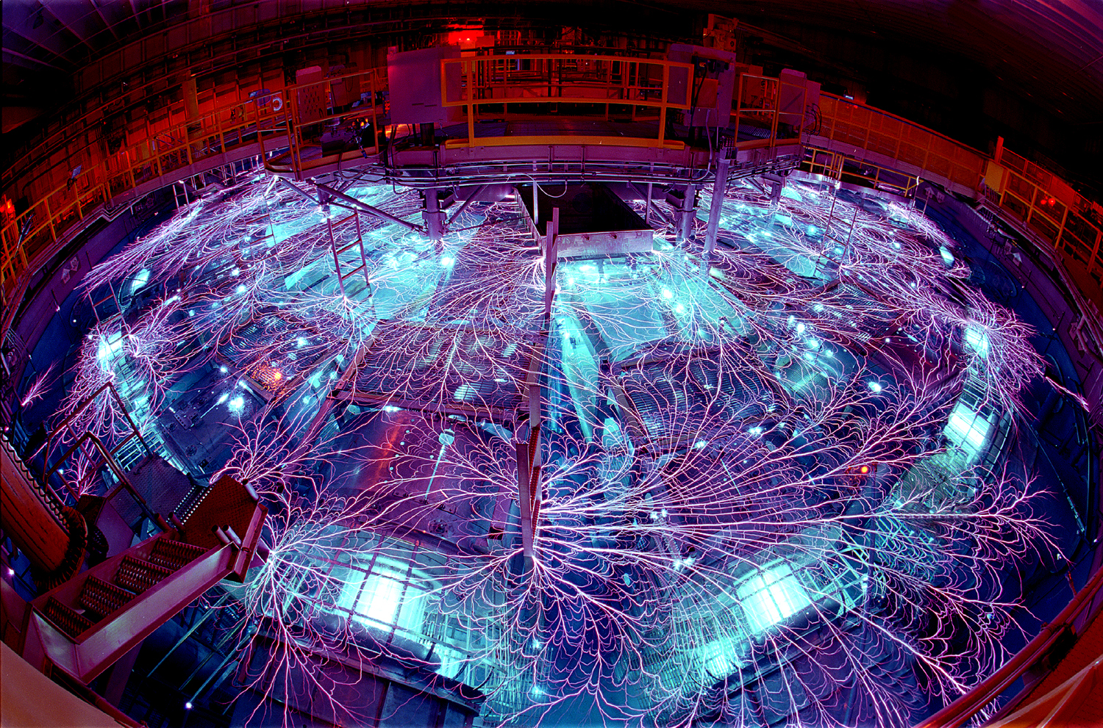
Question 4 (Chapter 28):
You now have a stream of protons exiting your tube at speed v =2.6⋅10⁵m/s at a rate of 1.2 μmoles per second. The stream is uniform in density, cylindrical in shape with r_{beam}=0.1mm
a. What is the i, I, and J of the proton flow?
b. How many seconds does it take for one Coulomb of protons to go by?

Slide 10
Chapter 25– Electric Potential
In Ph 211, I let on in about Week 8 that we had been doing everything the “hard” way. Using conservation of energy made many Ph 211 questions easier.
In Ph 213, you only had to wait until week 4 to get the “easy” way.
The “Volt” has the units of “Joules/Coulomb”
Using the Work/Energy Theorum we find that the potential energy from a point charge is:
Note that a electric potential is a scalar helping make it often easier to use that the E-field concept.

Slide 11
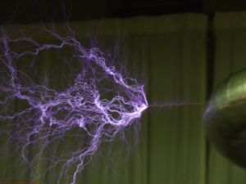
Question 5 (Chapter 25):
You now have a proton traveling at v = 2.6⋅10⁵m/s .
a. How close will it come to a stationary proton if it hits it “head-on”?
b. Draw the four potential field representations of a single, positive, charged particle.
In order for fusion to happen, the protons must be close enough together for long enough for quantum tunneling to allow fusion to happen.

Slide 12
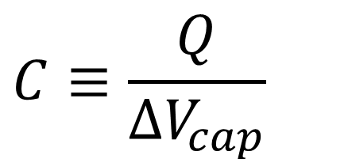
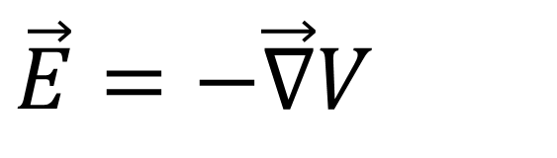
Chapter 26 – Potential vs. Field
We discussed the relationship between E-fields and Electric Potential:
$$\vec{E}=−\vec{∇}V$$
We also discussed capacitors:
$$C≡\frac{Q}{ΔV_{cap}}$$

Slide 13
Question 6
(Chapter 26):
We’ve just discovered that we need to speed up the proton a little bit more.
Thus, you let the beam of protons go through a series of parallel plate capacitors each with a Voltage of 1,000,000 Volts and a plate separate of the 1mm.
What happens to the speed of the protons as they approach the plates? (i.e. are the protons attracted or repelled as they approach the positive plate?)
How much energy do the electrons gain as they travel through each plate?
What is the E-field between the plates?
What is the charge on each 1cm x 1cm plate?
What is the capacitance of each plate?
What is the capacitance of all the plates together?
+
-
+
-
+
-

Slide 14
Chapter 27 and –Circuits
This actually started back in Chp. 26 – but, in general we considered capacitors and resistors in parallel and series and found that:

Slide 15
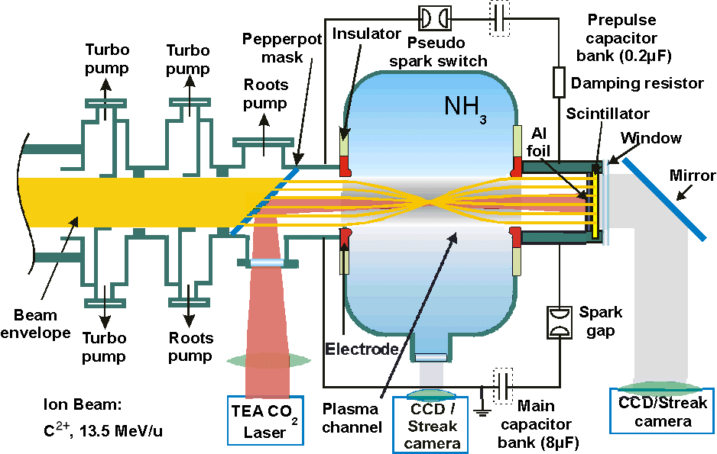
Question 7 (Chp 26/27)
Your machine works in pulses.
The capacitors need to be discharged and recharged between each pulse.
To discharge satisfactory, they need only to be discharged to 40% of their peak value.
How long will it take them to discharge through twenty 10MΩ resistors placed in parallel to the capacitor value in the previous question?

Slide 16
Chapter 29 – The Magnetic Field
The magnetic field created by a single moving charge is given by Biot-Savart:
In this chapter we discovered that it was a moving charge that makes a magnetic field and that only a moving charge is affected by a magnetic field.
Ampere’s Law is easier to use to find the B-field of a group of moving charges as long as there is plenty of symmetry:
The Force on a charged particle moving through a magnetic field is given by:

Slide 17
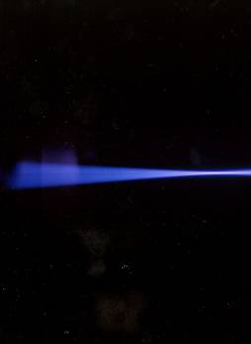
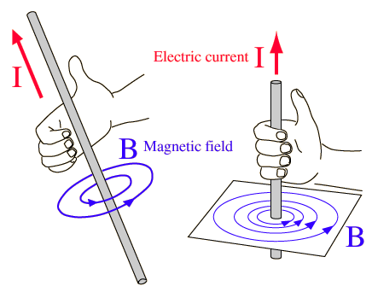
Question 8 (Chapter 29):
The beam of protons is 1mm in radius and the velocity profile is homogeneous across the cross section.
What is the B-field of our beam for a point outside of the beam?
What is the B-field inside the beam?
c. Should the protons in the beam be repelling or attracting each other?

Slide 18
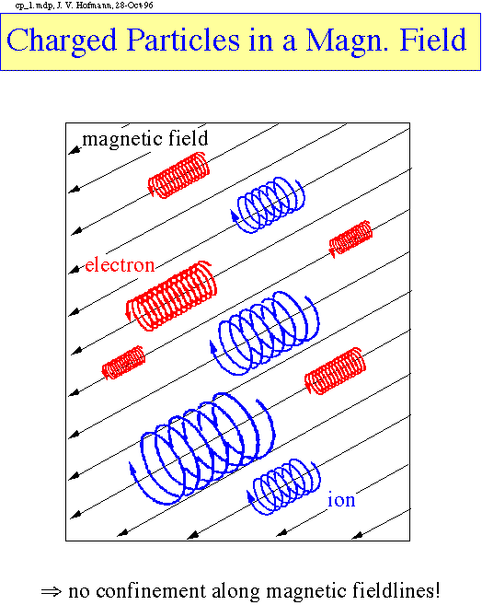
Question 8b – Chapter 29
We’re now going to have our beam enter a tokamak.
The B-field is created by
What happens to the motion of the protons if they are slightly off axis with the B-field?
Does the B-field increase or decrease the speed of the protons? (i.e. does the B-field heat up or cool down the protons?

Slide 19
Chapter 30 – Electromagnetic Induction
In the last chapter we looked at the force created on a single particle by a Magnetic Field. We also found out what happened to a line and a box of current in a magnetic field. In Chp. 34, we generalize to find:

Slide 20
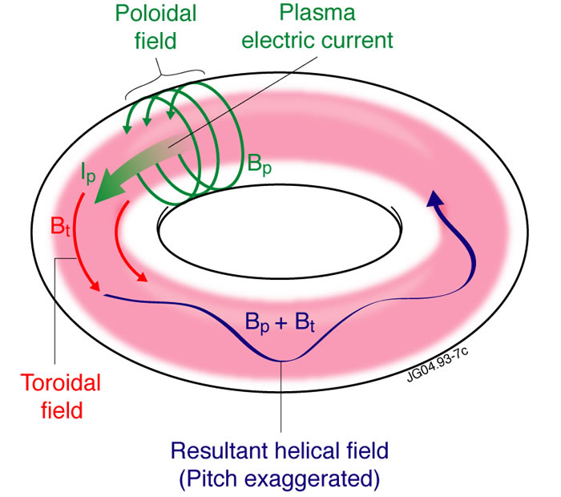
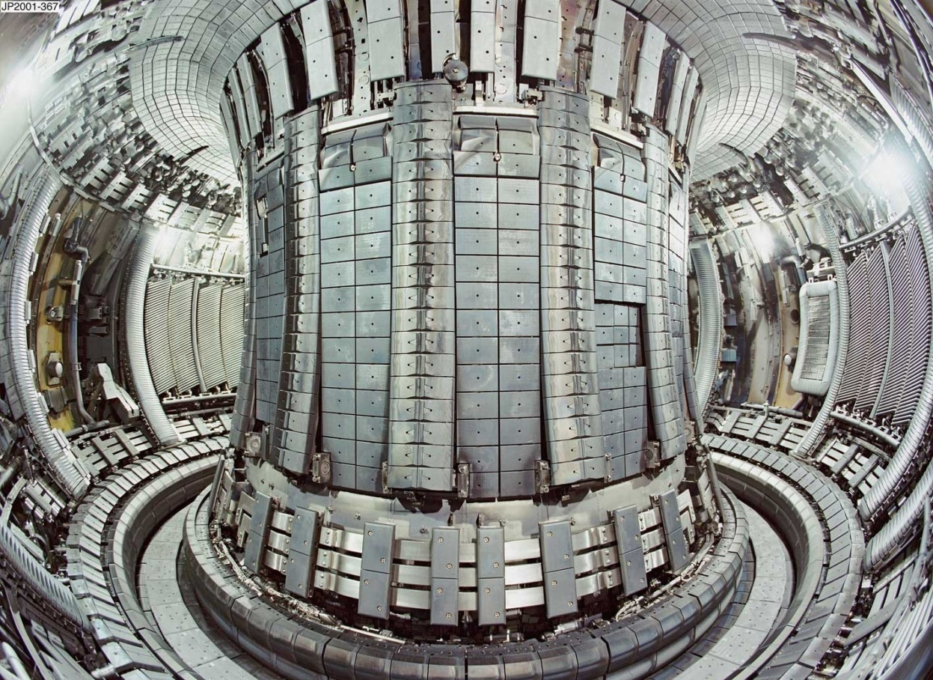
Question 9 (Chapter 30)
The B-Field of the tokamak pulses as well. The entire B-Field goes from a max to zero in 20 μs. What is the induced current in the surface of the tokamak? If there were a “scratch” in the surface, what is the total amount of charge that could build up there in this time.

Slide 21
Chapter 31 – Electromagnetic Fields and Waves
We discovered light using Maxwell’s equations and discovered that it was polarized.
I_{transmitted} = I_{o}cos²θ

Slide 22
Question 10 -- (Chapter 31):
Success! Two protons have just turned into a Helium nucleus. The amount of mass that “disappeared” is 4.8 x 10⁻²⁹ kg.
a. What wavelength of photon is emitted?
b. How fast is that photon moving?
You want to create a viewing port into the side of your tokamak that can allow you to see in or not see in at will. The photons start out randomly polarized. You send them through two polarizers that are at right angles to each other.
c. What fraction of photons get through both polarizers?
d. You slip a third polarizer in between the first two. This third polarizer is at 30° with respect to the first polarizer. What fraction of photons get through all three polarizers?

Slide 24
