Slide 1
Lab1 Intro
Vitis HLS Design Flow

Slide 2
Objectives
After completing this lab, you will be able to:
  Create a project in Vitis HLS
  Run C-simulation
  Use debugger
  Synthesize and implement the design using the default options
  Use design analysis perspective to see what is going on under the hood
  Understand and analyze the generated output

Slide 3
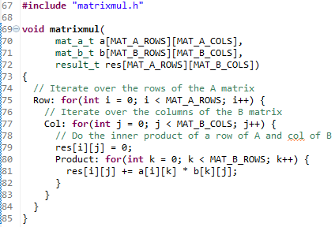
The Design
This lab uses a simple matrix multiplication example to walk you through the Vitis HLS project creation and analysis steps. The design consists of three nested loops. The Product loop is the inner most loop performing the actual elements product. The Col loop is the outer-loop which feeds next column element data with the passed row element data to the Product loop. Finally, Row is the outer-most loop. The res[i][j]=0 (line 79) resets the result every time a new row element is passed and new column element is used

Slide 4
Procedure
Create a project after starting Vitis HLS in GUI mode
Run C simulation
  to understand the design behavior
Run the debugger
  to see how the top-level module works
Synthesize the design
Analyze the generated output using the Analysis perspective
Run C/RTL cosimulation
  to perform RTL simulation
View simulation results in Vitis
  to understand the IO protocol
Export RTL in the Evaluate mode and run the implementation

Slide 5
Summary
In this lab, you completed the major steps of the high-level synthesis design flow using Vitis HLS. You created a project, added source files, synthesized the design, simulated the design, and implemented the design. You also learned that how to use the Analysis perspective to understand the scheduling

