Slide 1
Data Types

Slide 2
Objectives
After completing this module, you will be able to:
  State various data types of C, C++
  Identify advantages and pitfalls of using arbitrary precision
  List various supported quantization and overflow modes
  Describe the floating point support

Slide 3
Objectives
After completing this module, you will be able to:
  State various data types of C, C++, and SystemC are supported
  Identify advantages and pitfalls of using arbitrary precision
  List various supported quantization and overflow modes
  Describe the floating point support

Slide 4
Outline
C and C++ Data Types
Arbitrary Precision Data Types
Floating Point Support
Summary

Slide 5
Data Types and Bit-Accuracy
C and C++ have standard types created on the 8-bit boundary
  char (8-bit), short (16-bit), int (32-bit), long long (64-bit)
    Also provides stdint.h (for C), and stdint.h and cstdint (for C++)
    Types: int8_t, uint16_t, uint32_t, int_64_t etc.
  They result in hardware which is not bit-accurate and can give sub-standard QoR
Vitis HLS provides both integer and fixed-point arbitrary precision types for C++
  Allow any arbitrary bit-width to be specified
  Hence designers can improve the QoR of the hardware by specifying exact data widths
    Can be specified in the code and simulated to ensure there is no loss of accuracy
Notes:
For C++ Only

Slide 6
Data Types and Bit-Accuracy
C and C++ have standard types created on the 8-bit boundary
  char (8-bit), short (16-bit), int (32-bit), long long (64-bit)
    Also provides stdint.h (for C), and stdint.h and cstdint (for C++)
    Types: int8_t, uint16_t, uint32_t, int_64_t etc.
  They result in hardware which is not bit-accurate and can give sub-standard QoR
Vitis HLS provides both integer and fixed-point arbitrary precision types for C++
  Allow any arbitrary bit-width to be specified
  Hence designers can improve the QoR of the hardware by specifying exact data widths
    Can be specified in the code and simulated to ensure there is no loss of accuracy
Vitis HLS also provides half-precision floating-point data types
14- 6
Notes:
For C++ Only

Slide 7
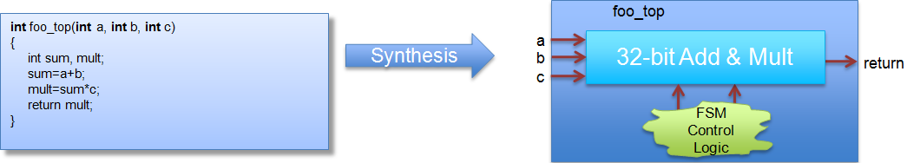
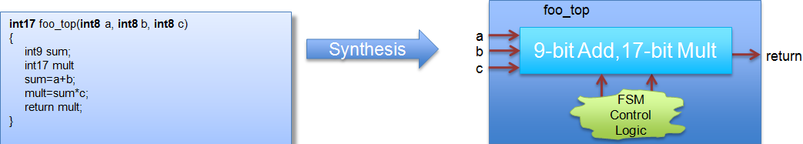
Why is arbitrary precision Needed?
Code using native C int type
However, if the inputs will only have a max range of 8-bit
  Arbitrary precision data-types should be used
  It will result in smaller & faster hardware with the full required precision
  Full precision can be simulated/validated with C simulation and hardware will behave the same
Notes:
Full precision can be simulated/validated with C simulation and hardware will behave the same

Slide 8
Why is arbitrary precision Needed?
Code using native C int type
However, if the inputs will only have a max range of 8-bit
  Arbitrary precision data-types should be used
  It will result in smaller & faster hardware with the full required precision
  With arbitrary precision types on function interfaces, Vitis HLS can propagate the correct bit-widths throughout the design
Notes:
Full precision can be simulated/validated with C simulation and hardware will behave the same

Slide 9
HLS & C Types
There are 3 basic types you can use for HLS
  Standard C/C++ Types
  Vitis HLS enhancements to C++: ap_int,
  Vitis HLS enhancements to C++: ap_fixed
Notes:
system-C files are not supported by Vitis HLS.
Vitis HLS does not support Arbitrary precision C-types, user is advised to use C++ types with
arbitrary precision.

Slide 10
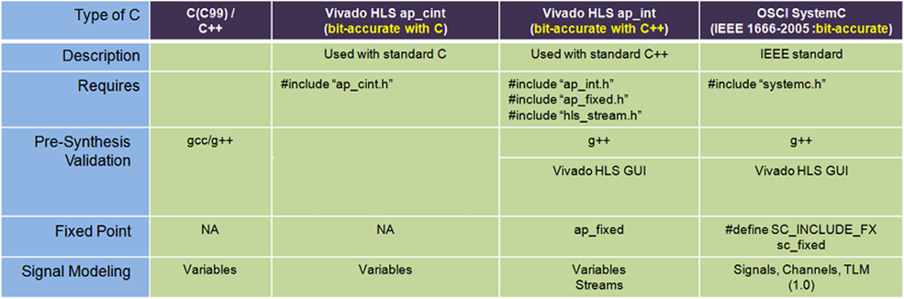
HLS & C Types
There are 4 basic types you can use for HLS
  Standard C/C++ Types
  Vivado HLS enhancements to C: apint
  Vivado HLS enhancements to C++: ap_int, ap_fixed
  SystemC types
14- 10
Notes:
system-C files are not supported by Vitis HLS.
Vitis HLS does not support Arbitrary precision C-types, user is advised to use C++ types with
arbitrary precision.

Slide 11
Arbitrary Precision Data Types

Slide 12
Arbitrary Precision : C apint types
For C
  Vivado HLS types apint can be used
  Range: 1 to 1024 bits
  Specify the integers as shown and just use them like any other variable
There are two issues to be aware of
  C compilation : YOU MUST use apcc to simulate (no debugger support)
  Be aware of integer promotion issues
Include header file
#include ap_cint.h
void foo_top (…) {
int9 var1; // 9-bit
uint10 var2; // 10-bit unsigned
Failure to use apcc to compile the C will result in INCORRECT results
This only applies to C
NOT C++ or SystemC
14- 12

Slide 13
Using apcc
apcc
  Command line compatible with gcc
  Required to support arbitrary precision for C
  Use apcc at the Vivado HLS CLI (shell)
  HLS uses apcc automatically when it sees arbitrary precision is used in C model
apcc understands bit-accurate types
  Once you create bit-accurate types you must re-validate the C
  It’s the only way to discover rounding and truncation issues
    It’s fast in C !!!
shell> apcc –o my_test test.c test_tb.c
#include “ap_cint.h”
int3 ex_bit_accurate (
int3 x1,
int3 y1
) {
return x1+y1;
}
gcc simulation
apcc simulation
Given: x1=2
y1=2
x1
y1
0
0
…
0
0
0
1
0
2
2
0
1
0
2
2
Simulates as hardware
+
0
0
…
0
0
0
1
0
+
0
1
0
return
0
0
…
0
0
1
0
0
4
1
0
0
-4

Slide 14
Integer Promotion
Integer promotion
  The apcc utility must still obey standard C/gcc rules and protocols
  Integer promotion:
    If the operator result is a larger type ➔
    The result is promoted to the target type (on 8, 16, 32 or 64 boundaries)
#include "ap_cint.h"
int36 mult (int18 a,int18 b) {
int36 tmp;
tmp = a * b;
return tmp;
}
Result in Hex
a
b
0
0
0
1
0
0
0
0
65536
65536
Integer promotion promotes a*b to 32-bit then assigns this to tmp: the top-bits are lost
Given: a=0x10000
b=0x10000
*
0
0
0
1
0
0
0
0
1
0
0
0
0
0
0
0
0
0
0
0
0
0
0
0
0
0
0
0
Solution: cast before the operation
a
b
0
0
0
1
0
0
0
0
65536
65536
tmp = (int36)a * (int36)b;
*
0
0
0
1
0
0
0
0
1
0
0
0
0
0
0
0
0
4294967296

Slide 15
C apint types: Bit-Selection & Manipulation
Function |  | Example
Length | Returns the length of the variable. | res=apint_bitwidthof(var);
Concatenation | Concatenation low to high | res=apint_concatenate(var_high, var_low)
Get a range | Return a bit-range from high to low. | res= apint_get_range(var, high,low)
Set a range | Reserve the bits in the variable | apint_set_range(res, high, low, res)
(n)and_reduce | (N)And reduce all bits. | bool t = apint_(n)and_reduce(var);
(n)or_reduce | (N)Or reduce all bits | bool t = apint_(n)or_reduce(var);
X(n)or_reduce | X(N)or reduce all bits | bool t = apint_x(n)or_reduce(var);
Get a bit | Get a specific bit | res=apint_get_bit(var, bit-number)
Set bit value | Sets the value of a specific bit | apint_set_bit(res, bit-number)
Print value | Print the value of an apint variable | apint_print(int#N value, int radix));
Print value to file | Print the value of an apint variable to a file | apint_fprint(FILE* file, int#N value, int radix)
14- 15

Slide 16
Arbitrary Precision : C++ ap_int types
For C++
  Vitis HLS types ap_int can be used
  Range: 1 to 1024 bits
      Signed: ap_int<W>
      Unsigned: ap_uint<W>
  The bit-width is specified by W
C++ compilation
  Use g++ at the Vitis HLS CLI (shell)
    Include the path to the Vitis HLS tool header file
Include header file
#include ap_int.h
void foo_top (…) {
ap_int<9> var1; // 9-bit
ap_uint<10> var2; // 10-bit unsigned
shell> g++ –o my_test test.c test_tb.c -I$VITIS_HLS_HOME/include

Slide 17
Arbitrary Precision : C++ ap_int types
For C++
  Vivado HLS types ap_int can be used
  Range: 1 to 1024 bits
      Signed: ap_int<W>
      Unsigned: ap_uint<W>
  The bit-width is specified by W
C++ compilation
  Use g++ at the Vitis HLS CLI (shell)
    Include the path to the Vitis HLS tool header file
Include header file
#include ap_int.h
void foo_top (…) {
ap_int<9> var1; // 9-bit
ap_uint<10> var2; // 10-bit unsigned
shell> g++ –o my_test test.c test_tb.c -I$VIVADO_HLS_HOME/include
14- 17

Slide 18
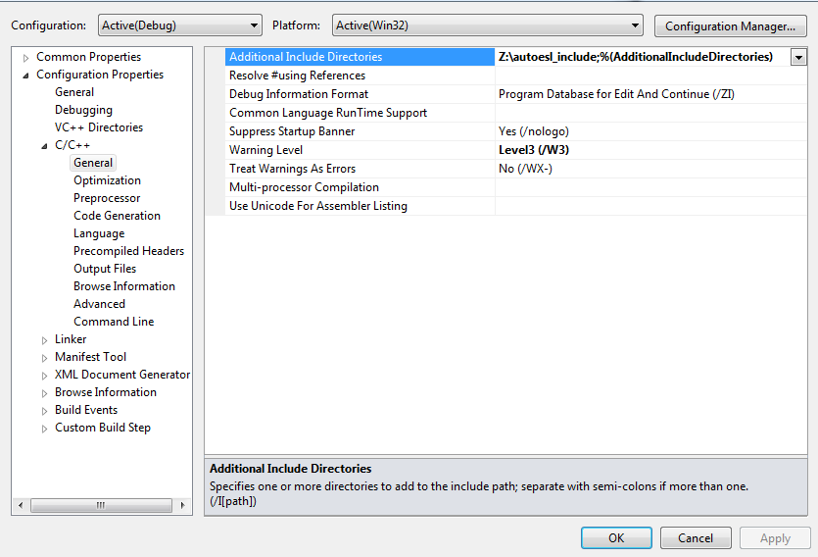
Microsoft Visual Studio Support
C++ Arbitrary Precision Types are supported in Microsoft Visual Studio Compiler
  Simply include the Vivado HLS directory $(VIVADO_HLS_HOME)/include
  Note: C designs using arbitrary precision types (apint) must still use apcc
C++ Designs using AP_INT types
  In the MVS Project
    Click Project
    Click Properties
    In the panel that shows up, select C/C++
    Select general
    Click on additional include directories and
    add the path
14- 18

Slide 19
AP_INT operators & conversions
Fully Supported for all Arithmetic operator
Methods for type conversion
Operations
Arithmetic | + - * / % ++ --
Logical | ~ !
Bitwise | & | ^
Relational | > < <= >= == !=
Assignment | *= /= %= += -= <<= >>= &= ^= |=
Methods |  | Example
To integer | Convert to an integer type | res = var.to_int();
To unsigned integer | Convert to an unsigned integer type | res = var.to_uint();
To 64-bit integer | Convert to a 64-bit long long type | res = var.to_int64();
To 64-bit unsigned integer | Convert to an unsigned long long type | res = var.to_uint64();
To double | Convert to double type | res = var.to_double();

Slide 20
AP_INT operators & conversions
Fully Supported for all Arithmetic operator
Methods for type conversion
Operations
Arithmetic | + - * / % ++ --
Logical | ~ !
Bitwise | & | ^
Relational | > < <= >= == !=
Assignment | *= /= %= += -= <<= >>= &= ^= |=
Methods |  | Example
To integer | Convert to an integer type | res = var.to_int();
To unsigned integer | Convert to an unsigned integer type | res = var.to_uint();
To 64-bit integer | Convert to a 64-bit long long type | res = var.to_int64();
To 64-bit unsigned integer | Convert to an unsigned long long type | res = var.to_uint64();
To double | Convert to double type | res = var.to_double();
14- 20

Slide 21
AP_INT Bit Manipulation methods
Methods |  | Example
Length | Returns the length of the variable. | res=var.length;
Concatenation | Concatenation low to high | res=var_hi.concat(var_lo); Or res= (var_hi,var_lo)
Range or Bit-select | Return a bit-range from high to low or a specific bit. | res=var.range(high bit,low bit); Or res=var[bit-number]
(n)and_reduce | (N)And reduce all bits. | bool t = var.and_reduce();
(n)or_reduce | (N)Or reduce all bits | bool t = var.or_reduce();
X(n)or_reduce | X(N)or reduce all bits | bool t = var.xor_reduce();
Reverse | Reserve the bits in the variable | var.reverse();
Test bit | Tests if a bit is true | bool t = var.test(bit-number)
Set bit value | Sets the value of a specific bit | var.set_bit(bit-number, value)
Set bit | Set a specific bit to one | var.set(bit-number);
Clear bit | Clear a specific bit to zero | var.clear(bit-number);
Invert Bit | Invert a specific bit | var.invert(bit-number);
Rotate right | Rotate the N-bits to the right | var.rrotate(N);
Rotate left | Rotate the N-bits to the left | var.lrotate(N);
Bitwise Invert | Invert all bits | var.b_not();
Test sign | Test if the sign is negative (return true) | bool t = var.sign();

Slide 22
AP_INT Bit Manipulation methods
Methods |  | Example
Length | Returns the length of the variable. | res=var.length;
Concatenation | Concatenation low to high | res=var_hi.concat(var_lo); Or res= (var_hi,var_lo)
Range or Bit-select | Return a bit-range from high to low or a specific bit. | res=var.range(high bit,low bit); Or res=var[bit-number]
(n)and_reduce | (N)And reduce all bits. | bool t = var.and_reduce();
(n)or_reduce | (N)Or reduce all bits | bool t = var.or_reduce();
X(n)or_reduce | X(N)or reduce all bits | bool t = var.xor_reduce();
Reverse | Reserve the bits in the variable | var.reverse();
Test bit | Tests if a bit is true | bool t = var.test(bit-number)
Set bit value | Sets the value of a specific bit | var.set_bit(bit-number, value)
Set bit | Set a specific bit to one | var.set(bit-number);
Clear bit | Clear a specific bit to zero | var.clear(bit-number);
Invert Bit | Invert a specific bit | var.invert(bit-number);
Rotate right | Rotate the N-bits to the right | var.rrotate(N);
Rotate left | Rotate the N-bits to the left | var.lrotate(N);
Bitwise Invert | Invert all bits | var.b_not();
Test sign | Test if the sign is negative (return true) | bool t = var.sign();

Slide 23
Arbitrary Precision : C++ ap_fixed types
Support for fixed point datatypes in C++
  Include the path to the ap_fixed.h header file
  Both signed (ap_fixed) and unsigned types (ap_ufixed)
Advantages of Fixed Point types
  The result of variables with different sizes is automatically taken care of
  The binary point is automatically aligned
    Quantization: Underflow is automatically handled
    Overflow: Saturation is automatically handled
#include ap_fixed.h
void foo_top (…) {
ap_fixed<9, 5, AP_RND_CONV, AP_SAT> var1; // 9-bit,
// 5 integer bits, 4 decimal places
ap_ufixed<10, 7, AP_RND_CONV, AP_SAT> var2; // 10-bit unsigned
// 7 integer bits, 3 decimal places
$AUTOESL_HOME/include/ap_fixed.h
Alternatively, make the result variable large enough such that overflow or underflow does not occur

Slide 24
Arbitrary Precision : C++ ap_fixed types
Support for fixed point datatypes in C++
  Include the path to the ap_fixed.h header file
  Both signed (ap_fixed) and unsigned types (ap_ufixed)
Advantages of Fixed Point types
  The result of variables with different sizes is automatically taken care of
  The binary point is automatically aligned
    Quantization: Underflow is automatically handled
    Overflow: Saturation is automatically handled
#include ap_fixed.h
void foo_top (…) {
ap_fixed<9, 5, AP_RND_CONV, AP_SAT> var1; // 9-bit,
// 5 integer bits, 4 decimal places
ap_ufixed<10, 7, AP_RND_CONV, AP_SAT> var2; // 10-bit unsigned
// 7 integer bits, 3 decimal places
$AUTOESL_HOME/include/ap_fixed.h
Alternatively, make the result variable large enough such that overflow or underflow does not occur
14- 24

Slide 25
Definition of ap_fixed type
Fixed point types are specified by
  Total bit width (W)
  The number of integer bits (I)
  The quantization/rounding mode (Q)
  The overflow/saturation mode (O)
  The number of saturation bits
ap_[u]fixed<W, I , Q, O , N>
I-1
…
1
0
-1
…
-B
Binary point : W = I + B
 | Description
W | Word length in bits
I | The number of bits used to represent the integer value (the number of bits above the decimal point)
Q | Quantization mode (modes detailed below) dictates the behavior when greater precision is generated than can be defined by the LSBs.
 | AP_Fixed Mode | Description
 | AP_RND | Rounding to plus infinity
 | AP_RND_ZERO | Rounding to zero
 | AP_RND_MIN_INF | Rounding to minus infinity
 | AP_RND_INF | Rounding to infinity
 | AP_RND_CONV | Convergent rounding
 | AP_TRN | Truncation to minus infinity(default)
 | AP_TRN_ZERO | Truncation to zero
O | Overflow mode (modes detailed below) dictates the behavior when more bits are required than the word contains.
 | AP_Fixed Mode | Description
 | AP_SAT | Saturation
 | AP_SAT_ZERO | Saturation to zero
 | AP_SAT_SYM | Symmetrical saturation
 | AP_WRAP | Wrap around (default)
 | AP_WRAP_SM | Sign magnitude wrap around
N | The number of saturation bits in wrap modes.

Slide 26
Definition of ap_fixed type
Fixed point types are specified by
  Total bit width (W)
  The number of integer bits (I)
  The quantization/rounding mode (Q)
  The overflow/saturation mode (O)
  The number of saturation bits
ap_[u]fixed<W, I , Q, O , N>
I-1
…
1
0
-1
…
-B
Binary point : W = I + B
 | Description
W | Word length in bits
I | The number of bits used to represent the integer value (the number of bits above the decimal point)
Q | Quantization mode (modes detailed below) dictates the behavior when greater precision is generated than can be defined by the LSBs.
 | AP_Fixed Mode | Description
 | AP_RND | Rounding to plus infinity
 | AP_RND_ZERO | Rounding to zero
 | AP_RND_MIN_INF | Rounding to minus infinity
 | AP_RND_INF | Rounding to infinity
 | AP_RND_CONV | Convergent rounding
 | AP_TRN | Truncation to minus infinity(default)
 | AP_TRN_ZERO | Truncation to zero
O | Overflow mode (modes detailed below) dictates the behavior when more bits are required than the word contains.
 | AP_Fixed Mode | Description
 | AP_SAT | Saturation
 | AP_SAT_ZERO | Saturation to zero
 | AP_SAT_SYM | Symmetrical saturation
 | AP_WRAP | Wrap around (default)
 | AP_WRAP_SM | Sign magnitude wrap around
N | The number of saturation bits in wrap modes.
14- 26

Slide 27
Quantization Modes
Quantization mode
  Determines the behavior when an operation generates more precision in the LSBs than is available
Quantization Modes (rounding):
  AP_RND, AP_RND_MIN_IF, AP_RND_IF
  AP_RND_ZERO, AP_RND_CONV
Quantization Modes (truncation):
  AP_TRN, AP_TRN_ZERO
Notes:
AP_RND_MIN:
This mode is used for rounding to minus infinity
Always decrease the value of the number and removes the redundant bits (truncate)
For example:01.01(1.25 using 4 bits) rounds to 01.0(1)
10.11(-1.25 using 4 bits) rounds to 10.1(-1.5)
AP_RND_IF:
This mode is used for rounding to infinity
Rounding depends on the least significant bit
Positive numbers are rounded to plus infinity, and the MSB of deleted bits is added to the remaining bits
Negative numbers are rounded to minus infinity, and the redundant bits are truncated
For example:01.01(1.25) -> 01.1(1.5) round up for the positive number
10.11(-1.25) -> 10.1(-1.5) truncation for the negative number
AP_RND:
This mode is used for rounding to plus infinity
Rounds the vale by add the MSB of the removed bits to the remaining bits
Effect is to round towards plus infinity(increase in value)
For example:01.01(1.25 using 4 bits) rounds to 01.1(1.5 using 3 bits)
10.11为补码形式，转换为源码为11.01，符号位不变其余位取反+最低位

Slide 28
Quantization Modes
Quantization mode
  Determines the behavior when an operation generates more precision in the LSBs than is available
Quantization Modes (rounding):
  AP_RND, AP_RND_MIN_IF, AP_RND_IF
  AP_RND_ZERO, AP_RND_CONV
Quantization Modes (truncation):
  AP_TRN, AP_TRN_ZERO
14- 28
Notes:
AP_RND_MIN:
This mode is used for rounding to minus infinity
Always decrease the value of the number and removes the redundant bits (truncate)
For example:01.01(1.25 using 4 bits) rounds to 01.0(1)
10.11(-1.25 using 4 bits) rounds to 10.1(-1.5)
AP_RND_IF:
This mode is used for rounding to infinity
Rounding depends on the least significant bit
Positive numbers are rounded to plus infinity, and the MSB of deleted bits is added to the remaining bits
Negative numbers are rounded to minus infinity, and the redundant bits are truncated
For example:01.01(1.25) -> 01.1(1.5) round up for the positive number
10.11(-1.25) -> 10.1(-1.5) truncation for the negative number
AP_RND:
This mode is used for rounding to plus infinity
Rounds the vale by add the MSB of the removed bits to the remaining bits
Effect is to round towards plus infinity(increase in value)
For example:01.01(1.25 using 4 bits) rounds to 01.1(1.5 using 3 bits)
10.11为补码形式，转换为源码为11.01，符号位不变其余位取反+最低位

Slide 29
Quantization Modes: Rounding
AP_RND_ZERO: rounding to zero
  For positive numbers, the redundant bits are truncated
  For negative numbers, add MSB of removed bits to the remaining bits.
  The effect is to round towards zero.
    01.01 (1.25 using 4 bits) rounds to 01.0 (1 using 3 bits)
    10.11 (-1.25 using 4 bits) rounds to 11.0 (-1 using 3 bits)
AP_RND_CONV: rounded to the nearest value
  The rounding depends on the least significant bit
  If the least significant bit is set, rounding towards plus infinity
  Otherwise, rounding towards minus infinity
    00.11 ( 0.75 using 4-bit) rounds to 01.0 (1.0 using 3-bit)
    10.11 (-1.25 using 4-bit) rounds to 11.0 (-1.0 using 3-bit)
Notes:
AP_RND_ZERO:
This mode is used for rounding to zero.
For positive numbers, redundant bits are truncated.
For negative numbers, add MSB of removed bits to the remaining bits.
Effect is to round towards zero.
For example:01.01(1.25 using 4bits) rounds to 01.0(1 using 3bits)
10.11(-1.25—>0.75?) rounds to 11.0(-1 using 3 bits)
AP_RND_CONV:
This mode is used to round the value to the nearest representable value.
Rounding depends on the least significant bit.
If the least significant bit is set, it rounds towards plus infinity; otherwise, it rounds towards minus infinity
For example: 00.11(0.75 using 4 bits) rounds to 01.0(1.0 using 3 bits)
10.11(-1.25 using 4 bits) rounds to 11.0(-1.0 using 3 bits)

Slide 30
Quantization Modes: Rounding
AP_RND_ZERO: rounding to zero
  For positive numbers, the redundant bits are truncated
  For negative numbers, add MSB of removed bits to the remaining bits.
  The effect is to round towards zero.
    01.01 (1.25 using 4 bits) rounds to 01.0 (1 using 3 bits)
    10.11 (-1.25 using 4 bits) rounds to 11.0 (-1 using 3 bits)
AP_RND_CONV: rounded to the nearest value
  The rounding depends on the least significant bit
  If the least significant bit is set, rounding towards plus infinity
  Otherwise, rounding towards minus infinity
    00.11 ( 0.75 using 4-bit) rounds to 01.0 (1.0 using 3-bit)
    10.11 (-1.25 using 4-bit) rounds to 11.0 (-1.0 using 3-bit)
14- 30
Notes:
AP_RND_ZERO:
This mode is used for rounding to zero.
For positive numbers, redundant bits are truncated.
For negative numbers, add MSB of removed bits to the remaining bits.
Effect is to round towards zero.
For example:01.01(1.25 using 4bits) rounds to 01.0(1 using 3bits)
10.11(-1.25—>0.75?) rounds to 11.0(-1 using 3 bits)
AP_RND_CONV:
This mode is used to round the value to the nearest representable value.
Rounding depends on the least significant bit.
If the least significant bit is set, it rounds towards plus infinity; otherwise, it rounds towards minus infinity
For example: 00.11(0.75 using 4 bits) rounds to 01.0(1.0 using 3 bits)
10.11(-1.25 using 4 bits) rounds to 11.0(-1.0 using 3 bits)

Slide 31
Quantization Modes: Truncation
AP_TRN: truncate
  Remove redundant bits. Always rounds to minus infinity
  This is the default.
    01.01(1.25) ➔ 01.0 (1)
AP_TRN_ZERO: truncate to zero
  For positive numbers, the same as AP_TRN
    For positive numbers: 01.01(1.25) ➔ 01.0(1)
  For negative numbers, round to zero
    For negative numbers: 10.11 (-1.25) ➔ 11.0(-1)
Notes:
AP_TRN:
This mode is used for truncating
Removes the redundant bits and always rounds to minus infinity
For example: 01.01(1.25) -> 01.0(1)
AP_TRN_ZERO:
This mode is used to truncate to zero
For positive numbers, works the same as AP_TRN
For example: 01.01(1.25) -> 01.0(1)
For negative numbers, rounds to zero
For example: 10.11(-1.25) -> 11.0(-1)

Slide 32
Quantization Modes: Truncation
AP_TRN: truncate
  Remove redundant bits. Always rounds to minus infinity
  This is the default.
    01.01(1.25) ➔ 01.0 (1)
AP_TRN_ZERO: truncate to zero
  For positive numbers, the same as AP_TRN
    For positive numbers: 01.01(1.25) ➔ 01.0(1)
  For negative numbers, round to zero
    For negative numbers: 10.11 (-1.25) ➔ 11.0(-1)
14- 32
Notes:
AP_TRN:
This mode is used for truncating
Removes the redundant bits and always rounds to minus infinity
For example: 01.01(1.25) -> 01.0(1)
AP_TRN_ZERO:
This mode is used to truncate to zero
For positive numbers, works the same as AP_TRN
For example: 01.01(1.25) -> 01.0(1)
For negative numbers, rounds to zero
For example: 10.11(-1.25) -> 11.0(-1)

Slide 33
Overflow Modes
Overflow mode
  Determines the behavior when an operation generates more bits than can be satisfied by the MSB
Overflow Modes (saturation)
  AP_SAT, AP_SAT_ZERO, AP_SAT_SYM
Overflow Modes (wrap)
  AP_WRAP, AP_WRAP_SM
  The number of saturation bits, N, is considered when wrapping

Slide 34
Overflow Modes
Overflow mode
  Determines the behavior when an operation generates more bits than can be satisfied by the MSB
Overflow Modes (saturation)
  AP_SAT, AP_SAT_ZERO, AP_SAT_SYM
Overflow Modes (wrap)
  AP_WRAP, AP_WRAP_SM
  The number of saturation bits, N, is considered when wrapping
14- 34

Slide 35
Overflow Mode: Saturation
AP_SAT: saturation
  This overflow mode will convert the specified value to MAX for an overflow or MIN for an underflow condition
  MAX and MIN are determined from the number of bits available
AP_SAT_ZERO: saturates to zero
  Will set the result to zero, if the result is out of range
AP_SAT_SYM: symmetrical saturation
  In 2’s complement notation one more negative value than positive value can be represented
  If it is desirable to have the absolute values of MIN and MAX symmetrical around zero, AP_SAT_SYM can be used
  Positive overflow will generate MAX and negative overflow will generate -MAX
    0110(6) => 011(3)
    1011(-5) => 101(-3)

Slide 36
Overflow Mode: Saturation
AP_SAT: saturation
  This overflow mode will convert the specified value to MAX for an overflow or MIN for an underflow condition
  MAX and MIN are determined from the number of bits available
AP_SAT_ZERO: saturates to zero
  Will set the result to zero, if the result is out of range
AP_SAT_SYM: symmetrical saturation
  In 2’s complement notation one more negative value than positive value can be represented
  If it is desirable to have the absolute values of MIN and MAX symmetrical around zero, AP_SAT_SYM can be used
  Positive overflow will generate MAX and negative overflow will generate -MAX
    0110(6) => 011(3)
    1011(-5) => 101(-3)
14- 36

Slide 37
Overflow Mode: Wrap Sign Magnitude
AP_WRAP_SM, N = 0
  This mode uses sign magnitude wrapping
  Sign bit set to the value of the least significant deleted bit
  If the most significant remaining bit is different from the original MSB, all the remaining bits are inverted
  IF MSBs are same, the other bits are copied over
    Step 1: First delete redundant MSBs. 0100(4) => 100(-4)
    Step 2: The new sign bit is the least significant bit of the deleted bits. 0 in this case
    Step 3: Compare the new sign bit with the sign of the new value
  If different, invert all the numbers. They are different in this case
    011 (3) 11
AP_WRAP_SM, N > 0
  Uses sign magnitude saturation
  Here N MSBs will be saturated to 1
  Behaves similar to case where N = 0, except that positive numbers stay positive and negative numbers stay negative
Notes:
AP_WRAP:
AP_WRAP, N= 0
This mode is the default overflow mode
When N = 0, any MSB bits outside the range are deleted
For the unsigned numbers, it acts as a counter; after MAX wraps, around to zero
For the signed numbers, after MAX, the next value is MIN
For example:0100(4) -> 100(-4)
1011(-5) -> 011(3)
AP_WRAP, N>0
When N>0, then N MSB bits are to be saturated or set to 1
Sign bit is retained, so the positive numbers remain positive, and the negative numbers remain negative
Bits that are not saturated are copied from the LSB side

Slide 38
Overflow Mode: Wrap Sign Magnitude
AP_WRAP_SM, N = 0
  This mode uses sign magnitude wrapping
  Sign bit set to the value of the least significant deleted bit
  If the most significant remaining bit is different from the original MSB, all the remaining bits are inverted
  IF MSBs are same, the other bits are copied over
    Step 1: First delete redundant MSBs. 0100(4) => 100(-4)
    Step 2: The new sign bit is the least significant bit of the deleted bits. 0 in this case
    Step 3: Compare the new sign bit with the sign of the new value
  If different, invert all the numbers. They are different in this case
    011 (3) 11
AP_WRAP_SM, N > 0
  Uses sign magnitude saturation
  Here N MSBs will be saturated to 1
  Behaves similar to case where N = 0, except that positive numbers stay positive and negative numbers stay negative
14- 38
Notes:
AP_WRAP:
AP_WRAP, N= 0
This mode is the default overflow mode
When N = 0, any MSB bits outside the range are deleted
For the unsigned numbers, it acts as a counter; after MAX wraps, around to zero
For the signed numbers, after MAX, the next value is MIN
For example:0100(4) -> 100(-4)
1011(-5) -> 011(3)
AP_WRAP, N>0
When N>0, then N MSB bits are to be saturated or set to 1
Sign bit is retained, so the positive numbers remain positive, and the negative numbers remain negative
Bits that are not saturated are copied from the LSB side

Slide 39
AP_FIXED operators & conversions
Fully Supported for all Arithmetic operator
Methods for type conversion
Operations
Arithmetic | + - * / % ++ --
Logical | ~ !
Bitwise | & | ^
Relational | > < <= >= == !=
Assignment | *= /= %= += -= <<= >>= &= ^= |=
Methods |  | Example
To integer | Convert to an integer type | res = var.to_int();
To unsigned integer | Convert to an unsigned integer type | res = var.to_uint();
To 64-bit integer | Convert to a 64-bit long long type | res = var.to_int64();
To 64-bit unsigned integer | Convert to an unsigned long long type | res = var.to_uint64();
To double | Convert to double type | res = var.to_double();
To ap_int | Convert to an ap_int | res = var.to_ap_int();

Slide 40
AP_FIXED operators & conversions
Fully Supported for all Arithmetic operator
Methods for type conversion
Operations
Arithmetic | + - * / % ++ --
Logical | ~ !
Bitwise | & | ^
Relational | > < <= >= == !=
Assignment | *= /= %= += -= <<= >>= &= ^= |=
Methods |  | Example
To integer | Convert to an integer type | res = var.to_int();
To unsigned integer | Convert to an unsigned integer type | res = var.to_uint();
To 64-bit integer | Convert to a 64-bit long long type | res = var.to_int64();
To 64-bit unsigned integer | Convert to an unsigned long long type | res = var.to_uint64();
To double | Convert to double type | res = var.to_double();
To ap_int | Convert to an ap_int | res = var.to_ap_int();
14- 40

Slide 41
AP_FIXED methods
Methods for bit manipulation
Methods |  | Example
Length | Returns the length of the variable. | res=var.length;
Concatenation | Concatenation low to high | res=var_hi.concat(var_lo); Or res= (var_hi,var_lo)
Range or Bit-select | Return a bit-range from high to low or a specific bit. | res=var.range(high bit,low bit); Or res=var[bit-number]

Slide 42
AP_FIXED methods
Methods for bit manipulation
Methods |  | Example
Length | Returns the length of the variable. | res=var.length;
Concatenation | Concatenation low to high | res=var_hi.concat(var_lo); Or res= (var_hi,var_lo)
Range or Bit-select | Return a bit-range from high to low or a specific bit. | res=var.range(high bit,low bit); Or res=var[bit-number]
14- 42

Slide 43
Floating Point Support

Slide 44
Floating Point Support
Synthesis for floating point
  Data types (IEEE-754 standard compliant)
    Single-precision
      32 bit: 24-bit fraction, 8-bit exponent
    Double-precision
      64 bit: 53-bit fraction, 11-bit exponent
Support for Operators
  Vitis HLS supports the Floating Point (FP) cores for each Xilinx technology
    If Xilinx has a FP core, Vitis HLS supports it
    It will automatically be synthesized
  If there is no such FP core in the Xilinx technology
    Design should be re-coded to fixed-point types
Notes:
https://www.xilinx.com/support/documentation/ip_documentation/floating_point/v7_1/pg060-floating-point.pdf
page 4

Slide 45
Floating Point Support
Synthesis for floating point
  Data types (IEEE-754 standard compliant)
    Single-precision
      32 bit: 24-bit fraction, 8-bit exponent
    Double-precision
      64 bit: 53-bit fraction, 11-bit exponent
    Half-precision
      16-bit:1-bit sign, 5-bit exponent, 10-bit mantissa
      16-bit:11-bit fraction, 5-bit exponent.
Support for Operators
  Vitis HLS supports the Floating Point (FP) cores for each Xilinx technology
    If Xilinx has a FP core, Vitis HLS supports it
    It will automatically be synthesized
  If there is no such FP core in the Xilinx technology, it will not be in the library
    The design will be still synthesized
    Design should be re-coded to fixed-point types
14- 45
Notes:
https://www.xilinx.com/support/documentation/ip_documentation/floating_point/v7_1/pg060-floating-point.pdf
page 4

Slide 46
Half-Precision Floating Point Operations
Supported operations
  Addition
  Division
  Multiplication
  Subtraction
Include “hls_half.h”
  // Include half-float header file
  #include “hls_half.h”
  // Use data-type “half”
  typedef half data_t;
  // Use typedef or “half” on arrays and pointers
  void top( data_t in[SIZE], half &out_sum);
Notes:
https://www.xilinx.com/support/documentation/sw_manuals/xilinx2017_4/ug902-vivado-high-level-synthesis.pdf

Slide 47
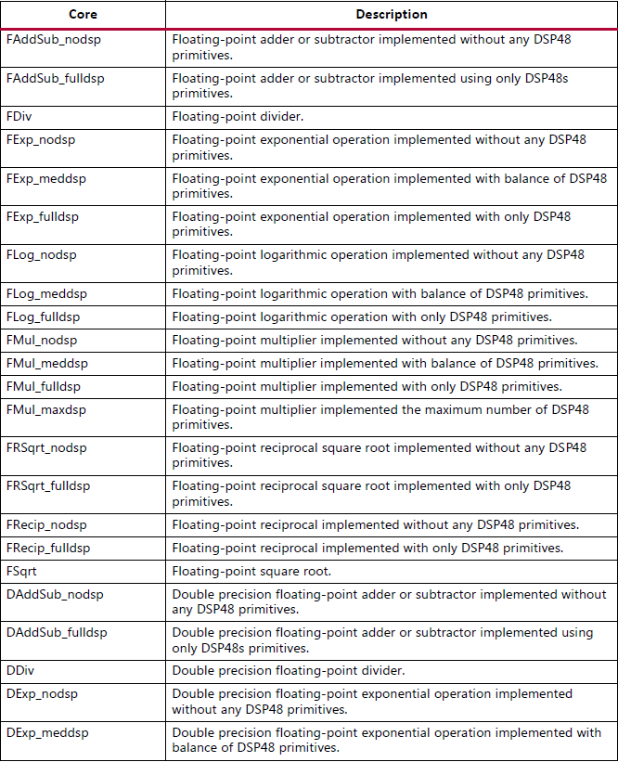
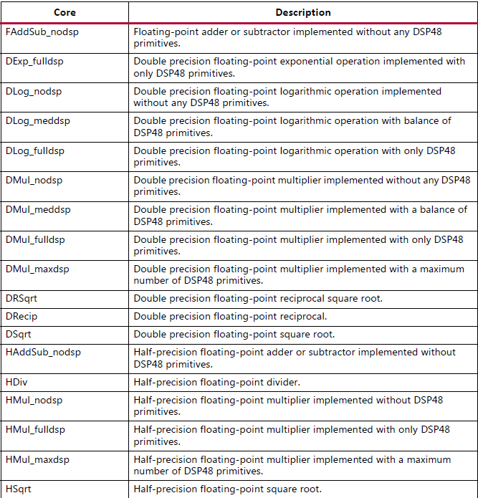
Floating-Point Cores
Notes:
https://www.xilinx.com/support/documentation/sw_manuals/xilinx2017_4/ug902-vivado-high-level-synthesis.pdf

Slide 48

Using Floating-Point Types Example
Floats and doubles are commonly used with math.h for C and cmath.h for C++
While converting C functions to C++ to take advantage of math.h support, be sure that the new C++ code compiles correctly before synthesizing with the Vitis HLS tool
Using a sqrtf(function)
  Remove the need for the type converters in the hardware/Save the area and improves the timing
double foo_d = 3.1459;
float foo_f = 3.1459 ;
ap_fixed<14,4> foo_fx = -1.4142;
int foo_i = 42;
Using ap_fixed requires:
C++
$VITIS_HLS_HOME/include/ap_fixed.h
Required if it is a C++ function
extern “C” float sqrtf(float);
double var_d = sqrt(foo_d); //64-bit sqrt core
float var_f = sqrtf(foo_f); //This will lead to a single precision core
var_f = sqrt(foo_f); //Still 64-bit, with format conversion cores(single to double and back)
ap_fixed<14,4> var_fx = sqrtf(foo_fx); //fixed-point to single precision conversion
//Fixed -> 32-bt sqrt core -> floating to fixed conversion
int var_i = sqrtf(foo_i); //int to float conversion
Int -> 32-bit sqrt -> float to int
Using sqrt instead of sqrtf would imply a single-to-double conversion and back

Slide 49
Support for Math Functions
Many other functions from the C/C++ standard math library for which are no floating-point operator cores available
  These functions are implemented in a bit-approximate manner
  Results for these functions may differ within a few units of least precision(ULP) to the C/C++ standards
Stand C math library
  C simulation results and the C/RTL co-simulation results may be different
Hls_math.h library
  C simulation and C/RTL co-simulation results are identical
  These results of C simulation are not the same as those using standard C libraries
Notes:
Recommendation: Replace math.h or cmath.h with hls_math.h or to add the files hls_lib.c and keep math/cmath.h

Slide 50
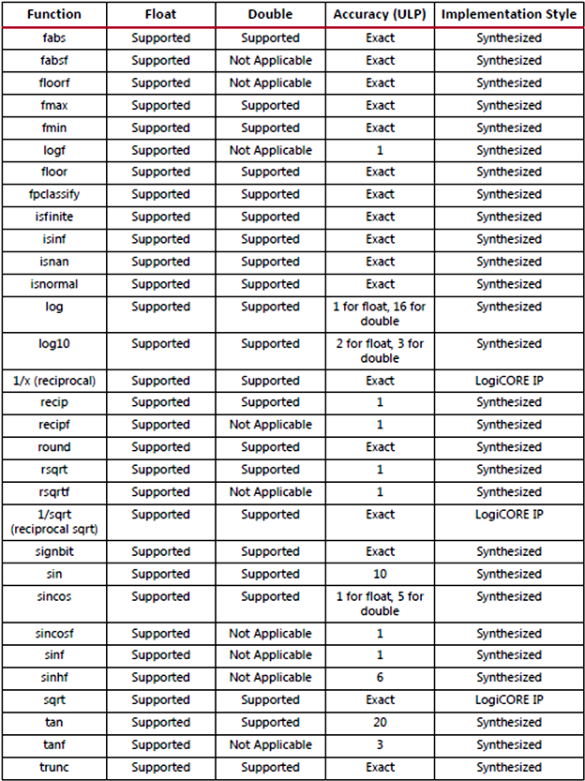
Support for Math Functions

Slide 51
Summary

Slide 52
Summary
C and C++ have standard types created on the 8-bit boundary
  char (8-bit), short (16-bit), int (32-bit), long long (64-bit)
Arbitrary precision in C++ is supported using ap_int
  Arbitrary precision types can define bit-accurate operators leading to better QoR
Fixed point precision is supported in C++
  Both signed (ap_fixed) and unsigned types (ap_ufixed)

Slide 53
Summary
C and C++ have standard types created on the 8-bit boundary
  char (8-bit), short (16-bit), int (32-bit), long long (64-bit)
Vivado HLS supports SystemC 1.3 Synthesizable subset
Arbitrary precision in C++ is supported using apint and ap_int in C++
  Compile using apcc for arbitrary precision
  Arbitrary precision types can define bit-accurate operators leading to better QoR
Fixed point precision is supported in C++
  Both signed (ap_fixed) and unsigned types (ap_ufixed)

Slide 54
Summary
Various quantization and overflow modes supported
  Quantization
    AP_RND, AP_RND_ZERO, AP_RND_MIN_INF, AP_RND_INF, AP_RND_CONV, AP_TRN, AP_TRN_ZERO
  Overflow
    AP_SAT, AP_SAT_ZERO, AP_SAT_SYM, AP_WRAP, AP_WRAP_SYM
Single- and double-precision floating point data types are supported
  If a corresponding floating point core is available then it will automatically be used
  If floating point core is not available then VITIS HLS will generate the RTL model

Slide 55
Summary
Various quantization and overflow modes supported
  Quantization
    AP_RND, AP_RND_ZERO, AP_RND_MIN_INF, AP_RND_INF, AP_RND_CONV, AP_TRN, AP_TRN_ZERO
  Overflow
    AP_SAT, AP_SAT_ZERO, AP_SAT_SYM, AP_WRAP, AP_WRAP_SYM
Half-, single- and double-precision floating point data types are supported
  If a corresponding floating point core is available then it will automatically be used
  If floating point core is not available then VITIS HLS will generate the RTL model

