Slide 1
Coding Considerations

Slide 2
Objectives
After completing this module, you will be able to:
  List language support in Vitis HLS
  State when a construct is not synthesizable
  List unsupported constructs
  Describe multi-access pointer and restriction imposed on using it
  Describe how structs and pointers are handled in Vitis HLS
  Generate efficient hardware from C sources using stream and shift register classes
  List supported functions in Vitis Vision library

Slide 3
Objectives
After completing this module, you will be able to:
  List language support in Vitis HLS
  State when a construct is not synthesizable
  List unsupported constructs
  Describe multi-access pointer and restriction imposed on using it
  Describe how structs and pointers are handled in Vitis HLS
  Generate efficient hardware from C sources using stream and shift register classes
  List supported functions in OpenCVVitis Vision library

Slide 4
Outline
Language Support
Pointers
Coding Considerations and IO
Streams
Libraries Support
  FFT, FIR and Shift Registers
  Vitis Vision
Summary

Slide 5
Outline
Language Support
Pointers
Coding Considerations and IO
Streams
Libraries Support
  FFT, FIR, Shift Registers and Linear Algebra
  OpenCVVitis Vision
Summary

Slide 6
C/C++ Support
A Complete C/C++ Validation & Verification Environment
  Vitis HLS supports complete bit-accurate validation of the C++ model
  Vitis HLS provides a productive C-RTL co-simulation verification solution
Vitis HLS supports C, C++
  Functions can be written in C or C++
  Wide support for coding constructs in C and C++
    It’s easier to discuss what’s not supported than what is
Modeling with bit-accuracy
  Supports arbitrary precision types for C++
  Allowing the exact bit-widths to be modeled and synthesized
Floating point support
  Support for the use of float and double in the code

Slide 7
Comprehensive C/C++ Support
A Complete C/C++ Validation & Verification Environment
  Vitis HLS supports complete bit-accurate validation of the C++ model
  Vitis HLS provides a productive C-RTL co-simulation verification solution
Vitis HLS supports C, C++ and SystemC
  Functions can be written in any version of CC or C++
  Wide support for coding constructs in all three variants of CC and C++
    It’s easier to discuss what’s not supported than what is
Modeling with bit-accuracy
  Supports arbitrary precision types for all input languages C++
  Allowing the exact bit-widths to be modeled and synthesized
Floating point support
  Support for the use of float and double in the code

Slide 8
C/C++ Support
Pointers based applications
  Multi-access pointer issues and streams
Streaming and shift registering applications
  Generate efficient hardware from C sources using stream and shift register classes
Support for OpenCV functions
  Enable migration of OpenCV designs into Xilinx FPGA
  Vitis vision libraries target real-time full HD video processing

Slide 9
Comprehensive C/C++ Support
Pointers based applications
  Multi-access pointer issues and streams
Streaming and shift registering applications
  Generate efficient hardware from C sources using stream and shift register classes
Support for OpenCV functions
  Enable migration of OpenCV designs into Xilinx FPGA
  Vitis vision libraries target real-time full HD video processing

Slide 10
C, C++ Support
The vast majority of C, C++ is supported
  Provided it is statically defined at compile time
  The C constructs must be of a fixed or bounded size and must be unamiguous
  If it’s not defined until run time, it won’t be synthesizable
  System calls to OS are not synthesizable
  If C is used, Vitis HLS expects the file extensions to be .c
  For C++ it expects file extensions .cpp
Let’s look at an example using a FIR
  Single data input x
  Coefficients are stored in a ROM
  A single output: function return

Slide 11
C, C++ and SystemC Support
The vast majority of C, C++ and SystemC is supported
  Provided it is statically defined at compile time
  The C constructs must be of a fixed or bounded size and must be unamiguous
  If it’s not defined until run time, it won’t be synthesizable
  System calls to OS are not synthesizable
Any of the three variants of C can be used
  If C is used, Vitis HLS expects the file extensions to be .c
  For C++ and SystemC it expects file extensions .cpp
Let’s look at an example using a FIR
  Single data input x
  Coefficients are stored in a ROM
  A single output: function return

Slide 12
FIR Filter with C
C coding style
  The top-level function defines the IO ports
  If required, sub-functions can be added
Storage
  Static: required for anything which must hold it’s
  value between invocations
    A C simulation will confirm what is required to be
    a static
    Will become a register or memory
    Other variables may become storage, depending on
    the implementation
  Const: ensures the values are seen as constants
  which never changed
FIR details
  Coefficients are loaded from a file
    Use the “const” keyword to ensure the data is seen as
    constant and a ROM is used
fir.c
data_t fir (
data_t x
) {
static data_t shift_reg[N];
acc_t acc;
int i;
const coef_t c[N+1]={
#include "fir_coef.h"
};
acc=0;
mac_loop: for (i=N-1;i>=0;i--) {
if (i==0) {
acc+=x*c[0];
shift_reg[0]=x;
} else {
shift_reg[i]=shift_reg[i-1];
acc+=shift_reg[i]*c[i];
}
}
return=acc;
}
fir_coeff.h
-1,
-20,
-19,
84,
271,
370,
271,
88,
-19,
-20,
-1,

Slide 13
FIR Filter with C
C coding style
  The top-level function defines the IO ports
  If required, sub-functions can be added
Storage
  Static: required for anything which must hold it’s
  value between invocations
    A C simulation will confirm what is required to be
    a static
    Will become a register or memory
    Other variables may become storage, depending on
    the implementation
  Const: ensures the values are seen as constants
  which never changed
FIR details
  Coefficients are loaded from a file
    Use the “const” keyword to ensure the data is seen as
    constant and a ROM is used
fir.c
data_t fir (
data_t x
) {
static data_t shift_reg[N];
acc_t acc;
int i;
const coef_t c[N+1]={
#include "fir_coef.h"
};
acc=0;
mac_loop: for (i=N-1;i>=0;i--) {
if (i==0) {
acc+=x*c[0];
shift_reg[0]=x;
} else {
shift_reg[i]=shift_reg[i-1];
acc+=shift_reg[i]*c[i];
}
}
return=acc;
}
fir_coeff.h
-1,
-20,
-19,
84,
271,
370,
271,
88,
-19,
-20,
-1,

Slide 14
Arrays to RAMs : Initialization
Static and Const have great impact on array implementation
  Const, as shown on previous slide, implies a ROM
  Static can impact how RAMs are initialized
A typical coding style changes
  Implies coeff is set each time the function is executed
  Resets in the RAM being explicitly loaded each transaction
    Costs clock cycles
  The array can be initialized as a static
  Statics are initialized at “start up” only
    In the C, in the RTL via bitstream
int coeff[8] = {-2, 8, -4, 10, 14, 10, -4, 8, -2};
Init RAM
Run
static int coeff[8] = {4, -2, 8, -4, 10, 14, 10, -4, 8, -2, 4};
Run
A coefficient array does not need to be initialized every time but doing that costs “nothing” in software, unlike hardware

Slide 15
Arrays to RAMs : Initialization
Static and Const have great impact on array implementation
  Const, as shown on previous slide, implies a ROM
  Static can impact how RAMs are initialized
A typical coding style changes
  Implies coeff is set each time the function is executed
  Resets in the RAM being explicitly loaded each transaction
    Costs clock cycles
  The array can be initialized as a static
  Statics are initialized at “start up” only
    In the C, in the RTL via bitstream
int coeff[8] = {-2, 8, -4, 10, 14, 10, -4, 8, -2};
Init RAM
Run
static int coeff[8] = {4, -2, 8, -4, 10, 14, 10, -4, 8, -2, 4};
Run
A coefficient array does not need to be initialized every time but doing that costs “nothing” in software, unlike hardware

Slide 16
FIR Filter with C++
template<class coef_T, class data_T, class acc_T>
const coef_T CFir<coef_T, data_T, acc_T>::c[] =
{
#include "fir_coeff.h"
};
template<class coef_T, class data_T, class acc_T>
data_T CFir<coef_T, data_T, acc_T>::operator()(data_T x)
{
int i;
acc_t acc = 0;
data_t m;
mac_loop: for (i=N-1;i>=0;i--) {
if (i==0) {
acc+=x*c[0];
shift_reg[0]=x;
} else {
shift_reg[i]=shift_reg[i-1];
acc+=shift_reg[i]*c[i];
}
}
return acc;
}
data_t fir(data_t x)
{
static CFir<coef_t, data_t, acc_t> fir1;
return fir1(x);
}
fir.cpp
C++ Coding Style
  Top-level defines RTL IO
  A class defines the functionality
    Additional classes or sub-functions
    can be added
  The class is instantiated in the
  top-level function
    Methods can be used
fir_coeff.h
-1,
-20,
-19,
84,
271,
370,
271,
88,
-19,
-20,
-1,
CFir functionality defined
fir.h
#include “types.h”
template<class coef_T, class data_T, class acc_T>
class CFir
{
protected:
static const coef_T c[];
data_T shift_reg[N-1];
private:
public:
data_T operator()(data_T x);
template<class coef_TT, class data_TT, class acc_TT>
};
data_t fir(data_t x);
Top-level function defines the IO Class CFIR is instantiated as fir1
CFir Class defined

Slide 17
FIR Filter with C++
template<class coef_T, class data_T, class acc_T>
const coef_T CFir<coef_T, data_T, acc_T>::c[] =
{
#include "fir_coeff.h"
};
template<class coef_T, class data_T, class acc_T>
data_T CFir<coef_T, data_T, acc_T>::operator()(data_T x)
{
int i;
acc_t acc = 0;
data_t m;
mac_loop: for (i=N-1;i>=0;i--) {
if (i==0) {
acc+=x*c[0];
shift_reg[0]=x;
} else {
shift_reg[i]=shift_reg[i-1];
acc+=shift_reg[i]*c[i];
}
}
return acc;
}
data_t fir(data_t x)
{
static CFir<coef_t, data_t, acc_t> fir1;
return fir1(x);
}
fir.cpp
C++ Coding Style
  Top-level defines RTL IO
  A class defines the functionality
    Additional classes or sub-functions
    can be added
  The class is instantiated in the
  top-level function
    Methods can be used
fir_coeff.h
-1,
-20,
-19,
84,
271,
370,
271,
88,
-19,
-20,
-1,
CFir functionality defined
fir.h
#include “types.h”
template<class coef_T, class data_T, class acc_T>
class CFir
{
protected:
static const coef_T c[];
data_T shift_reg[N-1];
private:
public:
data_T operator()(data_T x);
template<class coef_TT, class data_TT, class acc_TT>
};
data_t fir(data_t x);
Top-level function defines the IO Class CFIR is instantiated as fir1
CFir Class defined

Slide 18
FIR Filter with SystemC
SystemC Style
  The header defines the IO ports
  The constructor calls the functions
    Can be SC_CTHREAD sensitive on the clock (with optional reset)
    Can be SC_METHOD sensitive on any signal
  Multiple threads, methods and functions can be used
fir.cpp
#include “fir.h"
const sc_int<8> c ={
#include "fir_coeff.h“
};
void fir::go (void) {
if (reset.read() == 1) {
acc=0;
i=0;
}
wait ();
while (1) {
mac_loop: for (i=N-1;i>=0;i--) {
    if (i==0) {
    acc+=x*c[0];
    shift_reg[0]=x;
    } else {
    shift_reg[i]=shift_reg[i-1];
    acc+=shift_reg[i]*c[i];
    }
    }
    y=acc;
    wait();
}
}
fir_coeff.h
Reset behavior is defined in the code (optional)
SC_MODULE (fir) {
//-----------Input Ports---------------
sc_in <bool> clk;
sc_in <bool> reset;
sc_in <sc_uint<8> > x;
//-----------Output Ports---------------
sc_out <sc_uint<8> > y;
//------------Internal Variables--------
sc_uint<8> acc, m, i;
sc_uint<8> shift_reg[N];
//-------------Code Starts Here---------
void go ();
SC_CTOR(fir) {
SC_CTHREAD (go, clk.pos());
reset_signal_is(reset, true);
}
};
fir.h
IO defined
Wait() allows for a break in the infinitive processing loop
Clock sensitive thread (SC_CTHREAD)
SC_METHOD is also supported (combo)
SC_THREAD is not supported

Slide 19
Unsupported C/C++ Constructs: Overview
System calls and function pointers
  Dynamic memory allocation
    malloc()/free()/alloc()
  Standard I/0 and file I/O operations
    fprintf() / fscanf() etc.
  System calls
    time(), sleep() etc.
Recursive Functions
  Recursive functions cannot be synthesized. This applies to functions that can form endless recursion
  Vitis HLS also does not support tail recursion, in which there is a finite number of function calls
Non-standard Pointers
  Pointer casting between general data types
    OK with native integers types
  Function pointers are not supported.
    Pointer to pointer is not supported.

Slide 20
Unsupported C/C++ Constructs: Overview
System calls and function pointers
  Dynamic memory allocation
    malloc() & /free()/alloc()
  Standard I/0 and file I/O operations
    fprintf() / fscanf() etc.
  System calls
    time(), sleep() etc.
Data types
  Forward declared type
  Recursive type definitions
    Type contains members with the same type
Recursive Functions
  Recursive functions cannot be synthesized. This applies to functions that can form endless recursion
  Vitis HLS also does not support tail recursion, in which there is a finite number of function calls
Non-standard Pointers
  Pointer casting between general data types
    OK with native integers types
  If a double pointer is used in multiple functions, Vivado HLS will inline all the functions
    Slower synthesis, may increase area & run time
  Function pointers are not supported.
    Pointer to pointer is not supported.

Slide 21
Unsupported: Dynamic Memory Allocation
Dynamic memory allocation
  Not allowed since it requires the construction (or destruction) of hardware at runtime
  malloc, alloc, free are not synthesizable
  Similarly for constructor initialization
  Use persistent static variables and fixed-size arrays instead
Dynamic virtual function call
  Virtual Functions are not supported
long long x = malloc (sizeof(long long));
int* arr = malloc (64 * sizeof(int));
static long long x;
int array[64];
Class A {
public:
virtual void bar() {…};
};
void fun(A* a) {
a->bar();
}
A* a = 0;
if (base) A= new A();
else A = new B();
foo(a);
Coding Considerations 23- 21

Slide 22
Unsupported: Dynamic Memory Allocation
Dynamic memory allocation
  Not allowed since it requires the construction (or destruction) of hardware at runtime
  malloc, alloc, free are not synthesizable
  Similarly for constructor initialization
  Use persistent static variables and fixed-size arrays instead
Dynamic virtual function call
  Virtual Functions are not supported
long long x = malloc (sizeof(long long));
int* arr = malloc (64 * sizeof(int));
static long long x;
int array[64];
Class A {
public:
virtual void bar() {…};
};
void fun(A* a) {
a->bar();
}
A* a = 0;
if (base) A= new A();
else A = new B();
foo(a);

Slide 23
Unsupported: System Calls
System calls
  Most of C system calls do not have hardware counterparts and are not synthesizable
    printf(), getc(), time(), …
  Vitis HLS will ignore system calls
    They can also be removed by the __SYNTHESIS__ macro
  Good Practice:
    Use Macro “__SYNTHESIS__” to remove code segment involving system calls from synthesis
    Macro “__SYNTHESIS__” is automatically defined by the Vivado HLS during elaboration
void foo (…]) {
...
#ifndef __SYNTHESIS__
Code will be seen by simulation.
But not synthesis.
#endif
…
}
Only read this code if macro __SYNTHESIS__ is not set

Slide 24
Unsupported: System Calls
System calls
  Most of C system calls do not have hardware counterparts and are not synthesizable
    printf(), getc(), time(), …
  Vitis HLS will ignore system calls
    They can also be removed by the __SYNTHESIS__ macro
  Good Practice:
    Use Macro “__SYNTHESIS__” to remove code segment involving system calls from synthesis
    Macro “__SYNTHESIS__” is automatically defined by the Vivado HLS during elaboration
void foo (…]) {
...
#ifndef __SYNTHESIS__
Code will be seen by simulation.
But not synthesis.
#endif
…
}
Only read this code if macro __SYNTHESIS__ is not set

Slide 25
Unsupported: General Pointer Casting
Pointer reinterpretation
  Casting a pointer to a different type is
  not allowed in the general case
Pointer casting is allowed between native C integer types
  Solution: assign values using the original type
struct {
short first;
short second;
} pair;
*(unsigned*)pair = -1U;
struct {
short first;
short second;
} pair;
pair.first = -1U;
pair.second = -1U;
int foo (int index, int A[N]) {
char* ptr;
int i =0, result = 0;
ptr = (char*)(&A[index]);
for (i = 0; i < 4*N; ++i) {
result += *ptr;
ptr+=1;
}
return result;
}

Slide 26
Unsupported: General Pointer Casting
Pointer reinterpretation
  Casting a pointer to a different type is
  not allowed in the general case
Pointer casting is allowed between native C integer types
  Solution: assign values using the original type
struct {
short first;
short second;
} pair;
*(unsigned*)pair = -1U;
struct {
short first;
short second;
} pair;
pair.first = -1U;
pair.second = -1U;
int foo (int index, int A[N]) {
char* ptr;
int i =0, result = 0;
ptr = (char*)(&A[index]);
for (i = 0; i < 4*N; ++i) {
result += *ptr;
ptr+=1;
}
return result;
}

Slide 27
Unsupported: Recursive Functions
Avoid recursive functions
  Not synthesizable in general
    The code re-entrance indirectly uses dynamic memory allocation
Standard Template Libraries (STLs)
  Many are unbounded or use recursive functions
    In general they cannot be synthesized
  Re-code to create a local bounded model
    Use arrays instead of vectors
    Shifts instead of queues
unsigned foo (unsigned n)
{
if (n == 0 || n == 1) return 1;
return (foo(n-2) + foo(n-1));
}
Not synthesizable: Endless recursion

Slide 28
Unsupported: Recursive Functions
Avoid recursive functions
  Not synthesizable in general
    The code re-entrance indirectly uses dynamic memory allocation
Standard Template Libraries (STLs)
  Many are unbounded or use recursive functions
    In general they cannot be synthesized
  Re-code to create a local bounded model
    Use arrays instead of vectors
    Shifts instead of queues
unsigned foo (unsigned n)
{
if (n == 0 || n == 1) return 1;
return (foo(n-2) + foo(n-1));
}
Not synthesizable: Endless recursion

Slide 29
Test Bench: Gotcha 1
Use a RETURN value
  RTL verification re-uses the C test bench to verify the RTL design
  If the test bench does not return a 0, RTL sim will say it failed
@I [LIC-101] Checked in features [ Vivado HLS_FLOW Vivado HLS_OPT Vivado HLS_SC Vivado HLS_XILINX ]
Generating autosim.sc.exe
@I [SIM-6] Starting SystemC simulation ...
SystemC 2.2.0 --- Sep 15 2011 23:59:06
Copyright (c) 1996-2006 by all Contributors
ALL RIGHTS RESERVED
Note: VCD trace timescale unit is set by user to 1.000000e-12 sec.
0 3
1 2
2 1
3 0
@E Simulation failed: Function 'main' returns nonzero value '1'.
@E [SIM-1] 'csim_design' failed: nonzero return value*
The test bench could show the correct results after RTL sim
But if there is no return 0, Vivado HLS will report a failure

Slide 30
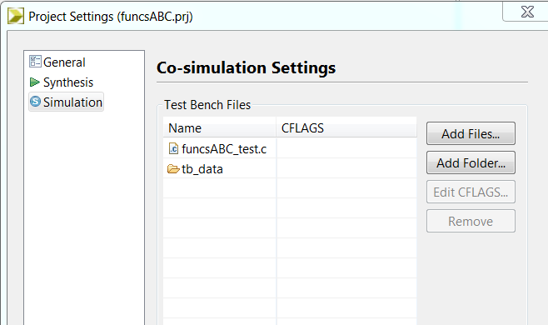
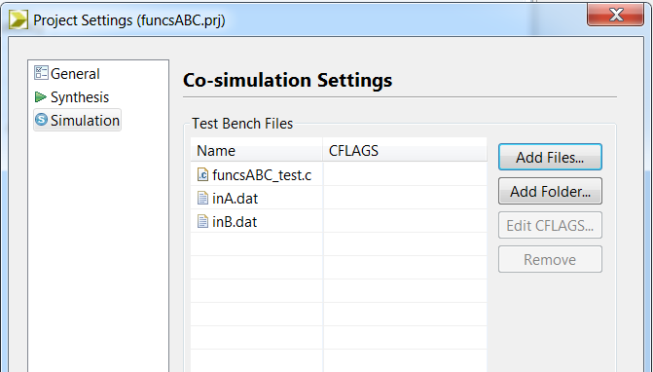
Test Bench : Gotcha 2
Include all files used by the test bench in Vivado HLS
  This test bench reads golden data from files
  Include all files or RTL verification will fail
int main () {
…
// Get data from files
fp=fopen("tb_data/inA.dat","r");
for (i=0; i<N*NUM_TRANS; i++){
int tmp;
fscanf(fp, "%d", &tmp);
a_gold[i] = tmp;
}
fclose(fp);
fp=fopen("tb_data/inB.dat","r");
for (i=0; i<N*NUM_TRANS; i++){
int tmp;
fscanf(fp, "%d", &tmp);
b_gold[i] = tmp;
}
fclose(fp);
…
return ret;
}
Include file directory with the test bench
Or include both files

Slide 31
Pointers

Slide 32
Using Pointer
Structs as pointers
  Structs are implemented differently as pointers or pass-by-value
Pointer arithmetic
  The pointer arithmetic does not access the pointer data in sequence
  The interface supplies an address to index the data
Converting pointers using malloc
  Must be converted to fixed sized resources
Multi-access Pointers
  Must be marked as volatile or reads and writes will be optimized away
  Cannot be rigorously validated with C simulation
  Require a depth specification for RTL simulation
Arrays of Pointers
  When using arrays of pointers, each pointer must point to a scalar or a scalar array (not another pointer)

Slide 33
Using Pointer
Structs as pointers
  Structs are implemented differently as pointers or pass-by-value
Pointer arithmetic
  Only supported as interface using ap_bus
  The pointer arithmetic does not access the pointer data in sequence
  The interface supplies an address to index the data
Converting pointers using malloc
  Must be converted to fixed sized resources
Multi-access Pointers
  Must be marked as volatile or reads and writes will be optimized away
  Cannot be rigorously validated with C simulation
  Require a depth specification for RTL simulation
Arrays of Pointers
  When using arrays of pointers, each pointer must point to a scalar or a scalar array (not another pointer)

Slide 34
Pointer & Structs
Struct passed as a pointer
  When a struct is passed as a pointer
  The data will be accessed as pass-by-reference
Struct passed by-value
  When a struct is passed directly and not as a pointer
  The data will be accessed as pass-by-value
typedef struct{
unsigned char A; unsigned char B[4]; unsigned char C;
} my_data;
void foo(my_data *in);
foo
8-bit
A
8-bit Memory port
B
8-bit
C
Pointer
typedef struct{
unsigned char A; unsigned char B[4]; unsigned char C;
} my_data;
void foo(my_data in);
8-bit
foo
A
32(4x8)-bit
B
8-bit
C

Slide 35
Pointer & Structs
Struct passed as a pointer
  When a struct is passed as a pointer
  The data will be accessed as pass-by-reference
Struct passed by-value
  When a struct is passed directly and not as a pointer
  The data will be accessed as pass-by-value
typedef struct{
unsigned char A; unsigned char B[4]; unsigned char C;
} my_data;
void foo(my_data *in);
foo
8-bit
A
8-bit Memory port
B
8-bit
C
Pointer
typedef struct{
unsigned char A; unsigned char B[4]; unsigned char C;
} my_data;
void foo(my_data in);
8-bit
foo
A
32(4x8)-bit
B
8-bit
C

Slide 36
Struct Access
Accessing a struct: pass-by-reference
Accessing a struct: pass-by-value
void foo(my_data *a_in, my_data *b_out) {
int i;
b_out->A = a_in->A + 1;
for(i=0; i <= 319; i++) {
b_out->B[i] = a_in->B[i] +1 ;
}
b_out->C = a_in->C +1;
}
typedef struct {
unsigned char A;
unsigned char B[320];
unsigned char C;
}my_data;
my_data foo(my_data a_in, my_data b_out) {
int i;
b_out.A = a_in.A+1;
for(i=0; i <= N-1; i++) {
b_out.B[i] = a_in.B[i]+1;
}
b_out.C = a_in.C+1;
return b_out;
}

Slide 37
Struct Access
Accessing a struct: pass-by-reference
Accessing a struct: pass-by-value
void foo(my_data *a_in, my_data *b_out) {
int i;
b_out->A = a_in->A + 1;
for(i=0; i <= 319; i++) {
b_out->B[i] = a_in->B[i] +1 ;
}
b_out->C = a_in->C +1;
}
typedef struct {
unsigned char A;
unsigned char B[320];
unsigned char C;
}my_data;
my_data foo(my_data a_in, my_data b_out) {
int i;
b_out.A = a_in.A+1;
for(i=0; i <= N-1; i++) {
b_out.B[i] = a_in.B[i]+1;
}
b_out.C = a_in.C+1;
return b_out;
}

Slide 38
Pointer Arithmetic: One Interface
Pointer arithmetic
  This function uses some pointer arithmetic to accumulate the data values
Wire, handshake, FIFO interfaces
  All reads & writes must be sequential (start from location 0 implied)
Modify the code with an array on the interface and implemented with ap_memory
  Output address 4 is never written
  If wire, handshake and FIFO interfaces are used here, RTL co-simulation fails
# int main () {
int d[5];
int i;
for (i=0;i<5;i++) {
d[i] = i;
}
foo(d);
// Check results
…
}
#include "bus.h"
void foo (int *d) {
static int acc = 0;
int i;
for (i=0;i<4;i++) {
acc += *(d+i+1);
*(d+i) = acc;
}
}
Value of “d” are defined in the test bench
Pointer arithmetic
Notes:
ap_bus no longer support

Slide 39
Pointer Arithmetic: One Interface
Pointer arithmetic
  This function uses some pointer arithmetic to accumulate the data values
  Argument can be implemented as ap_bus or ap_fifo
With a FIFO interfaceWire, handshake, FIFO interfaces
  All reads & writes must be sequential (start from location 0 implied)
  This functionality can only be implemented using ap_bus
Address generated by pointer arithmetic
  Can only exported externally using ap_bus
  All other pointer interfaces are streaming type
Modify the code with an array on the interface and implemented with ap_memory
  Output address 4 is never written
  If wire, handshake and FIFO interfaces are used here, RTL co-simulation fails
# int main () {
int d[5];
int i;
for (i=0;i<5;i++) {
d[i] = i;
}
foo(d);
// Check results
…
}
#include "bus.h"
void foo (int *d) {
static int acc = 0;
int i;
for (i=0;i<4;i++) {
acc += *(d+i+1);
*(d+i) = acc;
}
}
Value of “d” are defined in the test bench
Pointer arithmetic
Notes:
ap_bus no longer support

Slide 40
Converting Malloc Pointers
#include "malloc_removed.h"
#include <stdlib.h>
//#define NO_SYNTH
dout_t malloc_removed(din_t din[N], dsel_t width) {
#ifdef NO_SYNTH
long long *out_accum = malloc (sizeof(long long));
int* array_local = malloc (64 * sizeof(int));
#else
long long _out_accum;
long long *out_accum = &_out_accum;
int _array_local[64];
int* array_local = &_array_local[0];
#endif
int i,j;
LOOP_SHIFT:for (i=0;i<N-1; i++) {
if (i<width)
*(array_local+i)=din[i];
else
*(array_local+i)=din[i]>>2;
}
*out_accum=0;
LOOP_ACCUM:for (j=0;j<N-1; j++) {
*out_accum += *(array_local+j);
}
return *out_accum;
}
Many design use Malloc and Pointer
  Malloc is not supported for synthesis
  Must be converted to a resource of a defined size ➔ array
  This can mean changing lots of code: *var ➔ var[ ]
The following workaround can ensure limited code impact
  Add user-defined macro NO_SYNTH to select synthesizable and no-synthesizable version
  Enable and disable macro NO_SYNTH for C simulation and verify the results
  Disable macro NO_SYNTH for synthesis
Notes:
UG1399->Vitis HLS Coding styles->Unsupported C/C++ Constructs->Dynamic Memory Usage

Slide 41
Converting Malloc Pointers
Many design use Malloc and Pointer
  Malloc is not supported for synthesis
  Must be converted to a resource of a defined size ➔ array
  This can mean changing lots of code: *var ➔ var[ ]
The following workaround can ensure limited code impact
  Create a dummy variable
  Set the pointer to the dummy variable
// Internal image buffers
#ifndef __SYNTHESIS__
my_type *yuv = (my_type *)malloc(N*sizeof(my_type));
my_type *scale = (my_type *)malloc(N*sizeof(my_type));
#else // Workaround malloc() calls w/o changing rest of code
my_type _yuv[N];
my_type _scale[N];
my_type *yuv = &_yuv;
my_type *scale = &_scale;
#endif
res = *yuv;
Code for non-synthesis flow (simulation)
Fixed size resource
Point to new fixed sized resource
Keep pointer in code

Slide 42
Converting Malloc Pointers
#include "malloc_removed.h"
#include <stdlib.h>
//#define NO_SYNTH
dout_t malloc_removed(din_t din[N], dsel_t width) {
#ifdef NO_SYNTH
long long *out_accum = malloc (sizeof(long long));
int* array_local = malloc (64 * sizeof(int));
#else
long long _out_accum;
long long *out_accum = &_out_accum;
int _array_local[64];
int* array_local = &_array_local[0];
#endif
int i,j;
LOOP_SHIFT:for (i=0;i<N-1; i++) {
if (i<width)
*(array_local+i)=din[i];
else
*(array_local+i)=din[i]>>2;
}
*out_accum=0;
LOOP_ACCUM:for (j=0;j<N-1; j++) {
*out_accum += *(array_local+j);
}
return *out_accum;
}
Many design use Malloc and Pointer
  Malloc is not supported for synthesis
  Must be converted to a resource of a defined size ➔ array
  This can mean changing lots of code: *var ➔ var[ ]
The following workaround can ensure limited code impact
  Create a dummy variable
  Set the pointer to the dummy variable
  Add user-defined macro NO_SYNTH to select synthesizable and no-synthesizable version
  Enable and disable macro NO_SYNTH for C simulation and verify the results
  Disable macro NO_SYNTH for synthesis
Notes:
UG1399->Vitis HLS Coding styles->Unsupported C/C++ Constructs->Dynamic Memory Usage

Slide 43
Coding Considerations and IO

Slide 44
Coding and IO
There is one major issue with IO and coding
  Multi-access pointers
A multi-access pointer is a pointer argument which is …
  Read or written to multiple times
  This introduce unexpected behavior after synthesis
#include "pointer_stream_bad.h"
void pointer_stream_bad ( dout_t *d_o, din_t *d_i) {
din_t acc = 0;
acc += *d_i;
acc += *d_i;
*d_o = acc;
acc += *d_i;
acc += *d_i;
*d_o = acc;
}
*d_i is read multiple times
*d_o is written to multiple times
Yes, you can use this coding style (if you REALLY wish)…. With the following workarounds

Slide 45
Coding and IO
There is one major issue with IO and coding
  Multi-access pointers
A multi-access pointer is a pointer argument which is …
  Read or written to multiple times
  This can result in incorrect hardware
  This cannot be verified using a test bench
  This can give incorrect results at RTL verification
void fifo (int *d_o,
int *d_i
) {
static int acc = 0;
int cnt;
for (cnt=0;cnt<4;cnt++) {
acc += *d_i;
if (cnt%2==1) {
*d_o = acc;
}
}
}
*d_i is read multiple times
*d_o is written to multiple times
Yes, you can use this coding style (if you REALLY wish)…. With the following workarounds

Slide 46
Coding and IO
There is one major issue with IO and coding
  Multi-access pointers
A multi-access pointer is a pointer argument which is …
  Read or written to multiple times
  This introduce unexpected behavior after synthesis
  This can result in incorrect hardware
  This cannot be verified using a test bench
  This can give incorrect results at RTL verification
#include "pointer_stream_bad.h"
void pointer_stream_bad ( dout_t *d_o, din_t *d_i) {
din_t acc = 0;
acc += *d_i;
acc += *d_i;
*d_o = acc;
acc += *d_i;
acc += *d_i;
*d_o = acc;
}
*d_i is read multiple times
*d_o is written to multiple times
Yes, you can use this coding style (if you REALLY wish)…. With the following workarounds

Slide 47
Multi-Access Pointers: Use Volatile!!!
Without Volatile
C compilers will optimize to 1 read
and 1 write
Vitis HLS will create a design with 1 read
and 1 write
With Volatile
C Compilers will not optimize the IO accesses
  Will assume the pointer value may change outside the scope of the function & leave the accesses
Vitis HLS will create a design with 4 reads and 2 write
void pointer_stream_bad ( dout_t *d_o, din_t *d_i) {
din_t acc = 0;
acc += *d_i;
acc += *d_i;
*d_o = acc;
acc += *d_i;
acc += *d_i;
*d_o = acc;
}
void pointer_stream_better ( volatile dout_t *d_o, volatile din_t *d_i) {
din_t acc = 0;
acc += *d_i;
acc += *d_i;
*d_o = acc;
acc += *d_i;
acc += *d_i;
*d_o = acc;
}
To complicate matters, if the IF condition is complex, Vitis HLS may not be able to optimize the accesses into 1

Slide 48
Multi-Access Pointers: Use Volatile!!!
Without Volatile
C compilers will optimize to 1 read
and 1 write
Vivado HLS will create a design with 1 read
and 1 write
With Volatile
C Compilers will not optimize the IO accesses
  Will assume the pointer value may change outside the scope of the function & leave the accesses
Vivado HLS will create a design with 4 reads and 2 write
void fifo (int *d_o,
int *d_i) {
static int acc = 0;
int cnt;
for (cnt=0;cnt<4;cnt++) {
acc += *d_i;
if (cnt%2==1) {
*d_o = acc;
}
}
}
void fifo (volatile int *d_o,
volatile int *d_i) {
static int acc = 0;
int cnt;
for (cnt=0;cnt<4;cnt++) {
acc += *d_i;
if (cnt%2==1) {
*d_o = acc;
}
}
}
To complicate matters, if the IF condition is complex, Vivado HLS may not be able to optimize the accesses into 1

Slide 49
Multi-Access Pointers: Use Volatile!!!
Without Volatile
C compilers will optimize to 1 read
and 1 write
Vitis HLS will create a design with 1 read
and 1 write
With Volatile
C Compilers will not optimize the IO accesses
  Will assume the pointer value may change outside the scope of the function & leave the accesses
Vitis HLS will create a design with 4 reads and 2 write
void pointer_stream_bad ( dout_t *d_o, din_t *d_i) {
din_t acc = 0;
acc += *d_i;
acc += *d_i;
*d_o = acc;
acc += *d_i;
acc += *d_i;
*d_o = acc;
}
void pointer_stream_better ( volatile dout_t *d_o, volatile din_t *d_i) {
din_t acc = 0;
acc += *d_i;
acc += *d_i;
*d_o = acc;
acc += *d_i;
acc += *d_i;
*d_o = acc;
}
To complicate matters, if the IF condition is complex, Vitis HLS may not be able to optimize the accesses into 1

Slide 50
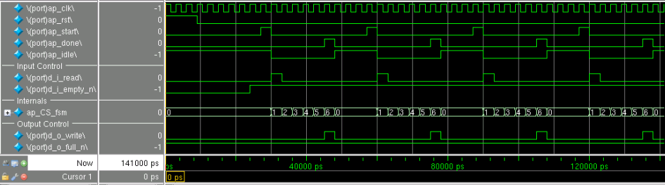
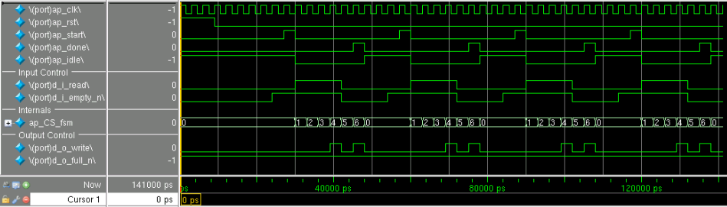
Multi-Access Pointers: the effect of volatile
C compilers will optimize multiple accesses on the same (non-volatile) pointer into a single access : Vitis HLS matches this behavior
Easier to see with a simple example
void pointer_stream_bad (
int *d_o,
int *d_i
) {
static int acc = 0;
acc += *d_i;
acc += *d_i;
*d_o = acc;
acc += *d_i;
acc += *d_i;
*d_o = acc;
}
1 Input read
1 Output write
void pointer_stream_better (
volatile int *d_o,
volatile int *d_i
) {
static int acc = 0;
acc += *d_i;
acc += *d_i;
*d_o = acc;
acc += *d_i;
acc += *d_i;
*d_o = acc;
}
4 Input reads
2 Output writes

Slide 51
Multi-Access Pointers: the effect of volatile
C compilers will optimize multiple accesses on the same (non-volatile) pointer into a single access : Vitis HLS matches this behavior
Easier to see with a simple example
void fifo pointer_stream_bad (
int *d_o,
int *d_i
) {
static int acc = 0;
int cnt;
acc += *d_i;
acc += *d_i;
*d_o = acc;
acc += *d_i;
acc += *d_i;
*d_o = acc;
}
1 Input read
1 Output write
void fifo pointer_stream_better (
volatile int *d_o,
volatile int *d_i
) {
static int acc = 0;
int cnt;
acc += *d_i;
acc += *d_i;
*d_o = acc;
acc += *d_i;
acc += *d_i;
*d_o = acc;
}
4 Input reads
2 Output writes

Slide 52
Multi-Access Pointers: Limited Visibility
The intermediate results are hard to use for verification
  Only the final pointer value is passed to the test bench
            The final value of *d_o can be captured in the test bench and compared
            The intermediate values can only be seen by using printf : they cannot be automatically verified by the test bench
Code could be added to the DUT
  Use __SYNTHESIS__ to add un-synthesizable code for checking
  Which will not be there in the RTL
  HLS:STREAMS class can be used instead: discussed in next section
void fifo (int *d_o,
int *d_i
) {
static int acc = 0;
int cnt;
for (cnt=0;cnt<4;cnt++) {
acc += *d_i;
if (cnt%2==1) {
*d_o = acc;
}
}
}
Not the most ideal coding style for verification

Slide 53
Multi-Access Pointers: Limited Visibility
The intermediate results are hard to use for verification
  Only the final pointer value is passed to the test bench
            The final value of *d_o can be captured in the test bench and compared
            The intermediate values can only be seen by using printf : they cannot be automatically verified by the test bench
Code could be added to the DUT
  Use __SYNTHESIS__ to add un-synthesizable code for checking
  Which will not be there in the RTL
  HLS:STREAMS class can be used instead: discussed in next section
void fifo (int *d_o,
int *d_i
) {
static int acc = 0;
int cnt;
for (cnt=0;cnt<4;cnt++) {
acc += *d_i;
if (cnt%2==1) {
*d_o = acc;
}
}
}
Not the most ideal coding style for verification

Slide 54
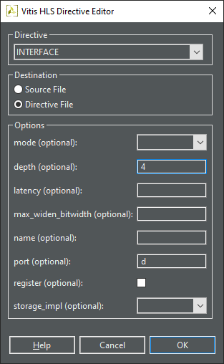
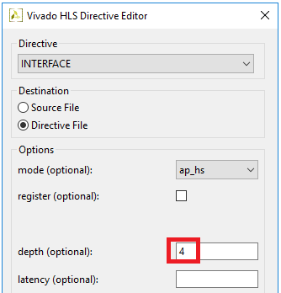
Multi-Access Pointers: Test bench Depth
Let’s look at an example
  This code will access four samples using a pointer
Co-Simulation(RTL Verification) only sees a pointer on the interface
  And will create a SystemC co-simulation wrapper to supply or store 1 sample
  Use the depth option to specify the actual depth
  Vitis HLS will issue a warning in case
#include "bus.h"
void foo (int *d) {
static int acc = 0;
int i;
for (i=0;i<4;i++) {
acc += *(d+i);
*(d+i) = acc;
}
}
int main () {
int d[5];
int i;
for (i=0;i<4;i++) {
d[i] = i;
}
foo(d);
return 0;
}
The C test bench may correctly provide 4 values
Notes:
Didn’t see warning in vitis

Slide 55
Multi-Access Pointers: Test bench Depth
Let’s look at an example
  This code will access four samples using a pointer
Co-Simulation(RTL Verification) only sees a pointer on the interface
  And will create a SystemC co-simulation wrapper to supply or store 1 sample
  Use the depth option to specify the actual depth
  Vitis HLS will issue a warning in case
#include "bus.h"
void foo (int *d) {
static int acc = 0;
int i;
for (i=0;i<4;i++) {
acc += *(d+i);
*(d+i) = acc;
}
}
int main () {
int d[5];
int i;
for (i=0;i<4;i++) {
d[i] = i;
}
foo(d);
return 0;
}
The C test bench may correctly provide 4 values
@I [SIM-76] 'd' has a depth of ‘4'. Interface directive option '-depth' can be used to set to a different value. Incorrect depth may result in simulation mismtach.
Notes:
Didn’t see warning in vitis

Slide 56
Streams

Slide 57
Designing with Streams
Streams can be used instead of multi-access pointers
  None of the issues
Streams simulate like an infinite FIFO in software
  Implemented as a FIFO of user-defined size in hardware
Streams have support for multi-access
  Streams interface to the testbench
  Streams can be read in the testbench to check the intermediate values
  Streams store values: no chance of the volatile effect
Streams are supported on the interface and internally
  Define the stream as static to make it internal only

Slide 58
Designing with Streams
Streams can be used instead of multi-access pointers
  None of the issues
Streams simulate like an infinite FIFO in software
  Implemented as a FIFO of user-defined size in hardware
Streams have support for multi-access
  Streams interface to the testbench
  Streams can be read in the testbench to check the intermediate values
  Streams store values: no chance of the volatile effect
Streams are supported on the interface and internally
  Define the stream as static to make it internal only

Slide 59
Using Streams
Streams are C++ classes
  Modeled in C++ an as infinite depth FIFO
  Can be written to or read from
Ideal for Hardware Modeling
  Ideal for modeling designs in which the data is known to be streaming (data is always in sequential order)
    Video or Communication designs typically stream data
  No need to model the design in C++ as a “frame”
  Streams allow it to be modeled as per-sample processing
    Just fill the stream in the test bench
    Read and write to the stream as if it’s an infinite FIFO
    Read from the stream in the test bench to confirm results
Stream are by default implemented as a FIFO of depth 2
  Can be specified by the user: needed for decimation/interpolation designs
Notes:
By default, an hls::stream is implemented as a FIFO with a depth of 2.

Slide 60
Using Streams
Streams are C++ classes
  Modeled in C++ an as infinite depth FIFO
  Can be written to or read from
Ideal for Hardware Modeling
  Ideal for modeling designs in which the data is known to be streaming (data is always in sequential order)
    Video or Communication designs typically stream data
  No need to model the design in C++ as a “frame”
  Streams allow it to be modeled as per-sample processing
    Just fill the stream in the test bench
    Read and write to the stream as if it’s an infinite FIFO
    Read from the stream in the test bench to confirm results
Stream are by default implemented as a FIFO of depth 2
  Can be specified by the user: needed for decimation/interpolation designs
Notes:
By default, an hls::stream is implemented as a FIFO with a depth of 2.

Slide 61
Stream Example
Create using hls::stream or define the hls namespace
Blocking and Non-Block accesses supported
#include <ap_int.h>
#include <hls_stream.h>
typedef ap_uint<128> uint128_t; // 128-bit user defined type
hls::stream<uint128_t> my_wide_stream; // A stream declaration
#include <ap_int.h>
#include <hls_stream.h>
using namespace hls; // Use hls namespace
typedef ap_uint<128> uint128_t; // 128-bit user defined type
stream<uint128_t> my_wide_stream; // hls:: no longer required
// Blocking Write
hls::stream<int> my_stream;
int src_var = 42;
my_stream.write(src_var);
// OR use: my_stream << src_var;
hls::stream<int> my_stream;
int src_var = 42;
bool stream_full;
// Non-Blocking Write
if (my_stream.write_nb(src_var)) {
// Perform standard operations
} else {
// Write did not happen
}
// Full test
stream_full = my_stream.full();
hls::stream<int> my_stream;
int dst_var;
bool stream_empty;
// Non-Blocking Read
if (my_stream.read_nb(dst_var)) {
// Perform standard operations
} else {
// Read did not happen
}
// Empty test
fifo_empty = my_stream.empty();
// Blocking Read
hls::stream<int> my_stream;
int dst_var;
my_stream.read(dst_var);
// OR use: dst_var = my_stream.read();
Stream arrays and structs are not supported for RTL simulation at this time: must be verified manually.
e.g. hls::stream<uint8_t> chan[4])

Slide 62
Stream Example
Create using hls::stream or define the hls namespace
Blocking and Non-Block accesses supported
#include <ap_int.h>
#include <hls_stream.h>
typedef ap_uint<128> uint128_t; // 128-bit user defined type
hls::stream<uint128_t> my_wide_stream; // A stream declaration
#include <ap_int.h>
#include <hls_stream.h>
using namespace hls; // Use hls namespace
typedef ap_uint<128> uint128_t; // 128-bit user defined type
stream<uint128_t> my_wide_stream; // hls:: no longer required
// Blocking Write
hls::stream<int> my_stream;
int src_var = 42;
my_stream.write(src_var);
// OR use: my_stream << src_var;
hls::stream<int> my_stream;
int src_var = 42;
bool stream_full;
// Non-Blocking Write
if (my_stream.write_nb(src_var)) {
// Perform standard operations
} else {
// Write did not happen
}
// Full test
stream_full = my_stream.full();
hls::stream<int> my_stream;
int dst_var;
bool stream_empty;
// Non-Blocking Read
if (my_stream.read_nb(dst_var)) {
// Perform standard operations
} else {
// Read did not happen
}
// Empty test
fifo_empty = my_stream.empty();
// Blocking Read
hls::stream<int> my_stream;
int dst_var;
my_stream.read(dst_var);
// OR use: dst_var = my_stream.read();
Stream arrays and structs are not supported for RTL simulation at this time: must be verified manually.
e.g. hls::stream<uint8_t> chan[4])

Slide 63
Libraries Support -
FFT, FIR and Shift Registers

Slide 64
FFT and FIR IP in HLS
The Xilinx FFT and FIR IP are available in Vitis HLS
  Fully configurable within the C++ source code
    Pre-defined C++ structs allow the IP to be configured & accessed
Supported only for C++
  Implemented with templates
High-Quality Implementation
  Same hardware as implemented by RTL versions of this IP
  Functionality fully described in Xilinx Documentation
    LogiCORE IP Fast Fourier Transform v9.1 (document PG109)
    LogiCORE IP FIR Compiler v7.2 (document PG149)

Slide 65
FFT and FIR IP in HLS
The Xilinx FFT and FIR IP are available in Vitis HLS
  C simulates with a bit-accurate model
  Fully configurable within the C++ source code
    Pre-defined C++ structs allow the IP to be configured & accessed
Supported only for C++
  Implemented with templates
High-Quality Implementation
  Same hardware as implemented by RTL versions of this IP
  Functionality fully described in Xilinx Documentation
    LogiCORE IP Fast Fourier Transform v9.0v9.1 (document PG109)
    LogiCORE IP FIR Compiler v7.2 (document PG149)

Slide 66
FFT Function
Using the FFT
  Include the hls_fft.h library in the code
    This defines the FFT and supporting
    structs and types
    Allows hls::fft to be instantiated in your code
  Use the STATIC_PARAM template parameter to parameterize the FFT
    The STATIC_PARAM template parameter defines all static configuration values
    The Library provides a pre-defined struct hls::ip_fft::params_t to perform this
  Optionally modify the default parameters by creating a new user defined STATIC_PARAM struct based on the default
#include "hls_fft.h“
hls::fft<STATIC_PARAM> ( // Static Parameterization Struct
INPUT_DATA_ARRAY, // Input data fixed or float
OUTPUT_DATA_ARRAY, // Output data fixed or float
OUTPUT_STATUS, // Output Status
INPUT_RUN_TIME_CONFIGURATION); // Input Run Time Configuration

Slide 67
FFT Function
Using the FFT
  Include the hls_fft.h library in the code
    This defines the FFT and supporting
    structs and types
    Allows hls::fft to be instantiated in your code
  Use the STATIC_PARAM template parameter to parameterize the FFT
    The STATIC_PARAM template parameter defines all static configuration values
    The Library provides a pre-defined struct hls::ip_fft::params_t to perform this
  Optionally modify the default parameters by creating a new user defined STATIC_PARAM struct based on the default
#include "hls_fft.h“
hls::fft<STATIC_PARAM> ( // Static Parameterization Struct
INPUT_DATA_ARRAY, // Input data fixed or float
OUTPUT_DATA_ARRAY, // Output data fixed or float
OUTPUT_STATUS, // Output Status
INPUT_RUN_TIME_CONFIGURATION); // Input Run Time Configuration

Slide 68
FFT Static Configuration
Default Configuration Pre-defined
  The hls_fft.h header file defines struct hls::ip_fft::params_t
  This contains the default values for configuring the FFT
User defined struct
  Allows the FFT to be easily configured
  Based on hls::ip_fft::params_t
  User struct simply updates any specified value
#include "hls_fft.h“
struct param1 : hls::ip_fft::params_t {
static const unsigned ordering_opt = hls::ip_fft::natural_order;
static const unsigned config_width = FFT_CONFIG_WIDTH;
static const unsigned status_width = FFT_STATUS_WIDTH;
};
// FFT IP
hls::fft<param1> (xn1, xk1, &fft_status1, &fft_config1);
Include Header File
Create struct based on hls::ip::fft:params_t
  params_t includes the default values
  Struct param1 overrides 3 default values in this example
  Struct param1 is then used to configure the FFT
  Used as STATIC_PARAM in previous slide

Slide 69
FFT Static Configuration
Default Configuration Pre-defined
  The hls_fft.h header file defines struct hls::ip_fft::params_t
  This contains the default values for configuring the FFT
User defined struct
  Allows the FFT to be easily configured
  Based on hls::ip_fft::params_t
  User struct simply updates any specified value
#include "hls_fft.h“
struct param1 : hls::ip_fft::params_t {
static const unsigned ordering_opt = hls::ip_fft::natural_order;
static const unsigned config_width = FFT_CONFIG_WIDTH;
static const unsigned status_width = FFT_STATUS_WIDTH;
};
// FFT IP
hls::fft<param1> (xn1, xk1, &fft_status1, &fft_config1);
Include Header File
Create struct based on hls::ip::fft:params_t
  params_t includes the default values
  Struct param1 overrides 3 default values in this example
  Struct param1 is then used to configure the FFT
  Used as STATIC_PARAM in previous slide

Slide 70

FFT Configuration Parameters
Parameter | Description
input_width | Data input port width
output_width | Data output port width
status_width | Output status port width
config_width | Input configuration port width
max_nfft | The size of the FFT data set is specified as 1 << max_nfft
has_nfft | Determines if the size of the FFT can be run time configurable
channels | Number of channels
arch_opt | The implementation architecture.
phase_factor_width | Configure the internal phase factor precision
ordering_opt | The output ordering mode
ovflo | Enable overflow mode
scaling_opt | Define the scaling options
rounding_opt | Define the rounding modes
mem_data | Specify using block or distributed RAM for data memory
mem_phase_factors | Specify using block or distributed RAM for phase factors memory
mem_reorder | Specify using block or distributed RAM for output reorder memory
stages_block_ram | Defines the number of block RAM stages used in the implementation
mem_hybrid | When block RAMs are specified for data, phase factor, or reorder buffer, mem_hybird specifies where or not to use a hybrid of block and distributed RAMs to reduce block RAM count in certain configurations
complex_mult_type | Defines the types of multiplier to use for complex multiplications
butterfly_type | Defines the implementation used for the FFT butterfly
These parameters are defined in param_t in hls_fft.h

Slide 71
FFT Configuration Parameters
Parameter | Description
input_width | Data input port width
output_width | Data output port width
status_width | Output status port width
config_width | Input configuration port width
max_nfft | The size of the FFT data set is specified as 1 << max_nfft
has_nfft | Determines if the size of the FFT can be run time configurable
channels | Number of channels
arch_opt | The implementation architecture.
phase_factor_width | Configure the internal phase factor precision
ordering_opt | The output ordering mode
ovflo | Enable overflow mode
scaling_opt | Define the scaling options
rounding_opt | Define the rounding modes
mem_data | Specify using block or distributed RAM for data memory
mem_phase_factors | Specify using block or distributed RAM for phase factors memory
mem_reorder | Specify using block or distributed RAM for output reorder memory
stages_block_ram | Defines the number of block RAM stages used in the implementation
mem_hybrid | When block RAMs are specified for data, phase factor, or reorder buffer, mem_hybird specifies where or not to use a hybrid of block and distributed RAMs to reduce block RAM count in certain configurations
complex_mult_type | Defines the types of multiplier to use for complex multiplications
butterfly_type | Defines the implementation used for the FFT butterfly
These parameters are defined in param_t in hls_fft.h

Slide 72
FFT Configuration Defaults and Valid Values
Parameter | C Type | Default Value | Valid Values
input_width | unsigned | 16 | 8-34
output_width | unsigned | 16 | input_width to (input_width + max_nfft + 1)
status_width | unsigned | 8 | Depends on FFT configuration
config_width | unsigned | 16 | Depends on FFT configuration
max_nfft | unsigned | 10 | 3-16
has_nfft | bool | false | True, False
channels | unsigned | 1 | 1-12
arch_opt | unsigned | pipelined_streaming_io | automatically_select, pipelined_streaming_io, radix_4_burst_io, radix_2_burst_io, radix_2_lite_burst_io
phase_factor_width | unsigned | 16 | 8-34
ordering_opt | unsigned | bit_reversed_order | bit_reversed_order natural_order
ovflo | bool | true | false true
scaling_opt | unsigned | scaled | Scaled, unscaled, block_floating_point
rounding_opt | unsigned | truncation | truncation convergent_rounding
mem_data | unsigned | block_ram | block_ram distributed_ram
mem_phase_factors | unsigned | block_ram | block_ram distributed_ram
mem_reorder | unsigned | block_ram | block_ram distributed_ram
stages_block_ram | unsigned | (max_nfft < 10) ? 0 : (max_nfft - 9) | 0-11
mem_hybrid | bool | false | false true
complex_mult_type | unsigned | use_mults_resources | use_luts use_mults_resources use_mults_performance
butterfly_type | unsigned | use_luts | use_luts use_xtremedsp_slices

Slide 73
FFT Configuration Defaults and Valid Values
Parameter | C Type | Default Value | Valid Values
input_width | unsigned | 16 | 8-34
output_width | unsigned | 16 | input_width to (input_width + max_nfft + 1)
status_width | unsigned | 8 | Depends on FFT configuration
config_width | unsigned | 16 | Depends on FFT configuration
max_nfft | unsigned | 10 | 3-16
has_nfft | bool | false | True, False
channels | unsigned | 1 | 1-12
arch_opt | unsigned | pipelined_streaming_io | automatically_select, pipelined_streaming_io, radix_4_burst_io, radix_2_burst_io, radix_2_lite_burst_io
phase_factor_width | unsigned | 16 | 8-34
ordering_opt | unsigned | bit_reversed_order | bit_reversed_order natural_order
ovflo | bool | true | false true
scaling_opt | unsigned | scaled | Scaled, unscaled, block_floating_point
rounding_opt | unsigned | truncation | truncation convergent_rounding
mem_data | unsigned | block_ram | block_ram distributed_ram
mem_phase_factors | unsigned | block_ram | block_ram distributed_ram
mem_reorder | unsigned | block_ram | block_ram distributed_ram
stages_block_ram | unsigned | (max_nfft < 10) ? 0 : (max_nfft - 9) | 0-11
mem_hybrid | bool | false | false true
complex_mult_type | unsigned | use_mults_resources | use_luts use_mults_resources use_mults_performance
butterfly_type | unsigned | use_luts | use_luts use_xtremedsp_slices

Slide 74
FFT Function: Data
Input & Output Data
  Data Input and Output
    Array arguments of type ap_fixed or float type
    Two-dimensional arrays are used for
    multi-channel functionality
      First dimension represents the channels; Second dimension the FFT data
#include "hls_fft.h“
hls::fft<STATIC_PARAM> ( // Static Parameterization Struct
INPUT_DATA_ARRAY, // Input data fixed or float
OUTPUT_DATA_ARRAY, // Output data fixed or float
OUTPUT_STATUS, // Output Status
INPUT_RUN_TIME_CONFIGURATION); // Input Run Time Configuration
Notes:
typedef float data_t;
static complex<data_t> xn[CHANNEL][FFT_LENGTH];
static complex<data_t> xk[CHANELL][FFT_LENGTH];

Slide 75
FFT Function: Data
Input & Output Data
  Data Input and Output
    Array arguments of type ap_fixed or float type
    Two-dimensional arrays are used for
    multi-channel functionality
      First dimension represents the channels; Second dimension the FFT data for each channel
      IP only supports multi-channels for ap_fixed (not float)
#include "hls_fft.h“
hls::fft<STATIC_PARAM> ( // Static Parameterization Struct
INPUT_DATA_ARRAY, // Input data fixed or float
OUTPUT_DATA_ARRAY, // Output data fixed or float
OUTPUT_STATUS, // Output Status
INPUT_RUN_TIME_CONFIGURATION); // Input Run Time Configuration
Notes:
typedef float data_t;
static complex<data_t> xn[CHANNEL][FFT_LENGTH];
static complex<data_t> xk[CHANELL][FFT_LENGTH];

Slide 76
FFT Function: Run Time Configuration
Dynamic Configuration
  Parameter INPUT_RUN_TIME_CONFIGURATION
  can be changed at run time
  Access is made using the pre-defined
  struct hls::ip_fft::config_t<STATIC_PARAM>
    Notice, this also uses the FFT parameterization struct
#include "hls_fft.h“
hls::fft<STATIC_PARAM> ( // Static Parameterization Struct
INPUT_DATA_ARRAY, // Input data fixed or float
OUTPUT_DATA_ARRAY, // Output data fixed or float
OUTPUT_STATUS, // Output Status
INPUT_RUN_TIME_CONFIGURATION); // Input Run Time Configuration
#include "hls_fft.h“
struct param1 : hls::ip_fft::params_t {
static const unsigned ordering_opt = hls::ip_fft::natural_order;
static const unsigned config_width = FFT_CONFIG_WIDTH;
static const unsigned status_width = FFT_STATUS_WIDTH;
};
typedef hls::ip_fft::config_t<param1> config_t;
config_t fft_config1;
// Set FFT length to 512 => log2(512) =>9
fft_config1-> setNfft(9);
// Forward FFT
fft_config1->setDir(0);
// Inverse FFT
fft_config1->setDir(1);
// Set FFT Scaling
fft_config1->setSch(0x2AB);
// FFT IP
hls::fft<param1> (xn1, xk1, &fft_status1, &fft_config1);

Slide 77
FFT Function: Run Time Configuration
Dynamic Configuration
  Parameter INPUT_RUN_TIME_CONFIGURATION
  can be changed at run time
  Access is made using the pre-defined
  struct hls::ip_fft::config_t<STATIC_PARAM>
    Notice, this also uses the FFT parameterization struct
#include "hls_fft.h“
hls::fft<STATIC_PARAM> ( // Static Parameterization Struct
INPUT_DATA_ARRAY, // Input data fixed or float
OUTPUT_DATA_ARRAY, // Output data fixed or float
OUTPUT_STATUS, // Output Status
INPUT_RUN_TIME_CONFIGURATION); // Input Run Time Configuration
#include "hls_fft.h“
struct param1 : hls::ip_fft::params_t {
static const unsigned ordering_opt = hls::ip_fft::natural_order;
static const unsigned config_width = FFT_CONFIG_WIDTH;
static const unsigned status_width = FFT_STATUS_WIDTH;
};
typedef hls::ip_fft::config_t<param1> config_t;
config_t fft_config1;
// Set FFT length to 512 => log2(512) =>9
fft_config1-> setNfft(9);
// Forward FFT
fft_config1->setDir(0);
// Inverse FFT
fft_config1->setDir(1);
// Set FFT Scaling
fft_config1->setSch(0x2AB);
// FFT IP
hls::fft<param1> (xn1, xk1, &fft_status1, &fft_config1);

Slide 78
FFT Function: Run Time Output Status
Dynamic Status Monitoring
  Parameter OUTPUT_STATUS can be read at run time
  Access is made using the pre-defined
  struct hls::ip_fft::status_t<STATIC_PARAM>
    Notice, this also uses the FFT parameterization struct
#include "hls_fft.h“
hls::fft<STATIC_PARAM> ( // Static Parameterization Struct
INPUT_DATA_ARRAY, // Input data fixed or float
OUTPUT_DATA_ARRAY, // Output data fixed or float
OUTPUT_STATUS, // Output Status
INPUT_RUN_TIME_CONFIGURATION); // Input Run Time Configuration
#include "hls_fft.h“
struct param1 : hls::ip_fft::params_t {
static const unsigned ordering_opt = hls::ip_fft::natural_order;
static const unsigned config_width = FFT_CONFIG_WIDTH;
static const unsigned status_width = FFT_STATUS_WIDTH;
};
typedef hls::ip_fft::status_t<param1> status_t;
status_t fft_status1;
// FFT IP
hls::fft<param1> (xn1, xk1, &fft_status1, &fft_config1);
// Check the overflow flag
bool *ovflo = fft_status1->getOvflo();
// Obtain the block exponent
unsigned int *blk_exp = fft_status1-> getBlkExp();

Slide 79
FFT Function: Run Time Output Status
Dynamic Status Monitoring
  Parameter OUTPUT_STATUS can be read at run time
  Access is made using the pre-defined
  struct hls::ip_fft::status_t<STATIC_PARAM>
    Notice, this also uses the FFT parameterization struct
#include "hls_fft.h“
hls::fft<STATIC_PARAM> ( // Static Parameterization Struct
INPUT_DATA_ARRAY, // Input data fixed or float
OUTPUT_DATA_ARRAY, // Output data fixed or float
OUTPUT_STATUS, // Output Status
INPUT_RUN_TIME_CONFIGURATION); // Input Run Time Configuration
#include "hls_fft.h“
struct param1 : hls::ip_fft::params_t {
static const unsigned ordering_opt = hls::ip_fft::natural_order;
static const unsigned config_width = FFT_CONFIG_WIDTH;
static const unsigned status_width = FFT_STATUS_WIDTH;
};
typedef hls::ip_fft::status_t<param1> status_t;
status_t fft_status1;
// FFT IP
hls::fft<param1> (xn1, xk1, &fft_status1, &fft_config1);
// Check the overflow flag
bool *ovflo = fft_status1->getOvflo();
// Obtain the block exponent
unsigned int *blk_exp = fft_status1-> getBlkExp();

Slide 80
FIR Function
Using the FIR
  Include the hls_fir.h library in the code
    This defines the FIR and supporting structs and types
    Allows hls::FIR to be instantiated in your code
    Unlike the FFT, the FIR is instantiated as a class
    and executed with the run method
  Create the STATIC_PARAM template parameter to configure the FIR
    The STATIC_PARAM template parameter defines all static configuration values
    The library provides a pre-defined struct hls::ip_fir::params_t to perform this
  There are no default values for the Coefficients
    You Must Always create a user defined struct based on hls::ip_fir::params_t
#include "hls_fir.h“
// Create an instance of the FIR
static hls::FIR<STATIC_PARAM> fir1; // Static parameterization
// Execute the FIR instance fir1
fir1.run(INPUT_DATA_ARRAY, // Input Data
OUTPUT_DATA_ARRAY); // Output Data

Slide 81
FIR Function
Using the FIR
  Include the hls_fir.h library in the code
    This defines the FIR and supporting structs and types
    Allows hls::FIR to be instantiated in your code
    Unlike the FFT, the FIR is instantiated as a class
    and executed with the run method
  Create the STATIC_PARAM template parameter to configure the FIR
    The STATIC_PARAM template parameter defines all static configuration values
    The library provides a pre-defined struct hls::ip_fir::params_t to perform this
  There are no default values for the Coefficients
    You Must Always create a user defined struct based on hls::ip_fir::params_t
#include "hls_fir.h“
// Create an instance of the FIR
static hls::FIR<STATIC_PARAM> fir1; // Static parameterization
// Execute the FIR instance fir1
fir1.run(INPUT_DATA_ARRAY, // Input Data
OUTPUT_DATA_ARRAY); // Output Data

Slide 82
FIR Static Configuration
Default Configuration Pre-defined
  The hls_fir.h header file defines struct hls::ip_fir::params_t
  This contains the most default values for configuring the FIR
User defined struct must be created
  Allows the FIR to be easily configured
  Based on hls::ip_fir::params_t
  User struct simply updates any specified value
#include "hls_fir.h“
struct param1 : hls::ip_fir::params_t {
static const double coeff_vec[sg_fir_srrc_coeffs_len];
static const unsigned num_coeffs = sg_fir_srrc_coeffs_len;
static const unsigned input_width = INPUT_WIDTH;
static const unsigned quantization = hls::ip_fir::quantize_only;};
// Execute FIR
static hls::FIR<param1> fir1;
fir1.run(fir_in, fir_out);
Include Header File
Create struct based on hls::ip::fir:params_t
  params_t includes the default values
  Struct param1 overrides 3 default value in this example and specifies the coefficients
    The coeff_vec has no default
  Struct param1 is then used to configure the FIR
  Used as STATIC_PARAM in previous slide

Slide 83
FIR Static Configuration
Default Configuration Pre-defined
  The hls_fir.h header file defines struct hls::ip_fir::params_t
  This contains the most default values for configuring the FIR
User defined struct must be created
  Allows the FIR to be easily configured
  Based on hls::ip_fir::params_t
  User struct simply updates any specified value
#include "hls_fir.h“
struct param1 : hls::ip_fir::params_t {
static const double coeff_vec[sg_fir_srrc_coeffs_len];
static const unsigned num_coeffs = sg_fir_srrc_coeffs_len;
static const unsigned input_width = INPUT_WIDTH;
static const unsigned quantization = hls::ip_fir::quantize_only;};
// Execute FIR
static hls::FIR<param1> fir1;
fir1.run(fir_in, fir_out);
Include Header File
Create struct based on hls::ip::fir:params_t
  params_t includes the default values
  Struct param1 overrides 3 default value in this example and specifies the coefficients
    The coeff_vec has no default
  Struct param1 is then used to configure the FIR
  Used as STATIC_PARAM in previous slide

Slide 84
FIR Configuration Parameters
Parameter | Description
input_width | Data input port width
input_fractional_bits | Number of fractional bits on the input port
output_width | Data output port width
output_fractional_bits | Number of fractional bits on the output port
coeff_width | Bit-width of the coefficients
coeff_fractional_bits | Number of fractional bits in the coefficients
num_coeffs | Number of coefficients
coeff_sets | Number of coefficient sets
input_length | Number of samples in the input data
output_length | Number of samples in the output data
num_channels | Specify the number of channels of data to process
total_number_coeff | Total number of coefficients
coeff_vec[total_num_coeff] | The coefficient array
filter_type | The type implementation used for the filter
rate_change | Specifies integer or fractional rate changes
interp_rate | The interpolation rate
decim_rate | The decimation rate
zero_pack_factor | Number of zero coefficients used in interpolation
rate_specification | Specify the rate as frequency or period
hardware_oversampling_rate | Specify the rate of over-sampling
sample_period | The hardware oversample period
sample_frequency | The hardware oversample frequency
quantization | The quantitation method to be used
best_precision | Enable or disable the best precision
coeff_structure | The type of coefficient structure to be used
output_rounding_mode | Type of rounding used on the output
filter_arch | Selects a systolic or transposed architecture
optimization_goal | Specify a speed or area goal for optimization
inter_column_pipe_length | The pipeline length required between DSP columns
column_config | Specifies the number of DSP48 column
config_method | Specifies how the DSP48 columns are configured
coeff_padding | Number of zero padding added to the front of the filter
These parameters are defined in param_t in hls_fir.h

Slide 85
FIR Configuration Parameters
Parameter | Description
input_width | Data input port width
input_fractional_bits | Number of fractional bits on the input port
output_width | Data output port width
output_fractional_bits | Number of fractional bits on the output port
coeff_width | Bit-width of the coefficients
coeff_fractional_bits | Number of fractional bits in the coefficients
num_coeffs | Number of coefficients
coeff_sets | Number of coefficient sets
input_length | Number of samples in the input data
output_length | Number of samples in the output data
num_channels | Specify the number of channels of data to process
total_number_coeff | Total number of coefficients
coeff_vec[total_num_coeff] | The coefficient array
filter_type | The type implementation used for the filter
rate_change | Specifies integer or fractional rate changes
interp_rate | The interpolation rate
decim_rate | The decimation rate
zero_pack_factor | Number of zero coefficients used in interpolation
rate_specification | Specify the rate as frequency or period
hardware_oversampling_rate | Specify the rate of over-sampling
sample_period | The hardware oversample period
sample_frequency | The hardware oversample frequency
quantization | The quantitation method to be used
best_precision | Enable or disable the best precision
coeff_structure | The type of coefficient structure to be used
output_rounding_mode | Type of rounding used on the output
filter_arch | Selects a systolic or transposed architecture
optimization_goal | Specify a speed or area goal for optimization
inter_column_pipe_length | The pipeline length required between DSP columns
column_config | Specifies the number of DSP48 column
config_method | Specifies how the DSP48 columns are configured
coeff_padding | Number of zero padding added to the front of the filter
These parameters are defined in param_t in hls_fir.h

Slide 86
FIR Configuration Defaults and Valid Values
Parameter | C Type | Default Value | Valid Values
input_width | unsigned | 16 | No limitation
input_fractional_bits | unsigned | 0 | Limited by size of input_width
output_width | unsigned | 24 | No Limitation
output_fractional_bits | unsigned | 0 | Limited by size of output_width
coeff_width | unsigned | 16 | No Limitation
coeff_fractional_bits | unsigned | 0 | Limited by size of coeff_width
num_coeffs | bool | 21 | Full
coeff_sets | unsigned | 1 | 1-1024
input_length | unsigned | 21 | No Limitation
output_length | unsigned | 21 | No Limitation
num_channels | unsigned | 1 | 1-1024
total_number_coeff | unsigned | 21 | num_coeffs * coeff_sets
coeff_vec[total_num_coeff] | double array | None | Not applicable
filter_type | unsigned | single_rate | single_rate, interpolation, decimation, hibert, interpolated
rate_change | unsigned | integer | integer, fixed_fractional
interp_rate | unsigned | 1 | 2-1024
decim_rate | unsigned | 1 | 2-1024
zero_pack_factor | unsigned | 1 | 2-8
rate_specification | unsigned | period | frequency,period
hardware_oversampling_rate | unsigned | 1 | No Limitation
sample_period | bool | 1 | No Limitation
sample_frequency | unsigned | 0.001 | No Limitation
quantization | unsigned | integer_coefficients | integer_coefficients , quantize_only, maximize_dynamic_range
best_precision | unsigned | false | false true
coeff_structure | unsigned | non_synmetric | inferred , non_symmetric, symmetric, negative_symmetric, half_band, hilbert
output_rounding_mode | unsigned | full_precision | full_precision, truncate_lsbs, non_symmetric_rounding_down, non_symmetric_rounding_up, symmetric_rounding_to_zero, symmetric_rounding_to_infinity, convergent_rounding_to_even, convergent_rounding_to_odd
filter_arch | unsigned | systolic_multiply_accumulate | systolic_multiply_accumulate, transpose_multiply_accumulate
optimization_goal | unsigned | area | area, speed
inter_column_pipe_length | unsigned | 4 | 1-16
column_config | unsigned | 1 | Limited by number of DSP48s used
config_method | unsigned | single | single, by_channel
coeff_padding | bool | false | false true

Slide 87
FIR Configuration Defaults and Valid Values
Parameter | C Type | Default Value | Valid Values
input_width | unsigned | 16 | No limitation
input_fractional_bits | unsigned | 0 | Limited by size of input_width
output_width | unsigned | 24 | No Limitation
output_fractional_bits | unsigned | 0 | Limited by size of output_width
coeff_width | unsigned | 16 | No Limitation
coeff_fractional_bits | unsigned | 0 | Limited by size of coeff_width
num_coeffs | bool | 21 | Full
coeff_sets | unsigned | 1 | 1-1024
input_length | unsigned | 21 | No Limitation
output_length | unsigned | 21 | No Limitation
num_channels | unsigned | 1 | 1-1024
total_number_coeff | unsigned | 21 | num_coeffs * coeff_sets
coeff_vec[total_num_coeff] | double array | None | Not applicable
filter_type | unsigned | single_rate | single_rate, interpolation, decimation, hibert, interpolated
rate_change | unsigned | integer | integer, fixed_fractional
interp_rate | unsigned | 1 | 2-1024
decim_rate | unsigned | 1 | 2-1024
zero_pack_factor | unsigned | 1 | 2-8
rate_specification | unsigned | period | frequency,period
hardware_oversampling_rate | unsigned | 1 | No Limitation
sample_period | bool | 1 | No Limitation
sample_frequency | unsigned | 0.001 | No Limitation
quantization | unsigned | integer_coefficients | integer_coefficients , quantize_only, maximize_dynamic_range
best_precision | unsigned | false | false true
coeff_structure | unsigned | non_synmetric | inferred , non_symmetric, symmetric, negative_symmetric, half_band, hilbert
output_rounding_mode | unsigned | full_precision | full_precision, truncate_lsbs, non_symmetric_rounding_down, non_symmetric_rounding_up, symmetric_rounding_to_zero, symmetric_rounding_to_infinity, convergent_rounding_to_even, convergent_rounding_to_odd
filter_arch | unsigned | systolic_multiply_accumulate | systolic_multiply_accumulate, transpose_multiply_accumulate
optimization_goal | unsigned | area | area, speed
inter_column_pipe_length | unsigned | 4 | 1-16
column_config | unsigned | 1 | Limited by number of DSP48s used
config_method | unsigned | single | single, by_channel
coeff_padding | bool | false | false true

Slide 88
FIR Function: Data
Input & Output Data
  Data Input and Output
    Array arguments
Multi-channel functionality
  Supported through interleaving the data
#include "hls_fir.h“
// Create an instance of the FIR
static hls::FIR<STATIC_PARAM> fir1; // Static parameterization
// Execute the FIR instance fir1
fir1.run(INPUT_DATA_ARRAY, // Input Data
OUTPUT_DATA_ARRAY); // Output Data
Interleave 2 channels into the FIR input
De-Interleave 2 channels from the FIR output
for (unsigned i = 0; i < LENGTH; ++i) {
fir_input_data[2*i] = din_ch1[i];
fir_input_data[2*i + 1] = din_ch2[i];
}
for(unsigned i = 0; i < LENGTH; ++i) {
dout_ch1[i] = fir_output_data[2*i];
dout_ch2[i] = fir_output_data[2*i+1];
}

Slide 89
FIR Function: Data
Input & Output Data
  Data Input and Output
    Array arguments
Multi-channel functionality
  Supported through interleaving the data
#include "hls_fir.h“
// Create an instance of the FIR
static hls::FIR<STATIC_PARAM> fir1; // Static parameterization
// Execute the FIR instance fir1
fir1.run(INPUT_DATA_ARRAY, // Input Data
OUTPUT_DATA_ARRAY); // Output Data
Interleave 2 channels into the FIR input
De-Interleave 2 channels from the FIR output
for (unsigned i = 0; i < LENGTH; ++i) {
fir_input_data[2*i] = din_ch1[i];
fir_input_data[2*i + 1] = din_ch2[i];
}
for(unsigned i = 0; i < LENGTH; ++i) {
dout_ch1[i] = fir_output_data[2*i];
dout_ch2[i] = fir_output_data[2*i+1];
}

Slide 90
FIR Function: Run Time Configuration
Dynamic Configuration
  Parameter INPUT_RUN_TIME_CONFIGURATION
  can be changed at run time
  In some modes a dynamic input can control
  how the coefficients are used
    This is a standard 8-bit input
#include "hls_fir.h“
// Create an instance of the FIR
static hls::FIR<STATIC_PARAM> fir1; // Static parameterization
// Execute the FIR instance fir1
fir1.run(INPUT_DATA_ARRAY, // Input Data
OUTPUT_DATA_ARRAY, // Output Data
INPUT_RUN_TIME_CONFIGURATION); // Run time input configuration
#include "hls_fir.h“
struct param1 : hls::ip_fir::params_t {
static const double coeff_vec[sg_fir_srrc_coeffs_len];
static const unsigned num_coeffs = sg_fir_srrc_coeffs_len;
static const unsigned input_width = INPUT_WIDTH;
static const unsigned quantization = hls::ip_fir::quantize_only;
};
// Define the configuration type
typedef ap_uint<8> config_t;
// Define the configuration variable
config_t fir_config = 8;
// Use the configuration in the FFT
static hls::FIR<param1> fir1;
fir1.run(fir_in, fir_out, &fir_config);

Slide 91
FIR Function: Run Time Configuration
Dynamic Configuration
  Parameter INPUT_RUN_TIME_CONFIGURATION
  can be changed at run time
  In some modes a dynamic input can control
  how the coefficients are used
    This is a standard 8-bit input
#include "hls_fir.h“
// Create an instance of the FIR
static hls::FIR<STATIC_PARAM> fir1; // Static parameterization
// Execute the FIR instance fir1
fir1.run(INPUT_DATA_ARRAY, // Input Data
OUTPUT_DATA_ARRAY, // Output Data
INPUT_RUN_TIME_CONFIGURATION); // Run time input configuration
#include "hls_fir.h“
struct param1 : hls::ip_fir::params_t {
static const double coeff_vec[sg_fir_srrc_coeffs_len];
static const unsigned num_coeffs = sg_fir_srrc_coeffs_len;
static const unsigned input_width = INPUT_WIDTH;
static const unsigned quantization = hls::ip_fir::quantize_only;
};
// Define the configuration type
typedef ap_uint<8> config_t;
// Define the configuration variable
config_t fir_config = 8;
// Use the configuration in the FFT
static hls::FIR<param1> fir1;
fir1.run(fir_in, fir_out, &fir_config);

Slide 92
Using the FFT and FIR IP
FFT and FIR support pipelined implementations
  The functions themselves cannot be pipelined
  They should be parameterized for pipelined operation
The data arguments are always arrays
  These will be implemented as AXI4 Streams in the RTL
    By default, arrays are implemented as BRAM interfaces
Recommendation
  Use these IP in regions where dataflow optimization is used
  This will auto-convert the input and output arrays into streaming arrays
Alternatively, a Requirement:
  The input and output arrays must be marked as streaming using the command set_directive_stream (pragma HLS STREAM)

Slide 93
Using the FFT and FIR IP
FFT and FIR support pipelined implementations
  The functions themselves cannot be pipelined
  They should be parameterized for pipelined operation
The data arguments are always arrays
  These will be implemented as AXI4 Streams in the RTL
    By default, arrays are implemented as BRAM interfaces
Recommendation
  Use these IP in regions where dataflow optimization is used
  This will auto-convert the input and output arrays into streaming arrays
Alternatively, a Requirement:
  The input and output arrays must be marked as streaming using the command set_directive_stream (pragma HLS STREAM)

Slide 94
Shift Registers
Many C algorithms sequentially shift data through arrays
  Add a new value to the start of the array,
  Shift the existing data through array, and
  Drop the oldest data value
Common way to implement a shift register from C into hardware
  Completely partition the array into individual elements, and allow the data dependencies between the elements in the RTL to imply a shift register
SRL architectural resource is most efficient to implement the desired shift registers
  When data is accessed in the middle of the shift register, logic synthesis cannot directly infer an SRL
  Logic synthesis may implement the shift-resister in flip-flops, due to other factors
Use the ap_shift_reg class

Slide 95
Shift Registers
Many C algorithms sequentially shift data through arrays
  Add a new value to the start of the array,
  Shift the existing data through array, and
  Drop the oldest data value
Common way to implement a shift register from C into hardware
  Completely partition the array into individual elements, and allow the data dependencies between the elements in the RTL to imply a shift register
SRL architectural resource is most efficient to implement the desired shift registers
  When data is accessed in the middle of the shift register, logic synthesis cannot directly infer an SRL
  Logic synthesis may implement the shift-resister in flip-flops, due to other factors
Use the ap_shift_reg class

Slide 96
AP_SHIFT_REG Class
Class AP_SHIFT_REG infers an SRL
  Ensures that the behavior of an SRL component can be modeled in C
    Addressable shift register
  Ensures that an SRL is in fact used in the implementation
    Guarantees that the high-performance Xilinx primitive is used
Using the AP_SHIFT_REG
  For use in C++ designs
  Defined in the Vitis HLS tool header file ap_shift_reg.h
    Must be included
SRL operations modeled in C
  Supported in the C code
  Addressable read from the shift register
  Addressable read from the shift register and shift
  Addressable read from the shift register and shift if enabled

Slide 97
AP_SHIFT_REG Class
Class AP_SHIFT_REG infers an SRL
  Ensures that the behavior of an SRL component can be modeled in C
    Addressable shift register
  Ensures that an SRL is in fact used in the implementation
    Guarantees that the high-performance Xilinx primitive is used
Using the AP_SHIFT_REG
  For use in C++ designs
  Defined in the Vitis HLS tool header file ap_shift_reg.h
    Must be included
SRL operations modeled in C
  Supported in the C code
  Addressable read from the shift register
  Addressable read from the shift register and shift
  Addressable read from the shift register and shift if enabled

Slide 98
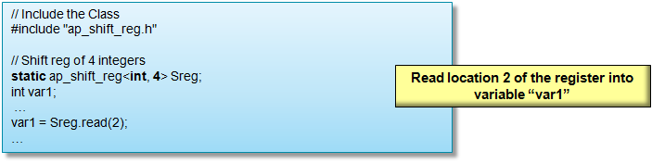
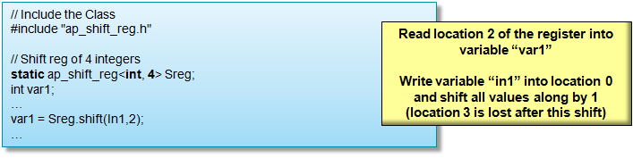
Using ap_shift_reg class
Read from the shift register
Read from and write to the shift register

Slide 99
Using ap_shift_reg class
Read from the shift register
Read from and write to the shift register

Slide 100
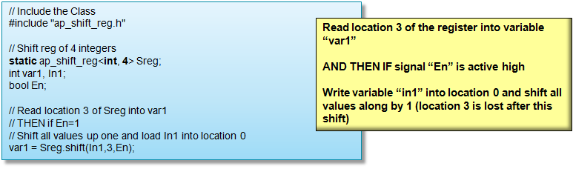
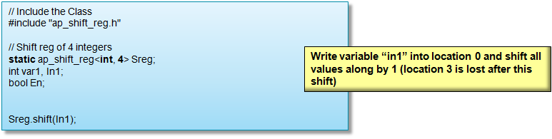
Using ap_shift_reg class
Read from and optionally write to the shift register
Shift only

Slide 101
Using ap_shift_reg class
Read from and optionally write to the shift register
Shift only

Slide 102
Linear Algebra Library
Provides a number of commonly used linear algebra functions
  All functions in this library use two-dimensional arrays to represent matrices
Functions | Data Types | Description
cholesky | float ap_fixed x_complex<float> x_complex<ap_fixed> | Computes the Cholesky decomposition of input matrix A, returning matrix L. Matrix L can be upper or lower triangular
cholesky_inverse | float ap_fixed x_complex<float> x_complex<ap_fixed> | Computes the inverse of symmetric positive definite input matrix A by the Cholesky decomposition method, producing matrix InverseA
matrix_multiply | float ap_fixed x_complex<float> x_complex<ap_fixed> | Computes the product of two matrices, returning a third matrix
qrf | float x_complex<float> | Computes the full QR factorization (QR decomposition) of input matrix A, producing orthogonal output matrix Q and upper-triangular matrix R
qr_inverse | float x_complex<float> | Computes the inverse of input matrix A by the QR factorization method, producing matrix InverseA
svd | float x_complex<float> | Computes the singular value decomposition of input matrix A, producing matrices U, S and V
Notes:
Do not support potrf
Deprecated and Unsupported Features

Slide 103
Libraries Support -
Vitis Vision

Slide 104
Migrating HLS Video Library to Vitis vision
The HLS video library has been deprecated.
  All the functions and most of the infrastructure available in HLS video library are now available in Vitis vision with their names changed and some modifications.
  These HLS video library functions ported to Vitis vision supports build flow also.
Vitis Vision Library
  The Vitis Vision library is a set of 90+ kernels, optimized for Xilinx™ FPGAs, AI Engine™, and SoCs, based on the OpenCV computer vision library.
  All the functions under L1 folder of the Vitis Vision library can be built through Vitis HLS flow in the following two modes:
    Tcl Script Mode
    GUI Mode
  Github:
    https://github.com/Xilinx/Vitis_Libraries/tree/master/vision

Slide 105
AXI Video Interface Functions
Vitis vision has functions that will transform the xf::cv::Mat into Xilinx® Video Streaming interface and vice-versa
  xf::cv::AXIvideo2xfMat() and xf::cv::xfMat2AXIVideo() act as video interfaces to the Ips
  cvMat2AXIvideoxf<NPC> and AXIvideo2cvMatxf<NPC> are used on the host side
Video Library Function | Description
AXIvideo2xfMat | Converts data from an AXI4 video stream representation to xf::cv::Mat format.
xfMat2AXIvideo | Converts data stored as xf::cv::Mat format to an AXI4 video stream.
cvMat2AXIvideoxf | Converts data stored as cv::Mat format to an AXI4 video stream
AXIvideo2cvMatxf | Converts data from an AXI4 video stream representation to cv::Mat format.

Slide 106
Video Libraries Supported in Vitis HLS
C video libraries
  Available within Vitis HLS tool header files
    hls_video.h library
    hls_opencv.h library
Enable migration of OpenCV designs for use with the Vitis HLS tool
HLS videoVitis Vision library is intended to replace many basic OpenCV functions
  Similar interfaces and algorithms to OpenCV
  Focus on image processing functions implemented in FPGA fabric such as full HD video processing
  Includes FPGA-specific optimizations
    Fixed-point operations instead of floating point
    On-chip line buffers and window buffers
  Not necessarily bit-accurate
  Libraries support standard AXI4 interfaces for easy system integration

Slide 107
Video Library Functions
C++ code contained in hls namespace: #include “hls_video.h”
Similar interface; equivalent behavior with OpenCV
  OpenCV library: cvScale(src, dst, scale, shift);
  HLS video library: hls::Scale<...>(src, dst, scale, shift);
Some constructor arguments have corresponding or replacement template parameters
  OpenCV library: cv::Mat mat(rows, cols, CV_8UC3);
  HLS video library: hls::Mat<ROWS, COLS, HLS_8UC3> mat(rows, cols);
    ROWS and COLS specify the maximum size of an image processed

Slide 108
Video Library Supported Functions
Video Data Modeling
Memory Window Buffer | Memory Line Buffer
AXI4-Stream I/O Functions
AXIvideo2xfMat | xfMat2AXIvideo
cvMat2AXIvideoxf | AXIvideo2cvMatxf
OpenCV interface functions
cvMat2AXIvideo | AXIvideo2cvMat
Videos functions
addS | AddWeighted | Cmp | CmpS | Max
MaxS | Min | MinS | PaintMask | Reduce
Zero | Sum | SubS | SubRS | Set
Absdiff | And | Dilate | Duplicate | EqualizeHist
erode | FASTX | Filter2D | GaussianBlur | Harris
CornerHarris | HoughLines2 | Integral | Merge | MinMaxLoc
Mul | Not | Range | Resize | sobel
split | Threshold | Scale | CvtColor
InitUndistortRectifyMapInverse |  |  | Avg, mean, AvgStddev

Slide 109
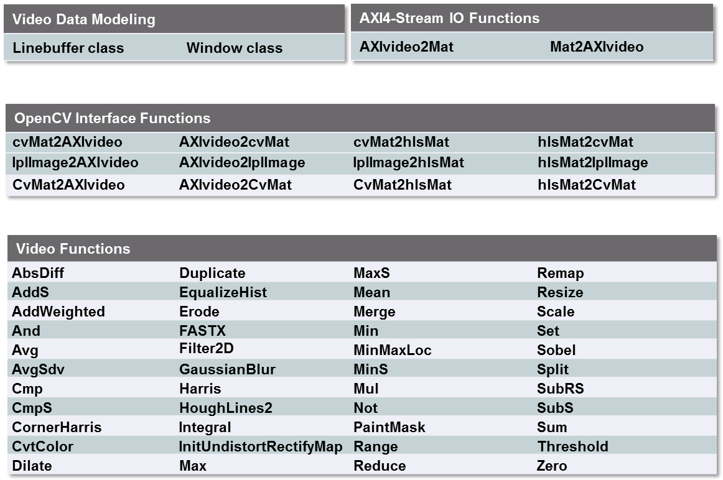
Video Library Supported Functions
Video Data Modeling
Memory Window Buffer | Memory Line Buffer
AXI4-Stream I/O Functions
AXIvideo2xfMat | xfMat2AXIvideo
cvMat2AXIvideoxf | AXIvideo2cvMatxf
OpenCV interface functions
cvMat2AXIvideo | AXIvideo2cvMat
Videos functions
addS | AddWeighted | Cmp | CmpS | Max
MaxS | Min | MinS | PaintMask | Reduce
Zero | Sum | SubS | SubRS | Set
Absdiff | And | Dilate | Duplicate | EqualizeHist
erode | FASTX | Filter2D | GaussianBlur | Harris
CornerHarris | HoughLines2 | Integral | Merge | MinMaxLoc
Mul | Not | Range | Resize | sobel
split | Threshold | Scale | CvtColor
InitUndistortRectifyMapInverse |  |  | Avg, mean, AvgStddev

Slide 110
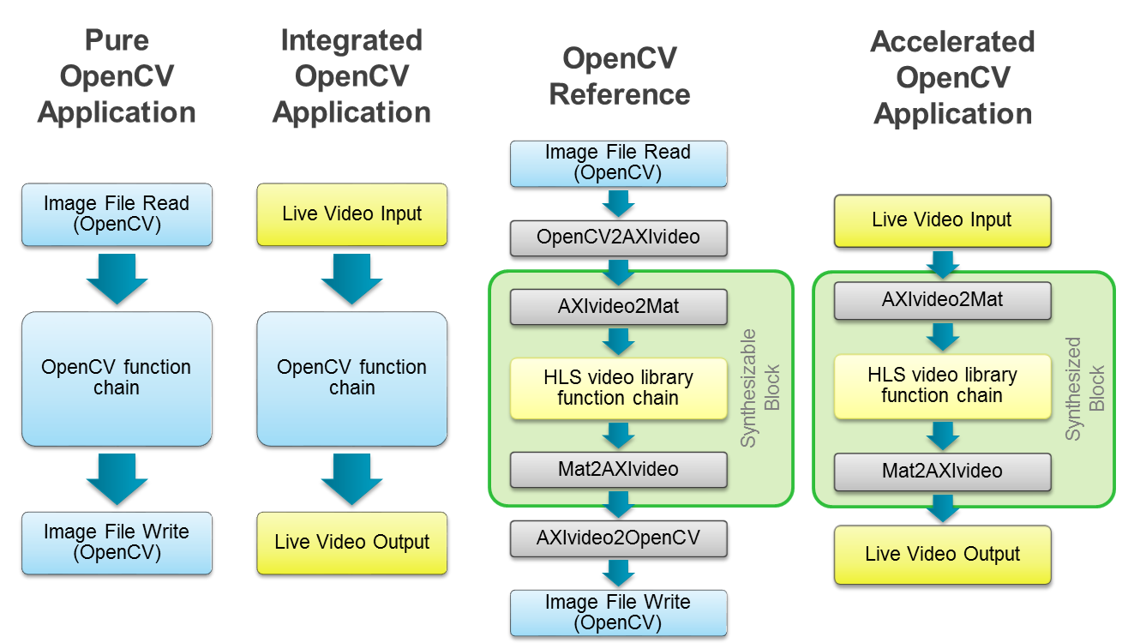
Using OpenCV in FPGA Designs

Slide 111
Using OpenCV in FPGA Designs

Slide 112
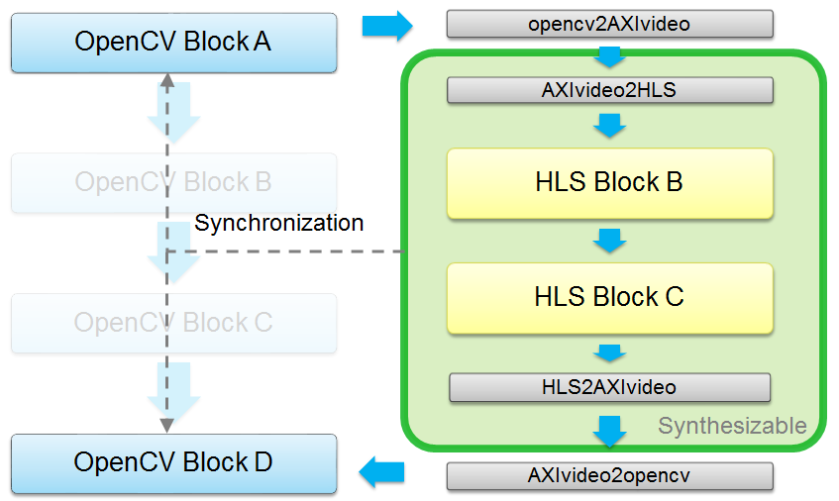
Partitioned OpenCV Application

Slide 113
Partitioned OpenCV Application

Slide 114
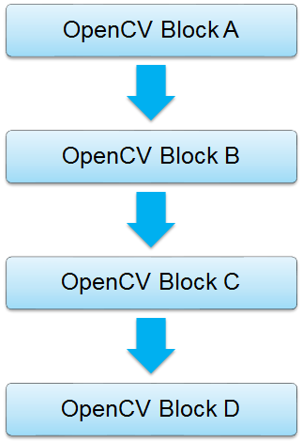
OpenCV Design Flow
Develop OpenCV application on desktop
Run OpenCV application on ARM® cores
without modification
Abstract FPGA portion using I/O functions
Replace OpenCV function calls with
synthesizable code
Run HLS to generate FPGA accelerator
Replace call to synthesizable code with call to
FPGA accelerator

Slide 115
OpenCV Design Flow
Develop OpenCV application on desktop
Run OpenCV application on ARM® cores
without modification
Abstract FPGA portion using I/O functions
Replace OpenCV function calls with
synthesizable code
Run HLS to generate FPGA accelerator
Replace call to synthesizable code with call to
FPGA accelerator

Slide 116
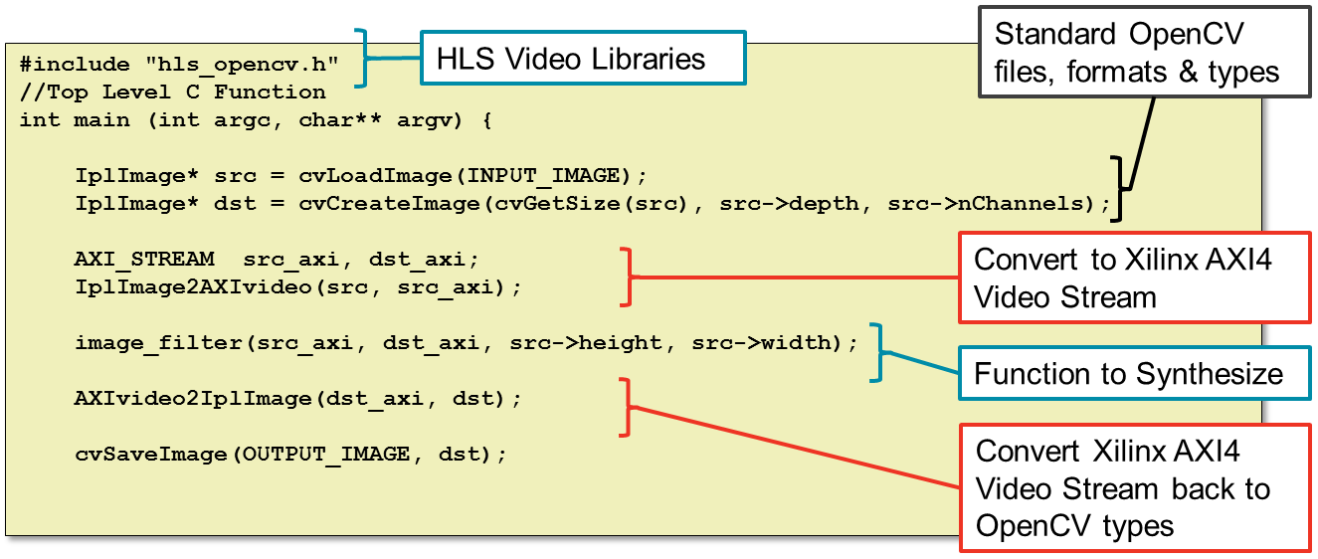
C Testbench: Interface Library Example
Interface libraries convert to/from OpenCV image to HLS type
  HLS MAT format: synthesizable and AXI4 Stream support

Slide 117
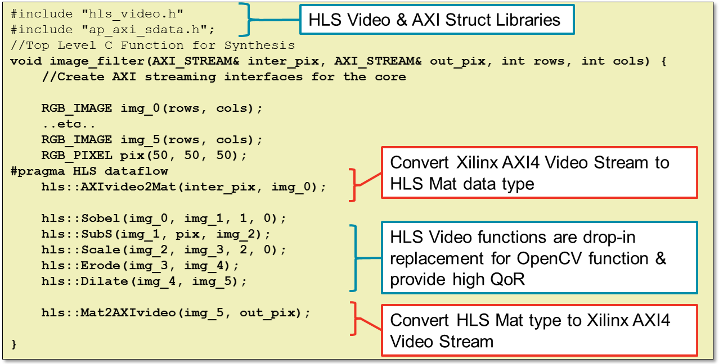
Synthesizable C Function Example

Slide 118
Summary

Slide 119
Summary
Vitis HLS supports C, C++
Vast majority of constructs are synthesizable provided they are statically defined at compile time
Some of the unsupported constructs are
  System calls and function pointer
  Forward declared data type
  Recursive type functions
  Dynamic memory allocation
  Dynamic virtual calls
  Pointer reinterpretation
Multi-access pointer is a pointer which is read and written to multiple times
  Must be marked as volatile or reads and writes will be optimized away
  Cannot be rigorously validated with C simulation
  Require a depth specification for RTL simulation

Slide 120
Summary
Vitis HLS supports C, C++, and SystemC
  Vast majority of constructs are synthesizable provided they are statically defined at compile time
Some of the unsupported constructs are
  System calls and function pointer
  Forward declared data type
  Recursive type functions
  Dynamic memory allocation
  Dynamic virtual calls
  Pointer reinterpretation
Multi-access pointer is a pointer which is read and written to multiple times
  Must be marked as volatile or reads and writes will be optimized away
  Cannot be rigorously validated with C simulation
  Require a depth specification for RTL simulation

Slide 121
Summary
When struct is passed as a pointer the data are accessed as pass-by-reference
When struct is not passed a pointer the data are accessed as by value
Stream can be used instead of multiple-access pointer
Vitis HLS provides support for FFT, FIR, SRL
Stream and shift registers classes may model and implement hardware better
Vitis Vision

Slide 122
Summary
When struct is passed as a pointer the data are accessed as pass-by-reference
When struct is not passed a pointer the data are accessed as by value
When pointer arithmetic is performed, argument may be implemented as ap_bus or ap_fifo
Stream can be used instead of multiple-access pointer
Vitis HLS provides support for FFT, FIR, SRL, and Linear Algebra
Stream and shift registers classes may model and implement hardware better
HLS video librariesVitis Vision
  Drop-in replacement for OpenCV and provide high QoR

