Slide 1
Lab2 Intro
Improving Performance
XUP

Slide 2
Objectives
After completing this lab, you will be able to:
  Add directives to your design
  Observe the effect of PIPELINE-ing functions
  Improve the performance using various directives

Slide 3
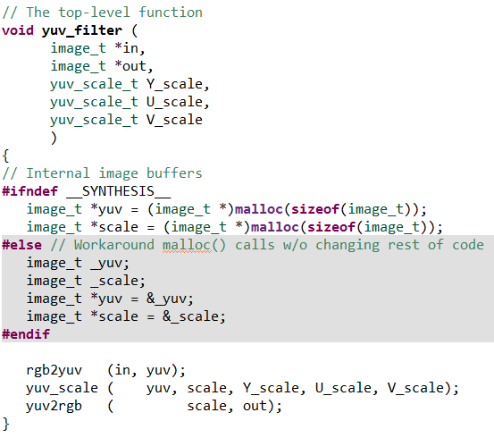
The Design
The design consists of YUV filter typically used in video processing. The design consists of three functions – rgb2yuv, yuv_scale, and yuv2rgb
  Each of these functions iterates over the
  entire source image, requiring a single
  source pixel to produce a pixel in the result
  image
  The scale function simply applies individual
  scale factors, supplied through top-level
  arguments

Slide 4
Procedure
Create a Vitis HLS project by executing script from the terminal
Open the created project in Vitis HLS GUI and analyze
Apply TRIPCOUNT directive using PRAGMA
Apply PIPELINE directive, generate solution, and analyze output
Apply DATAFLOW directive to improve performance
Export and Implement the design

Slide 5
Summary
In this lab you learned that even though this design could not be pipelined at the top-level, a strategy of pipelining the individual loops and then using dataflow optimization to make the functions operate in parallel was able to achieve the same high throughput, processing one pixel per clock. When DATAFLOW directive is applied, the default memory buffers (of ping-pong type) are automatically inserted between the functions. Using the fact that the design used only sequential (streaming) data accesses allowed the costly memory buffers associated with dataflow optimization to be replaced with simple 2 element FIFOs using the Dataflow command configuration

