Slide 1
Improving Area and Resources
XUP

Slide 2
Objectives
After completing this module, you will be able to:
  Describe how arbitrary precision data types can reduce resource utilization
  List various area optimization techniques
  List means by which resource utilization can be reduced

Slide 3
Outline
Optimizing Resource Utilization
Reducing Area Usage
Summary

Slide 4
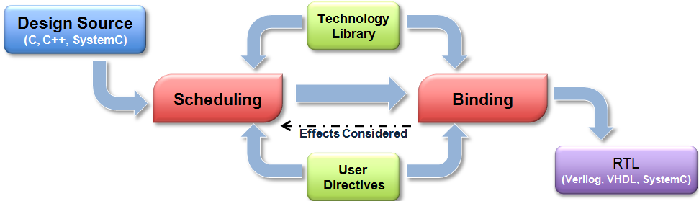
Review: Control Scheduling & Binding
Scheduling & Binding
  Scheduling and Binding are the processes at the heart of HLS
BIND_OP/ BIND_STORAGE
  Can be used to specify a device resource for implementation
  Can be used to assign a specific memory type in the RTL
The allocation directive
  Can be used to limit the number of operation in scheduling & binding stages

Slide 5
Review: Control Scheduling & Binding
Scheduling & Binding
  Scheduling and Binding are the processes at the heart of HLS
Binding configuration
  Can be used to minimize the number of operations
BIND_OP/ BIND_STORAGE
  Can be used to specify a device resource for implementation
  Can be used to assign a specific memory type in the RTL
The allocation directive
  Can be used to limit the number of operation in scheduling & binding stages
The resource directive
  Can be used to specify which cores are to be used during binding

Slide 6
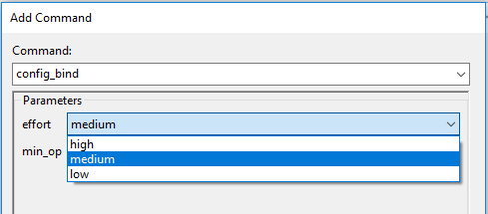
Configuring Binding
Binding is controlled via a configuration command
  The effort levels determine how much time is spent trying to map many operators onto fewer cores
  As with all effort levels, they are worth using if you can see the design close to what is required
    Else the tool will spend time exploring for possibilities
    And simply increase run time
    Use efforts judiciously
Binding can be configured to minimize specific operators
  Can be used to direct Vivado HLS to synthesize with the minimum number of operations
  The configuration command overrides muxing costs and can be used to force sharing
    Works on all scopes in a design
Operators which can be minimized and passed as arguments by listing in the min_op field
• add - Addition
• sub - Subtraction
• mul - Multiplication
• icmp - Integer Compare
• sdiv - Signed Division
• udiv - Unsigned Division
• srem - Signed Remainder
• urem - Unsigned Remainder
• lshr - Logical Shift-Right
• ashr - Arithmetic Shift-Right
• shl - Shift-Left
Notes:
config_bind已经弃用

Slide 7
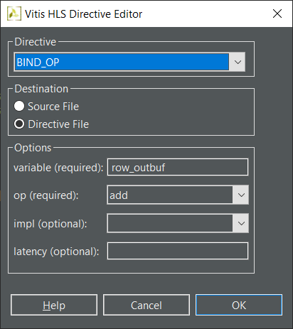
BIND_OP: Specific a device resource
BIND_OP specifies a device resource for implementation
  If not, Vitis HLS tool automatically determines the resource to use
Different specify option
  -op: Operation to bind to a specific implementation resource
  -impl: Implementation to use for the specified operation
  -latency: Latency for the operation

Slide 8
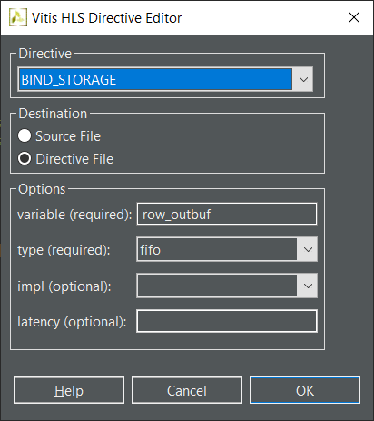
BIND_STORAGE: Assign a specific memory
BIND_STORAGE assigns a specific memory type in the RTL
  If not, Vitis HLS tool determines the memory type to assign
  Controls the array implementation as a single/dual-port RAM
Different specify option
  -type: Type of memory to bind to the specified variable
    Support types: fifo, ram_1p, ram_1wnr, ram_2p, ram_s2p, ram_t2p,
    rom_1p, rom_2p, and rom_np
  -impl: Implementation for the specified memory type
    Support impementations: bram, bram_ecc, lutram, uram, uram_ecc and srl
  -latency: Default latency for the binding of the storage type to the implementation

Slide 9
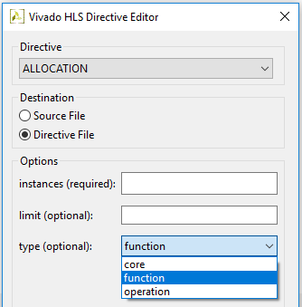
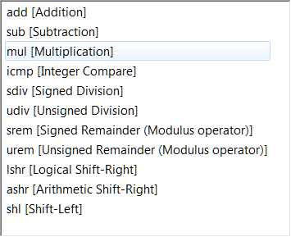
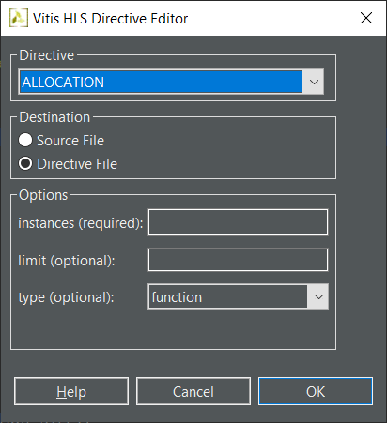
Allocation: Limit the Numbers
Allocation directive limits different types
  Type: Operation
    The instances are the operators
    Add, mul, urem, etc.
  Type: Core
    The instances are the cores
    Adder, Addsub, PipeMult2s, etc
  Type: Functions
    The functions in the code
    Discussed in more detail later
Allocations are defined for a scope
  Like all directives, allocations are set for the scope they are applied in
    If the directive is applied to a function, loop or region, it does not include
    objects outside that scope
Operators and Cores are listed in the VITIS HLS Library Guide
21- 9

Slide 10
Allocation: Limit the Numbers
Allocation directive limits different types
  Type: Operation
    The instances are the operators
    Add, mul, urem, etc.
  Type: Core
    The instances are the cores
    Adder, Addsub, PipeMult2s, etc
  Type: Functions
    The functions in the code
    Discussed in more detail later
Allocations are defined for a scope
  Like all directives, allocations are set for the scope they are applied in
    If the directive is applied to a function, loop or region, it does not include
    objects outside that scope
Operators and Cores are listed in the VITIS HLS Library Guide
21- 10

Slide 11
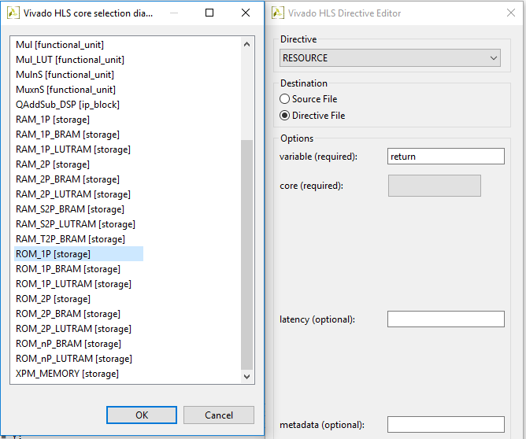
Additional Control: Specify Resources
User control of Resources
  The resource directive gives user control over the specific resource (core) used to implement operations
    Select the scope & right-click to apply the directive
    Select “core” for a list of resources
    Specify the variable
Multiple line coding caveat
  If multiple operations occur on a single line,
  a temporary variable is required to isolate the specific operation
In this example, “data” is implemented with a 2-stage pipelined multiplier
    a=b*c*d
    data= c*d;
    a = b*data;

Slide 12
Reducing Area Usage

Slide 13
Improving Area/Resource Utilization
Control the number of elements
  Directives can be used to control scheduling and binding
Control the design hierarchy
  Like RTL synthesis, removing the hierarchy can help optimize across function and loop boundaries
    Functions can be inlined
    Loops can be unrolled
Array implementation
  VITIS HLS provides directives for combining memories
    Allowing a single large memory to be used instead of multiple smaller memories
Bit-width optimization
  Bit width impact the size of the storage elements and operators
  Arbitrary precision types ensure correct operator sizing

Slide 14
Improving Area/Resource Utilization
Control the number of elements
  Directives can be used to control scheduling and binding
Control the design hierarchy
  Like RTL synthesis, removing the hierarchy can help optimize across function and loop boundaries
    Functions can be inlined
    Loops can be unrolled
Array implementation
  VITIS HLS provides directives for combining memories
    Allowing a single large memory to be used instead of multiple smaller memories
Bit-width optimization
  Bit width impact the size of the storage elements and operators
  Arbitrary precision types ensure correct operator sizing

Slide 15
Review: Functions & RTL Hierarchy
Each function is translated into an RTL block
  Verilog module, VHDL entity
Source Code
RTL hierarchy
void A() { ..body A..}
void B() { ..body B..}
void C() {
B();
}
void D() {
B();
}
void foo_top() {
A(…);
C(…);
D(…)
}
foo_top
C
B
A
D
B
my_code.c
Functions can be inlined – the hierarchy removed & the function dissolved into the surrounding function
21- 15

Slide 16
Review: Functions & RTL Hierarchy
Each function is translated into an RTL block
  Verilog module, VHDL entity
Source Code
RTL hierarchy
void A() { ..body A..}
void B() { ..body B..}
void C() {
B();
}
void D() {
B();
}
void foo_top() {
A(…);
C(…);
D(…)
}
foo_top
C
B
A
D
B
my_code.c
Functions can be inlined – the hierarchy removed & the function dissolved into the surrounding function
21- 16

Slide 17
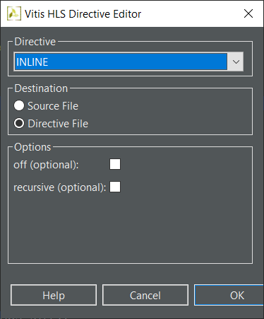
Controlling Inlining
Vitis HLS performs some inlining automatically
  This is performed on small logic functions if Vitis HLS determines area or performance will benefit
User Control
  Functions can be specifically inlined
    The function itself is inlined
  Optionally recursively down the hierarchy
  Optionally everything within a region can be inlined
    Everything named region or a function or a loop
  Optionally inlining can be explicitly prevented
    Turn inlining off
Inlining functions allows for greater optimization
  Like ungrouping RTL hierarchies: optimization across boundaries
  Like ungrouping RTL hierarchies it can result in lots of operations & impact run time
21- 17

Slide 18
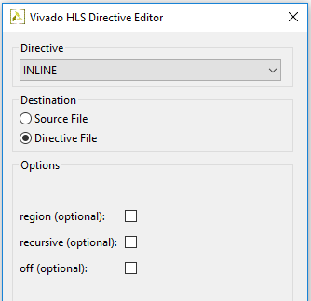
Controlling Inlining
Vitis HLS performs some inlining automatically
  This is performed on small logic functions if Vitis HLS determines area or performance will benefit
User Control
  Functions can be specifically inlined
    The function itself is inlined
  Optionally recursively down the hierarchy
  Optionally everything within a region can be inlined
    Everything named region or a function or a loop
  Optionally inlining can be explicitly prevented
    Turn inlining off
Inlining functions allows for greater optimization
  Like ungrouping RTL hierarchies: optimization across boundaries
  Like ungrouping RTL hierarchies it can result in lots of operations & impact run time
21- 18

Slide 19
Function Inlining
Inlining can be used to remove function hierarchy
No Inlining
int sumsub_func (int *in1, int *in2, int *outSum, int *outSub) {
*outSum = *in1 + *in2;
*outSub = *in1 - *in2;
}
int shift_func (int *in1, int *in2, int *outA, int *outB) {
*outA = *in1 >> 1;
*outB = *in2 >> 2;
}
void add_sub_pass(int A, int B, int *C, int *D) {
int apb, amb;
int a2, b2;
sumsub_func(&A,&B,&apb,&amb);
sumsub_func(&apb,&amb,&a2,&b2);
shift_func(&a2,&b2,C,D);
}
Inlining
add_sub_pass
add_sub_pass
A
B
A
B
sumsub_func
+
-
A+B
A-B
A
B>>1
Zero Area
sumsub_func
+
-
+
A+B
A-B
2A
A+B
A-B
2B
-
shift_func
2 Adders
2 Subtractors
Inlining allows optimization to be performed across function hierarchies
>>1
>>2
Like RTL ungrouping, too much inlining can create a lot of logic and slow runtime
A
B>>1
21- 19

Slide 20
Function Inlining
Inlining can be used to remove function hierarchy
No Inlining
int sumsub_func (int *in1, int *in2, int *outSum, int *outSub) {
*outSum = *in1 + *in2;
*outSub = *in1 - *in2;
}
int shift_func (int *in1, int *in2, int *outA, int *outB) {
*outA = *in1 >> 1;
*outB = *in2 >> 2;
}
void add_sub_pass(int A, int B, int *C, int *D) {
int apb, amb;
int a2, b2;
sumsub_func(&A,&B,&apb,&amb);
sumsub_func(&apb,&amb,&a2,&b2);
shift_func(&a2,&b2,C,D);
}
Inlining
add_sub_pass
add_sub_pass
A
B
A
B
sumsub_func
+
-
A+B
A-B
A
B>>1
Zero Area
sumsub_func
+
-
+
A+B
A-B
2A
A+B
A-B
2B
-
shift_func
2 Adders
2 Subtractors
Inlining allows optimization to be performed across function hierarchies
>>1
>>2
Like RTL ungrouping, too much inlining can create a lot of logic and slow runtime
A
B>>1
21- 20

Slide 21
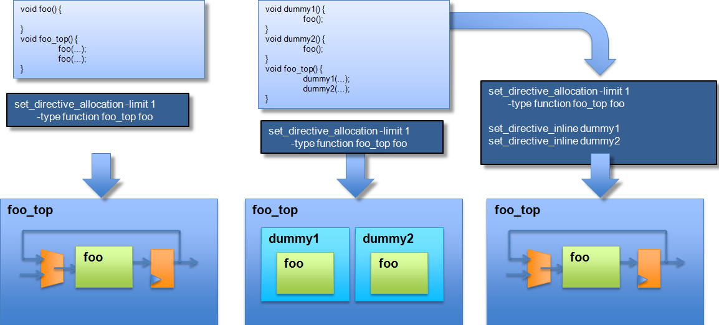
Inline and Allocation: Shape the Hierarchy
Easy to Share
Cannot be shared
Controlling Sharing
One RTL block is reused for both instances of function foo
Function foo is not within the immediate scope of foo_top
Inlining brings foo into function foo_top where it can be shared
21- 21

Slide 22
Inline and Allocation: Shape the Hierarchy
Easy to Share
Cannot be shared
Controlling Sharing
One RTL block is reused for both instances of function foo
Function foo is not within the immediate scope of foo_top
Inlining brings foo into function foo_top where it can be shared
21- 22

Slide 23
Loops
By default, loops are rolled
  Each C loop iteration ➔ Implemented in the same state
  Each C loop iteration ➔ Implemented with same resources
For Area optimization
N
foo_top
void foo_top (…) {
...
Add: for (i=3;i>=0;i--) {
b = a[i] + b;
...
}
Synthesis
+
b
a[N]
Keeping loops rolled maximizes sharing across loop iterations: each iteration of the loop uses the same hardware resources
21- 23

Slide 24
Loops
By default, loops are rolled
  Each C loop iteration ➔ Implemented in the same state
  Each C loop iteration ➔ Implemented with same resources
For Area optimization
N
foo_top
void foo_top (…) {
...
Add: for (i=3;i>=0;i--) {
b = a[i] + b;
...
}
Synthesis
+
b
a[N]
Keeping loops rolled maximizes sharing across loop iterations: each iteration of the loop uses the same hardware resources
21- 24

Slide 25
Loop Merging
Loop merging can remove the redundant computation among multiple (related) loops
  Improving area and performance
Allows Vitis HLS to perform optimizations
  Optimization cannot occur across loop boundaries
My_Region: {
#pragma HLS merge loop
for (i = 0; i < N; ++i)
A[i] = B[i] + 1;
for (i = 0; i < N; ++i)
C[i] = A[i] / 2;
}
Merge
for (i = 0; i < N; ++i) {
A[i] = B[i] + 1;
C[i] = A[i] / 2;
}
Effective code after compiler transformation
for (i = 0; i < N; ++i)
C[i] = (B[i] + 1) / 2;
Removes A[i], any address logic and any potential memory accesses
21- 25

Slide 26
Loop Merging & Flattening
Loop merging & flattening can remove the redundant computation among multiple (related) loops
  Improving area and performance(and sometimes performance)
Allows Vitis HLS to perform optimizations
  Optimization cannot occur across loop boundaries
My_Region: {
#pragma HLS merge loop
for (i = 0; i < N; ++i)
A[i] = B[i] + 1;
for (i = 0; i < N; ++i)
C[i] = A[i] / 2;
}
Merge
for (i = 0; i < N; ++i) {
A[i] = B[i] + 1;
C[i] = A[i] / 2;
}
Effective code after compiler transformation
for (i = 0; i < N; ++i)
C[i] = (B[i] + 1) / 2;
Removes A[i], any address logic and any potential memory accesses
21- 26

Slide 27
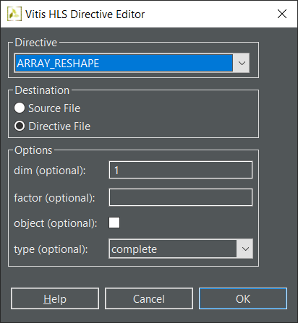
Mapping Arrays
The arrays in the C model may not be ideal for the available RAMs
  The code may have many small arrays, each array is mapped into a block RAM or UltraRAM
  Basic block RAM unit is 18K, the array may not utilize the RAMs very well
Array Mapping
  Mapping combines smaller arrays into larger arrays
    Reduce the number or block RAMs required
  Specify the array variable to be mapped
  Give all arrays to be combined the same instance name
  If an array is larger than 18K, they are automatically mapped into multiple 18K units?
ARRAY_RESHAPE directive supports mapping small arrays into a larger one
21- 27

Slide 28
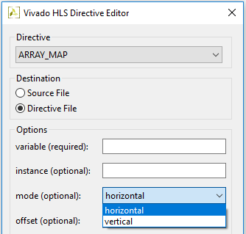
Mapping Arrays
The arrays in the C model may not be ideal for the available RAMs
  The code may have many small arrays, each array is mapped into a block RAM or UltraRAM
  Basic block RAM unit is 18K, the array may not utilize the RAMs very well
Array Mapping
  Mapping combines smaller arrays into larger arrays
    Allows arrays to be reconfigured without code edits
    Reduce the number or block RAMs required
  Specify the array variable to be mapped
  Give all arrays to be combined the same instance name
  If an array is larger than 18K, they are automatically mapped into multiple 18K units?
Vivado HLS provides options as to the type of mapping
  Combine the arrays without impacting performance
    Vertical & Horizontal mapping
ARRAY_RESHAPE directive supports mapping small arrays into a larger one
Global Arrays
  When a global array is mapped all arrays involved are promoted to global
  When arrays are in different functions, the target becomes global
Arrays which are function arguments
  All must be part of the same function interface
21- 28

Slide 29
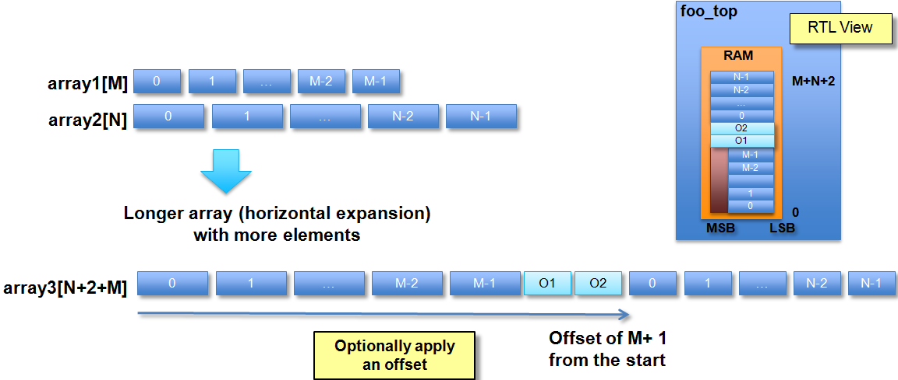
Horizontal Mapping
Horizontal Mapping
  Combines multiple arrays into longer (horizontal) array
  Optionally allows the arrays to be offset
    The default is to concatenate after the last element
    The first array specified (in GUI or Tcl script) starts at location zero
21- 29

Slide 30
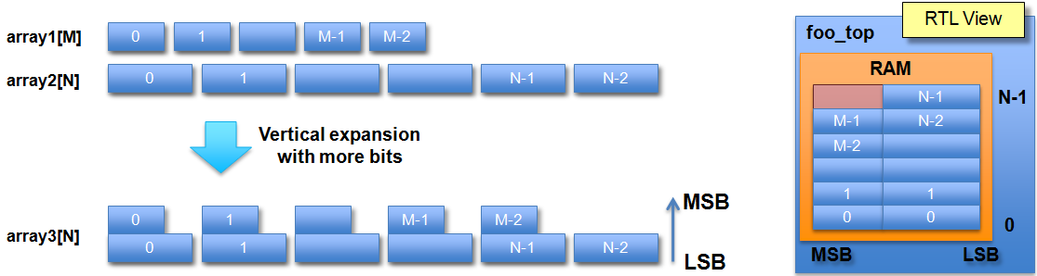
Vertical Mapping
Vertical Mapping
  Combines multiple arrays in to an array with more bits
  The first array specified (in Tcl or GUI) starts at the LSB
Vertical Mapping for performance
  Creates RAMs with wide words ➔ Parallel accesses

Slide 31
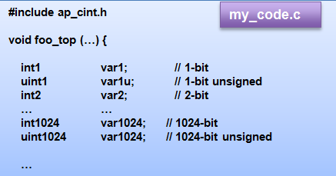
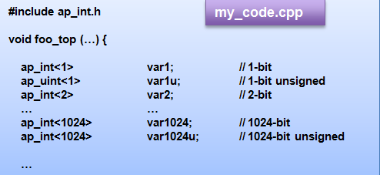
Arbitrary Precision Integers
C and C++ have standard types created on the 8-bit boundary
  char (8-bit), short (16-bit), int (32-bit), long long (64-bit)
    Also provides stdint.h (for C), and stdint.h and cstdint (for C++)
    Types: int8_t, uint16_t, uint32_t, int_64_t etc.
  Implemented hardware sometimes need different sizes of data types
  They result in hardware which is not bit-accurate and can give sub-standard QoR
Vitis HLS provides both integer and fixed-point arbitrary precision data types for C++
  Allow any arbitrary bit-width to be specified
  Will simulate with bit-accuracy
21- 31

Slide 32
Arbitrary Precision Integers
C and C++ have standard types created on the 8-bit boundary
  char (8-bit), short (16-bit), int (32-bit), long long (64-bit)
    Also provides stdint.h (for C), and stdint.h and cstdint (for C++)
    Types: int8_t, uint16_t, uint32_t, int_64_t etc.
  Implemented hardware sometimes need different sizes of data types
  They result in hardware which is not bit-accurate and can give sub-standard QoR
Vitis HLS provides bit-accurate types in both C and C++provides both integer and fixed-point arbitrary precision data types for C++
  Plus SystemC types can be used in C++
  Allow any arbitrary bit-width to be specified
  Will simulate with bit-accuracy
21- 32

Slide 33
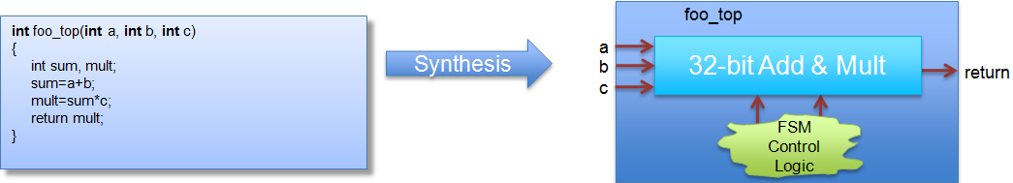
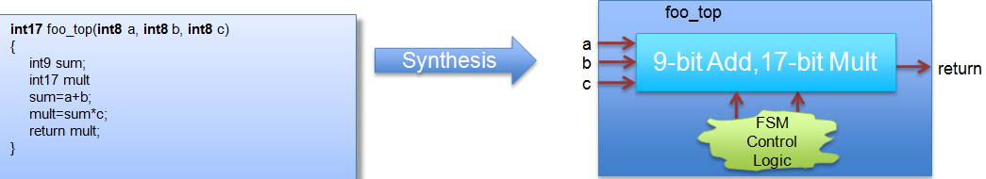
Why are Arbitrary Precision types Needed?
Code using native C int type
However, if the inputs will only have a max range of 8-bit
  Arbitrary precision data-types should be used
  It will result in smaller & faster hardware with full precision, full precision can be simulated/validated with C simulation and hardware will behave the same
21- 33

Slide 34
Why are Arbitrary Precision types Needed?
Code using native C int type
However, if the inputs will only have a max range of 8-bit
  Arbitrary precision data-types should be used
  It will result in smaller & faster hardware with full precision, full precision can be simulated/validated with C simulation and hardware will behave the same
21- 34

Slide 35
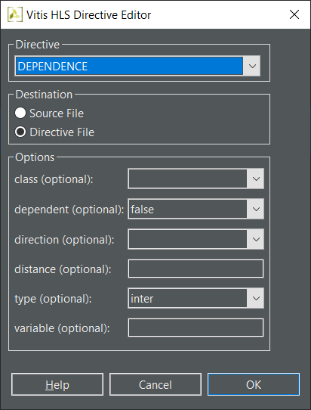
DEPEDENCE Directive
for (i=0;i<N;i++) {
A[i]=x;
y=A[i];
}
Loop-independent dependence
  The same element is accessed in a single loop iteration
Loop-carried dependence
  The same element is accessed from a different loop iteration
DEPENDENCE directive allows to explicitly define the dependencies and eliminate a false dependence
for (i=0;i<N;i++)
{
A[i]=A[i-1]*2;
}
for (row = 0; row < rows + 1; row++) {
L2: for (col = 0; col < cols + 1; col++) {
#pragma HLS PIPELINE II=1
#pragma HLS dependence variable=buff_A type=inter dependent=false
#pragma HLS dependence variable=buff_B type=inter dependent=false
if (col < cols) {
buff_A[2][col] = buff_A[1][col]; // read from buff_A[1][col]
buff_A[1][col] = buff_A[0][col]; // write to buff_A[1][col]
buff_B[1][col] = buff_B[0][col];
temp = buff_A[0][col];} } }

Slide 36
DEPEDENCE Directive
for (i=0;i<N;i++) {
A[i]=x;
y=A[i];
}
Loop-independent dependence
  The same element is accessed in a single loop iteration
Loop-carried dependence
  The same element is accessed from a different loop iteration
DEPENDENCE directive allows to explicitly define the dependencies and eliminate a false dependence
for (i=0;i<N;i++)
{
A[i]=A[i-1]*2;
}
for (row = 0; row < rows + 1; row++) {
L2: for (col = 0; col < cols + 1; col++) {
#pragma HLS PIPELINE II=1
#pragma HLS dependence variable=buff_A type=inter dependent=false
#pragma HLS dependence variable=buff_B type=inter dependent=false
if (col < cols) {
buff_A[2][col] = buff_A[1][col]; // read from buff_A[1][col]
buff_A[1][col] = buff_A[0][col]; // write to buff_A[1][col]
buff_B[1][col] = buff_B[0][col];
temp = buff_A[0][col];} } }

Slide 37
Summary

Slide 38
Summary
Resource utilization can be reduced using allocation and binding controls
Arbitrary precision data types help controlling both the area and resource utilization
The design structure can be controlled by
  Inlining functions: direct impact on RTL hierarchy & optimization possibilities
  Loops: direct impact on reuse of resources
  Arrays: direct impact on the RAM
Major area optimization techniques
  Minimize bit widths
  Map smaller arrays into larger arrays
    Make better use of existing RAMs
  Control loop hierarchy
  Control function call hierarchy
  Control the number of operators and cores

