Slide 1
Introduction to High-Level Synthesis with Vitis HLS
XUP

Slide 2
Objectives
After completing this module, you will be able to:
  Describe the high level synthesis flow
  Understand the control and datapath extraction
  Describe scheduling and binding phases of the HLS flow
  List the priorities of directives set by Vitis HLS
  List comprehensive language support in Vitis HLS
  Identify steps involved in validation and verification flows

Slide 3
Outline
Introduction to High-Level Synthesis
High-Level Synthesis with Vitis HLS
Language Support
Validation Flow
Summary

Slide 4
Need for High-Level Synthesis
Algorithmic-based approaches are getting popular due to accelerated design time and time to market (TTM)
  Larger designs pose challenges in design and verification of hardware at HDL level
Industry trend is moving towards hardware acceleration to enhance performance and productivity
  CPU-intensive tasks can be offloaded to hardware accelerator in FPGA
  Hardware accelerators require a lot of time to understand and design
Vitis HLS tool converts algorithmic description written in C-based design flow into hardware description (RTL)
  Elevates the abstraction level from RTL to algorithms
High-level synthesis is essential for maintaining design productivity for large designs

Slide 5
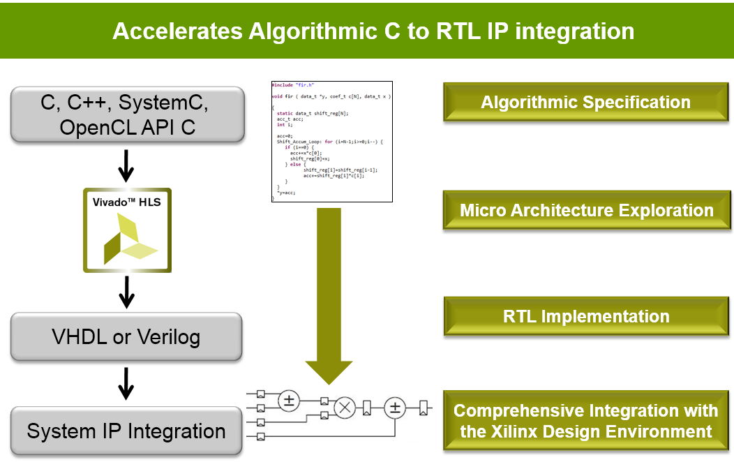

High-Level Synthesis: HLS
High-Level Synthesis
  Creates an RTL implementation from C, C++, OpenCL API C kernel code
  Extracts control and dataflow from the source code
  Implements the design based on defaults and user applied directives
Many implementation are possible from
the same source description
  Smaller designs, faster designs, optimal designs
  Enables design exploration
C, C++, OpenCL API C

Slide 6
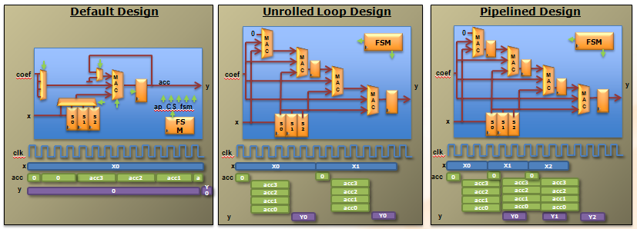
Design Exploration with Directives
…
loop: for (i=3;i>=0;i--) {
if (i==0) {
acc+=x*c[0];
shift_reg[0]=x;
} else {
shift_reg[i]=shift_reg[i-1];
acc+=shift_reg[i]*c[i];
}
}
….
One body of code:
Many hardware outcomes
Before we get into details, let’s look under the hood ….
The same hardware is used for each iteration of the loop:
Small area
Long latency
Low throughput
Different hardware is used for each iteration of the loop:
Higher area
Short latency
Better throughput
Different iterations are executed concurrently:
Higher area
Short latency
Best throughput

Slide 7
Introduction to High-Level Synthesis
How is hardware extracted from C code?
  Control and datapath can be extracted from C code at the top level
  The same principles used in the example can be applied to sub-functions
    At some point in the top-level control flow, control is passed to a sub-function
    Sub-function may be implemented to execute concurrently with the top-level and or other sub-functions
How is this control and dataflow turned into a hardware design?
  Vitis HLS maps this to hardware through scheduling and binding processes
How is my design created?
  How functions, loops, arrays and IO ports are mapped?

Slide 8
HLS: Control Extraction
Code
Control Behavior
void fir (
data_t *y,
coef_t c[4],
data_t x
) {
static data_t shift_reg[4];
acc_t acc;
int i;
acc=0;
loop: for (i=3;i>=0;i--) {
if (i==0) {
acc+=x*c[0];
shift_reg[0]=x;
} else {
shift_reg[i]=shift_reg[i-1];
acc+=shift_reg[i]*c[i];
}
}
*y=acc;
}
Finite State Machine (FSM) states
Function Start
0
For-Loop Start
1
For-Loop End
2
Function End
From any C code example ..
The loops in the C code correlated to states of behavior
This behavior is extracted into a hardware state machine

Slide 9
HLS: Control & Datapath Extraction
Code
Operations
Control Behavior
Control & Datapath Behavior
void fir (
data_t *y,
coef_t c[4],
data_t x
) {
static data_t shift_reg[4];
acc_t acc;
int i;
acc=0;
loop: for (i=3;i>=0;i--) {
if (i==0) {
acc+=x*c[0];
shift_reg[0]=x;
} else {
shift_reg[i]=shift_reg[i-1];
acc+=shift_reg[i]*c[i];
}
}
*y=acc;
}
Finite State Machine (FSM) states
Control Dataflow
RDx
RDc
>=
0
-
RDx
RDc
==
>=
-
==
-
+
1
+
*
*
+
*
+
*
2
WRy
WRy
From any C code example ..
Operations are extracted…
The control is known
A unified control dataflow behavior is created.

Slide 10
High-Level Synthesis: Scheduling & Binding
Scheduling & Binding
  Scheduling and Binding are at the heart of HLS
Scheduling determines in which clock cycle an operation will occur
  Takes into account the control, dataflow and user directives
  The allocation of resources can be constrained
Binding determines which library cell is used for each operation
  Takes into account component delays, user directives
Design Source
(C, C++)
Technology
Library
Scheduling
Binding
User
Directives
RTL
(Verilog, VHDL)

Slide 11
Scheduling
The operations in the control flow graph are mapped into clock cycles
The technology and user constraints impact the schedule
  A faster technology (or slower clock) may allow more operations to occur in the same clock cycle
The code also impacts the schedule
  Code implications and data dependencies must be obeyed
void foo (
…
t1 = a * b;
t2 = c + t1;
t3 = d * t2;
out = t3 – e;
}
a
b
*
c
+
d
*
e
-
out
Schedule 1
*
+
*
-
Schedule 2
*
+
*
-

Slide 12
Binding
Binding is where operations are mapped to cores from the hardware library
  Operators map to cores
Binding Decision: to share
  Given this schedule:
    Binding must use 2 multipliers, since both are in the same cycle
    It can decide to use an adder and subtractor or share one addsub
Binding Decision: or not to share
  Given this schedule:
    Binding may decide to share the multipliers (each is used in a different cycle)
    Or it may decide the cost of sharing (muxing) would impact timing and it may decide not to share them
    It may make this same decision in the first example above too
*
+
*
-
*
+
*
-

Slide 13
High-Level Synthesis with Vitis HLS

Slide 14
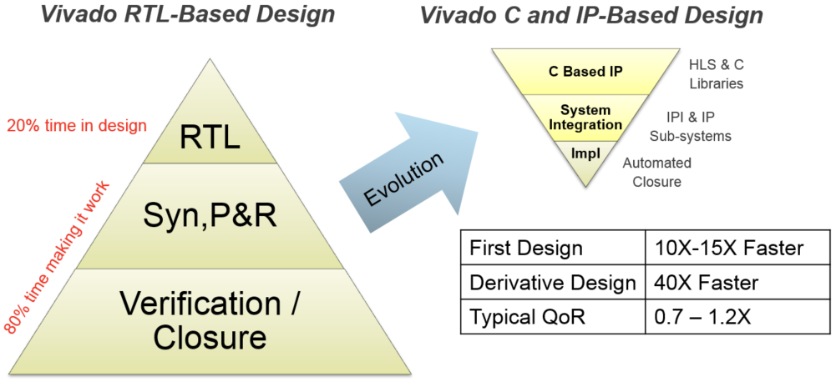
RTL vs High-Level Language
Vitis
Vitis
Notes:
RTL design cycles typically consist of verification and design closure iterations for each block, as well as for the entire design. As a consequence of this methodology, the platform connectivity design never stabilizes, as any change in the differentiated logic can cause an I/O interface (e.g. DDR memory, Ethernet, or PCIe® core) to fail timing requirements. Also, RTL verification cycles no longer allow for exhaustive functional tests prior to hardware bring up.
A high-level design methodology turns the development effort on its head, allowing designers to spend more time designing the value-add logic and less time trying to make it work. This flow provides a 15X reduction in design cycle compared to an RTL design flow.
The main attributes of a high-level methodology are:
Separation of platform development and differentiated logic, allowing designers to focus on the company’s high-value functionality.
Rapid configuration, generation and closure of the platform connectivity, using the Vivado® IP Integrator with board awareness, as well as the Vivado IP systems.
C-based simulation for the differentiated logic, decreasing simulation times by orders of magnitude over traditional RTL simulation.
High-level synthesis with the Vivado HLS tool and C/C++ libraries, as well as the Vivado IP integrator for rapid implementation and system integration from C to silicon.

Slide 15
Vitis HLS Benefits
Productivity
  Verification
    Functional
    Architectural
  Abstraction
    Datatypes
    Interface
    Classes
  Automation
Block level specification AND verification significantly reduced
Video Design Example
Input | C Simulation Time | RTL Simulation Time | Improvement
10 frames 1280x720 | 10s | ~2 days (ModelSim) | ~12000x
RTL (Spec)
RTL (Sim)
C (Spec/Sim)
RTL (Sim)

Slide 16
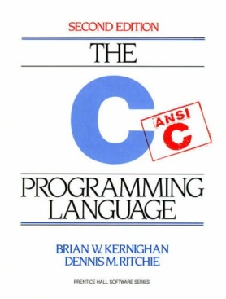






Vitis HLS Benefits
Portability
  Processors and FPGAs
  Technology migration
  Cost reduction
  Power reduction
Design and IP reuse
RTL
RTL
RTL
RTL
RTL
RTL

Slide 17
Vitis HLS Benefits
Permutability
  Architecture Exploration
    Timing
      Parallelization
      Pipelining
    Resources
      Sharing
  Better QoR
Rapid design exploration delivers QoR
rivaling hand-coded RTL
Untimed C
Specification
Area
RTL
Share Resources
RTL
RTL
Insert Pipelines
RTL
Unroll Loops
RTL
Partition Arrays
Timed RTL
Architectures
Performance

Slide 18
Understanding Vitis HLS Synthesis
Vitis HLS
  Determines in which cycle operations should occur (scheduling)
  Determines which hardware units to use for each operation (binding)
  Performs high-level synthesis by :
    Obeying built-in defaults
    Obeying user directives & constraints to override defaults
    Calculating delays and area using the specified technology/device
Priority of directives in Vitis HLS
  Meet Performance (clock & throughput)
    Vitis HLS will allow a local clock path to fail if this is required to meet throughput
    Often possible the timing can be met after logic synthesis
  Then minimize latency
  Then minimize area

Slide 19
The Key Attributes of C code
Functions: All code is made up of functions which represent the design hierarchy: the same in hardware
void fir (
data_t *y,
coef_t c[4],
data_t x
) {
static data_t shift_reg[4];
acc_t acc;
int i;
acc=0;
loop: for (i=3;i>=0;i--) {
if (i==0) {
acc+=x*c[0];
shift_reg[0]=x;
} else {
shift_reg[i]=shift_reg[i-1];
acc+=shift_reg[i] * c[i];
}
}
*y=acc;
}
Top Level IO : The arguments of the top-level function determine the hardware RTL interface ports
Types: All variables are of a defined type. The type can influence the area and performance
Loops: Functions typically contain loops. How these are handled can have a major impact on area and performance
Arrays: Arrays are used often in C code. They can influence the device IO and become performance bottlenecks
Operators: Operators in the C code may require sharing to control area or specific hardware implementations to meet performance
Let’s examine the default synthesis behavior of these …

Slide 20
Functions & RTL Hierarchy
Each function is translated into an RTL block
  Verilog module, VHDL entity
  By default, each function is implemented using a common instance
  Functions may be inlined to dissolve their hierarchy
    Small functions may be automatically inlined
Source Code
RTL hierarchy
void A() { ..body A..}
void B() { ..body B..}
void C() {
B();
}
void D() {
B();
}
void foo_top() {
A(…);
C(…);
D(…)
}
foo_top
C
B
A
D
B
my_code.c
Each function/block can be shared like any other component (add, sub, etc) provided it’s not in use at the same time

Slide 21
Types = Operator Bit-sizes
Code
Operations
Types
void fir (
data_t *y,
coef_t c[4],
data_t x
) {
static data_t shift_reg[4];
acc_t acc;
int i;
acc=0;
loop: for (i=3;i>=0;i--) {
if (i==0) {
acc+=x*c[0];
shift_reg[0]=x;
} else {
shift_reg[i]=shift_reg[i-1];
acc+=shift_reg[i]*c[i];
}
}
*y=acc;
}
Standard C types
RDx
long long (64-bit)
short (16-bit)
unsigned types
RDc
int (32-bit)
char (8-bit)
>=
float (32-bit)
double (64-bit)
-
==
Arbitary Precision types
+
*
C++: ap_(u)int types (1-1024)
ap_fixed types
+
*
WRy
Can be used to define any variable to be a specific bit-width (e.g. 17-bit, 47-bit etc).
From any C code example ...
Operations are extracted…
The C types define the size of the hardware used: handled automatically

Slide 22
Types = Operator Bit-sizes
Code
Operations
Types
void fir (
data_t *y,
coef_t c[4],
data_t x
) {
static data_t shift_reg[4];
acc_t acc;
int i;
acc=0;
loop: for (i=3;i>=0;i--) {
if (i==0) {
acc+=x*c[0];
shift_reg[0]=x;
} else {
shift_reg[i]=shift_reg[i-1];
acc+=shift_reg[i]*c[i];
}
}
*y=acc;
}
Standard C types
RDx
long long (64-bit)
short (16-bit)
unsigned types
RDc
int (32-bit)
char (8-bit)
>=
float (32-bit)
double (64-bit)
-
==
Arbitary Precision types
+
C: ap(u)int types (1-1024)
*
C++: ap_(u)int types (1-1024)
ap_fixed types
+
C++/SystemC: sc_(u)int types (1-1024)
sc_fixed types
*
WRy
Can be used to define any variable to be a specific bit-width (e.g. 17-bit, 47-bit etc).
From any C code example ...
Operations are extracted…
The C types define the size of the hardware used: handled automatically

Slide 23
Loops
By default, loops are rolled
  Each C loop iteration ➔ Implemented in the same state
  Each C loop iteration ➔ Implemented with same resources
  Loops can be unrolled if their indices are statically determinable at elaboration time
    Not when the number of iterations is variable
  Unrolled loops result in more elements to schedule but greater operator mobility
    Let’s look at an example ….
N
void foo_top (…) {
...
Add: for (i=3;i>=0;i--) {
b = a[i] + b;
...
}
foo_top
Synthesis
+
b
a[N]
Loops require labels if they are to be referenced by Tcl directives
(GUI will auto-add labels)

Slide 24
Data Dependencies: Good
Default Schedule
void fir (
…
acc=0;
loop: for (i=3;i>=0;i--) {
if (i==0) {
acc+=x*c[0];
shift_reg[0]=x;
} else {
shift_reg[i]=shift_reg[i-1];
acc+=shift_reg[i]*c[i];
}
}
*y=acc;
}
Example of good mobility
  The read on data port X can occur anywhere from the start to iteration 4
    The only constraint on RDx is that it occur before the final multiplication
  Vitis HLS has a lot of freedom with this operation
    It waits until the read is required, saving a register
    There are no advantages to reading any earlier (unless you want it registered)
    Input reads can be optionally registered
  The final multiplication is very constrained…
==
*
>=
==
*
>=
==
*
>=
==
*
>=
WRy
-
-
+
-
-
+
-
-
+
-
RDx
+
RDc
RDc
RDc
RDc
Iteration 1
Iteration 2
Iteration 3
Iteration 4
The read X operation has good mobility

Slide 25
Data Dependencies: Bad
Default Schedule
void fir (
…
acc=0;
loop: for (i=3;i>=0;i--) {
if (i==0) {
acc+=x*c[0];
shift_reg[0]=x;
} else {
shift_reg[i]=shift_reg[i-1];
acc+=shift_reg[i]*c[i];
}
}
*y=acc;
}
Example of bad mobility
  The final multiplication must occur before the read and final addition
    It could occur in the same cycle if timing allows
  Loops are rolled by default
    Each iteration cannot start till the previous iteration completes
    The final multiplication (in iteration 4) must wait for earlier iterations to complete
  The structure of the code is forcing a particular schedule
    There is little mobility for most operations
  Optimizations allow loops to be unrolled giving greater freedom
==
*
>=
==
*
>=
==
*
>=
==
*
>=
WRy
-
-
+
-
-
+
-
-
+
-
RDx
+
RDc
RDc
RDc
RDc
Iteration 1
Iteration 2
Iteration 3
Iteration 4
Mult is very constrained

Slide 26
Schedule after Loop Optimization
With the loop unrolled (completely)
  The dependency on loop iterations is gone
  Operations can now occur in parallel
    If data dependencies allow
    If operator timing allows
  Design finished faster but uses more operators
    2 multipliers & 2 Adders
Schedule Summary
  All the logic associated with the loop counters and index checking are
  now gone
  Two multiplications can occur at the same time
    All 4 could, but it’s limited by the number of input reads (2) on coefficient port C
  Why 2 reads on port C?
    The default behavior for arrays now limits the schedule…
RDc
RDc
RDc
RDc
RDx
*
*
*
*
+
+
+
WRy
void fir (
…
acc=0;
loop: for (i=3;i>=0;i--) {
if (i==0) {
acc+=x*c[0];
shift_reg[0]=x;
} else {
shift_reg[i]=shift_reg[i-1];
acc+=shift_reg[i]*c[i];
}
}
*y=acc;
}

Slide 27
Arrays in HLS
An array in C code is implemented by a memory in the RTL
  By default, arrays are implemented as RAMs, optionally a FIFO
The array can be targeted to any memory resource in the library
  The ports (Address, CE active high, etc.) and sequential operation (clocks from address to data out) are defined by the library model
  All RAMs are listed in the Vitis HLS Library Guide
Arrays can be merged with other arrays and reconfigured
  To implement them in the same memory or one of different widths & sizes
Arrays can be partitioned into individual elements
  Implemented as smaller RAMs or registers
void foo_top(int x, …)
{
int A[N];
L1: for (i = 0; i < N; i++)
A[i+x] = A[i] + i;
}
N-1
A[N]
SPRAMB
N-2
Synthesis
A_in
DIN
DOUT
A_out
…
ADDR
1
CE
0
WE

Slide 28
Top-Level IO Ports
Top-level function arguments
  All top-level function arguments have a default hardware port type
When the array is an argument of the top-level function
  The array/RAM is “off-chip”
  The type of memory resource determines the top-level IO ports
  Arrays on the interface can be mapped & partitioned
    E.g. partitioned into separate ports for each element in the array
Default RAM resource
  Dual port RAM if performance can be improved otherwise Single Port RAM
void foo_top( int A[3*N] , int x)
{
L1: for (i = 0; i < N; i++)
A[i+x] = A[i] + i;
}
DPRAMB
foo_top
DIN0
DOUT0
Synthesis
+
ADDR0
CE0
WE0
Number of ports defined by the RAM resource
DIN1
DOUT1
ADDR1
CE1
WE1

Slide 29
Schedule after an Array Optimization
With the existing code & defaults
  Port C is a dual port RAM
  Allows 2 reads per clock cycles
    IO behavior impacts performance
With the C port partitioned into (4) separate ports
  All reads and mults can occur in one cycle
  If the timing allows
    The additions can also occur in the same cycle
    The write can be performed in the same cycles
    Optionally the port reads and writes could be registered
loop: for (i=3;i>=0;i--) {
if (i==0) {
acc+=x*c[0];
shift_reg[0]=x;
} else {
shift_reg[i]=shift_reg[i-1];
acc+=shift_reg[i]*c[i];
}
}
*y=acc;
RDc
RDc
RDc
RDc
RDx
*
*
*
*
Note: It could have performed 2 reads in the original rolled design but there was no advantage since the rolled loop forced a single read per cycle
+
+
+
WRy
RDc
RDc
RDc
RDc
RDx
*
*
*
*
+
+
+
WRy

Slide 30
Operators
Operator sizes are defined by the type
  The variable type defines the size of the operator
Vitis HLS will try to minimize the number of operators
  By default Vitis HLS will seek to minimize area after constraints are satisfied
User can set specific limits & targets for the resources used
  Allocation can be controlled
    An upper limit can be set on the number of operators or cores allocated for the design: This can be used to force sharing
    e.g limit the number of multipliers to 1 will force Vitis HLS to share
  Resources can be specified
    The cores used to implement each operator can be specified
    e.g. Implement each multiplier using a 2 stage pipelined core (hardware)
Use 1 mult, but take 4 cycle even if it could be done in 1 cycle using 4 mults
3
2
1
0
Same 4 mult operations could be done with 2 pipelined mults (with allocation limiting the mults to 2)
3
1
2
0

Slide 31
Language Support

Slide 32
Comprehensive C Support
A Complete C Validation & Verification Environment
  Vitis HLS supports complete bit-accurate validation of the C model
  Vitis HLS provides a productive C-RTL co-simulation verification solution
Vitis HLS supports C, C++ and OpenCL API C kernel
  Functions can be written in C and C++
  Wide support for coding constructs in C and C++
Modeling with bit-accuracy
  Supports arbitrary precision types for all input languages
  Allowing the exact bit-widths to be modeled and synthesized
Floating point support
  Support for the use of float and double in the code
Support for OpenCV functions
  Enable migration of OpenCV designs into Xilinx FPGA
  Libraries target real-time full HD video processing

Slide 33
C and C++ Support
The vast majority of C and C++ is supported
  Provided it is statically defined at compile time
  If it’s not defined until run time, it won’ be synthesizable
Any of the two variants of C can be used
  If C is used, Vitis HLS expects the file extensions to be .c
  For C++ it expects file extensions .cpp

Slide 34
Validation Flow

Slide 35
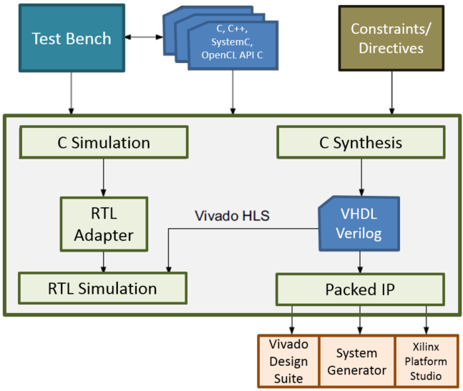
C Validation and RTL Verification
There are two steps to verifying the design
  Pre-synthesis: C Validation
    Validate the algorithm is correct
  Post-synthesis: RTL Verification
    Verify the RTL is correct
C validation
  A HUGE reason users want to use HLS
    Fast, free verification
  Validate the algorithm is correct before synthesis
    Follow the test bench tips given over
RTL Verification
  Vitis HLS can co-simulate the RTL with the
  original test bench
Validate C
Vitis
Verify RTL
Vitis Development
Environment
Vitis Model Composer

Slide 36
C Function Test Bench
The test bench is the level above the function
  The main() function is above the function to be synthesized
Good Practices
  The test bench should compare the results with golden data
    Automatically confirms any changes to the C are validated and verifies the RTL is correct
  The test bench should return a 0 if the self-checking is correct
    Anything but a 0 (zero) will cause RTL verification to issue a FAIL message
    Function main() should expect an integer return (non-void)
int main () {
int ret=0;
…
ret = system("diff --brief -w output.dat output.golden.dat");
if (ret != 0) {
printf("Test failed !!!\n");
ret=1;
} else {
printf("Test passed !\n");
}
…
return ret;
}

Slide 37
Determine or Create the Top-level Function
Determine the top-level function for synthesis
If there are Multiple functions, they must be merged
  There can only be 1 top-level function for synthesis
Given a case where functions func_A and func_B are to be implemented in FPGA
Re-partition the design to create a new single top-level function inside main()
main.c
main.c
int main () {
  ...
  func_A(a,b,*i1);
  func_B(c,*i1,*i2);
  func_C(*i2,ret)
  return ret;
}
#include func_AB.h
int main (a,b,c,d) {
  ...
  // func_A(a,b,i1);
  // func_B(c,i1,i2);
  func_AB (a,b,c, *i1, *i2);
  func_C(*i2,ret)
  return ret;
}
func_A
func_B
func_C
func_AB
func_C
func_AB.c
#include func_AB.h
func_AB(a,b,c, *i1, *i2) {
  ...
  func_A(a,b,*i1);
  func_B(c,*i1,*i2);
  …
}
Recommendation is to separate test bench and design files
func_A
func_B

Slide 38
Vitis Flow and Vivado Flow

Slide 39
Vitis Flow (Kernel Mode)
open_solution -flow_target vitis
Infer interfaces for the function arguments
Without the need to specify the INTERFACE pragma or directive
Output the synthesized RTL code as a Vitis kernel object file (.xo)

Slide 40
Vitis Flow (Kernel Mode)
Argument Type | Scalar |  | Pointer to an Array |  |  | Hls::stream
Interface Mode | Input | Return | I | I/O | O | I and O
ap_ctrl_none
ap_ctrl_hs
ap_ctrl_chain |  | D
axis |  |  |  |  |  | D
m_axi |  |  | D | D | D

Slide 41
Vitis Flow (Kernel Mode)
config_interface -default_slave_interface s_axilite
Argument Type | Scalar |  | Pointer to an Array |  |  | Hls::stream
Interface Mode | Input | Return | I | I/O | O | I and O
s_axi_lite | D | D | D | D | D

Slide 42
Vivado Flow (IP Mode)
The tool by default sets the following global options
open_solution -flow_target vivado
config_interface -default_slave_interface s_axilite
Strict use of pragmas and directives
Exporting the results as Vivado IP

Slide 43
Default Control Settings(Vivado flow)
Default Control Settings | Vivado HLS | Vitis HLS
config_compile -pipeline_loops | 0 | 64
config_export -vivado_optimization_level | 2 | 0
set_clock_uncertainty | 12.5 | 27%
config_interface -m_axi_alignment_byte_size | N/A | 0
config_interface -m_axi_max_widen_bitwidth | N/A | 0
config_export -vivado_phys_opt | place | none
config_interface -m_axi_addr64 | false | true
config_schedule -enable_dsp_full_reg | false | true
config_rtl -module_auto_prefix | false | true
interface pragma defaults | ip mode | ip mode

Slide 44
Default Control Settings(Vitis flow)
Default Control Settings | Vivado HLS | Vitis HLS
interface pragma defaults | ip mode | kernel mode (check default interfaces)
config_interface -m_axi_offset | N/A | direct
config_interface -m_axi_alignment_byte_size | N/A | 64
config_interface -m_axi_max_widen_bitwidth | N/A | 512
config_compile -name_max_length | 256 | 255
config_compile -pipeline_loops | 64 | 64
set_clock_uncertainty | 27% | 27%
config_rtl -register_reset_num | 3 | 3
config_interface -m_axi_latency | 0 | 64

Slide 45
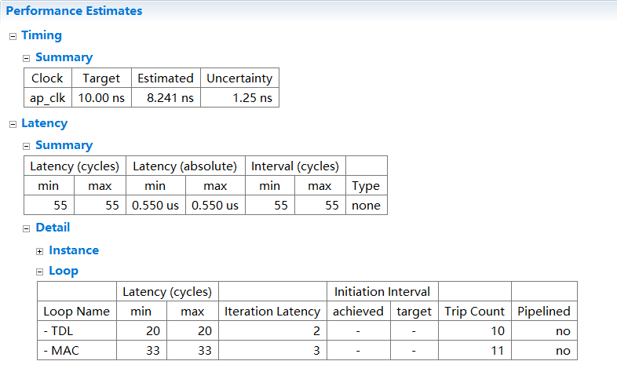
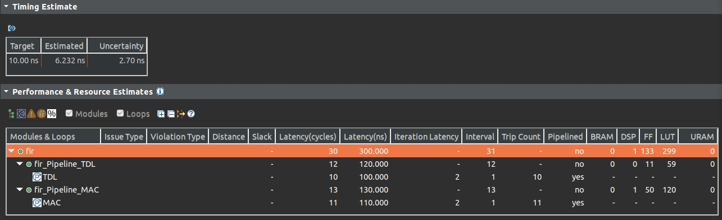
Example

Slide 46
Difference between Vitis HLS and Vivado HLS

Slide 47
Behavioral Differences
New more strict syntax checking is provided in Vitis HLS for both source code and pragma usage:
  Syntax Checker: The tool will error out for any incorrect/bad code fed to csynth_design
  Pragma Conflict Checker: New warnings and errors are reported for pragma conflicts

Slide 48
Assertions
The assert macro in C/C++ is not supported in Vitis HLS.
Usage of assertions can have unintended consequences that are not obvious to the user, causing bad logic to be created.
They can also prevent compiler optimizations depending on the complexity of the code.

Slide 49
C Arbitrary Precision Types
Vitis HLS does not support C arbitrary precision types. Xilinx recommends using C++ types with arbitrary precision.
In addition, C++ arbitrary precision types in Vitis HLS are limited to a maximum width of 4096 bits, instead of 32K bits supported by Vivado HLS.

Slide 50
Summary

Slide 51
Summary
In HLS
  C becomes RTL
  Operations in the code map to hardware resources
  Understand how constructs such as functions, loops and arrays are synthesized
HLS design involves
  Synthesize the initial design
  Analyze to see what limits the performance
    User directives to change the default behaviors
    Remove bottlenecks
  Analyze to see what limits the area
    The types used define the size of operators
    This can have an impact on what operations can fit in a clock cycle

Slide 52
Summary
Use directives to shape the initial design to meet performance
  Increase parallelism to improve performance
  Refine bit sizes and sharing to reduce area
Vitis HLS benefits
  Productivity
  Portability
  Permutability

