Slide 1
Improving Performance
XUP

Slide 2
Objectives
After completing this module, you will be able to:
  Add directives to your design
  List number of ways to improve performance
  State directives which are useful to improve latency
  Describe how loops may be handled to improve latency
  Recognize the dataflow technique that improves throughput of the design
  Describe the pipelining technique that improves throughput of the design
  Identify some of the bottlenecks that impact design performance

Slide 3
Outline
Adding Directives
Improving LatencyManipulating Loops
Improving Throughput
Performance Bottleneck
Summary

Slide 4
Improving Performance
Vitis HLS has a number of ways to improve performance
  Automatic (and default) optimizations
  Latency directives
  Pipelining to allow concurrent operations
Vitis HLS support techniques to remove performance bottlenecks
  Manipulating loops
  Partitioning and reshaping arrays
Optimizations are performed using directives
  Let’s look first at how to apply and use directives in Vitis HLS

Slide 5
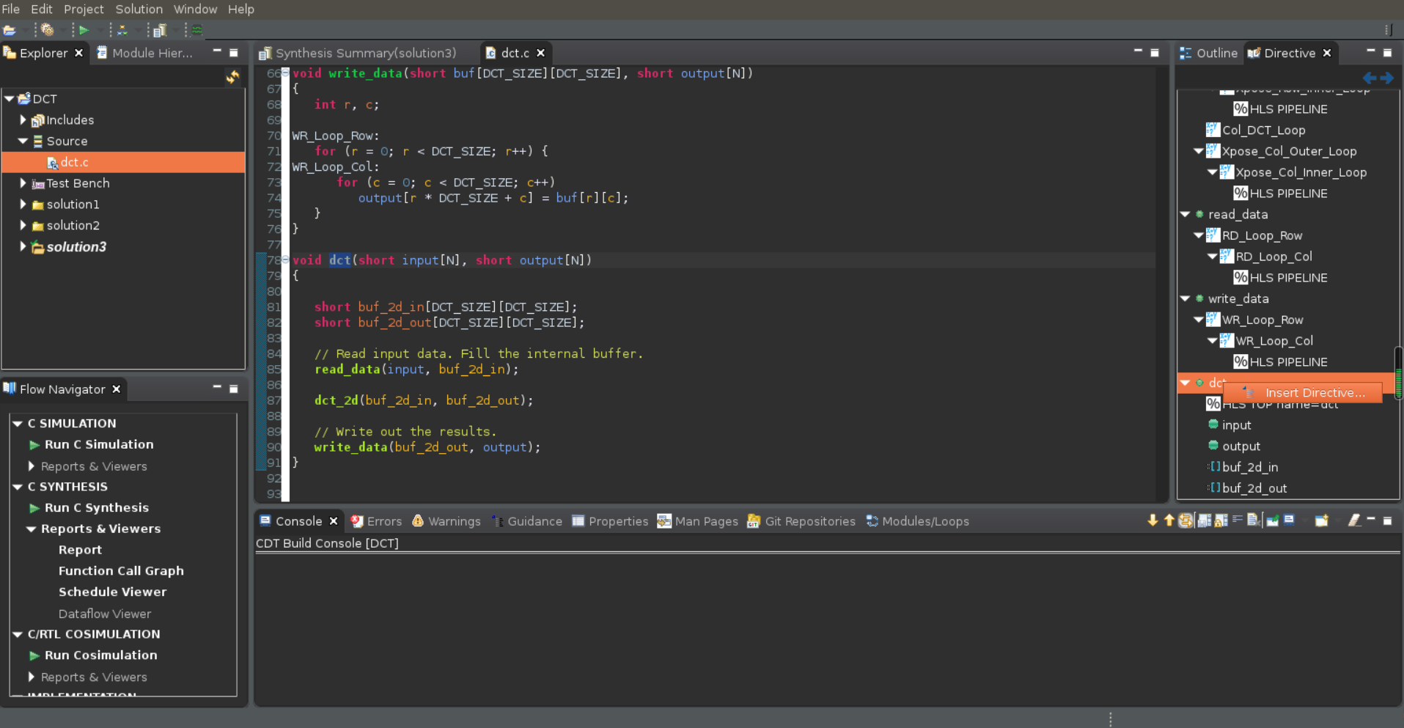
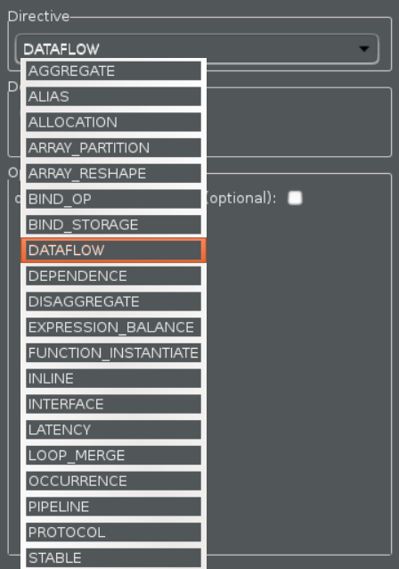
Applying Directives
If the source code is open in the GUI Information pane
  The Directive tab in the Auxiliary pane shows all the locations and objects upon which directives can be applied (in the opened C file, not the whole design)
    Functions, Loops, Regions, Arrays, Top-level arguments
  Select the object in the Directive Tab
    “dct” function is selected
  Right-click to open the editor dialog box
  Select a desired directive from the drop-
  down menu
    “DATAFLOW” is selected
  Specify the Destination
    Source File
    Directive File

Slide 6
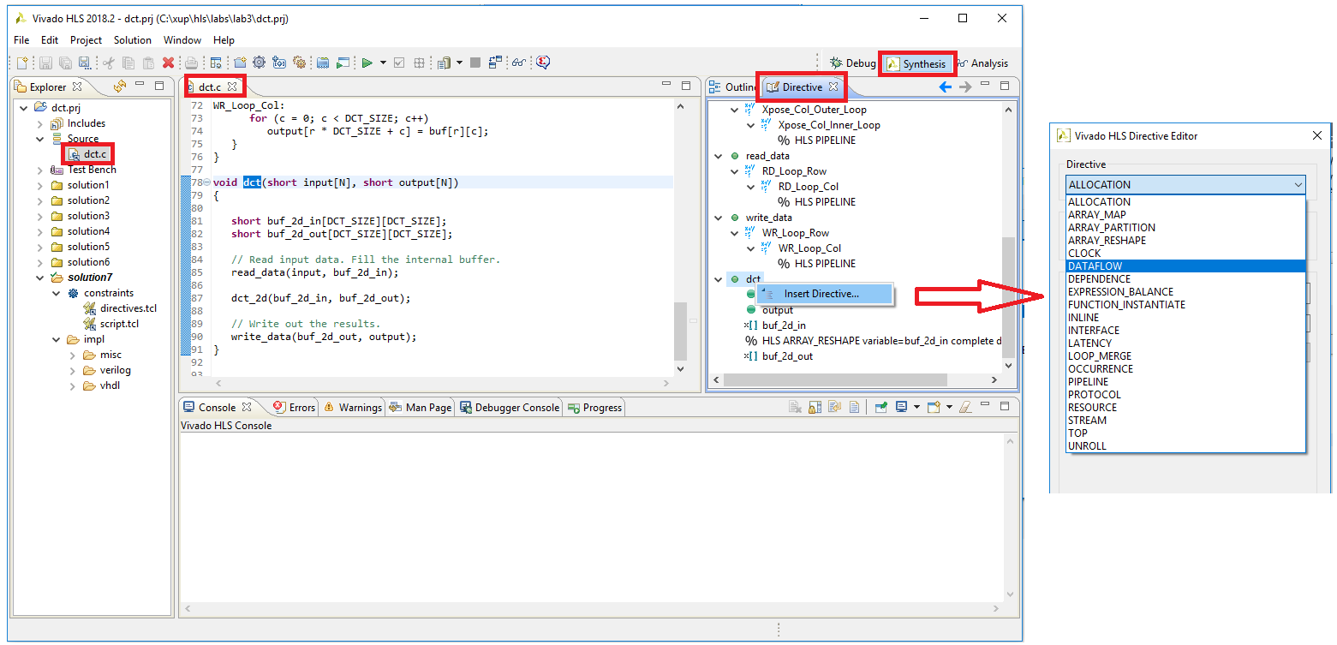
Applying Directives
If the source code is open in the GUI Information pane
  The Directive tab in the Auxiliary pane shows all the locations and objects upon which directives can be applied (in the opened C file, not the whole design)
    Functions, Loops, Regions, Arrays, Top-level arguments
  Select the object in the Directive Tab
    “dct” function is selected
  Right-click to open the editor dialog box
  Select a desired directive from the drop-
  down menu
    “DATAFLOW” is selected
  Specify the Destination
    Source File
    Directive File

Slide 7
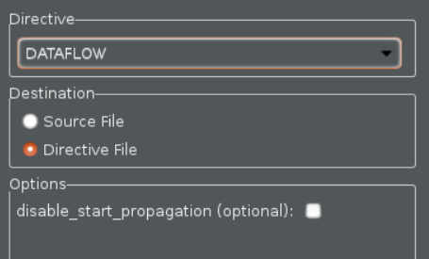

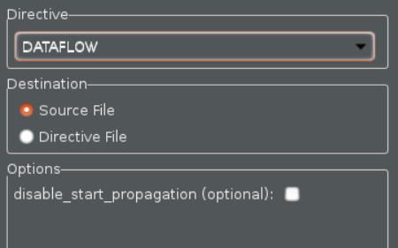


Optimization Directives: Tcl or Pragma
Directives can be placed in the directives file
  The Tcl command is written into directives.tcl
  There is a directives.tcl file in each solution
    Each solution can have different directives
Directives can be place into the C source
  Pragmas are added (and will remain) in the C
  source file
  Pragmas (#pragma) will be used by every
  solution which uses the code
Once applied the directive will be shown in the Directives tab (right-click to modify or delete)

Slide 8
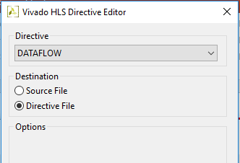
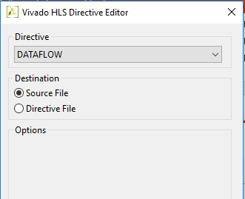
Optimization Directives: Tcl or Pragma
Directives can be placed in the directives file
  The Tcl command is written into directives.tcl
  There is a directives.tcl file in each solution
    Each solution can have different directives
Directives can be place into the C source
  Pragmas are added (and will remain) in the C
  source file
  Pragmas (#pragma) will be used by every
  solution which uses the code
Once applied the directive will be shown in the Directives tab (right-click to modify or delete)

Slide 9
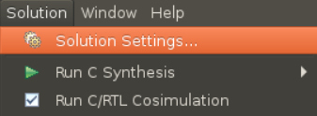
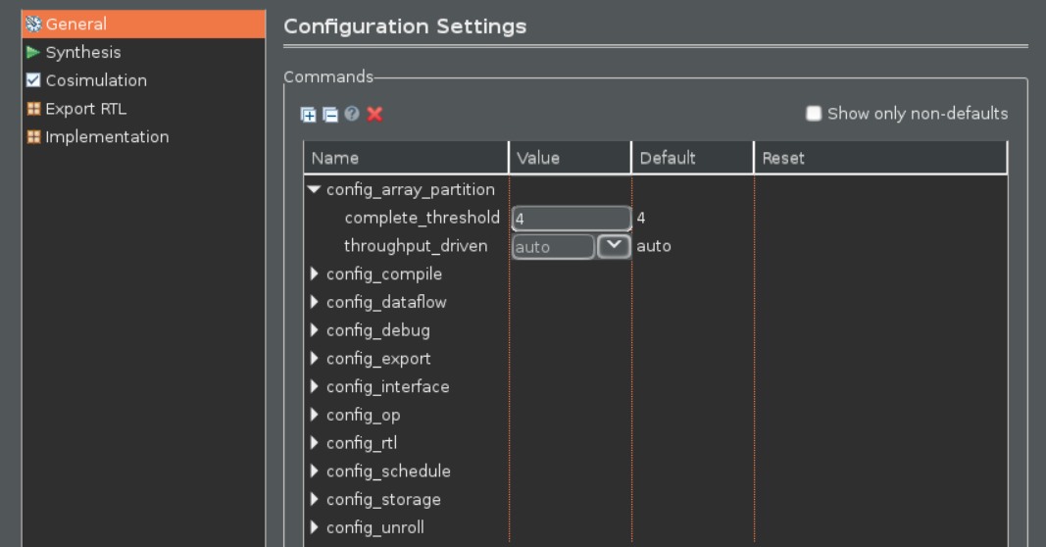
Solution Configurations
Configurations can be set on a solution
  Set the default behavior for that solution
    Open configurations settings from the menu (Solutions > Solution Settings…)
  Choose the configuration from the drop-down menu
    Array Partitioning, Dataflow Memory types, Interface, RTL Settings, Compile, Schedule efforts
Modify configuration settings
Select “General”

Slide 10
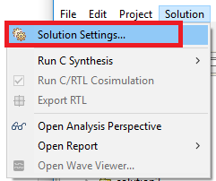
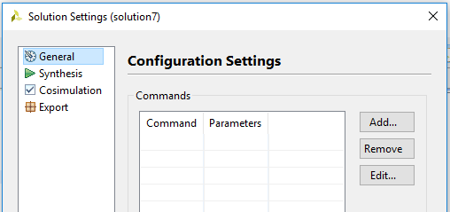
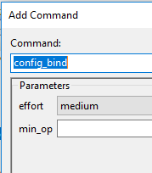
Solution Configurations
Configurations can be set on a solution
  Set the default behavior for that solution
    Open configurations settings from the menu (Solutions > Solution Settings…)
  Choose the configuration from the drop-down menu
    Array Partitioning, Binding, Dataflow Memory types, Interface, RTL Settings, Core, Compile, Schedule efforts
“Add” or “Remove” configuration settings
Select “General”

Slide 11
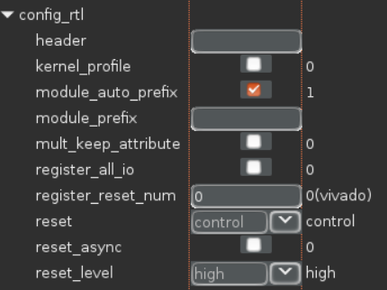
Example: Configuring the RTL Output
Specify the FSM encoding style
  By default the FSM is auto
Add a header string to all RTL output files
  Example: Copyright Acme Inc.
Add a user specified prefix to all RTL output filenames
  The RTL has the same name as the C functions
  Allow multiple RTL variants of the same top-level function to be
  used together without renaming files
Reset all registers
  By default only the FSM registers and variables initialized in the code
  are reset
  RAMs are initialized in the RTL and bitstream
Synchronous or Asynchronous reset
  The default is synchronous reset
Active high or low reset
  The default is active high
The remainder of the configuration commands will be covered throughout the course

Slide 12
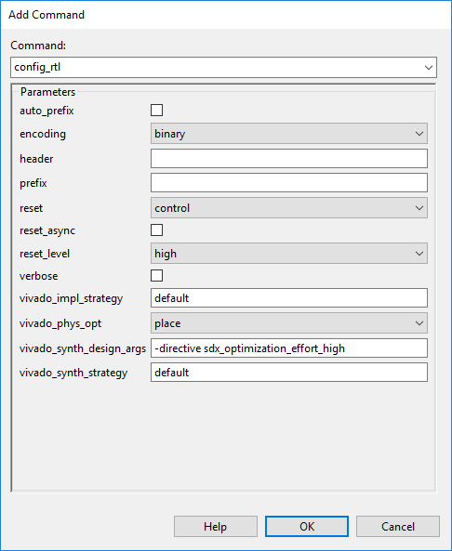
Example: Configuring the RTL Output
Specify the FSM encoding style
  By default the FSM is auto
Add a header string to all RTL output files
  Example: Copyright Acme Inc.
Add a user specified prefix to all RTL output filenames
  The RTL has the same name as the C functions
  Allow multiple RTL variants of the same top-level function to be
  used together without renaming files
Reset all registers
  By default only the FSM registers and variables initialized in the code
  are reset
  RAMs are initialized in the RTL and bitstream
Synchronous or Asynchronous reset
  The default is synchronous reset
Active high or low reset
  The default is active high
The remainder of the configuration commands will be covered throughout the course

Slide 13
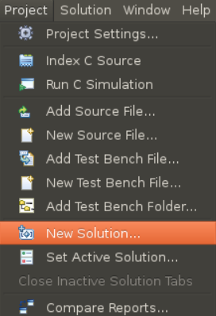
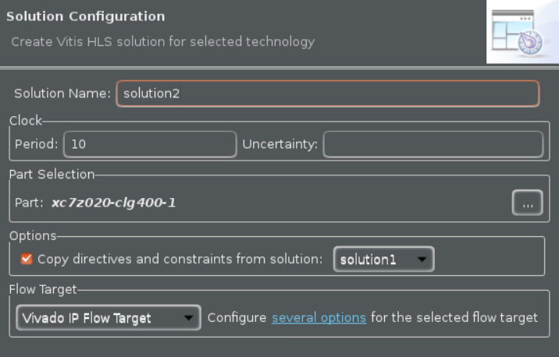
Copying Directives into New Solutions
Click the New Solution Button
Optionally modify any of the settings
  Part, Clock Period, Uncertainty
  Solution Name
Copy existing directives
  By default selected
  Uncheck if do not want to copy
  No need to copy pragmas, they are in the code

Slide 14
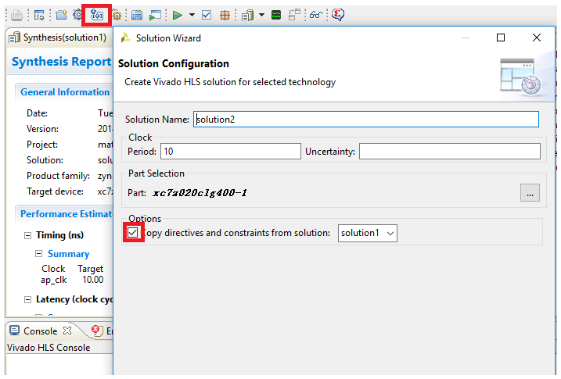
Copying Directives into New Solutions
Click the New Solution Button
Optionally modify any of the settings
  Part, Clock Period, Uncertainty
  Solution Name
Copy existing directives
  By default selected
  Uncheck if do not want to copy
  No need to copy pragmas, they are in the code

Slide 15
Improving Latency

Slide 16
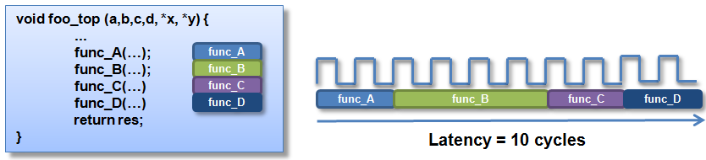
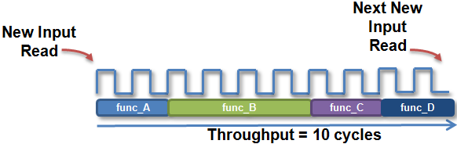
Latency and Throughput – The Performance Factors
Design Latency
  The latency of the design is the number of cycle it takes to output the result
    In this example the latency is
    10 cycles
Design Throughput
  The throughput of the design is the
  number of cycles between new inputs
    By default (no concurrency) this is the
    same as latency
    Next start/read is when this transaction ends

Slide 17
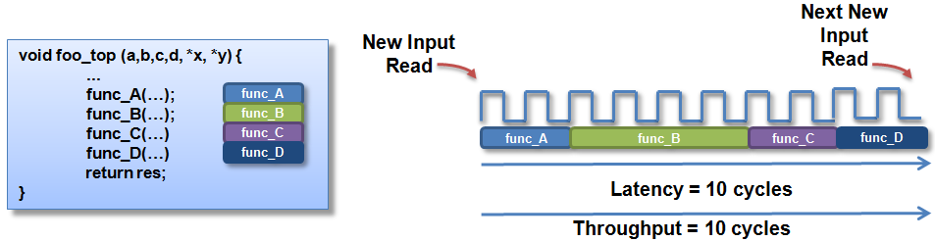
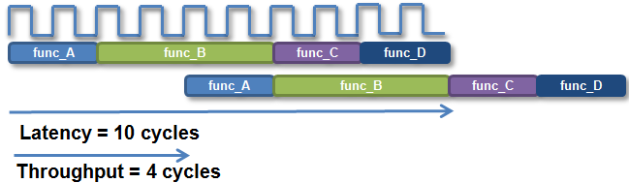
Latency and Throughput
In the absence of any concurrency
  Latency is the same as throughput
Pipelining for higher throughput
  Vitis HLS can pipeline functions and
  loops to improve throughput
  Latency and throughput are related
  We will discuss optimizing for latency
  first, then throughput

Slide 18
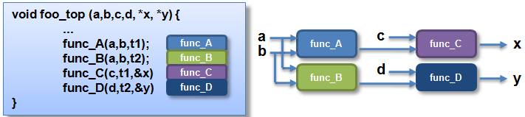
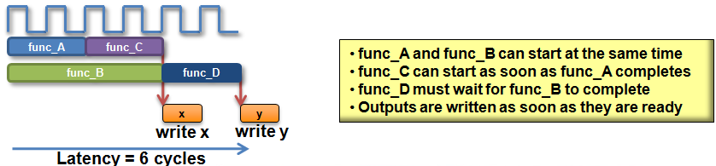
Vitis HLS: Minimize latency
Vitis HLS will by default minimize latency
  Throughput is prioritized above latency
  (no throughput directive is specified here)
  In this example
    The functions are connected as shown
    Assume function B takes longer than any
    other functions
Vitis HLS will automatically take advantage of the parallelism
  It will schedule functions to start
  as soon as they can
    Note it will not do this for loops
    within a function: by default they
    are executed in sequence

Slide 19
Reducing Latency
Vitis HLS has the following directives to reduce latency
  LATENCY
    Allows a minimum and maximum latency constraint to be specified
  LOOP_FLATTEN
    Allows nested loops to be collapsed into a single loop with improved latency
  LOOP_MERGE
    Merge consecutive loops to reduce overall latency, increase sharing, and improve logic optimization
  UNROLL

Slide 20
Default Behavior: Minimizing Latency
Functions
  Vitis HLS will seek to minimize latency by allowing functions to operate in parallel
    As shown on the previous slide
Loops
  Vitis HLS will not schedule loops to operate in parallel by default
    Dataflow optimization must be used or the loops must be unrolled
    Both techniques are discussed in detail later
Operations
  Vitis HLS will seek to minimize latency by allowing the operations to occur in parallel
  It does this within functions and within loops
Loop:for(i=1;i<3;i++) {
op_Read;
op_Compute;
op_Write;
}
RD
CMP
WR
Example of Minimizing latency with Parallel Operations
void foo(...) {
op_Read;
op_Compute;
op_Write;
}
Example with Sequential Operations
RD
CMP
RD
WR
WR
RD
CMP
WR
CMP

Slide 21
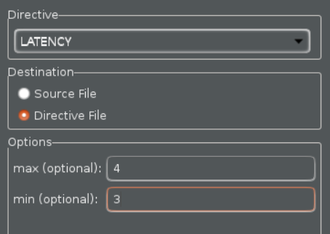
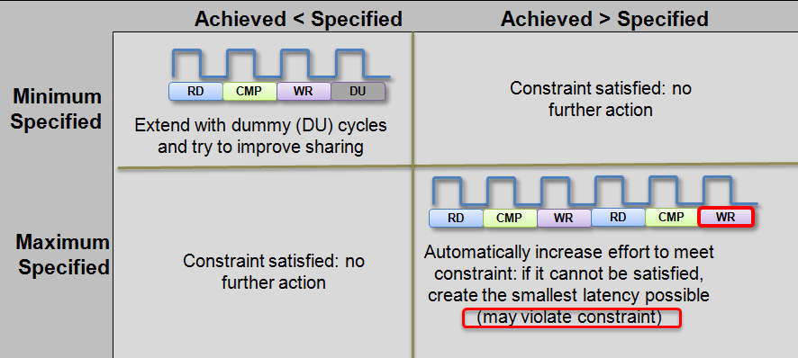
Latency Constraints
Latency constraints can be specified
  Can define a minimum and/or maximum latency for the location
    This is applied to all objects in the specified scope
  No range specification: schedule for minimum
    Which is the default
Impact of ranges

Slide 22
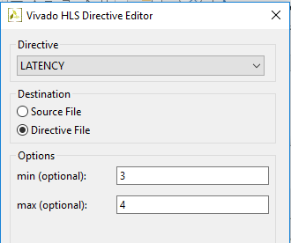
Latency Constraints
Latency constraints can be specified
  Can define a minimum and/or maximum latency for the location
    This is applied to all objects in the specified scope
  No range specification: schedule for minimum
    Which is the default
Impact of ranges

Slide 23
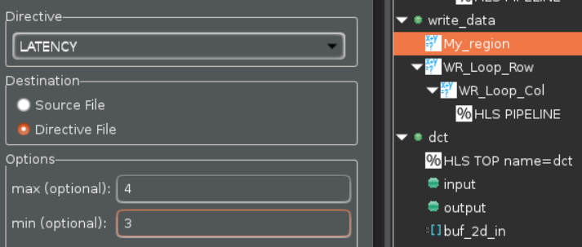
Region Specific Latency Constraint
Latency directives can be applied on functions, loops and regions
Use regions to specify specific locations for latency constraints
  A region is any set of named braces {…a region…}
    The region My_Region is shown in this example
  This allows the constraint to be applied to a specific range of code
    Here, only the else branch has a latency constraint
int write_data (int buf, int output) {
if (x < y) {
return (x + y);
} else {
My_Region: {
return (y – x) * (y + x);
}
}
Select the region in the Directives tab & right-click to apply latency directive

Slide 24
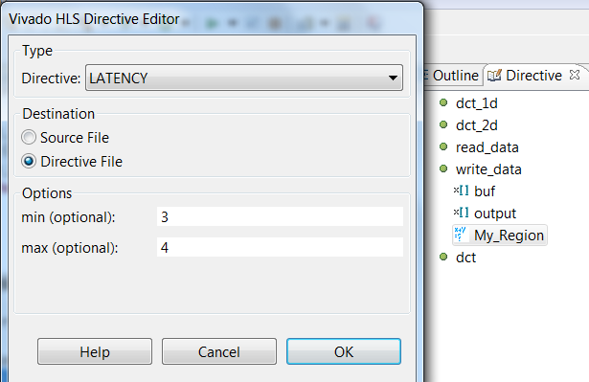
Region Specific Latency Constraint
Latency directives can be applied on functions, loops and regions
Use regions to specify specific locations for latency constraints
  A region is any set of named braces {…a region…}
    The region My_Region is shown in this example
  This allows the constraint to be applied to a specific range of code
    Here, only the else branch has a latency constraint
int write_data (int buf, int output) {
if (x < y) {
return (x + y);
} else {
My_Region: {
return (y – x) * (y + x);
}
}
Select the region in the Directives tab & right-click to apply latency directive

Slide 25
Improving Latency
- Manipulating Loops

Slide 26
Review: Loops
By default, loops are rolled
  Each C loop iteration ➔ Implemented in the same state
  Each C loop iteration ➔ Implemented with same resources
  Loops can be unrolled if their indices are statically determinable at elaboration time
    Not when the number of iterations is variable
N
void foo_top (…) {
...
Add: for (i=3;i>=0;i--) {
b = a[i] + b;
...
}
foo_top
Synthesis
+
b
a[N]
Loops require labels if they are to be referenced by Tcl directives
(GUI will auto-add labels)

Slide 27
Rolled Loops Enforce Latency
A rolled loop can only be optimized so much
  Given this example, where the delay of the adder is small compared to the clock frequency
  This rolled loop will never take less than 4 cycles
    No matter what kind of optimization is tried
    This minimum latency is a function of the loop iteration count
void foo_top (…) {
...
Add: for (i=3;i>=0;i--) {
b = a[i] + b;
...
}
Clock
Adder Delay
3
2
1
0

Slide 28
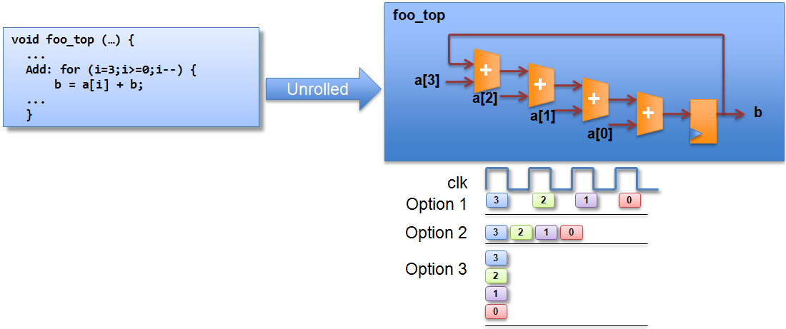
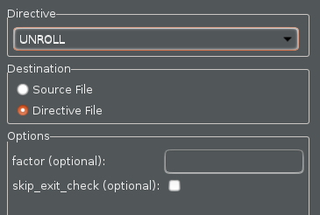
Unrolled Loops can Reduce Latency
Select loop “Add” in the directives pane and right-click
Unrolled loops allow greater option & exploration
Options explained on next slide
Unrolled loops are likely to result in more hardware resources and higher area

Slide 29
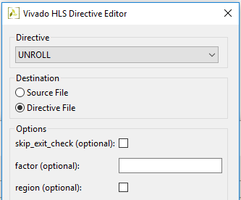
Unrolled Loops can Reduce Latency
Select loop “Add” in the directives pane and right-click
Unrolled loops allow greater option & exploration
Options explained on next slide
Unrolled loops are likely to result in more hardware resources and higher area

Slide 30
Partial Unrolling
Fully unrolling loops can create a lot of hardware
Loops can be partially unrolled
  Provides the type of exploration shown in the previous slide
Partial Unrolling
  A standard loop of N iterations can be unrolled to by a factor
  For example unroll by a factor 2, to have N/2 iterations
    Similar to writing new code as shown on the right ➔
    The break accounts for the condition when N/2 is not an integer
  If “i” is known to be an integer multiple of N
    The user can remove the exit check (and associated logic)
    Vitis HLS is not always be able to determine this is true
    (e.g. if N is an input argument)
    User takes responsibility: verify!
Add: for(int i = 0; i < N; i++) {
a[i] = b[i] + c[i];
}
Add: for(int i = 0; i < N; i += 2) {
a[i] = b[i] + c[i];
if (i+1 >= N) break;
a[i+1] = b[i+1] + c[i+1];
}
Effective code after compiler transformation
for(int i = 0; i < N; i += 2) {
a[i] = b[i] + c[i];
a[i+1] = b[i+1] + c[i+1];
}
An extra adder for N/2 cycles trade-off
Notes:
There is an adder for the loop iteration count “i” itself.

Slide 31
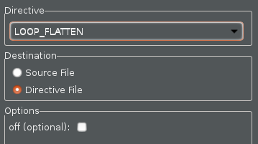
Loop Flattening
Vitis HLS can automatically flatten nested loops
  A faster approach than manually changing the code
Flattening should be specified on the inner most loop
  It will be flattened into the loop above
  The “off” option can prevent loops in the hierarchy from being flattened
void foo_top (…) {
...
L1: for (i=3;i>=0;i--) {
[loop body l1 ]
}
L2: for (i=3;i>=0;i--) {
L3: for (j=3;j>=0;j--) {
[loop body l3 ]
}
}
L4: for (i=3;i>=0;i--) {
[loop body l4 ]
}
void foo_top (…) {
...
L1: for (i=3;i>=0;i--) {
[loop body l1 ]
}
L2: for (k=15,k>=0;k--) {
[loop body l3 ]
}
L4: for (i=3;i>=0;i--) {
[loop body l1 ]
}
1
1
x4
x4
2
x4
2
x16
3
x4
4
4
x4
x4
36 transitions
Loops will be flattened by default: use “off” to disable
28 transitions

Slide 32
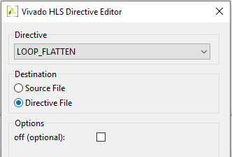
Loop Flattening
Vivado HLS can automatically flatten nested loops
  A faster approach than manually changing the code
Flattening should be specified on the inner most loop
  It will be flattened into the loop above
  The “off” option can prevent loops in the hierarchy from being flattened
void foo_top (…) {
...
L1: for (i=3;i>=0;i--) {
[loop body l1 ]
}
L2: for (i=3;i>=0;i--) {
L3: for (j=3;j>=0;j--) {
[loop body l3 ]
}
}
L4: for (i=3;i>=0;i--) {
[loop body l4 ]
}
void foo_top (…) {
...
L1: for (i=3;i>=0;i--) {
[loop body l1 ]
}
L2: for (k=15,k>=0;k--) {
[loop body l3 ]
}
L4: for (i=3;i>=0;i--) {
[loop body l1 ]
}
1
1
x4
x4
2
x4
2
x16
3
x4
4
4
x4
x4
36 transitions
Loops will be flattened by default: use “off” to disable
28 transitions

Slide 33
Perfect and Semi-Perfect Loops
Only perfect and semi-perfect loops can be flattened
  The loop should be labeled or directives cannot be applied
  Perfect Loops
    Only the inner most loop has body (contents)
    There is no logic specified between the loop statements
    The loop bounds are constant
  Semi-perfect Loops
  Only the inner most loop has body (contents)
  There is no logic specified between the loop statements
  The outer most loop bound can be variable
Other types
  Should be converted to perfect or semi-perfect loops
Loop_outer: for (i=3;i>=0;i--) {
Loop_inner: for (j=3;j>=0;j--) {
[loop body]
}
}
Loop_outer: for (i=3;i>N;i--) {
Loop_inner: for (j=3;j>=0;j--) {
[loop body]
}
}
Loop_outer: for (i=3;i>N;i--) {
[loop body]
Loop_inner: for (j=3;j>=M;j--) {
[loop body]
}
}

Slide 34
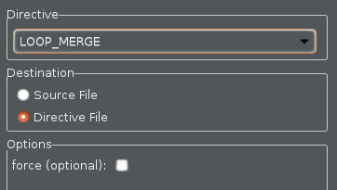
Loop Merging
Vitis HLS can automatically merge loops
  A faster approach than manually changing the code
  Allows for more efficient architecture explorations
  FIFO reads, which must occur in strict order, can prevent loop merging
    Can be done with the “force” option : user takes responsibility for correctness
1
void foo_top (…) {
...
L1: for (i=3;i>=0;i--) {
[loop body l1 ]
}
L2: for (i=3;i>=0;i--) {
L3: for (j=3;j>=0;j--) {
[loop body l3 ]
}
}
L4: for (i=3;i>=0;i--) {
[loop body l4 ]
}
x4
void foo_top (…) {
...
L123: for (l=16,l>=0;l--) {
if (cond1)
[loop body l1 ]
[loop body l3 ]
if (cond4)
[loop body l4 ]
}
2
x4
1
3
x4
1
Already flattened
x16
4
x4
36 transitions
18 transitions

Slide 35
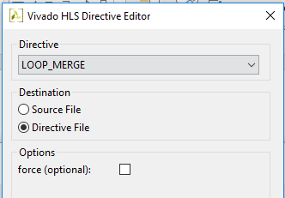
Loop Merging
Vivado HLS can automatically merge loops
  A faster approach than manually changing the code
  Allows for more efficient architecture explorations
  FIFO reads, which must occur in strict order, can prevent loop merging
    Can be done with the “force” option : user takes responsibility for correctness
1
void foo_top (…) {
...
L1: for (i=3;i>=0;i--) {
[loop body l1 ]
}
L2: for (i=3;i>=0;i--) {
L3: for (j=3;j>=0;j--) {
[loop body l3 ]
}
}
L4: for (i=3;i>=0;i--) {
[loop body l4 ]
}
x4
void foo_top (…) {
...
L123: for (l=16,l>=0;l--) {
if (cond1)
[loop body l1 ]
[loop body l3 ]
if (cond4)
[loop body l4 ]
}
2
x4
1
3
x4
1
Already flattened
x16
4
x4
36 transitions
18 transitions

Slide 36
Loop Merge Rules
If loop bounds are all variables, they must have the same value
If loops bounds are constants, the maximum constant value is used as the bound of the merged loop
  As in the previous example where the maximum loop bounds become 16 (implied by L3 flattened into L2 before the merge)
Loops with both variable bound and constant bound cannot be merged
The code between loops to be merged cannot have side effects
  Multiple execution of this code should generate same results
    A=B is OK, A=A+1 is not
Reads from a FIFO or FIFO interface must always be in sequence
  A FIFO read in one loop will not be a problem
  FIFO reads in multiple loops may become out of sequence
    This prevents loops being merged

Slide 37
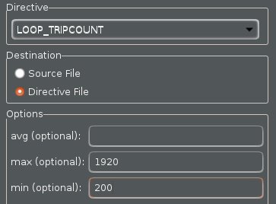
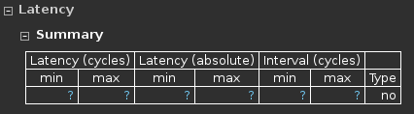
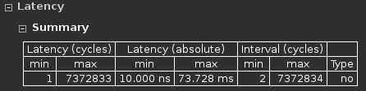
Loop Reports
Vitis HLS reports the latency of loops
  Shown in the report file and GUI
Given a variable loop index, the latency cannot be reported
  Vitis HLS does not know the limits of the loop index
  This results in latency reports showing unknown values
The loop tripcount (iteration count) can be specified
  Apply to the loop in the directives pane
  Allows the reports to show an estimated latency
Impacts reporting – not synthesis

Slide 38
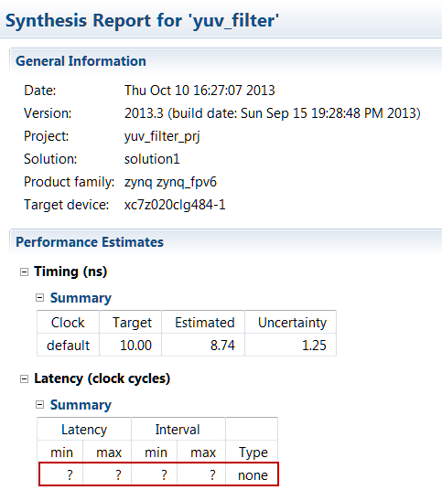
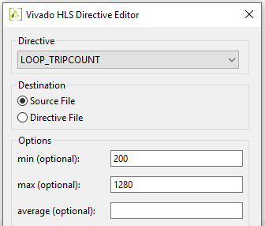
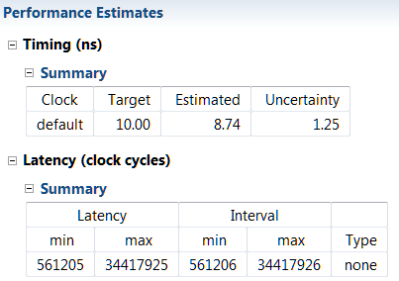
Loop Reports
Vivado HLS reports the latency of loops
  Shown in the report file and GUI
Given a variable loop index, the latency cannot be reported
  Vivado HLS does not know the limits of the loop index
  This results in latency reports showing unknown values
The loop tripcount (iteration count) can be specified
  Apply to the loop in the directives pane
  Allows the reports to show an estimated latency
Impacts reporting – not synthesis

Slide 39
Techniques for Minimizing Latency - Summary
Constraints
  Vitis HLS accepts constraints for latency
Loop Optimizations
  Latency can be improved by minimizing the number of loop boundaries
    Rolled loops (default) enforce sharing at the expense of latency
    The entry and exits to loops costs clock cycles

Slide 40
Improving Throughput

Slide 41
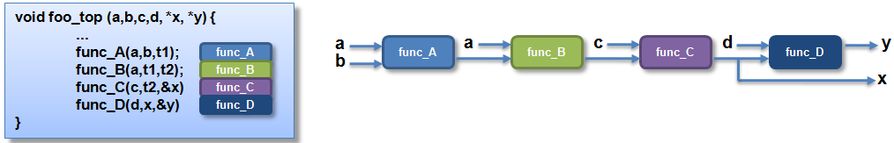

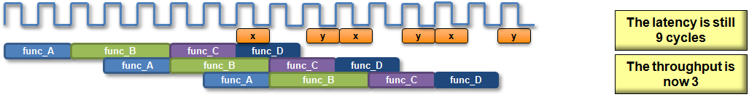
Improving Throughput
Given a design with multiple functions
  The code and dataflow are as shown
Vitis HLS will schedule the design
It can also automatically optimize the dataflow for throughput

Slide 42
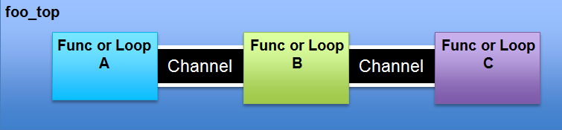
Dataflow Optimization
Dataflow Optimization
  Can be used at the top-level function
  Allows blocks of code to operate concurrently
    The blocks can be functions or loops
    Dataflow allows loops to operate concurrently
  It places channels between the blocks to maintain the data rate
    For arrays the channels will include memory elements to buffer the samples
    For scalars the channel is a register with hand-shakes
Dataflow optimization therefore has an area overhead
  Additional memory blocks are added to the design
  The timing diagram on the previous page should have a memory access delay between the blocks
    Not shown to keep explanation of the principle clear

Slide 43
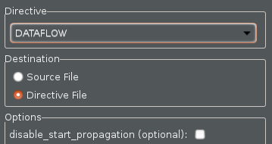
Dataflow Optimization Commands
Dataflow is set using a directive
  Vitis HLS will seek to create the highest performance design
    Throughput of 1

Slide 44
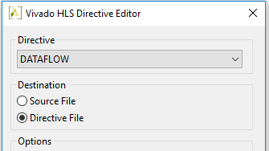
Dataflow Optimization Commands
Dataflow is set using a directive
  Vivado HLS will seek to create the highest performance design
    Throughput of 1

Slide 45
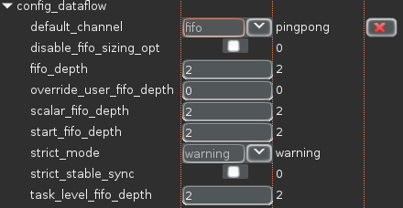
Dataflow Optimization through Configuration Command
Configuring Dataflow Memories
  Between functions Vitis HLS uses ping-pong memory buffers by default
    The memory size is defined by the maximum number of producer or consumer elements
  Between loops Vitis HLS will determine if a FIFO can be used in place of a ping-pong buffer
  The memories can be specified to be FIFOs using the Dataflow Configuration
    Menu: Solution > Solution Settings > config_dataflow
    With FIFOs the user can override the default size of the FIFO
    Note: Setting the FIFO too small may result in an RTL verification failure
Individual Memory Control
  When the default is ping-pong
    Select an array and mark it as Streaming (directive STREAM) to implement the array as a FIFO
  When the default is FIFO
    Select an array and mark it as Streaming (directive STREAM) with option “off” to implement the array as a ping-pong
To use FIFO’s the access must be sequential. If HLS determines that the access is not sequential then it will halt and issue a message. If HLS can not determine the sequential nature then it will issue warning and continue.

Slide 46
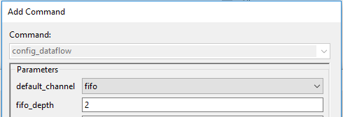
Dataflow Optimization through Configuration Command
Configuring Dataflow Memories
  Between functions Vivado HLS uses ping-pong memory buffers by default
    The memory size is defined by the maximum number of producer or consumer elements
  Between loops Vivado HLS will determine if a FIFO can be used in place of a ping-pong buffer
  The memories can be specified to be FIFOs using the Dataflow Configuration
    Menu: Solution > Solution Settings > config_dataflow
    With FIFOs the user can override the default size of the FIFO
    Note: Setting the FIFO too small may result in an RTL verification failure
Individual Memory Control
  When the default is ping-pong
    Select an array and mark it as Streaming (directive STREAM) to implement the array as a FIFO
  When the default is FIFO
    Select an array and mark it as Streaming (directive STREAM) with option “off” to implement the array as a ping-pong
To use FIFO’s the access must be sequential. If HLS determines that the access is not sequential then it will halt and issue a message. If HLS can not determine the sequential nature then it will issue warning and continue.

Slide 47
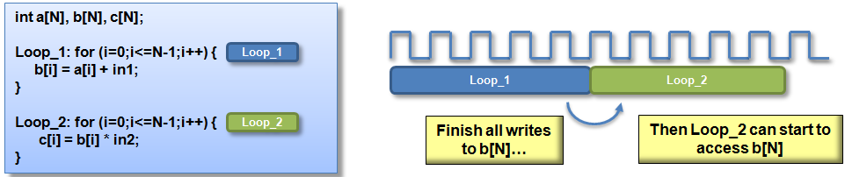
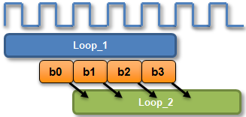
Dataflow : Ideal for streaming arrays & multi-rate functions
Arrays are passed as single entities by default
  This example uses loops but the same principle applies to functions
Dataflow pipelining allows loop_2 to start when data is ready
  The throughput is improved
  Loops will operate in parallel
    If dependencies allow
Multi-Rate Functions
  Dataflow buffers data when one function or loop consumes or produces data at different rate from others
IO flow support
  To take maximum advantage of dataflow in streaming designs, the IO interfaces at both ends of the datapath should be streaming/handshake types (ap_hs or ap_fifo)

Slide 48


Dataflow Limitations (1)
Must be single producer consumer; the following code violates the rule and dataflow does not work
The Fix
Notes:
For the dataflow optimization to work, the data must flow through the design from one task to the next. The following coding styles prevent the Vivado HLS tool from performing the dataflow optimization:
Single producer consumer violations
Bypassing tasks
Feedback between tasks
Conditional execution of tasks
Loop scopes with variable bounds
Loops with multiple exit conditions

Slide 49


Dataflow Limitations (2)
You cannot bypass a task; the following code violates this rule and dataflow does not work
The fix: make it systolic like datapath

Slide 50
Dataflow vs Pipelining Optimization
Dataflow Optimization
  Dataflow optimization is “coarse grain” pipelining at the function and loop level
  Increases concurrency between functions and loops
  Only works on functions or loops at the top-level of the hierarchy
    Cannot be used in sub-functions
Function & Loop Pipelining
  “Fine grain” pipelining at the level of the operators (*, +, >>, etc.)
  Allows the operations inside the function or loop to operate in parallel
  Unrolls all sub-loops inside the function or loop being pipelined
    Loops with variable bounds cannot be unrolled: This can prevent pipelining
    Unrolling loops increases the number of operations and can increase memory and run time

Slide 51
Function Pipelining
There are 3 clock cycles before operation RD can occur again
  Throughput = 3 cycles
There are 3 cycles before the 1st output is written
  Latency = 3 cycles
The latency is the same
The throughput is better
  Less cycles, higher throughput
Without Pipelining
With Pipelining
void foo(...) {
op_Read;
op_Compute;
op_Write;
}
RD
CMP
WR
Throughput = 3 cycles
Throughput = 1 cycle
RD
CMP
WR
RD
CMP
WR
RD
CMP
WR
RD
CMP
WR
Latency = 3 cycles
Latency = 3 cycles

Slide 52

Loop Pipelining
There are 3 clock cycles before operation RD can occur again
  Throughput = 3 cycles
There are 3 cycles before the 1st output is written
  Latency = 3 cycles
  For the loop, 6 cycles
Without Pipelining
With Pipelining
Loop:for(i=1;i<3;i++) {
op_Read;
op_Compute;
op_Write;
}
RD
CMP
WR
Throughput = 3 cycles
Throughput = 1 cycle
RD
CMP
WR
RD
CMP
WR
RD
CMP
WR
RD
CMP
WR
Latency = 3 cycles
Latency = 3 cycles
Loop Latency = 6 cycles
Loop Latency = 4 cycles
The latency is the same
  The throughput is better
    Less cycles, higher throughput
The latency for all iterations, the loop latency, has been improved

Slide 53
Pipelining and Function/Loop Hierarchy
Vitis HLS will attempt to unroll all loops nested below a PIPELINE directive
  May not succeed for various reason and/or may lead to unacceptable area
    Loops with variable bounds cannot be unrolled
    Unrolling Multi-level loop nests may create a lot of hardware
  Pipelining the inner-most loop will result in best performance for area
    Or next one (or two) out if inner-most is modest and fixed
      e.g. Convolution algorithm
    Outer loops will keep the inner pipeline fed
void foo(in1[ ][ ], in2[ ][ ], …) {
…
L1:for(i=1;i<N;i++) {
L2:for(j=0;j<M;j++) {
#pragma HLS PIPELINE
out[i][j] = in1[i][j] + in2[i][j];
}
}
}
void foo(in1[ ][ ], in2[ ][ ], …) {
…
L1:for(i=1;i<N;i++) {
#pragma HLS PIPELINE
L2:for(j=0;j<M;j++) {
out[i][j] = in1[i][j] + in2[i][j];
}
}
}
void foo(in1[ ][ ], in2[ ][ ], …) {
#pragma HLS PIPELINE
…
L1:for(i=1;i<N;i++) {
L2:for(j=0;j<M;j++) {
out[i][j] = in1[i][j] + in2[i][j];
}
}
}
1adder, 3 accesses
Unrolls L2
M adders, 3M accesses
Unrolls L1 and L2
N*M adders, 3(N*M) accesses

Slide 54

Pipeline Directive
The pipeline directive pipelines functions or loops
  This example pipelines the function with an Initiation
  Interval (II) of 2
    The II is the same as the throughput but this term is used
    exclusively with pipelines
Omit the target II and Vitis HLS will Automatically
pipeline for the fastest possible design
  Specifying a more accurate maximum may allow more
  sharing (smaller area)
The directive on loops provides loop rewinding option
RD
CMP
WR
RD
CMP
WR
Initiation Interval (or II)

Slide 55

Pipeline Directive
The pipeline directive pipelines functions or loops
  This example pipelines the function with an Initiation
  Interval (II) of 2
    The II is the same as the throughput but this term is used
    exclusively with pipelines
Omit the target II and Vivado HLS will Automatically
pipeline for the fastest possible design
  Specifying a more accurate maximum may allow more
  sharing (smaller area)
The directive on loops provides loop rewinding option
RD
CMP
WR
RD
CMP
WR
Initiation Interval (or II)

Slide 56
Pipeline Flush
Pipelines can optionally be flushed
  Flush: when the input enable goes low (no more data) all existing results are flushed out
    The input enable may be from an input interface or from another block in the design
  The default is to stall all existing values in the pipeline
With Flush
  When no new input reads are performed
  Values already in the pipeline are flushed out
Without Flush (default)
With Flush (optional)
Clk
Clk
Data Valid
Data Valid
RD
CMP
WR
out1
RD
CMP
WR
out1
RD
CMP
WR
out2
RD
CMP
WR
out2
RD
CMP
RD
CMP

Slide 57

Pipelining the Top-Level Loop
Loop Pipelining top-level loop may give a “bubble”
  A “bubble” here is an interruption to the data stream
  Given the following
  The function will process a stream of data
  The next time the function is called, it still needs to execute the initial (init) operations
    These operations are any which occur before the loop starts
    These operations may include interface start/stop/done signals
  This can result in an unexpected interruption of the data stream

Slide 58


Continuous Pipelining the Top-Level loop
Use the “rewind” option for continuous pipelining
  Immediate re-execution of the top-level loop
  The operation rewinds to the start of the loop
    Ignores any initialization statements before the start of the loop
The rewind portion only effects top-level loops
  Ensures the operations before the loop are never re-executed when the function is re-executed

Slide 59

Continuous Pipelining the Top-Level loop
Use the “rewind” option for continuous pipelining
  Immediate re-execution of the top-level loop
  The operation rewinds to the start of the loop
    Ignores any initialization statements before the start of the loop
The rewind portion only effects top-level loops
  Ensures the operations before the loop are never re-executed when the function is re-executed

Slide 60

Issues which prevent Pipelining
Pipelining functions unrolls all loops
  Loops with variable bounds cannot be unrolled
  This will prevent pipelining
    Re-code to remove the variables bounds: max bounds with an exit
Feedback prevent/limits pipelines
  Feedback within the code will prevent or limit pipelining
    The pipeline may be limited to higher initiation interval (more cycles, lower throughput)
Resource Contention may prevent pipelining
  Can occur within input and output ports/arguments
  This is a classis way in which arrays limit performance

Slide 61

Resource Contention: Unfeasible Initiation Intervals
Sometimes the II specification cannot be met
  In this example there are 2 read operations on the same port
  An II=1 cannot be implemented
    The same port cannot be read at the same time
    Similar effect with other resource limitations
    For example if functions or multipliers etc. are limited
Vitis HLS will automatically increase the II
  Vitis HLS will always try to create a design, even if constraints must be violated

Slide 62
Performance Bottleneck

Slide 63

Arrays : Performance bottlenecks
Arrays are intuitive and useful software constructs
  They allow the C algorithm to be easily captured and understood
Array accesses can often be performance bottlenecks
  Arrays are targeted to a default RAM
    May not be the most ideal memory for performance
    Cannot pipeline with a throughput of 1
Vitis HLS allows arrays to be partitioned and reshaped
  Allows more optimal configuration of the array
  Provides better implementation of the memory resource

Slide 64



Review: Arrays in HLS
An array in C code is implemented by a memory in the RTL
  By default, arrays are implemented as RAMs, optionally a FIFO
The array can be targeted to any memory
resource in the library
  The ports and sequential operation are
  defined by the library model
    All RAMs are listed in the Vitis HLS Library Guide
List of available Cores

Slide 65

Review: Arrays in HLS
An array in C code is implemented by a memory in the RTL
  By default, arrays are implemented as RAMs, optionally a FIFO
The array can be targeted to any memory
resource in the library
  The ports and sequential operation are
  defined by the library model
    All RAMs are listed in the Vivado HLS Library Guide
List of available Cores

Slide 66
Array and RAM selection
If no RAM resource is selected
  Vitis HLS will determine the RAM to use
    It will use a Dual-port if it improves throughput
    Else it will use a single-port
BRAM and LUTRAM selection
  If none is made (e.g. resource RAM_1P used) RTL synthesis will determine if RAM is implemented as BRAM or LUTRAM
  If the user specifies the RAM target (e.g. RAM_1P_BRAM or RAM_1P_LUTRAM is selected ) Vitis HLS will obey the target
    If LUTRAM is selected Vitis HLS reports registers not BRAM
Notes:
Transcript:
memory would give the best performance. So that's why you'll see at the interfaces sometimes you expect a single port being consumed by Vivado HLS and you'll see both ports because the tool currently does not look at the system integration context. It just looks at the performance you want and what your resources are. You can also choose between a block RAM or distributed RAM. And then there's also, if you don't select anything, we'll leave RTL in a way that ISE can then have the freedom of choosing where it wants to map a memory component.
Author's Original Notes:

Slide 67


Array Partitioning
Partitioning breaks an array into smaller elements
  If the factor is not an integer multiple the final array has fewer elements
  Arrays can be split along any dimension
    If none is specified dimension zero is assumed
    Dimension zero means all dimensions
  All partitions inherit the same resource target
    That is, whatever RAM is specified as the resource target
    Except of course “complete”

Slide 68

Array Partitioning
Partitioning breaks an array into smaller elements
  If the factor is not an integer multiple the final array has fewer elements
  Arrays can be split along any dimension
    If none is specified dimension zero is assumed
    Dimension zero means all dimensions
  All partitions inherit the same resource target
    That is, whatever RAM is specified as the resource target
    Except of course “complete”

Slide 69

Configuring Array Partitioning
Vitis HLS can automatically partition arrays to improve throughput
  This is controlled via the array configuration command
  Enable mode throughput_driven
Auto-partition arrays with constant indexing
  When the array index is not a variable
  Arrays below the threshold are auto-partitioned
  Set the threshold using option elem_count_limit

Slide 70

Configuring Array Partitioning
Vivado HLS can automatically partition arrays to improve throughput
  This is controlled via the array configuration command
  Enable mode throughput_driven
Auto-partition arrays with constant indexing
  When the array index is not a variable
  Arrays below the threshold are auto-partitioned
  Set the threshold using option elem_count_limit
Partition all arrays in the design
  Select option scalarize_all
Include all arrays in partitioning
  The include_ports option will include any arrays on the IO interface when partitioning is performed
    Partitioning these arrays will result in multiple ports and change the interface
    This may however improve throughput
  Any arrays defined as a global can be included in the partitioning by selecting option include_extern_globals
    By default, global arrays are not partitioned

Slide 71

Array Dimensions
The array options can be performed on dimensions of the array
Examples
my_array[10][6][4]
Dimension 1
Dimension 2
Dimension 3
Dimension 0
(All dimensions)
my_array_0[10][6]
my_array_1[10][6]
my_array_2[10][6]
my_array_3[10][6]
my_array[10][6][4] ➔ partition dimension 3 ➔
my_array_0[6][4]
my_array_1[6][4]
my_array_2[6][4]
my_array_3[6][4]
my_array_4[6][4]
my_array_5[6][4]
my_array_6[6][4]
my_array_7[6][4]
my_array_8[6][4]
my_array_9[6][4]
my_array[10][6][4] ➔ partition dimension 1 ➔
my_array[10][6][4] ➔ partition dimension 0 ➔ 10x6x4 = 240 individual registers
Notes:
Transcript:
So this will be dimension one, two, and three. If you say zero, it means everything. So for this 3D array where I'm partitioning on dimension three, it's the same as getting four new arrays that are 10 by six. And that's how the memory's going to look at in the hardware. If you partition it on dimension one, you're going to get 10 different memory that are six by four. And if you partition on zero, you're going to get 240 individual registers. So depending on where you put your partitioning is, yes, your memory bandwidth will go up, but also your resources will also go up. Any questions on this?
Author's Original Notes:

Slide 72

Array Dimensions
The array options can be performed on dimensions of the array
Examples
my_array[10][6][4]
Dimension 1
Dimension 2
Dimension 3
Dimension 0
(All dimensions)
my_array_0[10][6]
my_array_1[10][6]
my_array_2[10][6]
my_array_3[10][6]
my_array[10][6][4] ➔ partition dimension 3 ➔
my_array_0[6][4]
my_array_1[6][4]
my_array_2[6][4]
my_array_3[6][4]
my_array_4[6][4]
my_array_5[6][4]
my_array_6[6][4]
my_array_7[6][4]
my_array_8[6][4]
my_array_9[6][4]
my_array[10][6][4] ➔ partition dimension 1 ➔
my_array[10][6][4] ➔ partition dimension 0 ➔ 10x6x4 = 240 individual registers
Notes:
Transcript:
So this will be dimension one, two, and three. If you say zero, it means everything. So for this 3D array where I'm partitioning on dimension three, it's the same as getting four new arrays that are 10 by six. And that's how the memory's going to look at in the hardware. If you partition it on dimension one, you're going to get 10 different memory that are six by four. And if you partition on zero, you're going to get 240 individual registers. So depending on where you put your partitioning is, yes, your memory bandwidth will go up, but also your resources will also go up. Any questions on this?
Author's Original Notes:

Slide 73


Array Reshaping
Reshaping recombines partitioned arrays back into a single array
  Same options as array partition
  However, reshape automatically recombines
  the parts back into a single element
  The “new” array has the same name
    Same name used for resource targeting

Slide 74

Array Reshaping
Reshaping recombines partitioned arrays back into a single array
  Same options as array partition
  However, reshape automatically recombines
  the parts back into a single element
  The “new” array has the same name
    Same name used for resource targeting

Slide 75

Reshaping vs Partitioning
Both are useful for increasing the memory or data bandwidth
Reshaping
  Simply increases the width of the data word
  Does not increase the number of memory ports
Partitioning
  Increases the memory ports; thus more I/O to deal with
  Use it only if you have to use independent addressing
Common error message: cue to use reshaping or partitioning

Slide 76


Bottleneck Example
Array accesses (block RAM) can be bottlenecks inside functions or loops
  Still prevents a II of 1 despite PIPELINE and DATAFLOW
  Prevents processing of one sample per clock
Solution: Use ARRAY_PARTITION directive

Slide 77

Structs and Arrays: The Default Handling
Structs are a commonly used coding construct
  By default, structs are separated into their separate elements
Treated as separate elements
On the Interface
  This means separate ports
Internally
  Separate buses & wires
  Separate control logic, which may be more complex, slower and increase latency
Use the Aggregate directive to group them into a single element

Slide 78
Structs and Arrays: The Default Handling
Structs are a commonly used coding construct
  By default, structs are separated into their separate elements
Treated as separate elements
On the Interface
  This means separate ports
Internally
  Separate buses & wires
  Separate control logic, which may be more complex, slower and increase latency
Use the DATA_PACK directive to group them into a single element

Slide 79

Aggregate
Aggregate groups structs internally and at the IO Interface
  Creates a single wide bus of all struct elements
Grouped structure
  First element in the struct becomes the LSB
  Last struct element becomes the MSB
  Arrays are partitioning completely
On the Interface
  This means a single port
Internally
  Single bus
  May result in simplified control logic, faster and lower latency designs

Slide 80
Data Packing
Data packing groups structs internally and at the IO Interface
  Creates a single wide bus of all struct elements
Grouped structure
  First element in the struct becomes the LSB
  Last struct element becomes the MSB
  Arrays are partitioning completely
On the Interface
  This means a single port
Internally
  Single bus
  May result in simplified control logic, faster and lower latency designs

Slide 81

Using Aggregate Directive
Apply the Aggregate directive
  Select and specify the struct variable to pack

Slide 82

Using Data Pack Directive
Apply the DATA_PACK directive
  Select and specify the struct variable to pack

Slide 83
Summary

Slide 84
Summary
Directives may be added through GUI
  Tcl command is added into script.tcl file
  Pragmas are added into the source file
Latency is minimized by default
  Constraints can be set
Loops may have impact on the latency
Throughput may be improved by pipelining at
  The task, function, and loop level
Arrays may create performance bottleneck if not handled properly

Slide 85
Summary
Optimizing Performance
  Latency optimization
    Specify latency directives
    Unroll loops
    Merge and Flatten loops to reduce loop transition overheads
  Throughput optimization
    Perform Dataflow optimization at the top-level
    Pipeline individual functions and/or loops
    Pipeline the entire function: beware of lots of operations, lots to schedule and it’s not always possible
  Array Optimizations
    Focus on bottlenecks often caused by memory and port accesses
    Removing bottlenecks improves latency and throughput
      Use Array Partitioning, Reshaping, and Data packing directives to achieve throughput

