Slide 1
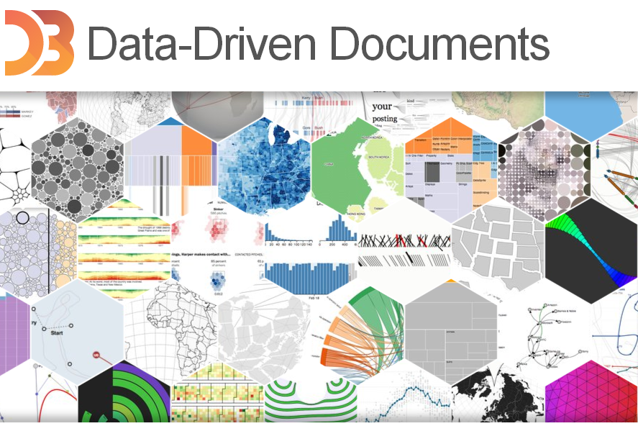
Chunyu Long

Slide 2
Demo-01

Slide 3
D3.js is？
D3.js is a JavaScript library for manipulating documents based on data.
D3 helps you bring data to life using HTML, SVG and CSS. D3’s emphasis on web standards gives you the full capabilities of modern browsers without tying yourself to a proprietary framework, combining powerful visualization components and a data-driven approach to DOM manipulation.

Slide 4
Technology Fundamentals
JavaScript
SVG
DOM
CSS

Slide 5

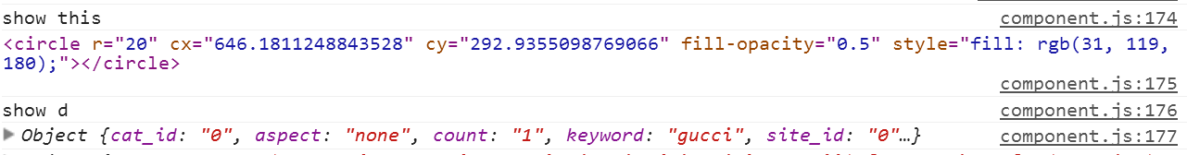
Basics - JavaScript
JavaScript is the scripting language that can make pages dynamic by manipulating the DOM after a page has already loaded in the browser

Slide 6
Basics-SVG
SVG(Scalable Vector Graphics)

Slide 7
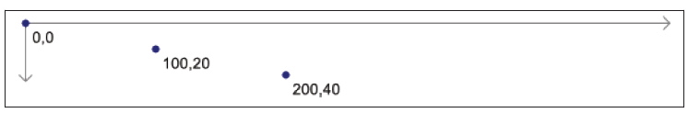
SVG – Coordinates System
0,0 is the top-left corner of the drawing space

Slide 8

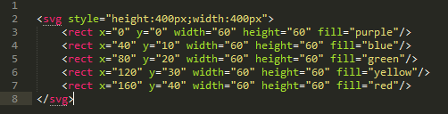
SVG-Layering and Drawing Order
SVG does not support CSS’s z-index property

Slide 9
Step by step (overview)

Slide 10
Reference
[1] http://d3js.org/
[2] Interactive data visualization for the web
[3]

