Slide 1

Chunyu Long

Slide 2
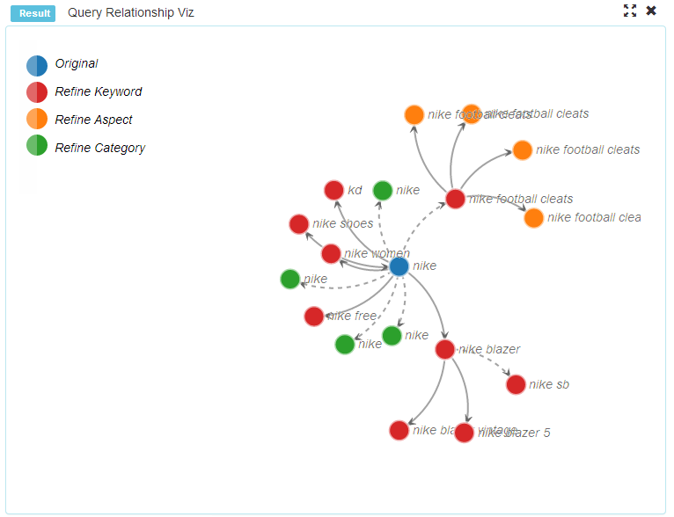
Demo
Notes:
Demo Project Session visualization

Slide 3
D3.js is？
Intro
D3.js is a JavaScript library for manipulating documents based on data.
D3 helps you bring data to life using HTML, SVG and CSS. D3’s emphasis on web standards gives you the full capabilities of modern browsers without tying yourself to a proprietary framework, combining powerful visualization components and a data-driven approach to DOM manipulation.

Slide 4
Technology Fundamentals
JavaScript
SVG
DOM (document object model)
CSS

Slide 5

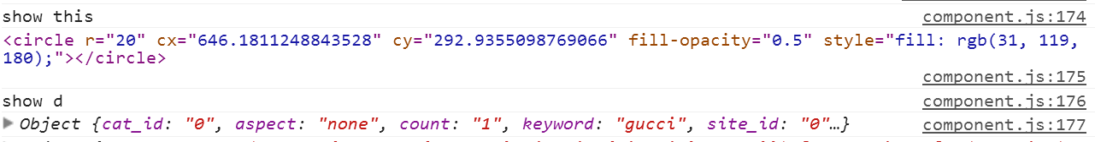
JavaScript
BASICS
JavaScript is the scripting language that can make pages dynamic by manipulating the DOM after a page has already loaded in the browser

Slide 6
JavaScript: Chaining Methods
d3.select("body").append("p").text("New paragraph!");
d3.select ("body")
.append("p")
.text("New paragraph!");

Slide 7
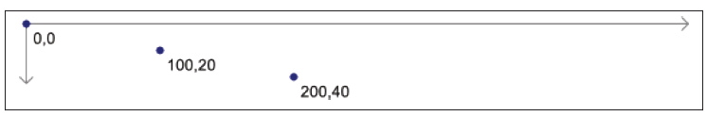
SVG
BASICS
SVG(Scalable Vector Graphics)
SVG : Coordinates System
0,0 is the top-left corner of the drawing space

Slide 8

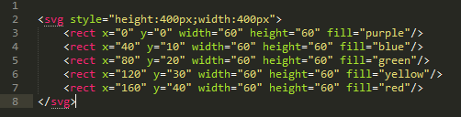
SVG:Layering and Drawing Order
SVG does not support CSS’s z-index property

Slide 9

Step by step

Slide 10

<!DOCTYPE HTML>
<html>
<body>
<script src="http://d3js.org/d3.v3.min.js" charset="utf-8"></script>
<script>
var rainbow = ['red', 'orange', 'yellow', 'green', 'blue', 'indigo', 'violet'];
var arc = d3.svg.arc()
.innerRadius(30)
.outerRadius(function(d, i){ return (rainbow.length - i) * 20 + 30})
.startAngle(-Math.PI / 2).endAngle(Math.PI / 2);
d3.select('body').append('svg')
.selectAll('path').data(rainbow).enter().append('path')
.attr({
d: arc,
transform: 'translate(200, 200)',
fill: function(d){ return d }
})
</script>
</body>
</html>
Example

Slide 11
selection
D3
D3’s atomic operand is the
selection: a filtered set of elements queried from the current document.
operators act on selections, modifying content.

Slide 12
selection
D3
D3 adopts the W3C Selectors API to identify elements for selection
by tag (“tag”)
by class (“.class”)
unique identifier (“#id”)
atrribute (“[name = value]”) ...
or intersected(“.a.b”) or unioned(“.a,.b”)
select/selectAll
subselection
https://github.com/mbostock/d3/wiki/Selections

Slide 13
operators
D3
Operators warp the W3C DOM API, setting
attributes (attr)
styles (style)
property (property)
HTML (html)
text (text)

Slide 14
Data Joins
D3
Data joins bind input data to elements, enabling functional operators that depend on data, and producing enter and exit subselections for the creation and destruction of elements in correspondence with data.
D3 uses format agnostic processing data is specified as an array of arbitrary values, such as numbers, strings or objects.
Once data is bound to elements, it is passed to functional operators as the first argument (by convention, d), along with the numeric index (i).
Data is “sticky”; once bound to nodes, it is available on subsequent re-selection without again requiring the data operator.
J. Heer and M. Bostock. Declarative language design for interactive visualization.
IEEE Trans Vis and Comp Graphics, 16(6):1149–1156, 2010.

Slide 15
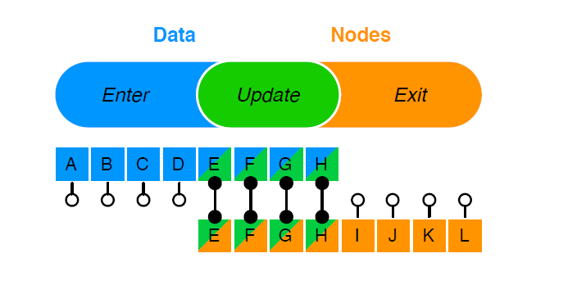


D3
In terms of relational algebra, given data D and nodes N,
the enter selection is D N (left),
the exit selection is N .D (right),
and the update selection is D N (inner).

Slide 16
Interaction
D3
The document object model supports event listeners: callback functions that receive user input events targeted at specific elements.
D3’s on operator exposes this functionality for native event types.
For consistency with other functional operators, the callback receives the data and index as arguments (d, i), allowing data-driven interaction. The targeted node is this, and the current event is d3.event.

Slide 17
modules
D3
Principle “Don’t get it original, get it right.”
shapes
scales
simplify visual encoding
Layout
supply reusable, flexible visualization techniques by generating abstract data structures
…

Slide 18
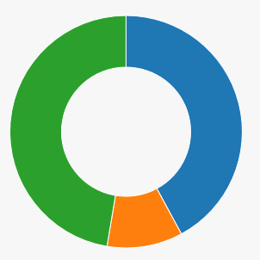
Angular.js
directive
<!DOCTYPE html>
<html>
<head>
<script src="https://ajax.googleapis.com/ajax/libs/angularjs/1.2.10/angular.min.js"></script>
<script src="http://d3js.org/d3.v3.min.js" charset="utf-8"></script>
</head>
<body ng-app="myApp" ng-init="ourSharedData=[8, 2, 9]">
<donut-chart data="ourSharedData"></donut-chart>
<script>…<script>
</body>
</html>
How this happen?
http://jsbin.com/yili/155/edit

Slide 19
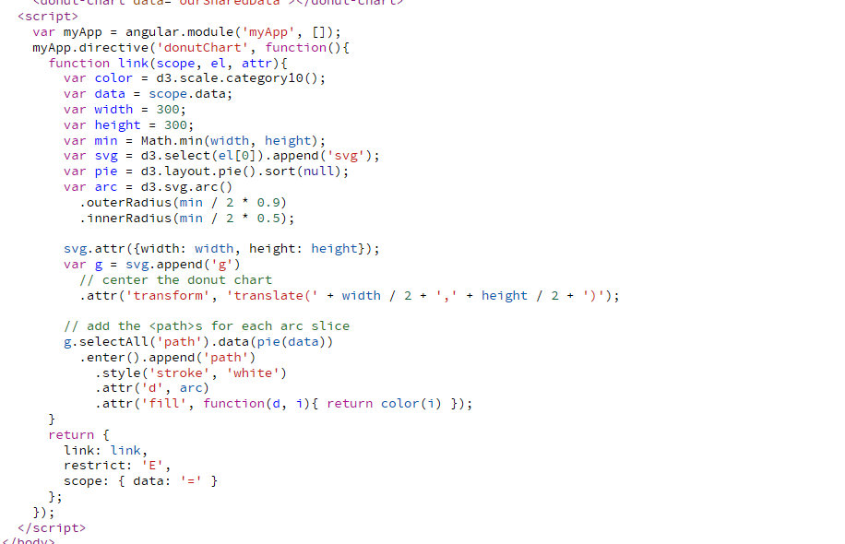
Ans.

Slide 20
Reference
[1] http://d3js.org/
[2] D3: Data-Driven Documents
[2] Interactive data visualization for the web
[3] D3 on AngularJS : Create Dynamic Visualizations with AngularJS

Slide 21


