Slide 1
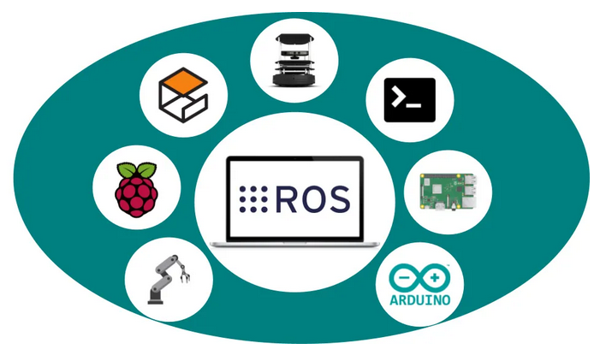
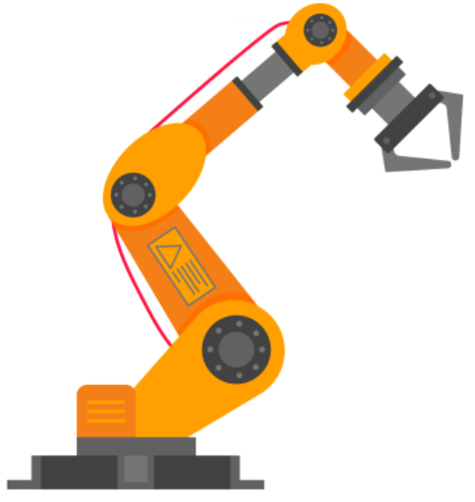
A Demo of Inverse Kinematic for Articulated Robot Arm (4-DOF)
Presenter: Chuong Nguyen (chuong19111996@gmail.com)
Institution: RMIT Vietnam
Last update: 29/6/2022
Notes:
https://opencloudware.com/robot-operating-system-ros-the-key-to-the-future-of-robotics-programming/
https://www.vecteezy.com/vector-art/2512616-robotic-arm-flat-style-design-vector-illustration-icon-sign-isolated-on-white-background-robot-arm-or-hand-industrial-robot-manipulator-modern-smart-industry-40-technology-automated-manufacturing

Slide 2

1. Overview

Slide 3
1.1 Forward Kinematic vs. Inverse Kinematic
In the context of robot manipulator:
Thus, there are a lot of different (Joint) solutions for Inverse Kinematic.
(Known) Joint Angles
Forward Kinematic
End Effector’s Pose
(Desired) End Effector’s Pose
Inverse Kinematic
Joint Angles
Notes:
http://wiki.ros.org/ROS/Introduction
https://softwareengineering.stackexchange.com/questions/140321/what-is-the-difference-between-building-and-compiling

Slide 4
1.1 Forward Kinematic vs. Inverse Kinematic
Example of many (Joint) solutions from Inverse Kinematic for a desired Pose:
Notes:
http://wiki.ros.org/ROS/Introduction
https://softwareengineering.stackexchange.com/questions/140321/what-is-the-difference-between-building-and-compiling

Slide 5
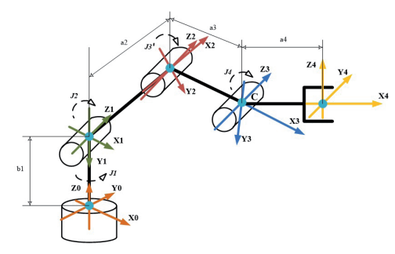
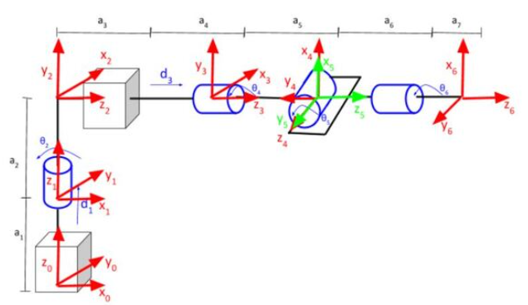
1.2 Inverse Kinematic Approaches
Analytical Approaches: Derive formula (of each Joint angles) based on specific robot’s configuration with constraints, involves matrix algebra and trigonometry. E.g.:
Pros: Fast (usually 1 iteration).
Cons: Not generalized for many robot configuration (need to redo for new type of robot).
First 3 Joints: Position
Last 3 Joints: Orientation
Derive Inverse Kinematic
Notes:
https://automaticaddison.com/the-ultimate-guide-to-inverse-kinematics-fo
https://www.actamechanica.sk/pdfs/ams/2016/03/07.pdfr-6dof-robot-arms/

Slide 6
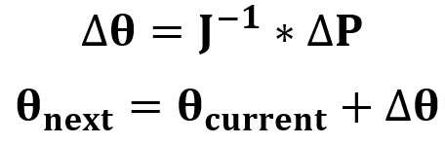
1.2 Inverse Kinematic Approaches
2. Iterative Approaches: Divide the difference between goal Pose and current Pose into Sub-goal Poses, and calculate the change of joint angles (at each time step) to reach the Sub-goal Poses. Uses (pseudo)Inverse Jacobian matrix.
Pros: Generalized for many robot’s configuration.
Cons: Slower (sufficiently large iterations), Easier to get stuck in singularity (Can be overcome with tricks).
Derive Forward Kinematic (from D-H parameters)
Derive formula of (pseudo) Inverse Jacobian matrix
Loop:
Notes:
https://automaticaddison.com/the-ultimate-guide-to-inverse-kinematics-fo
https://www.actamechanica.sk/pdfs/ams/2016/03/07.pdfr-6dof-robot-arms/

Slide 7
2. Iterative Inverse Kinematic

Slide 8
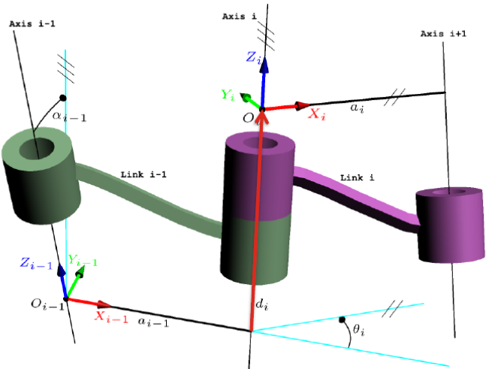
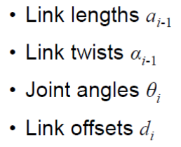
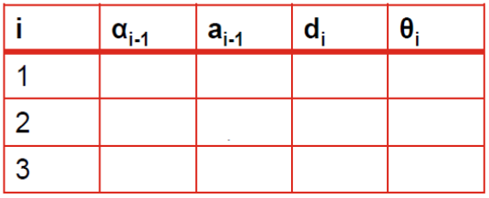
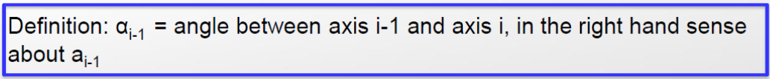
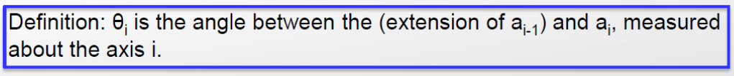

2.1 Forward Kinematic with D-H Parameters
* This table is called modified D-H table.

Slide 9
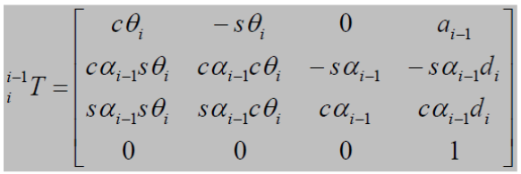
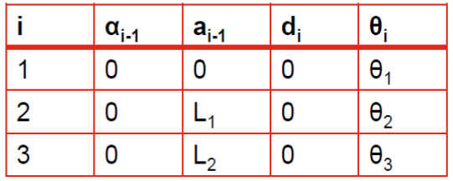
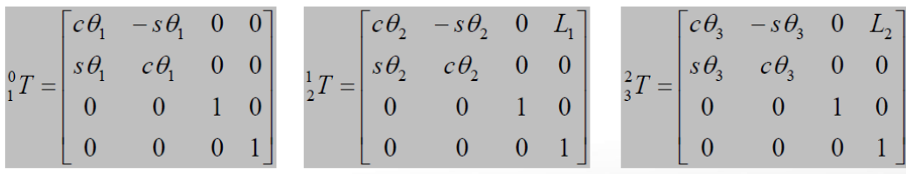
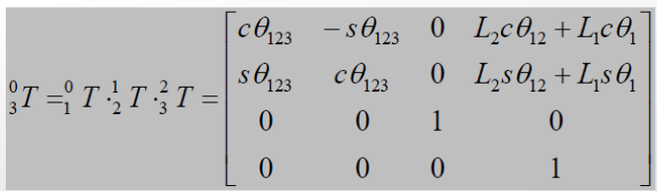
2.1 Forward Kinematic with D-H Parameters

Slide 10
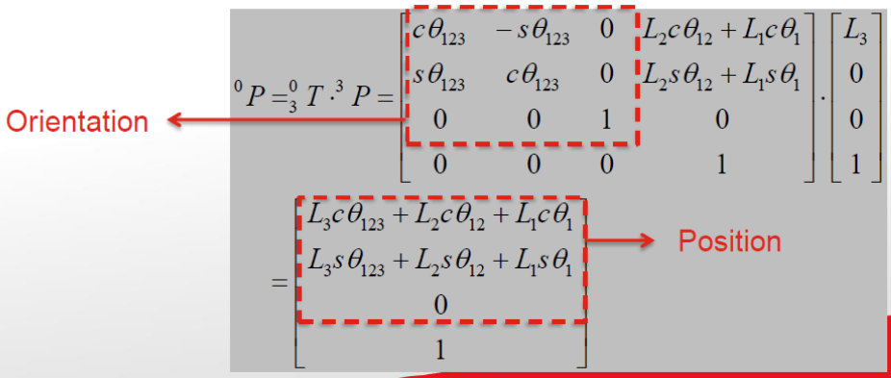

2.1 Forward Kinematic with D-H Parameters
* End Effector has position [L3, 0, 0]T , same orientation with frame {3}

Slide 11
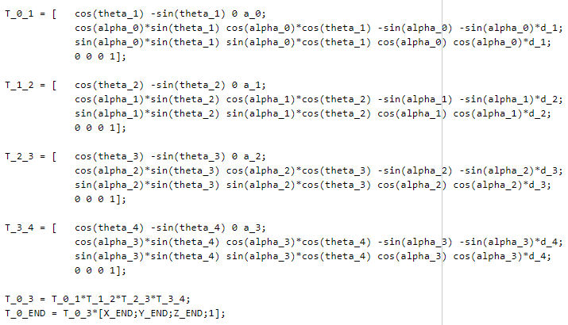
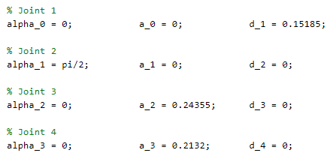

2.1 Forward Kinematic with D-H Parameters

Slide 12

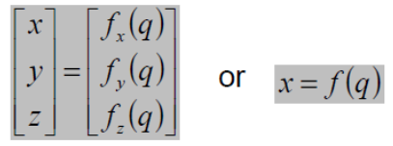
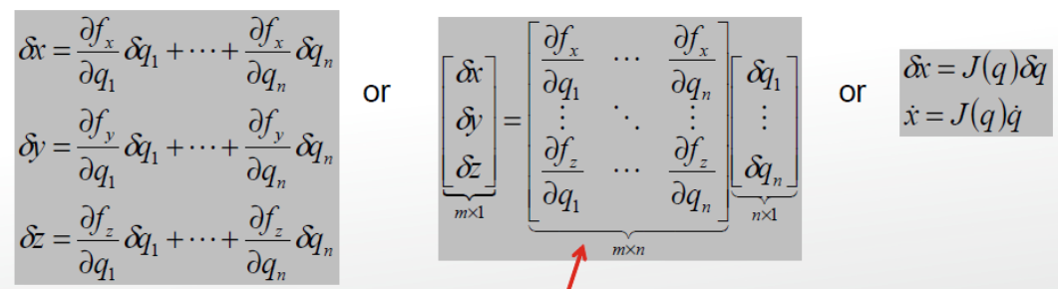

2.2 (pseudo)Inverse Jacobian Matrix
Forward Kinematic: q is joint angles
Inverse Jacobian Matrix: Take differentiation of FK & apply chain rule -> Take Jacobian matrix to other side -> Obtain formula to calculate the change of Joint angle.
More often than not, Jacobian matrix is not square -> Apply pseudo inverse.
Jacobian Matrix

Slide 13
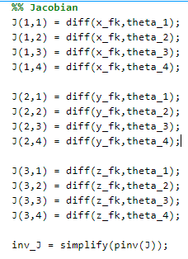
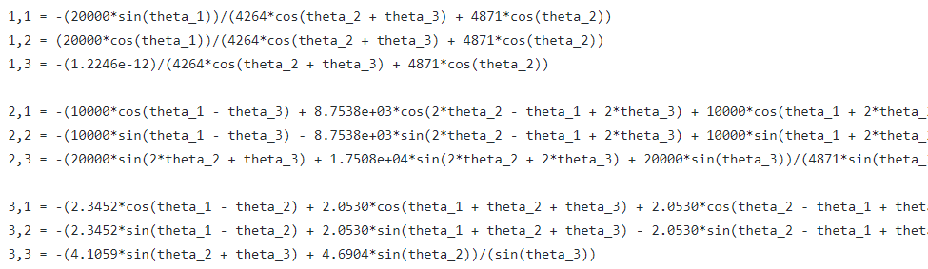
2.2 (pseudo)Inverse Jacobian Matrix

Slide 14
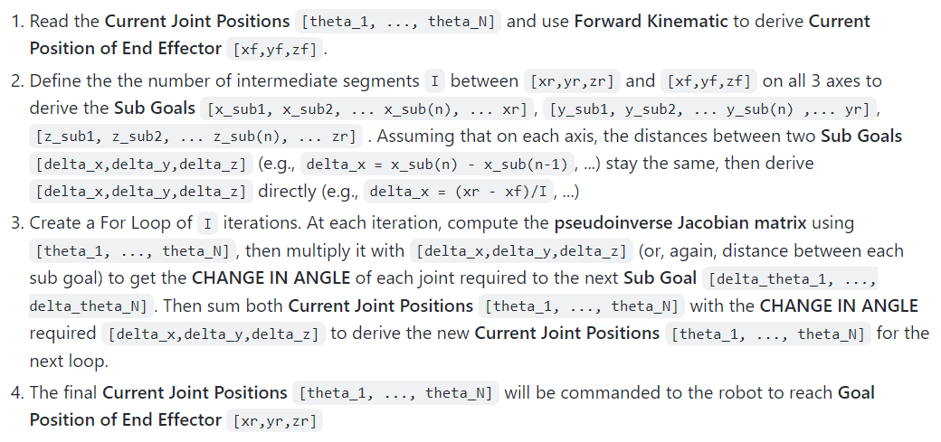
2.3 Programming

Slide 15
3. Demo

Slide 16
3.1 Gazebo & ROS
ROS (Robot Operating System)
Meta operating system, runs on top of Linux/Windows, alleviate concurrency management and module communication.
An abstraction of TCP/IP-based and UDP/IP-based protocol (Socket type in Inter-process Communication) (configuring pure socket programming is PAIN!).
Large community module/projects (largest in robotic software platform).
Not real-time however (because Linux/Window isn’t).
Open-source.
Gazebo
Popular robot simulation that integrated closely with ROS.
Open-source.

Slide 17
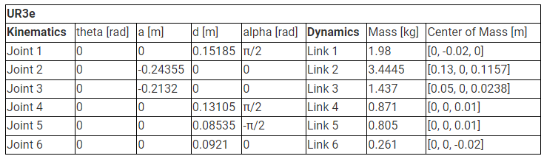
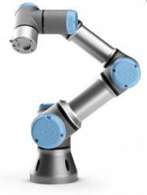
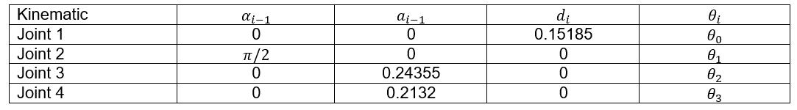
3.2 UR3 Universal Robots

Slide 18
4. Implementation

Slide 19
4.1 Implementation
Get Joint Angle -> Translate to PWM -> Command desired PWM to the controller.
Scheme 1: Laptop (IK) –(USB)–> Arduino (4 PWM).
Scheme 2: Laptop (IK) –(UART with USB-TTL)–> Arduino (4 PWM).
Scheme 3: Laptop (IK) –(I2C with USB-TTL)–> Servo Driver (>12 PWM).
Scheme 4: Pi/Jetson (IK) –(UART)–> Arduino (4 PWM).
Scheme 5: Pi/Jetson (IK) –(I2C)–> Servo Driver (>12 PWM).
Notes:
https://hshop.vn/products/mach-xuat-16-xung-pwmgiao-tiep-i2c
UART is single-single device while I2C and SPI can have theoretically as many as they want on a network hence these controller usually use I2C

