Slide 1
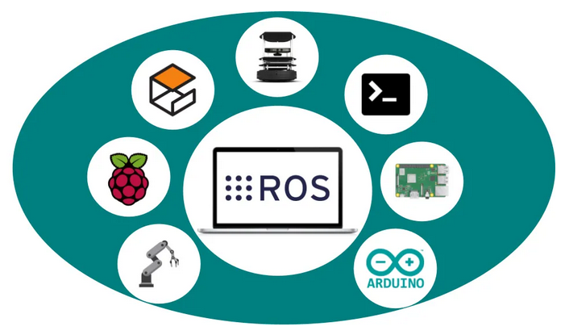
ROS – Robot Operating System 101
Presenter: Chuong Nguyen (chuong19111996@gmail.com)
Institution: RMIT Vietnam SGS
Last update: 26/6/2021
Notes:
https://opencloudware.com/robot-operating-system-ros-the-key-to-the-future-of-robotics-programming/

Slide 2

1. Definitions

Slide 3
1.1 What is it?
wiki.ros: ROS is an open-source, meta-operating system (for a robot), which means (1) it provides basic services of an OS. Also, (2) ROS provides tools to build, test, run codes.
Addition (ROS as a product): ROS is a software framework/philosophy that use a modified version of common build system to compile and run codes.
E.g.: ROS uses catkin build system, which is derived from CMake build system (a common multi-platform build system).
* A build system is a process that includes various step to deliver a complete software product: pre-processing, compiling, linking, converting data files, running automated tests, packaging, etc. In our case? It deliver ROS packages.
* Support object-oriented languages: C++, Python, Lisp; experimenting Java and Lua.
Notes:
http://wiki.ros.org/ROS/Introduction
https://softwareengineering.stackexchange.com/questions/140321/what-is-the-difference-between-building-and-compiling

Slide 4
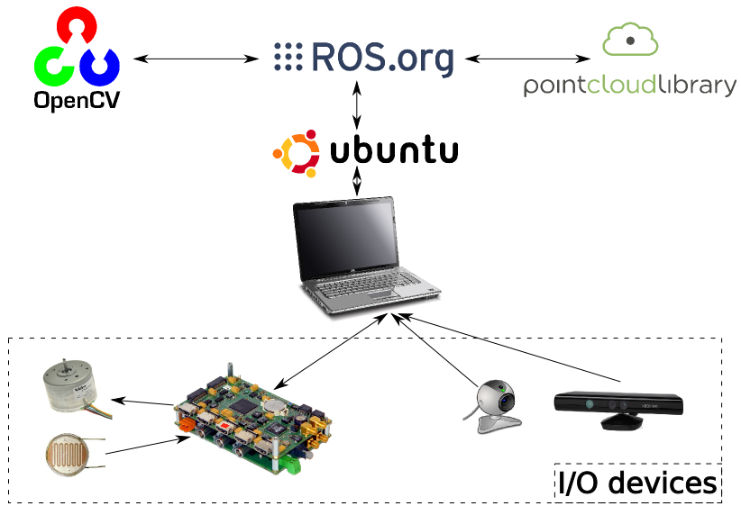
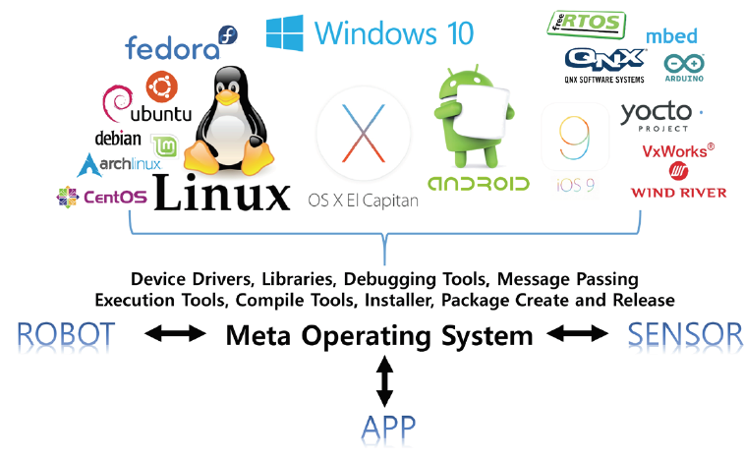
1.2 Why ROS?
1. ROS acts as an translator/communicator between different hardware/software platform.
2. Due to modularity, ROS allows reusability of codes (we download ROS packages from community on Github. ROS community is the largest)
However, ROS is not a real-time OS because it is built on top of Linux, which is not a real-time OS either. Hence, it is not suitable for time-critical applications.
Notes:
https://gtms1318.files.wordpress.com/2013/04/robot_working.png

Slide 5
2. How does it looks like?

Slide 6
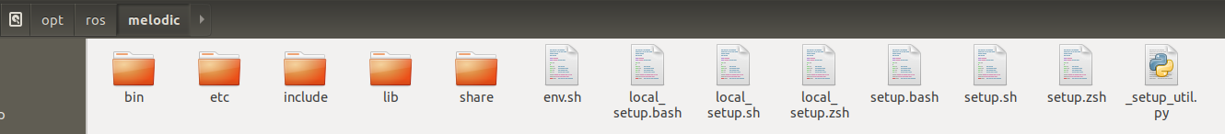
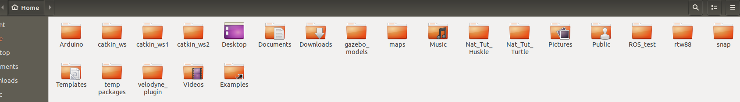
2.1 In File System
1. As add-ons: ROS is a collection of packages managed by apt (Advanced Package Tool) of Linux. Thus, after installing ROS, you can find it in /opt/ros/melodic. You are highly recommended not to modify anything in this.
2. ROS Workspace: often located at /home/user, manually created by user, contains source codes. This is where we will work. In this instance, ROS workspaces are catkin_ws, catkin_ws1, catkin_ws2 (or whatever names you want).
Notes:
https://gtms1318.files.wordpress.com/2013/04/robot_working.png

Slide 7
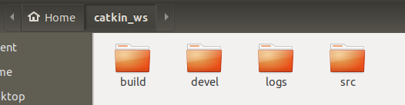
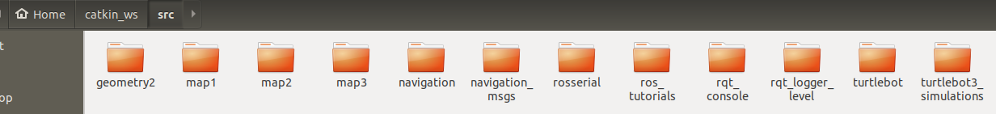
2.1 In File System
Inside a ROS workspace:
/build: Build related files.
/devel: msg, srv Headers and User Package Library, Execution Files.
/logs: build reports.
/src: source codes and data of User ROS packages (we dev in this folder, ignore the rest for now).
Inside /src: are user's written packages
Notes:
https://gtms1318.files.wordpress.com/2013/04/robot_working.png

Slide 8
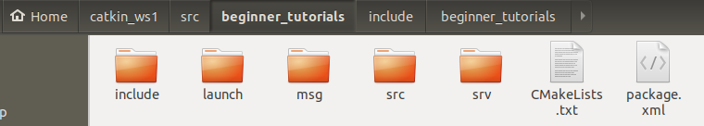
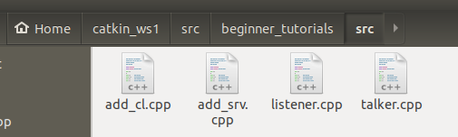
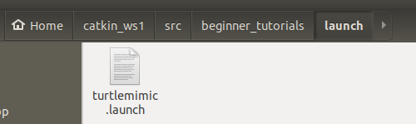
2.1 In File System
Inside a package:
In the simplest form, a ROS package only need 2 files: (1) package.xml defines "background" info such as pkg name, pkg version, author, etc. and (2) CMakeLists.txt defines build sequence of the package.
Other folders contain source codes and relevant files.
Notes:
https://gtms1318.files.wordpress.com/2013/04/robot_working.png

Slide 9
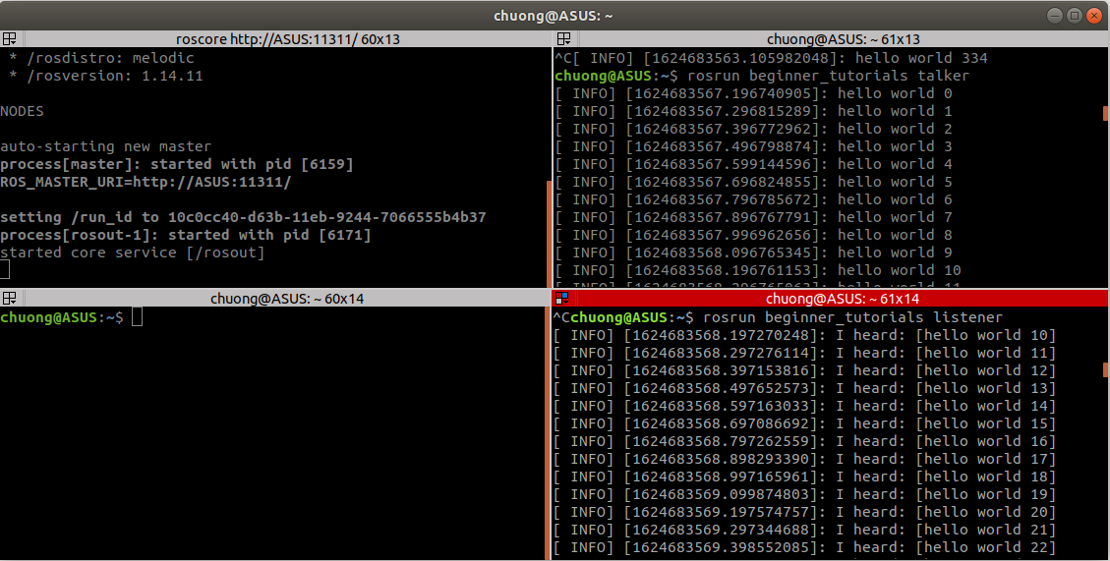
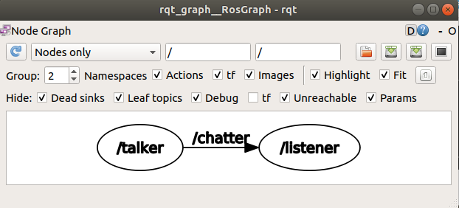
2.2 At Runtime
e.g: a simple publisher-subscriber example. Note that after creating a package, it needs to be built inside ROS workspace to be usable (yes I haven't shown the build process).
Notes:
https://gtms1318.files.wordpress.com/2013/04/robot_working.png

Slide 10
3. ROS Configurations

Slide 11
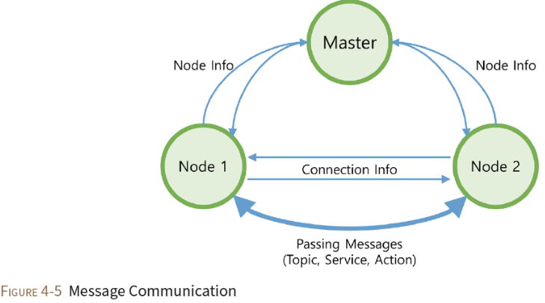
3.1 Basic Structure
Master: serves as a name server for ROS network, link the Nodes together. Generally, only ONE master runs inside a network.
Node: a ROS entity/object.
Message: data transferred between the nodes.
ROS is just an abstraction of TCP/IP-based and UDP/IP-based protocol (Socket type in Inter-process Communication), which is why ROS is seamless between devices on same network (great for IoT application).

Slide 12
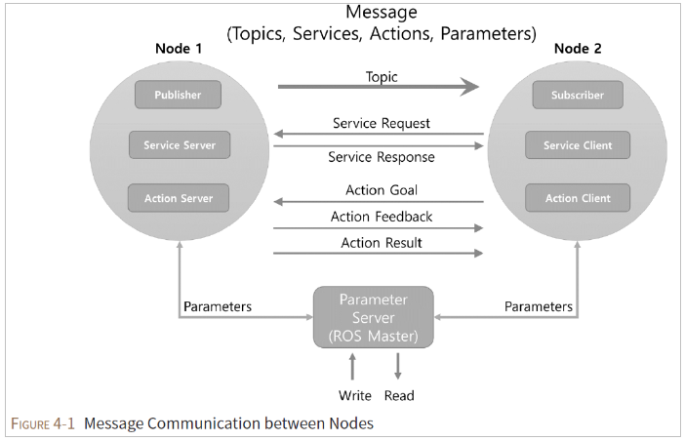
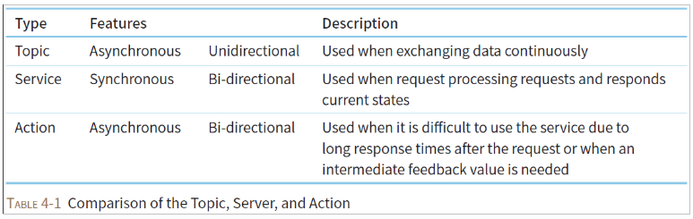
3.2 Communication Methods
Total 3 types: (1) Publisher-Subscriber, (2) Service-Client, (3) Action-Client.

Slide 13
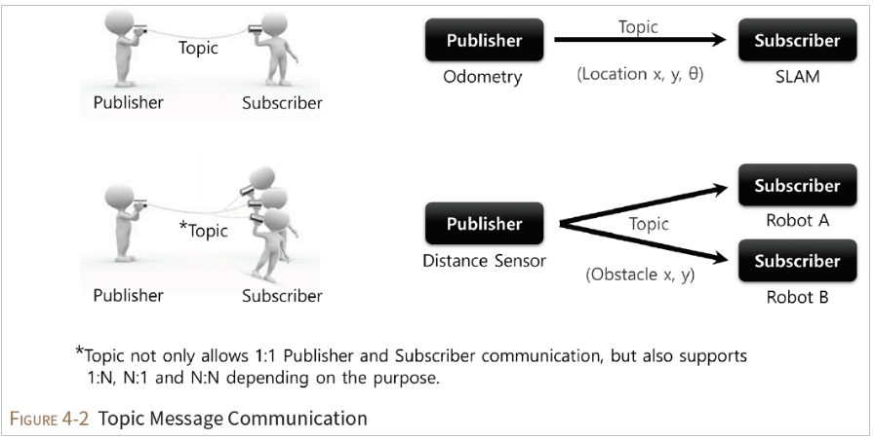
3.2.1 Publisher-Subscriber

Slide 14
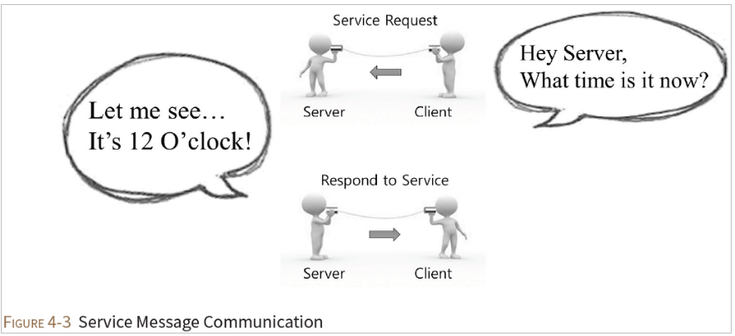
3.2.2 Service-Client

Slide 15
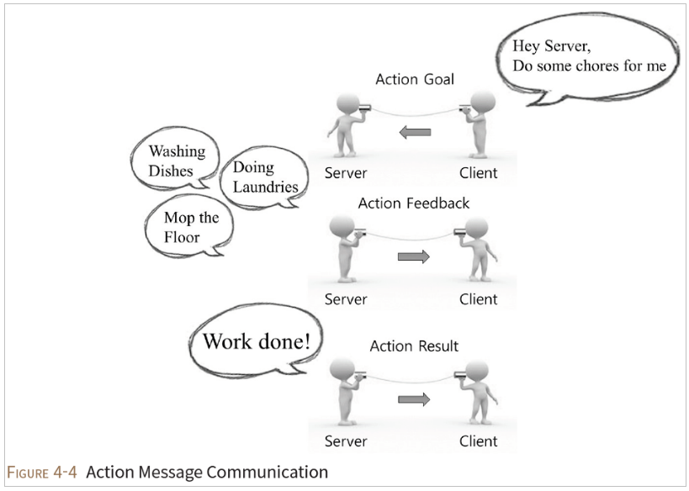
3.2.3 Action-Client

Slide 16
4. Examples

Slide 17
4.1 Create a ROS workspace & a blank package.
Step 1: Open terminal, type mkdir first_ROS_ws, a folder name first_ROS_ws appear at home. You can name it whatever you want.
Step 2: type cd first_ROS_ws to navigate inside first_ROS_ws folder, type mkdir src to make source folder.
Step 3 (requires catkin_tools): at first_ROS_ws folder, type catkin init to initialize ROS workspace.
Step 4: type cd src to navigate inside src folder, type catkin create pkg pkg_a to create a blank package named pkg_a.
Step 5(requires catkin_tools): type cd .. to navigate back to first_ROS_ws folder, type catkin build to build the package pkg_a.
DONE! :). You created your first ROS workspace and package.
What I didn't show? I didn’t create actual contents for package pkg_a and modify the CMakeLists.txt (define build sequence). I didn't demonstrate how to run package pkg_a too. Now let's move to ...
Notes:
https://gtms1318.files.wordpress.com/2013/04/robot_working.png

Slide 18
4.2 Simple Publisher-Subscriber (C++)
Link 1 – Create message file (and config CMakeLists.txt & package.xml)
http://wiki.ros.org/ROS/Tutorials/CreatingMsgAndSrv
Link 2 – Create "hello word" on Publisher-Subscriber (C++) (and config CMakeLists.txt)
http://wiki.ros.org/ROS/Tutorials/WritingPublisherSubscriber%28c%2B%2B%29
Notes:
https://gtms1318.files.wordpress.com/2013/04/robot_working.png

Slide 19
5. What's next?

Slide 20
5.1 ROS Tutorial – Beginner.
Link: http://wiki.ros.org/ROS/Tutorials
Change all "Kinetic" to your ROS version ("Melodic" or "Noetic").
For now, use catkin_make to build is fine, later on we need to use catkin build.
Skip Python for now.
More about CMakeLists.txt: http://wiki.ros.org/catkin/CMakeLists.txt
More about package.xml: http://wiki.ros.org/catkin/package.xml
Notes:
https://gtms1318.files.wordpress.com/2013/04/robot_working.png

Slide 21
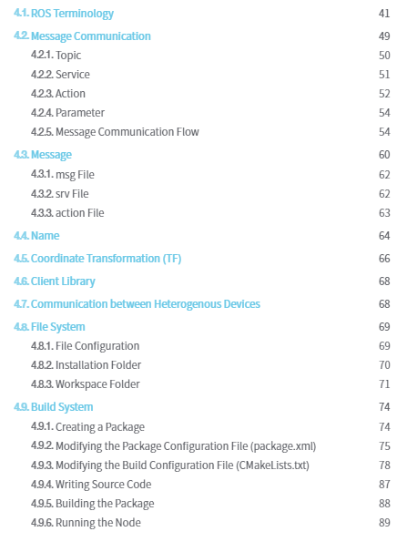
5.2 Extensive Readings
Book: ROS Robot Programming
Core concepts: 4.2, 4.3
File System: 4.8
Build System: 4.9
Terminology: 4.1
ROS is an abstraction TCP/IP communication.
Notes:
https://gtms1318.files.wordpress.com/2013/04/robot_working.png

