Slide 1
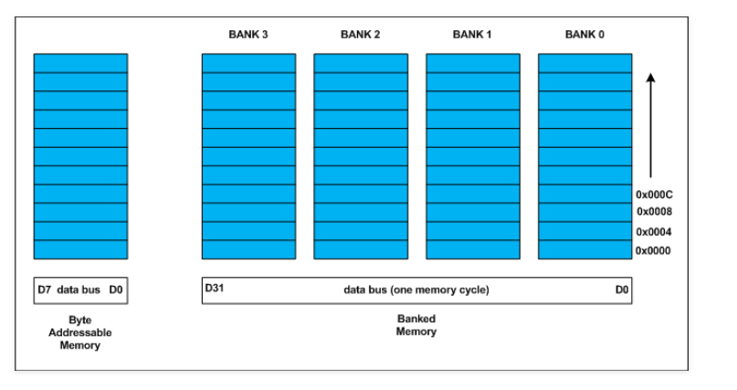
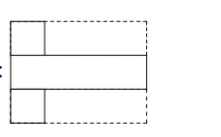

Struct
A struct (a structure) is a sequence of elements (called members) of arbitrary types.
Notice: Aligment

Slide 2
Struct and class
A struct is simply a class where the members are public by default.
Constructor
Inheritance
polymorphysm

Slide 3
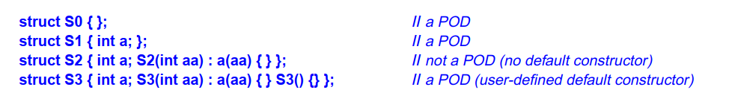
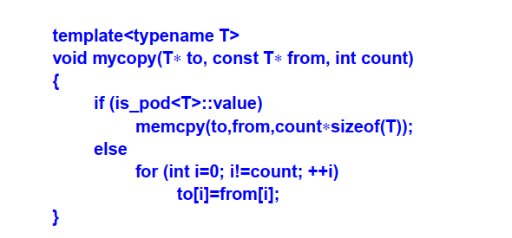
Plain Old Data
POD (‘‘Plain Old Data’’) is an object that can be manipulated as ‘‘just data’’ without worrying about complications of class layouts or user-defined semantics for construction, copy, and move
<type_traits>

Slide 4
Fields
Problem: present an on/off switch – but a char is the smallest object that can be independently allocated and addressed in C++ => It seems extravagant

Slide 5
Union – Union and class
A union is a struct in which all members are allocated at the same address so that the union occupies only as much space as its largest member
Some restrictions are imposed on unions: (not) inheritance

Slide 6
Enum
An enumeration is a type that can hold a set of integer values specified by the user
An enum class is a scoped and strongly typed enumeration
Plain enum

Slide 7
Statement – swith statement
Statements are fragments of the C++ program that are executed in sequence
A switch-statement selects among a set of alternatives (case-labels).
Declarations in Cases

