Slide 1
Using databases and exposing data to networks
JDBC and HTTP Servers

Slide 2
Practical information
We have one assignment which will be graded at the end of the course, upon submission
After each lesson, you will be able to implement a part of the assignment
We recommend to do it gradually
At the beginning of each lesson, we will do a "refresher" of the previous topic. Come with a smartphone
Each lesson includes some practice. Be here with a laptop and enough battery
Tooling:
VS Code or IntelliJ Idea
Java 21
Git
Setup everything by using the "cook-books" from oop-2: https://appliedmath.toi.inholland.nl/oop-2-code-projects/cook-books

Slide 3
Objectives
Understand the basics of JDBC (Java Database Connectivity)
Learn how to connect to a database
Perform basic CRUD operations

Slide 4
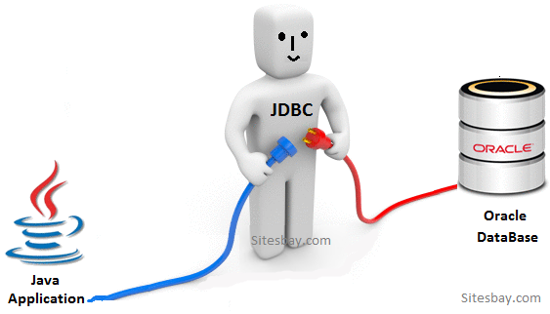
What is JDBC?
JDBC is an API for connecting and executing queries on a database.
It provides methods to query and update data in a database.
Driver
Connection
Statement
Result Set

Slide 5
Driver
public class App {
public static void main(String[] args) throws Exception {
Class.forName("org.h2.Driver");
}
}
Load the Driver

Slide 6
Connection
public class App {
public static void main(String[] args) throws Exception {
Class.forName("org.h2.Driver");
Connection connection = DriverManager.getConnection(
"jdbc:h2:mem:testdb",
"username",
"password");
}
}
Establish the connection

Slide 7
Statement
public class App {
public static void main(String[] args) throws Exception {
Class.forName("org.h2.Driver");
Connection connection = DriverManager.getConnection(
"jdbc:h2:mem:testdb",
"username",
"password");
Statement statement = connection.createStatement();
}
}
Create a statement

Slide 8
Result Set
public class App {
public static void main(String[] args) throws Exception {
Class.forName("org.h2.Driver");
Connection connection = DriverManager.getConnection(
"jdbc:h2:mem:testdb",
"username",
"password");
Statement statement = connection.createStatement();
ResultSet rs = statement.executeQuery("SELECT * FROM mytable");
}
}
Execute a query and capture the data in the result set

Slide 9
Basic CRUD operations
C reate
R ead
U pdate
D elete

Slide 10
Create
public class App {
public static void main(String[] args) throws Exception {
Class.forName("org.h2.Driver");
Connection connection = DriverManager.getConnection(
"jdbc:h2:mem:testdb",
"username",
"password");
Statement statement = connection.createStatement();
String sql = "INSERT INTO mytable (name, age) VALUES ('John',30)";
statement.executeUpdate(sql);
}
}
Execute a CREATE query

Slide 11
Read
public class App {
public static void main(String[] args) throws Exception {
Class.forName("org.h2.Driver");
Connection connection = DriverManager.getConnection(
"jdbc:h2:mem:testdb",
"username",
"password");
Statement statement = connection.createStatement();
String sql = "SELECT * FROM mytable";
ResultSet rs = stmt.executeQuery(sql);
while (rs.next()) {
System.out.println("Name: " +
rs.getString("name") +
", Age: " +
rs.getInt("age"));
}
}
}
Execute a READ query and show the data from the result set

Slide 12
Update
public class App {
public static void main(String[] args) throws Exception {
Class.forName("org.h2.Driver");
Connection connection = DriverManager.getConnection(
"jdbc:h2:mem:testdb",
"username",
"password");
Statement statement = connection.createStatement();
String sql = ”UPDATE mytable SET age=31 WHERE name='John’";
statement.executeUpdate(sql);
}
}
Execute an UPDATE query

Slide 13
Delete
public class App {
public static void main(String[] args) throws Exception {
Class.forName("org.h2.Driver");
Connection connection = DriverManager.getConnection(
"jdbc:h2:mem:testdb",
"username",
"password");
Statement statement = connection.createStatement();
String sql = ”DELETE FROM mytable WHERE name='John’";
statement.executeUpdate(sql);
}
}
Execute a DELETE query

Slide 14
Close the resources
public class App {
public static void main(String[] args) throws Exception {
Class.forName("org.h2.Driver");
Connection connection = DriverManager.getConnection(
"jdbc:h2:mem:testdb",
"username",
"password");
Statement statement = connection.createStatement();
String sql = "SELECT * FROM mytable";
ResultSet rs = stmt.executeQuery(sql);
while (rs.next()) {
System.out.println("Name: " +
rs.getString("name") +
", Age: " +
rs.getInt("age"));
}
rs.close();
stmt.close();
conn.close();
}
}
Avoid memory leaks and properly terminate the connection to the database

Slide 15
Let’s apply best practices and SOLID principles
public class App {
public static void main(String[] args) throws Exception {
Class.forName("org.h2.Driver");
Connection connection = DriverManager.getConnection(
"jdbc:h2:mem:testdb",
"username",
"password");
Statement statement = connection.createStatement();
String sql = "SELECT * FROM mytable";
ResultSet rs = stmt.executeQuery(sql);
while (rs.next()) {
System.out.println("Name: " +
rs.getString("name") +
", Age: " +
rs.getInt("age"));
}
rs.close();
stmt.close();
conn.close();
}
}
This piece of code works, but it’s full of problems and hard to maintain if we need to apply changes and add features

Slide 16



Single responsibility principle
public class App {
public static void main(String[] args) throws Exception {
Class.forName("org.h2.Driver");
Connection connection = DriverManager.getConnection(
"jdbc:h2:mem:testdb",
"username",
"password");
Statement statement = connection.createStatement();
String sql = "SELECT * FROM mytable";
ResultSet rs = stmt.executeQuery(sql);
while (rs.next()) {
System.out.println("Name: " +
rs.getString("name") +
", Age: " +
rs.getInt("age"));
}
rs.close();
stmt.close();
conn.close();
}
}
Interactions with DB
Let’s identify responsibilities
Display the data

Slide 17
Single responsibility principle
public record Person(String name, int age) {
@Override
public String toString() {
return "Name: " + name + ", Age: " + age;
}
}
Let’s represent our data with a record

Slide 18
Single responsibility principle
public class PeopleDatabaseManager {
public List<Person> getPeople() throws Exception {
List<Person> people = new ArrayList<>()
Class.forName("org.h2.Driver");
Connection connection = DriverManager.getConnection(
"jdbc:h2:mem:testdb",
"username",
"password");
Statement statement = connection.createStatement();
String sql = "SELECT * FROM mytable";
ResultSet rs = stmt.executeQuery(sql);
while (rs.next()) {
String name = rs.getString("name");
int age = rs.getInt("age");
people.add(new Person(name, age));
}
rs.close();
stmt.close();
conn.close();
return people;
}
}
Separate the logic to access the data

Slide 19
Single responsibility principle
public class App {
public static void main(String[] args) throws Exception {
PeopleDatabaseManager dbManager = new PeopleDatabaseManager();
dbManager.getPeople().forEach(System.out::println);
}
}
The main application is simplified

Slide 20



Best practices
public class PeopleDatabaseManager {
public List<Person> getPeople() throws Exception {
List<Person> people = new ArrayList<>()
Class.forName("org.h2.Driver");
Connection connection = DriverManager.getConnection(
"jdbc:h2:mem:testdb",
"username",
"password");
Statement statement = connection.createStatement();
String sql = "SELECT * FROM mytable";
ResultSet rs = stmt.executeQuery(sql);
while (rs.next()) {
String name = rs.getString("name");
int age = rs.getInt("age");
people.add(new Person(name, age));
}
rs.close();
stmt.close();
conn.close();
return people;
}
}
I can connect only to this DB
This class is still full of problems
The list is potentially huge
The resources might stay open

Slide 21
Best practices
public class PeopleDatabaseManager {
private final String url;
private final String user;
private final String password;
public PeopleDatabaseManager(
String driver,
String url,
String user,
String password) throws SQLException {
this.url = url;
this.user = user;
this.password = password;
try {
Class.forName(driver);
} catch (ClassNotFoundException e) {
throw new SQLException(”driver not found", e);
}
}
[ . . . ]
}
The constructor now enables us to connect to more databases, and addresses configuration errors

Slide 22
Best practices
public class PeopleDatabaseManager {
[ . . . ]
public List<Person> getPeople(int size, int page)
throws SQLException {
List<Person> people = new ArrayList<>();
int offset = (page - 1) * size;
String sql = "SELECT * FROM mytable LIMIT ? OFFSET ?";
PreparedStatement stmt = connection.prepareStatement(sql);
stmt.setInt(1, size);
stmt.setInt(2, offset); ResultSet rs = stmt.executeQuery();
while (rs.next()) {
String name = rs.getString("name");
int age = rs.getInt("age");
people.add(new Person(name, age));
}
rs.close();
stmt.close();
conn.close();
return people;
}
Size and page, as input, grant us to limit the output and avoid memory and performance issues.
When we accept input, we need to use prepared statements to avoid SQL injection

Slide 23
Best practices
public class PeopleDatabaseManager {
[ . . . ]
public List<Person> getPeople(int size, int page)
throws SQLException {
List<Person> people = new ArrayList<>();
int offset = (page - 1) * size;
String sql = "SELECT * FROM mytable LIMIT ? OFFSET ?";
try (Connection connection =
DriverManager.getConnection(url, user, password);
PreparedStatement preparedStatement =
connection.prepareStatement(sql)) {
preparedStatement.setInt(1, size);
preparedStatement.setInt(2, offset);
try (ResultSet resultSet = preparedStatement.executeQuery()) {
while (resultSet.next()) {
String name = resultSet.getString("name");
int age = resultSet.getInt("age");
people.add(new Person(name, age));
}
}
}
return people;
}
The nested try-with-resource blocks will close the resources for us (connection, statement, result set).

Slide 24
Best practices
public class App {
public static void main(String[] args) throws Exception {
PeopleDatabaseManager dbManager = new PeopleDatabaseManager(
”org.h2.Driver",
"jdbc:h2:mem:testdb",
"user",
"password");
dbManager.getPeople(10, 1).forEach(System.out::println);
}
}
The main application is a bit bigger, but quite simple

Slide 25
Transactions
Statement statement1 = connection.createStatement();
Statement statement2 = connection.createStatement();
String sql1 = "INSERT INTO mytable (name, age) VALUES ('John',30)";
String sql2 = "INSERT INTO mytable (name, age) VALUES ('Jane',30)";
try {
statement1.executeUpdate(sql1);
statement2.executeUpdate(sql2);
connection.commit();
} catch (SQLException e) {
System.err.println("An error occurred: " + e);
connection.rollback();
} finally {
if (statement1 != null) {
statement1.close();
}
if (connection != null) {
connection.close();
}
}
Execute all the operations on the connection or rollback them all

Slide 26

5 minutes break
See you in 5 minutes

Slide 27




Providing data to consumers using the http protocol
HTTP
request
JDBC connection
HTTP
response
JDBC result set
Devices connected to internet
Java application
Database

Slide 28
Providing data to consumers using the http protocol
HTTP
request
JDBC connection
Class HttpServer
Interface HttpHandler
Class HttpExchange
We need to provide an implementation
HTTP
response
JDBC result set
Java application

Slide 29
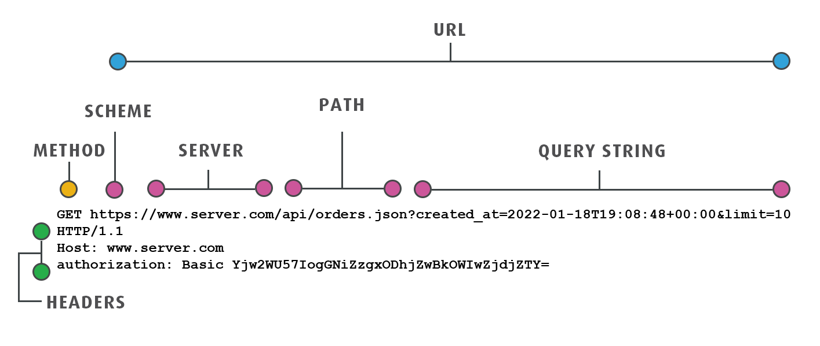
HTTP request

Slide 30
HTTP request
POST /people
Host: localhost:8080
Headers:
Content-Type: application/json
Accept: application/json
Content-Length: 34
Body:
{ "name": "John Doe", "age": 30 }
Here’s an example of a request to create a new person in the database
A response has a very similar structure

Slide 31
HTTP verbs and CRUD
POST = Create
GET = Read
PUT = Update
DELETE = Delete

Slide 32

HttpServer and HttpHandler
public class App {
public static void main(String[] args) throws Exception {
PeopleDatabaseManager dbManager = new PeopleDatabaseManager(
”org.h2.Driver",
"jdbc:h2:mem:testdb",
"user",
"password");
HttpServer httpServer = HttpServer.create(
new InetSocketAddress(8080), 0);
httpServer.createContext("/people", new PeopleHandler(dbManager));
httpServer.setExecutor(null);
httpServer.start();
}
}
How to link the web to the database

Slide 33
HttpHandler and PeopleDatabaseManager People Handler in details
public class PeopleHandler implements HttpHandler { private final PeopleDatabaseManager dbManager;
private final ObjectMapper objectMapper = new ObjectMapper();
public PeopleHandler(PeopleDatabaseManager dbManager) {
this.dbManager = dbManager;
}
@Override
public void handle(HttpExchange exchange) throws IOException {
String method = exchange.getRequestMethod();
String response = "";
[ . . . ]
}
}
A collaborator of the PeopleHandler is the PeopleDatabaseManager. We pass it throught the constructor to enable composability.
The ObjectMapper is used to transform strings into java object and vice versa.

Slide 34
HttpHandler and PeopleDatabaseManager PeopleHandler in details
@Override
public void handle(HttpExchange exchange) throws IOException {
String method = exchange.getRequestMethod();
String response = ""; try {
switch (method) {
case "GET":
response = handleGet(exchange);
break;
case "POST":
response = handlePost(exchange);
break;
[ . . . ]
}
exchange.sendResponseHeaders(200, response.getBytes().length);
OutputStream os = exchange.getResponseBody();
os.write(response.getBytes());
os.close();
} catch (SQLException e) {
e.printStackTrace();
exchange.sendResponseHeaders(500, -1); // Internal Server Error
}
}
The PeopleHandler needs to handle all the supported web calls. We see again the output stream in the end, that we can use to write the response to be returned to the client.

Slide 35
HttpHandler and PeopleDatabaseManager PeopleHandler in details
private String handleGet(HttpExchange exchange) throws Exception {
String query = exchange.getRequestURI().getQuery();
int size = 10; // Default size
int page = 1; // Default page
if (query != null) {
for (String param : query.split("&")) {
String[] keyValue = param.split("=");
if (keyValue.length == 2) {
switch (keyValue[0]) {
case "size" -> size = Integer.parseInt(keyValue[1]);
case "page" -> page = Integer.parseInt(keyValue[1]);
}
}
}
}
List<Person> people = dbManager.getPeople(size, page);
return objectMapper.writeValueAsString(people);
}
Here’s an example on how to handle a specific request, reading from the query string and returning a response with a response body

Slide 36
Homework
After each lesson, you get a piece of homework that serves as implementation of the final assignment.
Today you don’t get homework, because the next lesson is tomorrow. The piece of assignment of tomorrow will be related to 2 topics:
Interacting with databases through the web
Optimizing performance through multi-threading

