Slide 1
Principles of multi-threading
Increase performance by arranging parallel execution

Slide 2
Practical information
We have one assignment which will be graded at the end of the course, upon submission
After each lesson, you will be able to implement a part of the assignment
We recommend to do it gradually
At the beginning of each lesson, we will do a "refresher" of the previous topic. Come with a smartphone
Each lesson includes some practice. Be here with a laptop and enough battery
Tooling:
VS Code or IntelliJ Idea
Java 21
Git
Setup everything by using the "cook-books" from oop-2: https://appliedmath.toi.inholland.nl/oop-2-code-projects/cook-books

Slide 3
Objectives
Understand the concept of multi-threading.
Learn how to create and manage threads in Java.
Explore synchronization and thread safety.
Practice coding exercises to reinforce learning.

Slide 4
Introduction to multi-threading
Definition: Multi-threading
is the ability of a CPU, or a single core in a multi-core processor, to provide multiple threads of
execution concurrently.
Importance: Enhances performance by allowing multiple operations to run simultaneously.
Examples: Web servers handling multiple requests, video games rendering graphics and processing user input simultaneously.
Task 1: 400 milliseconds
Task 2: 500 milliseconds
Total:
A bit more than 500 ms (the slowest task)
Task 3: 100 milliseconds
Total:
1 sec
Task 1: 400 milliseconds
Task 2: 500 milliseconds
Task 3: 100 milliseconds
TIME

Slide 5
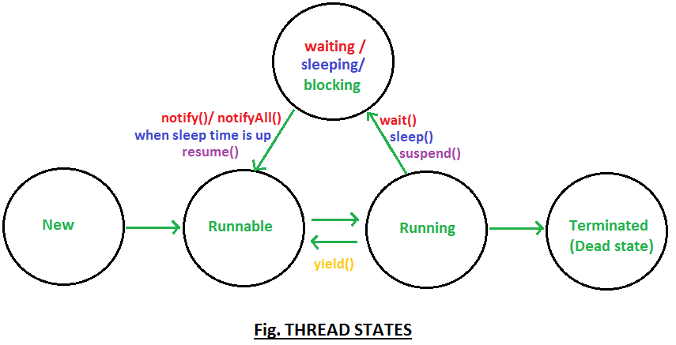
Thread model
Java supports multi-threading through the java.lang.Thread class and the java.lang.Runnable interface.
Thread Lifecycle:
New: Thread is created but not yet started.
Runnable: Thread is ready to run and waiting for CPU time.
Running: Thread is executing.
Blocked: Thread is waiting for a resource.
Terminated: Thread has finished execution

Slide 6
Creating threads
class MyThread extends Thread {
public void run() {
System.out.println(”Running");
}
}
Extending Thread

Slide 7
Creating threads
class MyRunnable implements Runnable {
public void run() {
System.out.println("Running");
}
}
Implementing Runnable

Slide 8
Starting threads
MyThread thread = new MyThread();
thread.start();
Thread runnableThread = new Thread(new MyRunnable());
runnableThread.start();
ExecutorService executor = Executors.newFixedThreadPool(2);
executor.submit(() -> System.out.println("Task is running"));
executor.shutdown();
How to start a thread or a runnable

Slide 9
The Future<T> class
ExecutorService executor = Executors.newFixedThreadPool(2);
Future<Integer> answer = executor.submit(() -> {
// thinking about the answer
return 42;
});
Future<String> question = executor.submit(() -> {
// thinking about the question
return "how many paths do we need to follow?";
});
System.out.println("Meanwhile, doing something else");
String resultQuestion = question.get(); // Waits for result
Integer resultAnswer = answer.get(); // Waits for result
executor.shutdown();
Future enables us to declare a variable for a value that will come later. Meanwhile, the program can continue doing something else

Slide 10

Practice time
Let’s create an application that saves two images from the internet at the same time

Slide 11

5 minutes break
See you in 5 minutes

Slide 12
Challenges of multi-threading
Overwrite Data: Multiple threads modifying shared data.
Reading Dirty Data: Reading data that is being modified.
Deadlocks: Two or more threads waiting indefinitely for each other.

Slide 13
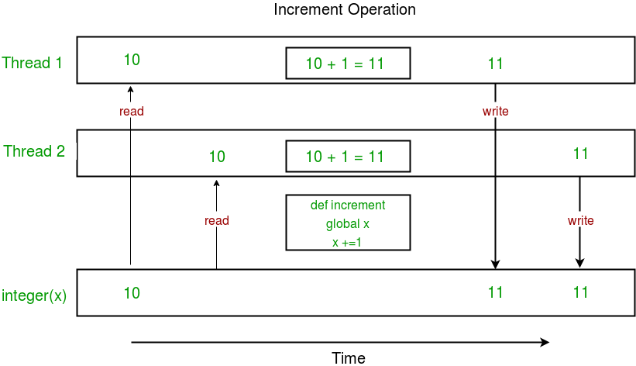
Challenges of multi-threading
Overwrite Data: Multiple threads modifying shared data.
Reading Dirty Data: Reading data that is being modified.
Deadlocks: Two or more threads waiting indefinitely for each other.

Slide 14
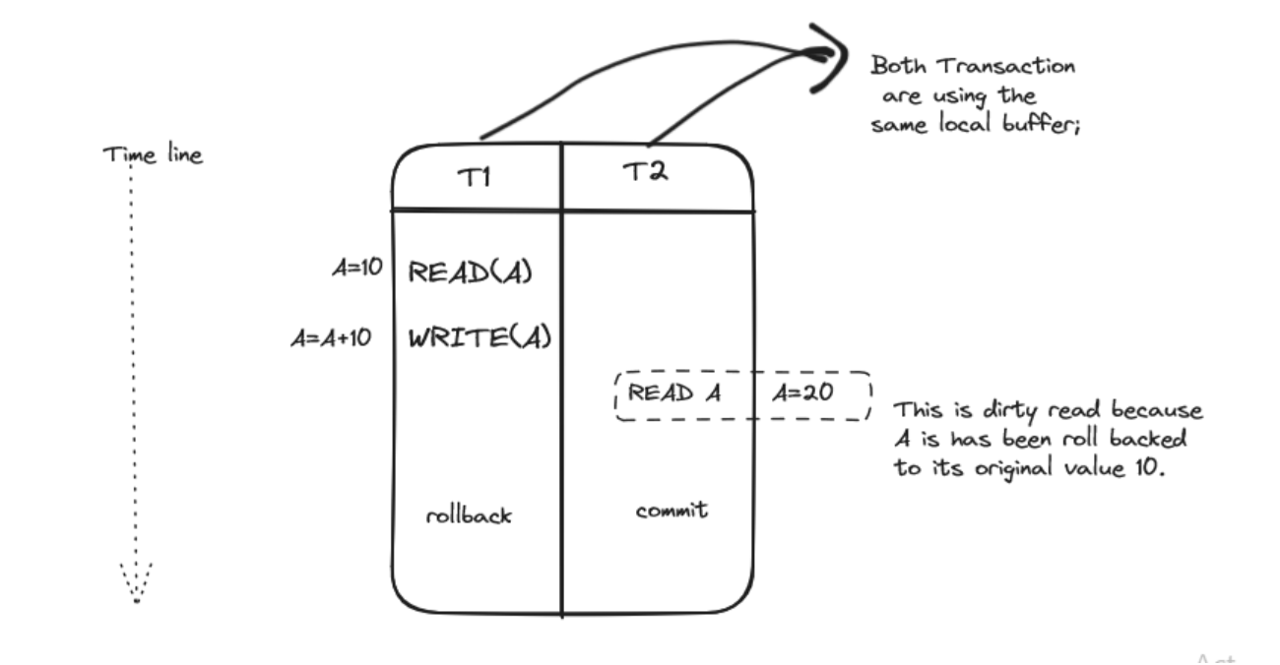
Challenges of multi-threading
Overwrite Data: Multiple threads modifying shared data.
Reading Dirty Data: Reading data that is being modified.
Deadlocks: Two or more threads waiting indefinitely for each other.

Slide 15
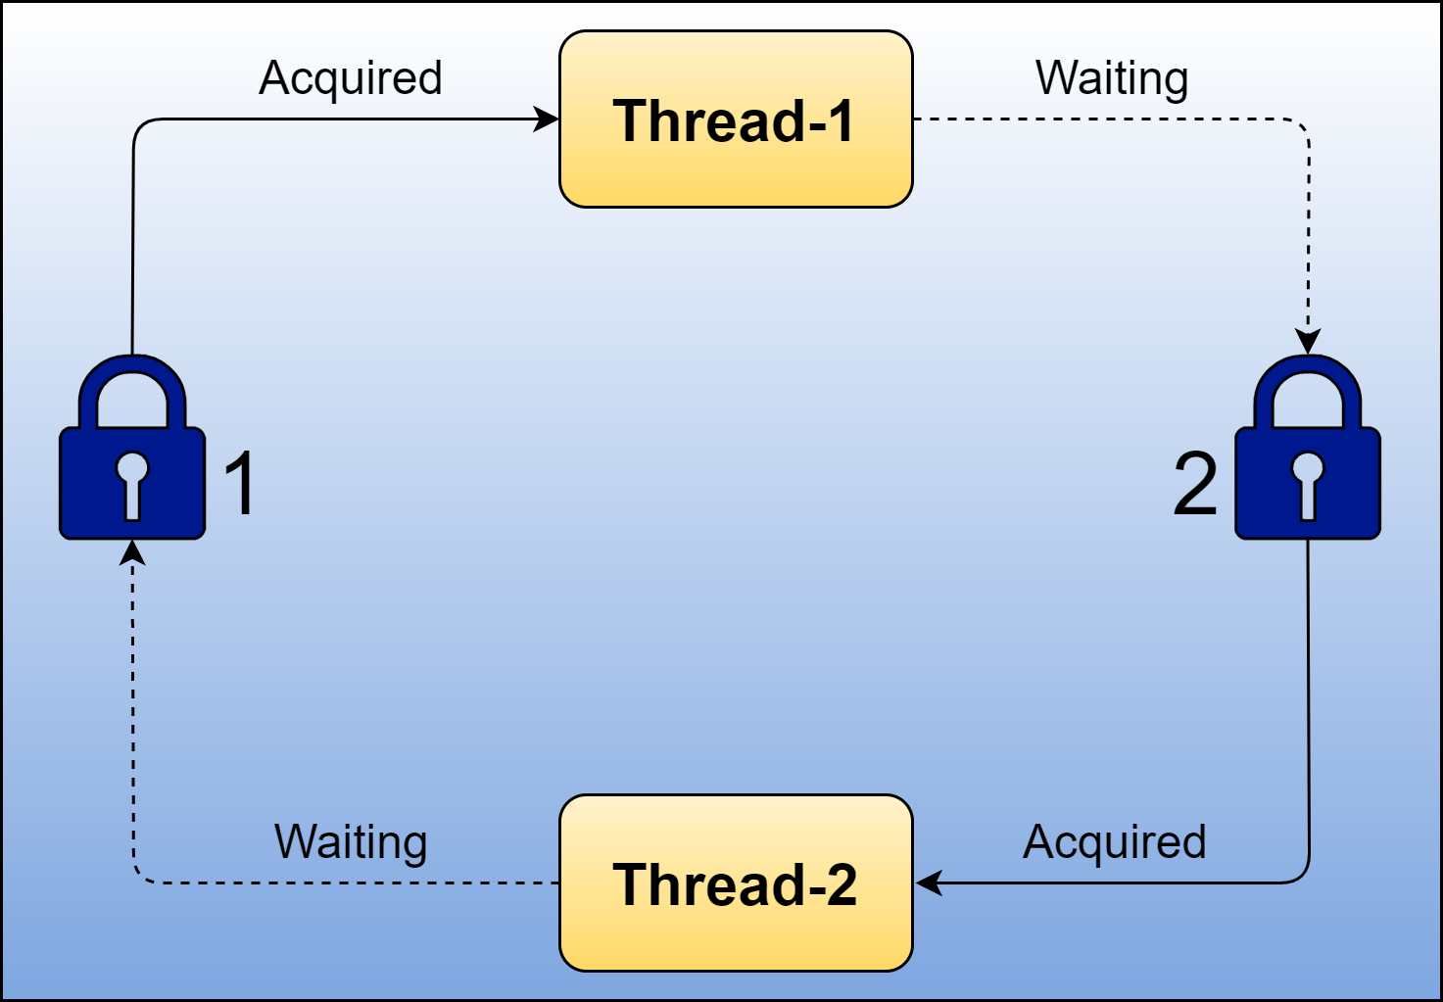
Challenges of multi-threading
Overwrite Data: Multiple threads modifying shared data.
Reading Dirty Data: Reading data that is being modified.
Deadlocks: Two or more threads waiting indefinitely for each other.

Slide 16
Solutions to challenges of multi-threading
Solution n. 1:
Don’t share resources.
If each thread is fully independent, you avoid all the challenges, and the software is easier to maintain.

Slide 17
Solutions to challenges of multi-threading
Solution n. 2:
Delegate the responsibility to a database.
In this case, the choice in a java application is between optimistic lock and pessimistic lock.

Slide 18
Solutions to challenges of multi-threading
Solution n. 3: use thread safe java classes
public class DirtySafeExample {
private final AtomicInteger count =
new AtomicInteger(0);
public void increment() {
count.incrementAndGet();
}
}
public class DirtySafeExample2 { private final Map<Integer, String> myData =
new ConcurrentHashMap<>();
public void put(Integer id, String data) {
myData.put(id, data);
}
public String get(Integer id) {
return myData.get(id);
}
}

Slide 19
Solutions to challenges of multi-threading
Solution n. 4: synchronized access
public class DirtySafeExample {
private static int count = 0;
public static synchronized void increment() {
count++;
}
public static synchronized int getCount() {
return count;
}
}

Slide 20
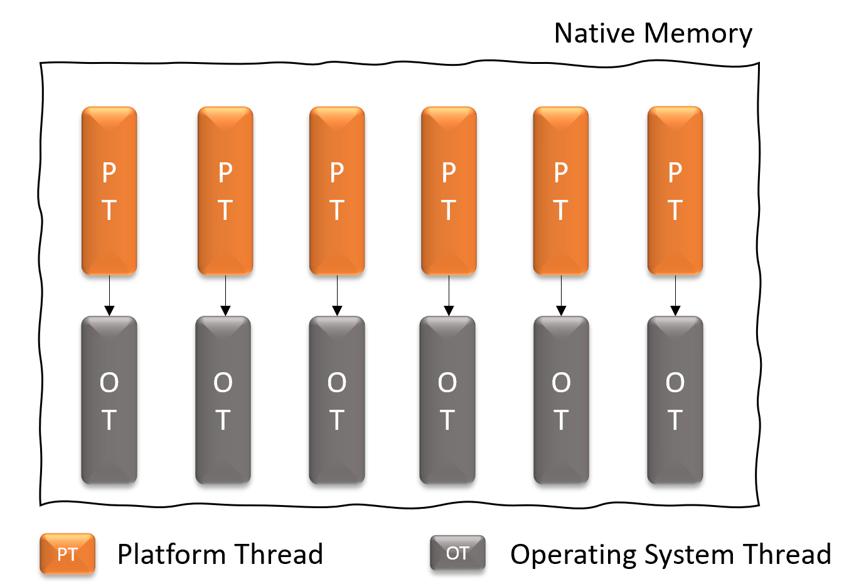
Limitation: OS Threads and memory
What we saw, so far, are Platform Threads. Whenever we create one, the JVM allocates a lot of memory (for context, callbacks, etc.) and reserves an OS Thread.
If we try to create too many Threads, we might run out of memory and we might reach the limitations of our CPU

Slide 21
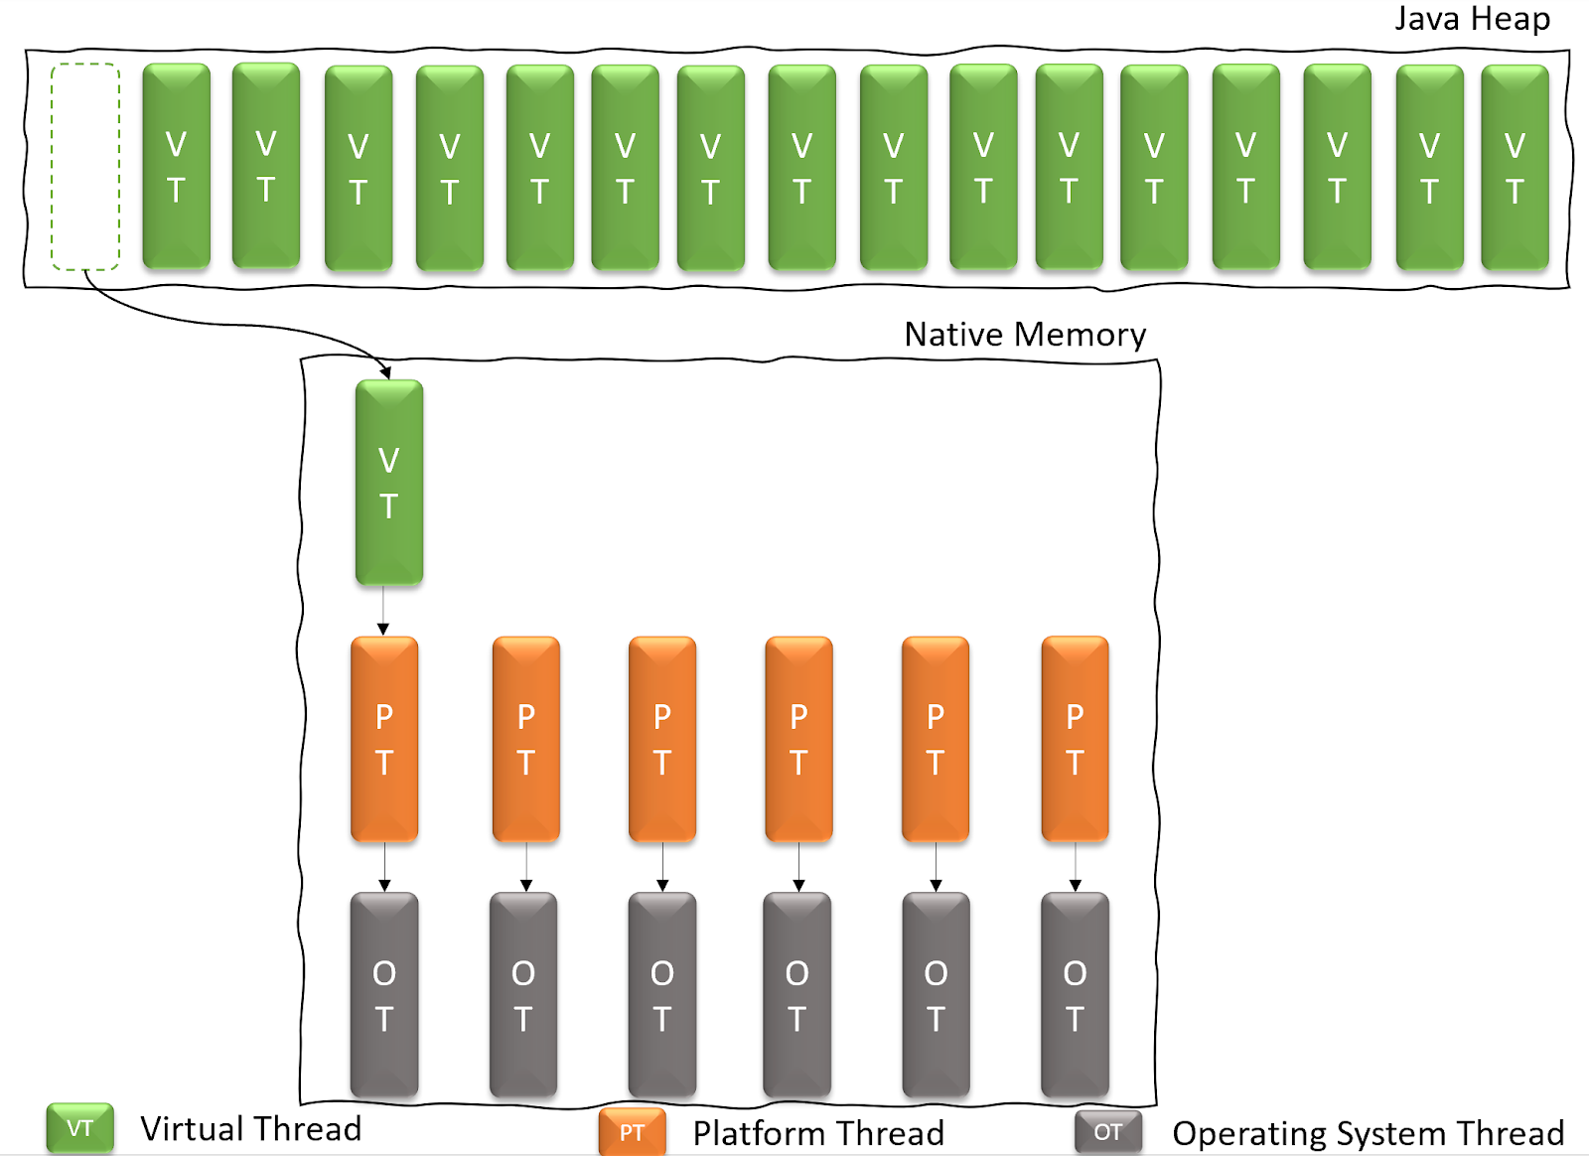
Solution: Virtual Threads
Virtual Threads are allocated in the Java Heap, which makes them lightweight and easy to handle.
Actual resources from the OS are taken only when a Virtual Thread needs to work, not while it’s waiting for a task to be executed.

Slide 22
Starting virtual threads
Thread.ofVirtual()
.name("Virtual")
.start(() -> System.out.println("I'm in a virtual thread"));
ExecutorService x = Executors.newVirtualThreadPerTaskExecutor();
Future<?> task = x.submit(() -> {
System.out.println("Me too");
});
task.get(); // wait for the task to finish
x.shutdown(); // then shutdown
How to start virtual threads: only with runnables and the executor service

Slide 23
Practice time
Let’s combine some learnings and let’s experiment with threads.
Our people database will download 2 images for each new person we add (through the HTTP protocol)
We will use virtual threads, and we will print out the time (start and end).

Slide 24
Homework
After each lesson, you get a piece of homework that serves as implementation of the final assignment.
After lesson 2 and 3, we learned how to interact with a database using http, and how to optimize performance using multi-threading.
Create an application that accepts a POST http request containing the title of a movie in the request body.
Upon receiving this request, the application should “Retrieve basic movie data (title, year, director, genre) from the OMDb API” and store it in the database. Meanwhile, use the logic implemented for the previous homework to download 3 images about that movie and store them as files in the filesystem, in a directory dedicated to the movie.

