Slide 1
Power in the Shell
Learning PowerShell by Malware
Morgen Nicodemus (ChurchOfJorts)

Slide 2
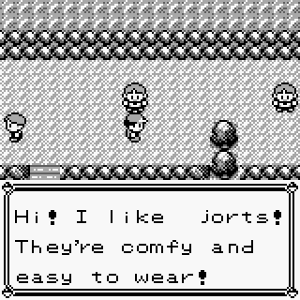
$ENV:Username
Morgen
My alias is ChurchOfJorts
Security Analyst @ SCU*
I like PowerShell
I think Malware is cool (In controlled environments)
Outside of computers, I’m a turbo nerd for rock climbing, medieval longsword fencing, and a million other things
* This research was conducted in a personal capacity and is unrelated to my current employer, views and opinions expressed are my own

Slide 3
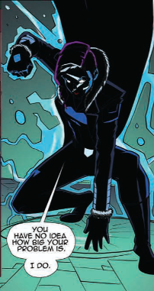
Get-LocalGroup Audience
Who is this presentation for?
People who like PowerShell
People who hate PowerShell
Official PowerShell mascot
PowerShell Hero
Don’t read the comic, it’s not worth it

Slide 4
Disclaimer
  This is not everything there is to know about
  PowerShell, .NET, or Windows

Slide 5
What is PowerShell?
PowerShell is Microsoft’s task automation solution built on .NET
Includes a command-line shell, a scripting language, and a configuration management framework.
Primarily different from Command Prompt and Bash in that PowerShell accepts and returns .NET objects instead of text

Slide 6
.NET
.NET is Microsoft’s application framework
The Common Language Runtime (CLR) handles code execution, memory management, etc.
Code compiles down to an intermediate language called Microsoft Intermediate Language (MSIL) or Common Intermediate Language (CIL)
Similar to Java’s bytecode

Slide 7
But really?
The core of PowerShell is the System.Management.Automation dll
PowerShell 5’s S.M.Automation is built on .NET Framework v4.5
PowerShell 7’s S.M.Automation is built on .NET Core
PowerShell.exe, PowerShell_ISE.exe, pwsh.exe, sdiagnhost.exe, all depend on S.M.Automation to execute PowerShell code

Slide 8
Malware 1:
A Clickfix sample

Slide 9
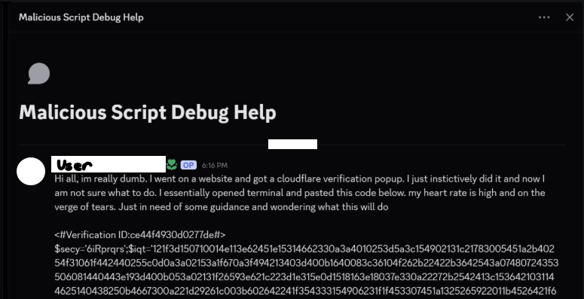
ClickFix - Discovery

Slide 10
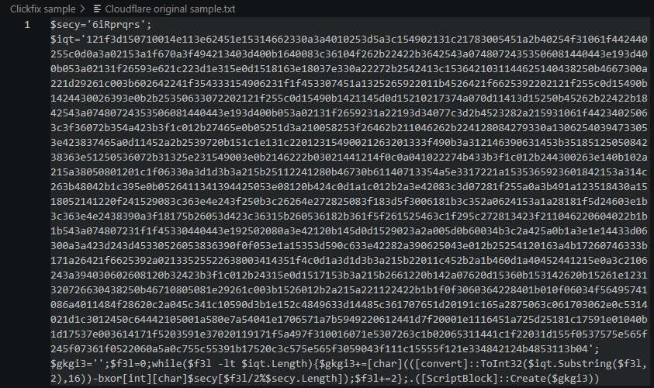
ClickFix - Obfuscated

Slide 11
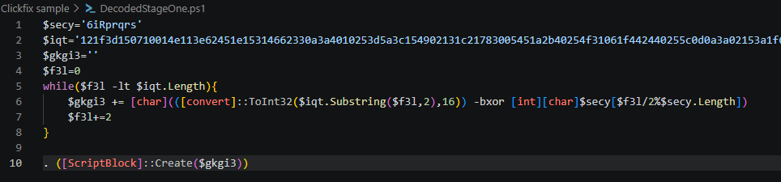
ClickFix - Deobfuscated

Slide 12
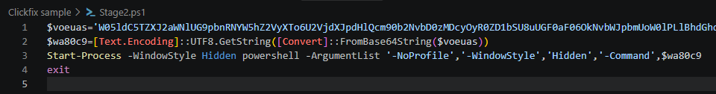
ClickFix – Stage 2

Slide 13
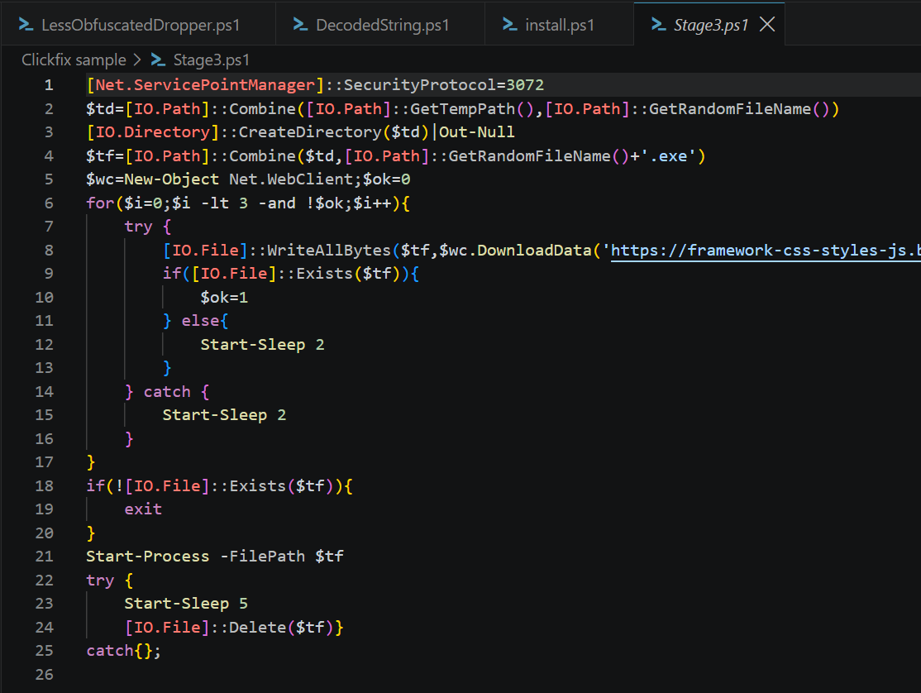
ClickFix – Stage 3

Slide 14
Lesson 1:
.NET Objects &
methods

Slide 15
Using .NET Object/Methods
This ClickFix sample makes usage of the ScriptBlock, IO.File, and Net.WebClient classes direct from .NET instead of using PowerShell’s equivalent built-in commands (cmdlets)
PowerShell is built on .NET, so it supports seamless usage of the native .NET methods, objects, etc.

Slide 16
Malware 2:
TinyPosh Trojan

Slide 17
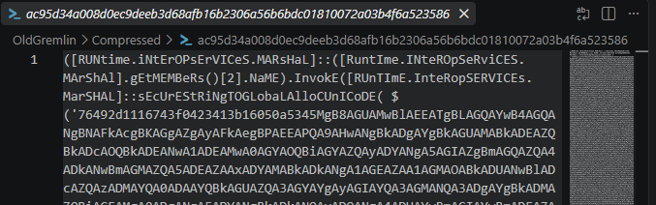
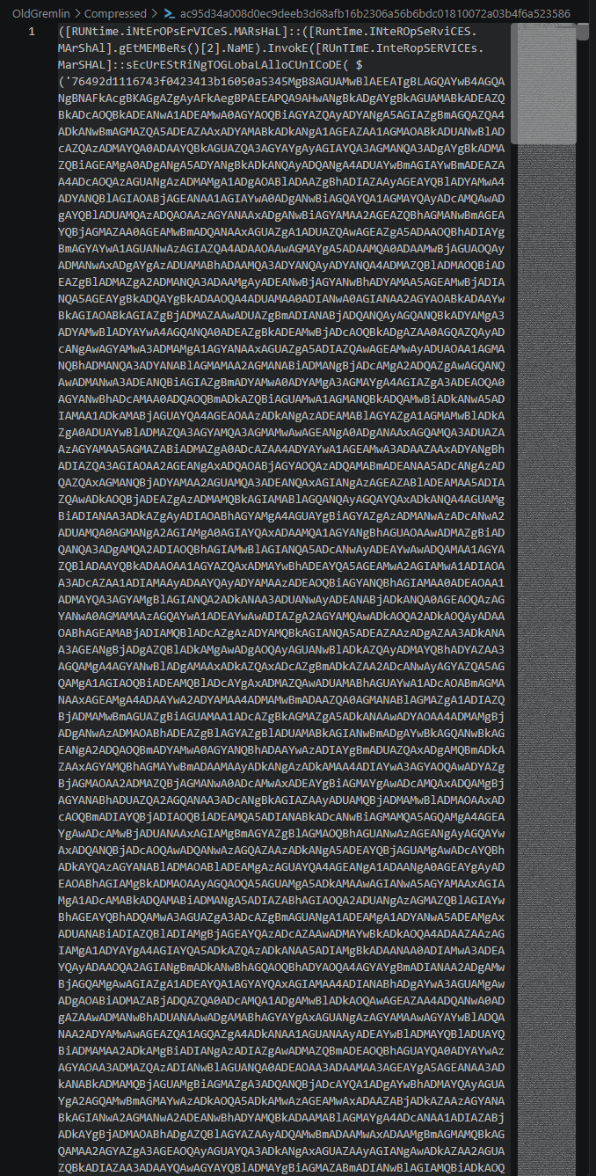
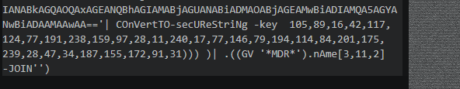
OldGremlin
Pasting this string into the PowerShell terminal takes 56 seconds

Slide 18
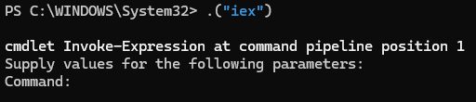
OldGremlin

Slide 19
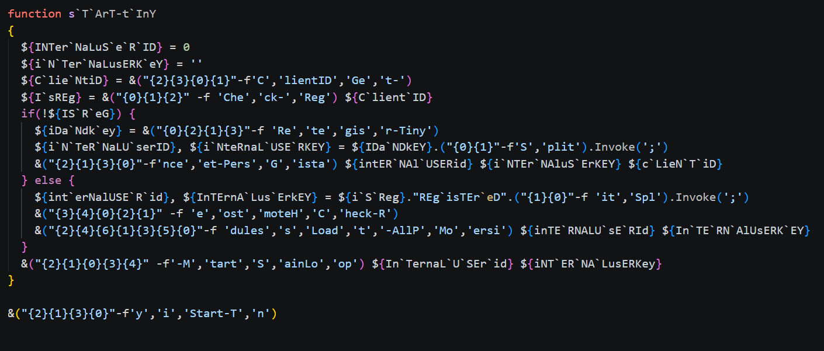
TinyPosh Trojan

Slide 20
Lesson 2:
Variables

Slide 21
Variables
Variable types are loosely typed and their type is determined by the .NET type of the value
Standard variables are what you’d expect
  $MyDCGroup = “608”
Braced variables allow for special characters, spaces, disambiguation and special behavior
  ${I Go To DC608} = $true
  Write-Output “I like to go to DC${MyDCGroup}”
  $FileContents = ${C:\temp\log.txt}

Slide 22
Lesson 3:
AST Parsing and
PowerShell Execution

Slide 23
AST Parsing
AST (Abstract Syntax Tree) is the hierarchical object representation of a script’s structure
The raw text of a script is parsed into individual tokens and parsed into the overall AST
Once the AST is generated, static validation occurs to verify variables are modifiable, check language mode, etc.

Slide 24
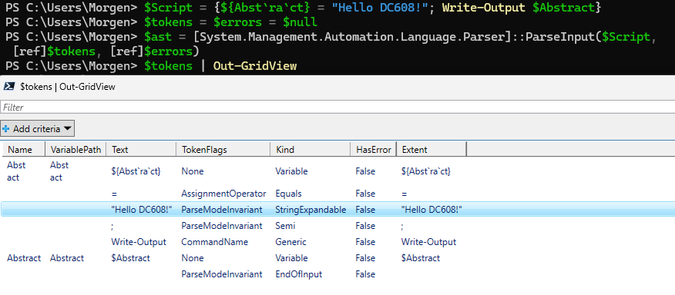
AST Example

Slide 25
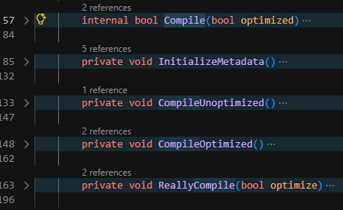
Execution
Once the AST is parsed, the resulting code will be compiled directly to MSIL

Slide 26
Malware 3:
Claude Code
PowerShell Trojan

Slide 27
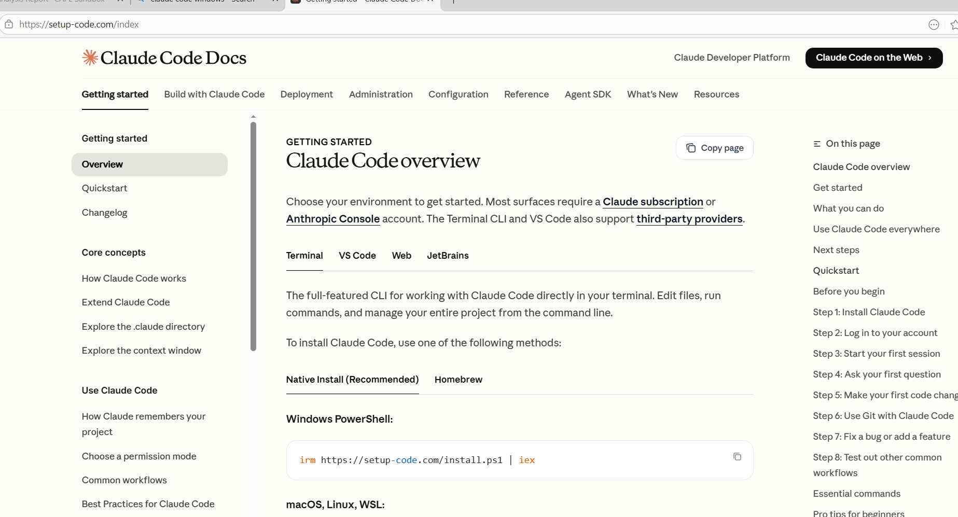
Claude Code Trojan

Slide 28
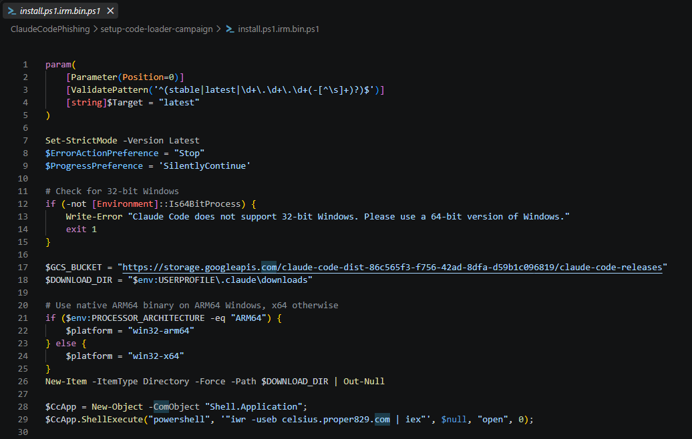
Claude Code Trojan

Slide 29
Lesson 4:
COM Objects

Slide 30
COM Objects
Component Object Model (COM) objects are reusable software components that were designed as a system to allow software components to interact
Like .NET, PowerShell can utilize COM objects

Slide 31
Bonus Lesson:
C# Code

Slide 32
C# Code
Via methods like the Add-Type cmdlet, you can create and execute C# code within your PowerShell Session
You can also call Win32 APIs from this C# to interact directly with the Windows kernel

Slide 33
Lesson 5:
PowerShell Security
Features

Slide 34
Detection Method 1:
The Antimalware Scan Interface

Slide 35
AMSI
The Antimalware Scan Interface (AMSI) is a built-in windows feature that provides a bridge for applications and antivirus/EDR programs.
In this case, all PowerShell code is sent through the AMSI as part of compilation

Slide 36
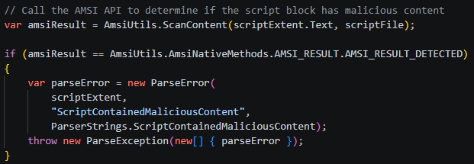
AMSI Call

Slide 37
Detection Method 2:
Event Tracing for Windows (ETW)

Slide 38
ETW
Event Tracing for Windows is the built-in logging feature of the operating system
ETW logging records the text of script blocks as they’re compiled & executed
Primarily controlled by GPO
Unless it’s suspicious

Slide 39
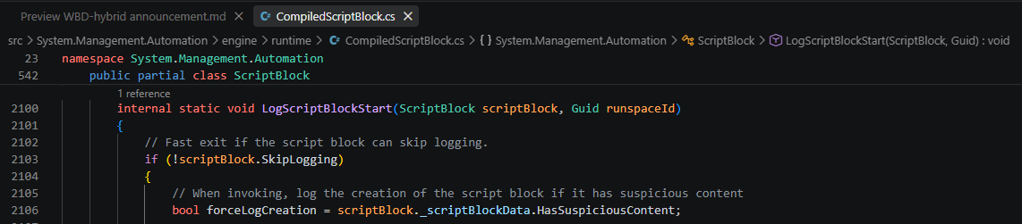

Slide 40
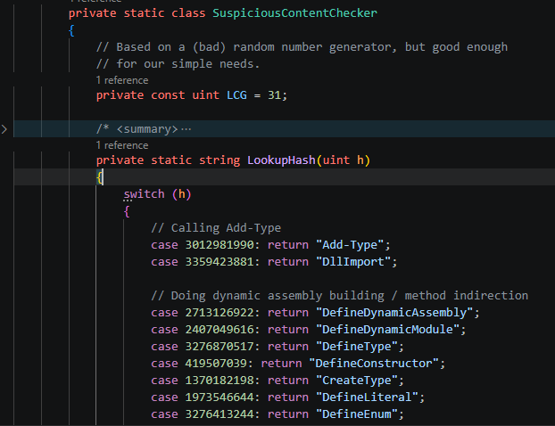
My favorite
The no-no list
If the AST contains a suspicious string? Log it

Slide 41
The No-no list
Looks for strings used for
  Dynamic assembly building (DefineDynamicAssembly)
  Doing things with System.Runtime.InteropServices
  Obfuscating code (EncodedCommand, FromBase64String)
  Making suspicious Win32 API calls (memcpy, VirtualAlloc)
  File encryption (CreateEncryptor)
  Log key strokes (GetAsyncKeyState)
  Change logging settings (ScriptBlockLogging)

Slide 42

Hash collision?

Slide 43
Honorable Mention:
Constrained Language
Mode

Slide 44
Why is any of this worth knowing?

Slide 45


Slide 46
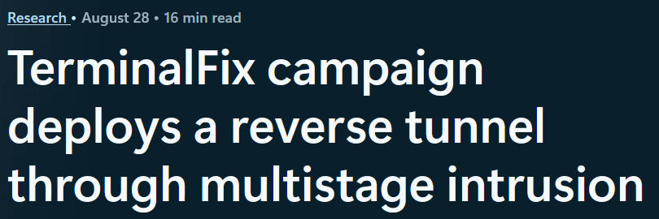

Slide 47
TerminalFix
PowerShell command impersonates Cloudflare, downloads ZIP archive
Malicious DLL launches PowerShell script to retrieve stage 3 with PNG steganography
Enumeration and async C2 done via PowerShell
Python for reverse-tunneling implant
Uses .NET methods and call operator (&)

Slide 48
References
vx-underground
SpecterOps’ Adversary Tactics: PowerShell
Microsofts’ PowerShell documentation
Microsofts’ .NET documentation
The PowerShell 7 Github Repo
Invoke-Obfuscation by Daniel Bohannon
EclecticIQ Threat Research
Microsoft Threat Intel

Slide 49
Questions

