Slide 1
Exploring Crime Clearance in Austin
Charlie Miner and Prashant Aryal

Slide 2
Our question and data
What happens to crime cases, and how long do cleared cases take?
159,464 Austin crime records from 2014-2015
We use crime type, district, zip code, status, and dates
70,019 cases for outcomes; 12,673 cleared cases for time

Slide 3
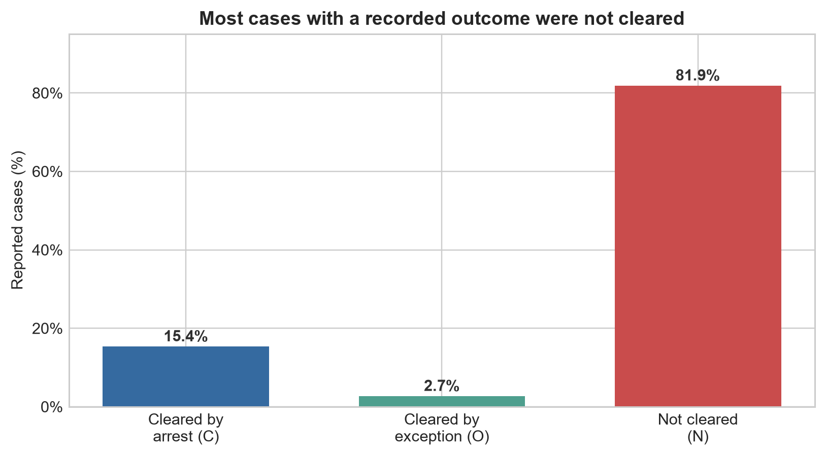
Most cases were not cleared
Most cases were not cleared
More cases were cleared by arrest than by exception
Being cleared and taking a long time are different things

Slide 4
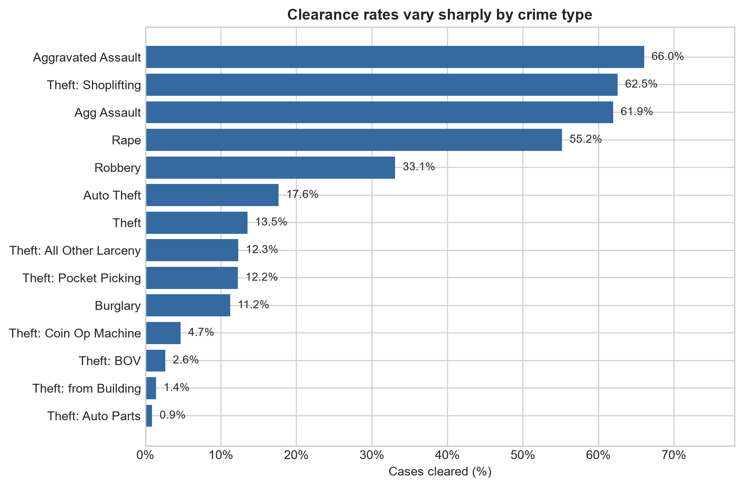
Clearance rate varies by case type and district
Theft cases were rarely cleared
Assault and shoplifting cases were cleared more often
Results also differed by police district

Slide 5
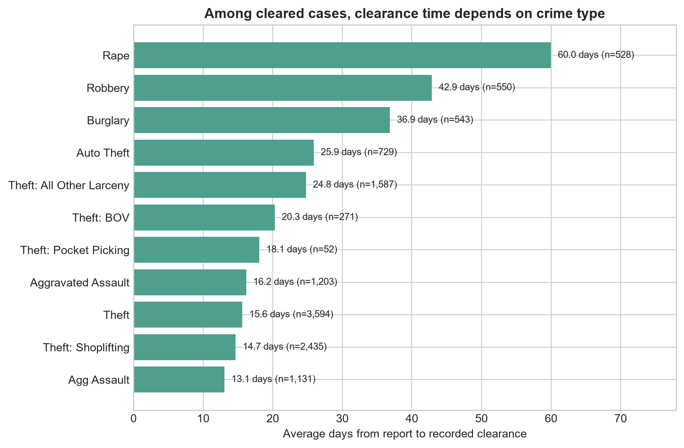
Some cleared case types take much longer
Some types were cleared faster than others
Rape and robbery took the longest on average
Cases of the same type still varied a lot

Slide 6
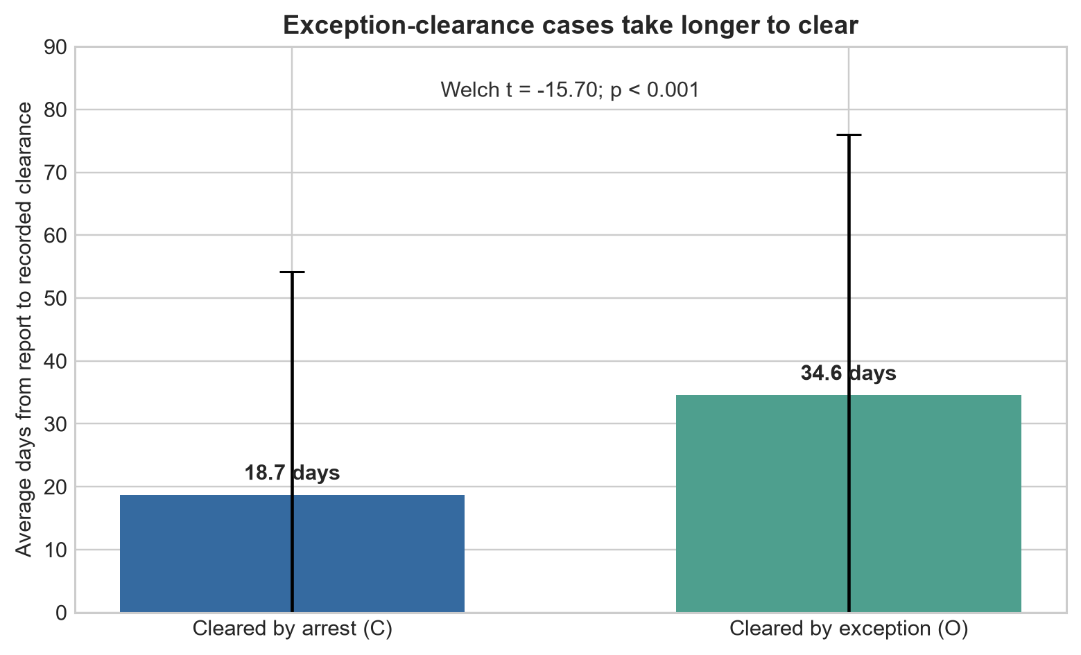
Exception clearances took about 16 extra days
Arrest cases: about 19 days
Exception cases: about 35 days
Exception cases took about 16 extra days; p < 0.001

Slide 7
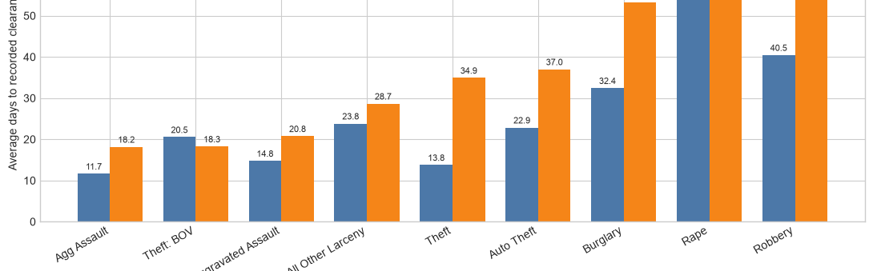
The difference appears within several crime types
Exception cases took longer in 7 of 9 crime types
This was not caused by only one type of crime
Robbery and rape had especially long O-case times

Slide 8
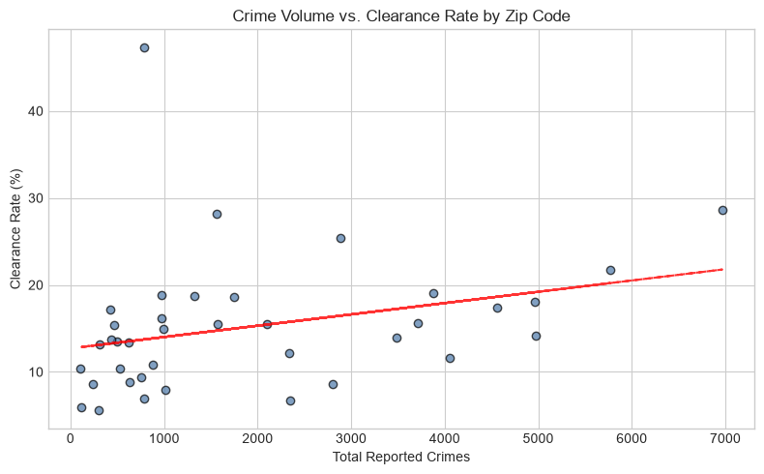
Zip-code crime volume was not a reliable predictor
Pearson r = 0.274, p = 0.100
The pattern was small and not statistically significant
More crime reports did not clearly mean more or fewer cleared cases

Slide 9
Takeaway
Most cases were not cleared
Cases cleared by exception usually took longer than cases cleared by arrest
The data does not tell us why a case was cleared by exception
Use the results to guide review, not to blame a district or officer

Slide 10
Thank you!

