Slide 1
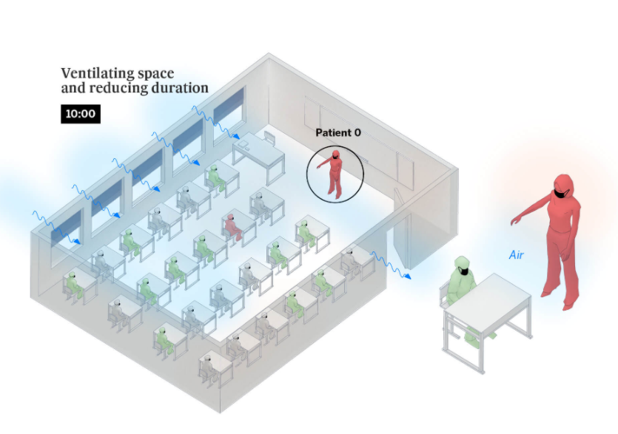


Image source: https://english.elpais.com/society/2020-10-28/a-room-a-bar-and-a-class-how-the-coronavirus-is-spread-through-the-air.html

Slide 2
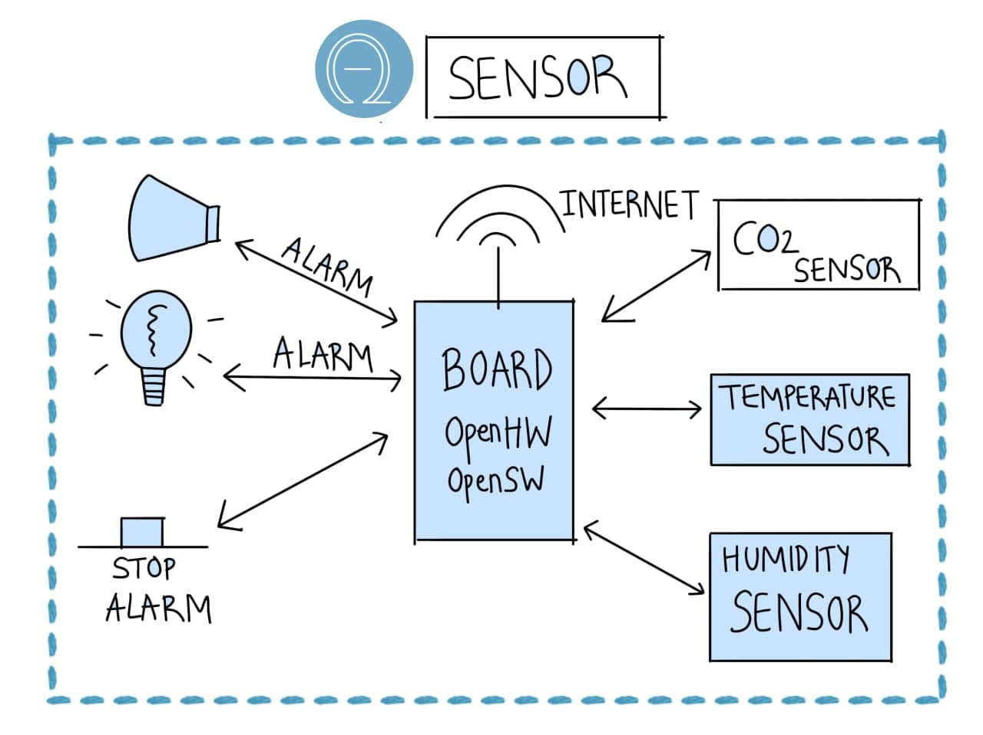

Slide 3
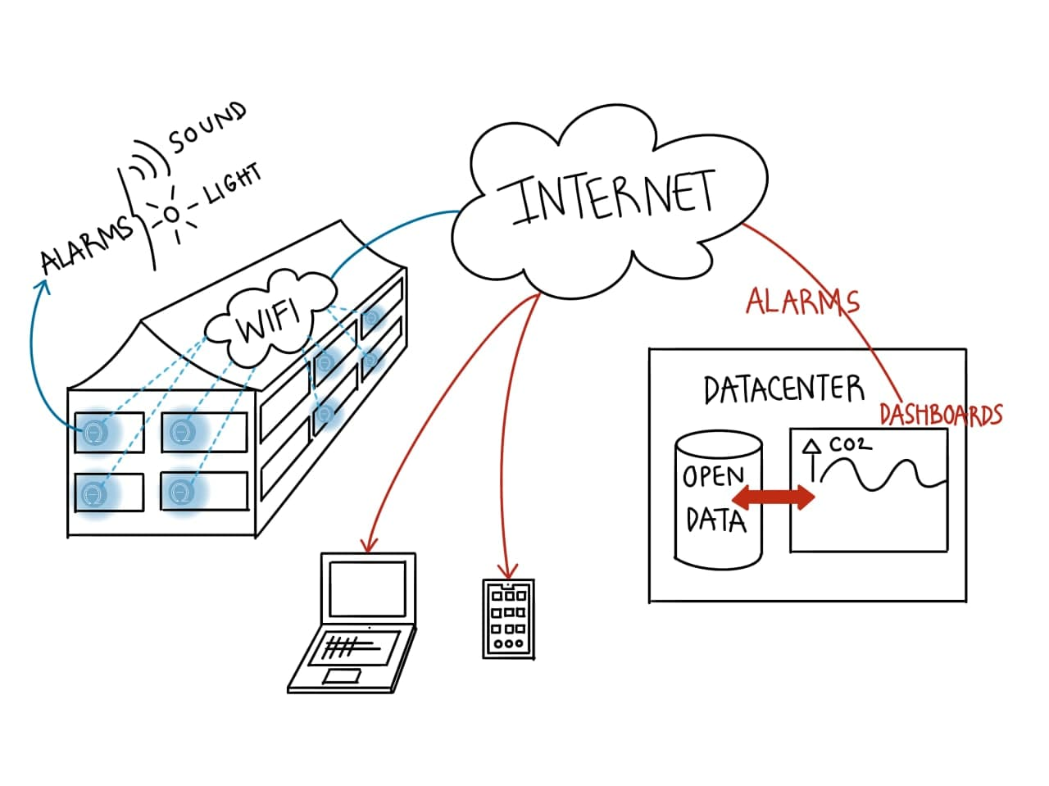

Slide 4

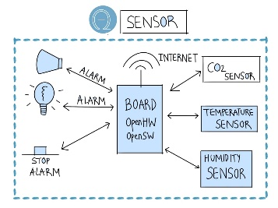



=
x 50
$150.000 budget
<
$100
x 20
INCLUDING 2 YEARS CLOUD HOSTING
x 1 year < $1000
1 cole con 50 dispositivos, dos años de monitorización = $7.000
Con $150.000 Budget = 150000/7000 > 20 coles

