Slide 1
CMSC433 GROUP PROJECT2
TEAM 110
MEMBERS |
Dylan Chu
Kayoung Kim
Neh Patel

Slide 2

PROJECT DESCRIPTION
Computer Science Degree Tracker
This a revised project that the authors received from another
group. The purpose of the project is to create a web page
that helps advisors in the department of computer science
at UMBC. It helps them advise students on what classes
the can take currently depending on what courses they have
already taken previously. The web page allow the student to
login or sign up, by entering their name, email, and
UMBC student ID. Using the ID the database selects their
information and views it on the page, if the ID does not
exist in the DB, then it creates a new account, and stores
the new information in the database.

Slide 3
IMPROVEMENT
communication between businesses – Imane Tate
1
customer and vendor registration – Victoria Philips
2
customer view inventory – Kayoung Kim
3
vendor update inventory – Derek Wang
4
customer and vendor login – Michael Young
5

Slide 4


USECASE | 1
Communication between users
Author: Imane Badra Tate
• Created compose message.php with username, recipient, subject, and message input values
• The messages are stored in message table, with corresponding sender, and recipient IDs
Notes:
http://userpages.umbc.edu/~dwang3/is448/project/smallBizy_d4_final/home/
http://userpages.umbc.edu/~dwang3/is448/project/smallBizy_d4_final/info/contactus.html
http://userpages.umbc.edu/~dwang3/is448/project/smallBizy_d4_final/info/message.html

Slide 5
USECASE | 1
Communication between users
Author: Imane Badra Tate
• Created inbox.php where a user can see his/her received messages, and sent messages.
• Created a viewMessage.php file where user can click on message from the inbox page, and read the message content, the user can reply to the message from here, which will point them to the composemessage.php file.
Notes:
http://userpages.umbc.edu/~dwang3/is448/project/smallBizy_d4_final/home/
http://userpages.umbc.edu/~dwang3/is448/project/smallBizy_d4_final/info/contactus.html
http://userpages.umbc.edu/~dwang3/is448/project/smallBizy_d4_final/info/message.html

Slide 6

USECASE | 2
customer and vendor registration
Customers and vendors can sign up for small bizzy.
Vendors need to include business license information when they sign up, though.

Slide 7

USECASE | 3
Customer View inventory
Author: Kayoung Kim
This use-case is based on the process of buying product(s) for customer view.
viewItems.php
Customer’s view of inventory
Display Item details : name, quantities, price, and description
Validate item quentity input
Button link to shopping cart

Slide 8

USECASE | 3
shoppingCart.php
Insert or update cart information to db
Get user input for updating quantities
Empty cart : delete cart information in db
Button link to buyItem.php

Slide 9

USECASE | 3
buyItem.php
Insert order information to database
Display tax and total price information
Display Thank you message

Slide 10
USECASE | 4
vendor update inventory
Sellers can update what merchandise
they have for sale as well as add new items to sell.
The inventory manager portal provide 3 pages critical to the update inventory
*Vendor home page:
- Provides a vendor specific inventory search which reads inventory products written to the database.
*Add inventory:
- The accessing vendor can add a new product item to the inventory database.
*Update inventory
- Vendor can update the product item database record values per composite key “MFG, Part #” as input by the business during add inventory.

Slide 11
USECASE | 5
customer and vendor login
Customers and vendors already signed up can login and
can manage their account(s)
View Account
Edit Account
Close Account : Ask confirmation to close the account
Under View Account, the following can be viewed
Statement viewer
: List of monthly statements for the user to review
Invoice viewer
: List of invoices related to the user’s account

Slide 12
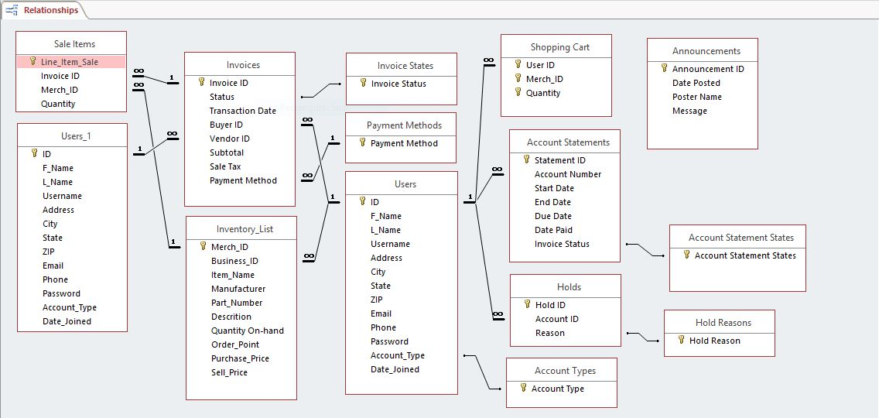
DATABASETABLE

