Slide 1


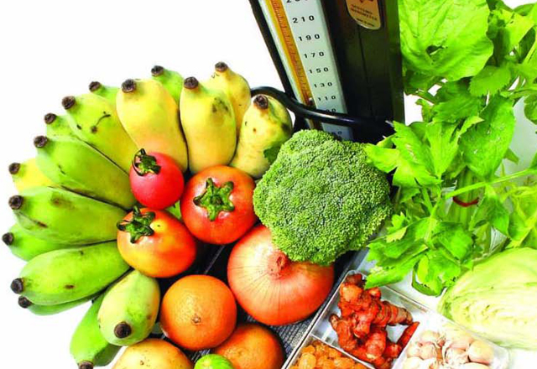
Is it better to get nutrients from food or supplements?

Slide 2
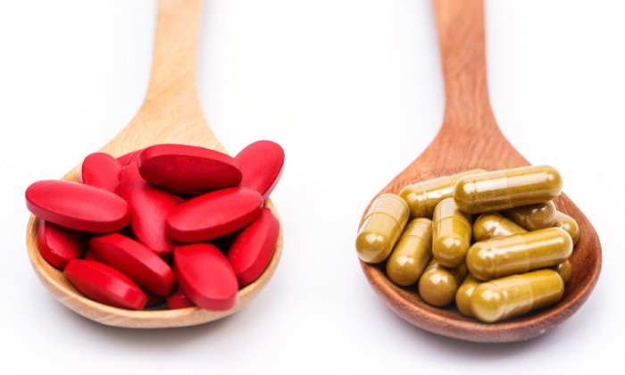
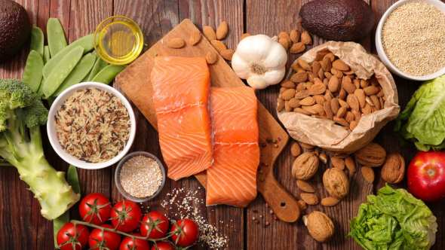
Food is something that we eat in and therefore benefits the body in various areas. Does not cause penalties such as meat, rice, flour, vegetables, fruits, milk, etc. except medicines.
Nutrients are substances derived from food. That is ingested into the body Will be used to benefit the various parts of the body. Such as giving energy to life.
Supplement is a nutrient used to eat more from the main meal to meet the needs of the body.

Slide 3

Types of supplements
1. Health care category
2. Type of prevention and treatment of diseases
3. Type of weight control, weight loss
4. Power-up type to work
5. Products that add or add nutrients

Slide 4

Why should you take supplements?
Can substitute nutrients That the body cannot create enough to meet the needs
Helps to treat or relieve symptoms Of certain diseases
Can prevent some diseases to occur slowly
Good effect on the beauty of the body, such as eating vitamin Chi, helping to reduce the pigment formation of the skin.

Slide 5

Dangers of supplements
If overeating causes vomiting waves
If overeating causes chemical accumulation
If the supplement produced is not standardized Cause harm to the body and if severe to death

Slide 6
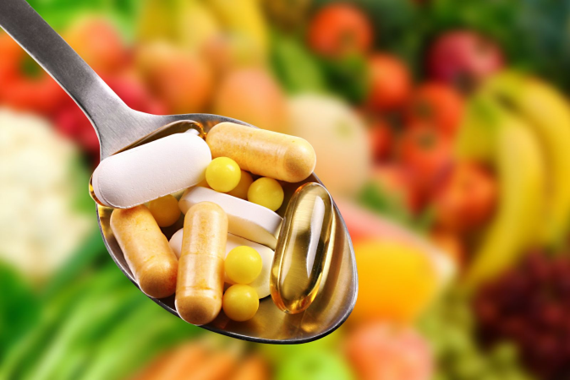
Safe food consumption guidelines
Before taking any type of supplement Should consider and seek medical advice
Study the information on the product label.
Do not consume supplements to treat the illness they suspect.
After consuming supplements If side effects are found, any illness should go to see a doctor for immediate treatment.

Slide 7
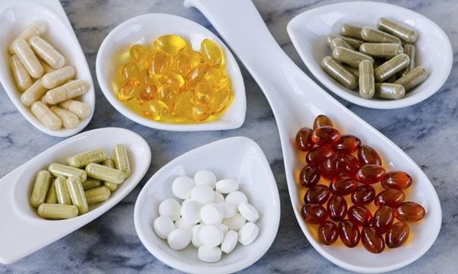
Therefore, to eat supplementary food to be effective and safe Consumers should therefore look for information from reliable sources. And even if you are a person with a previous disease, you should consult your doctor or pharmacist first for the safety of yourself.

Slide 8
Group members

