Slide 1

LOGISTICS OPTIMIZATION
An AI-Native Platform for
Delivery, Fleet & Warehouse Operations
Synthetic data generation, machine learning & optimization, and an executive dashboard — built end to end as one connected system.
CEOs
COOs
Operations Directors
Supply Chain Managers
Investors
Portfolio project — prompt 04 of 4 • August 2026

Slide 2
AGENDA
Six acts, nineteen topics
1
Why This Matters
2
The Data Foundation
The business problem, and where AI changes the economics
A causally-consistent synthetic dataset, built to be learned from
3
The Intelligence Layer
4
The Product
Machine learning, deep learning, optimization, explainability
A nine-module executive dashboard, live and interactive
5
Business Impact
6
Getting to Production
Worked case studies and a quantified ROI estimate
Architecture, security, cloud deployment, roadmap
1

Slide 3

Why This Matters
The business problem, and where AI changes the economics of moving things around.
WHY THIS MATTERS
2

Slide 4
BUSINESS PROBLEM
Logistics runs on thin margins and manual judgment
8–10%
~$95B/yr
~20% CAGR
of global GDP is spent on logistics costs
lost in North America alone to traffic, missed time windows and manual planning errors
projected growth of AI spend inside supply-chain operations through the early 2030s
Every one of those numbers describes the same underlying gap: decisions — which route, which vehicle, how much stock, which order is at risk — are still made on averages and gut feel, not on the data the business already collects.
Sources: Grand View Research / IMARC / Coherent Market Insights (logistics market sizing); FutureCar (North American inefficiency loss); MarketsandMarkets / Precedence Research (AI-in-supply-chain growth). Estimates vary across providers — shown as an order-of-magnitude range, not a precise forecast.
WHY THIS MATTERS
3

Slide 5




BUSINESS PROBLEM
The same pain points show up inside our own network
11.3% of deliveries run late
against an 88.7% on-time rate across 50,150 orders — and adverse weather or heavy traffic reliably makes it worse (+2–3pp).
77% of routes carry under 40% of vehicle capacity
median load is just 7% — vehicles and drivers are routinely dispatched far below what they could carry.
44% of the fleet is past 8 years old
219 of 500 vehicles, where unplanned-failure rates climb sharply and maintenance cost follows.
1.36% of warehouse-SKU snapshots are stocked out
enough to block fulfilment at the affected sites during peak windows.
All figures measured on the 50,150-order synthetic dataset generated for this project — see Act 2, The Data Foundation.
WHY THIS MATTERS
4

Slide 6



AI IN LOGISTICS
Where AI intervenes across the delivery lifecycle
Demand
Dispatch
Route
Deliver
Warehouse
Replenish
Forecast volume by zone and day
Flag orders at risk before they ship
Solve vehicle routing under real constraints
Track, explain, and intervene in real time
Allocate facilities and staff to demand
Set inventory policy from EOQ economics
Each stage of this deck maps to one of these six touchpoints — the dataset makes them measurable, the platform makes them automatable, the dashboard makes them visible.
None of this replaces dispatcher and planner judgment — it gives them a ranked, explained shortlist instead of a blank screen.
WHY THIS MATTERS
5

Slide 7

The Data Foundation
A causally-consistent synthetic dataset, engineered so there is something real to learn from it.
THE DATA FOUNDATION
6

Slide 8



DATA PIPELINE
One connected system, four repositories
Generator
Storage
ML Platform
Registry & API
Dashboard
Config-driven synthetic engine — 20 tables, physics-based
CSV · Parquet · SQLite · SQL · DuckDB, with a leakage-free ML table
7 stages: preprocess → EDA → models → optimize → explain
Versioned models, promote / rollback, feature-contract API
Pre-aggregated JSON payload → one self-contained HTML file
Every stage reads real output from the stage before it — the dashboard's numbers trace back to the same 50,150-order run the ML platform trained on.
Each stage degrades gracefully: an optional library that's missing skips its model and says so, rather than aborting the run.
THE DATA FOUNDATION
7

Slide 9


DATA PIPELINE
Built to be reproduced, and to scale on command
Same seed, same bytes
One number changes the scale
Every generator draws from its own named RNG stream, derived from the project seed via a keyed BLAKE2b hash. Reordering or adding a table never perturbs the others.
project.scale multiplies every entity count together: 0.05 for a 50,150-order sample (~66s), 1.0 for the full 1M-delivery / ~17M-row spec.
Five export formats, one run
Validated, not assumed
CSV, Parquet, SQLite, portable SQL, and DuckDB all come out of the same run. A failure writing one format never aborts the others.
26 automated checks: referential integrity across 13 foreign keys, physical plausibility, missingness rates on target, and zero leakage columns surviving preprocessing.
THE DATA FOUNDATION
8

Slide 10
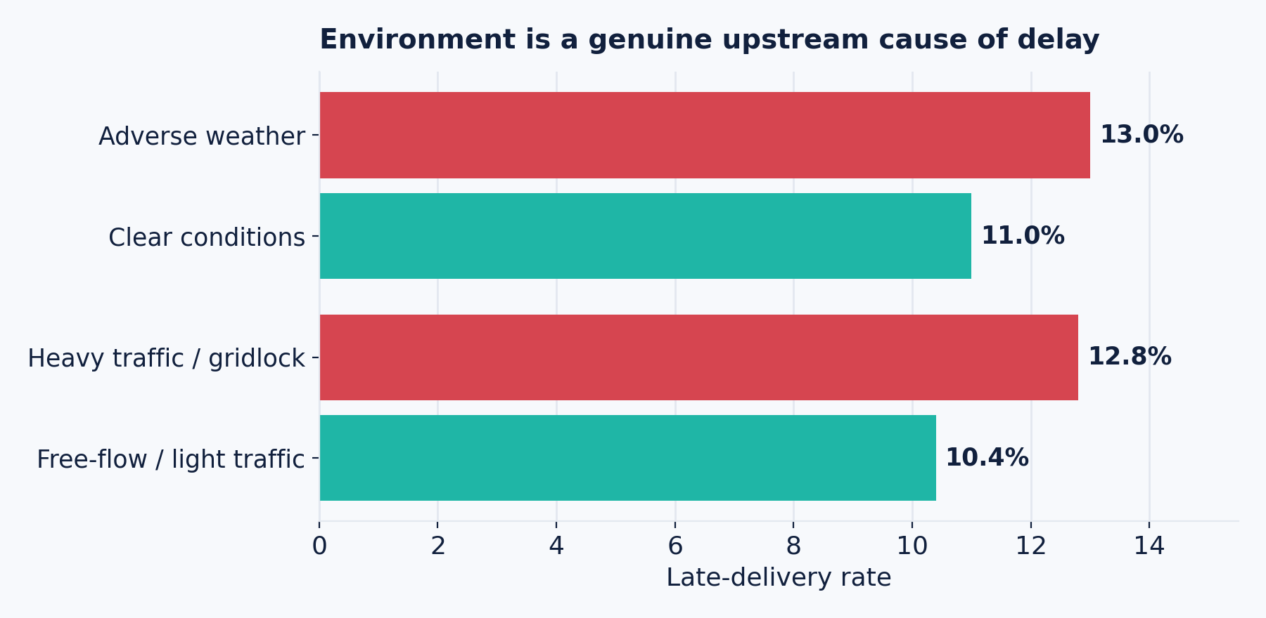
ARTIFICIAL DATASET
Numbers that are built, not drawn
20
related tables, from dimensions to derived ML features
50,150
orders in the sample run used throughout this deck
1,000,000
deliveries at the full configured scale (1.0×)
9
effective_speed = base_speed ÷ (traffic × weather)
duration = travel_time + service + handling
delay = (pickup_lag + duration) − promised_SLA
business domains: courier, e-commerce, grocery, pharma, manufacturing...
SLA calibration lands the fleet on the configured 88.5% on-time target (88.7% achieved) by scaling promised windows with a single constant, preserving relative SLA structure across priorities and domains.
THE DATA FOUNDATION
9

Slide 11


ARTIFICIAL DATASET
Geography and freight physics are enforced, not decorative
Geography is real
Delivery zones only exist in cities that have a warehouse, and each city is served by its nearest site. Median distance 21 km — 18.5 km urban, 27 km suburban, 51 km rural.
Domains behave differently
Freight domains carry heavy loads with a long-haul tail — manufacturing runs a 211 kg median load and a 1,458 km p95 distance. Courier and grocery stay last-mile: 0.8–2.7 kg, ~50 km at p95.
Routes are multi-stop
Orders are clustered by warehouse-day into runs of about 5 stops sharing one vehicle and driver, then rolled up into 9,764 route facts with consolidation savings on distance.
THE DATA FOUNDATION
10

Slide 12
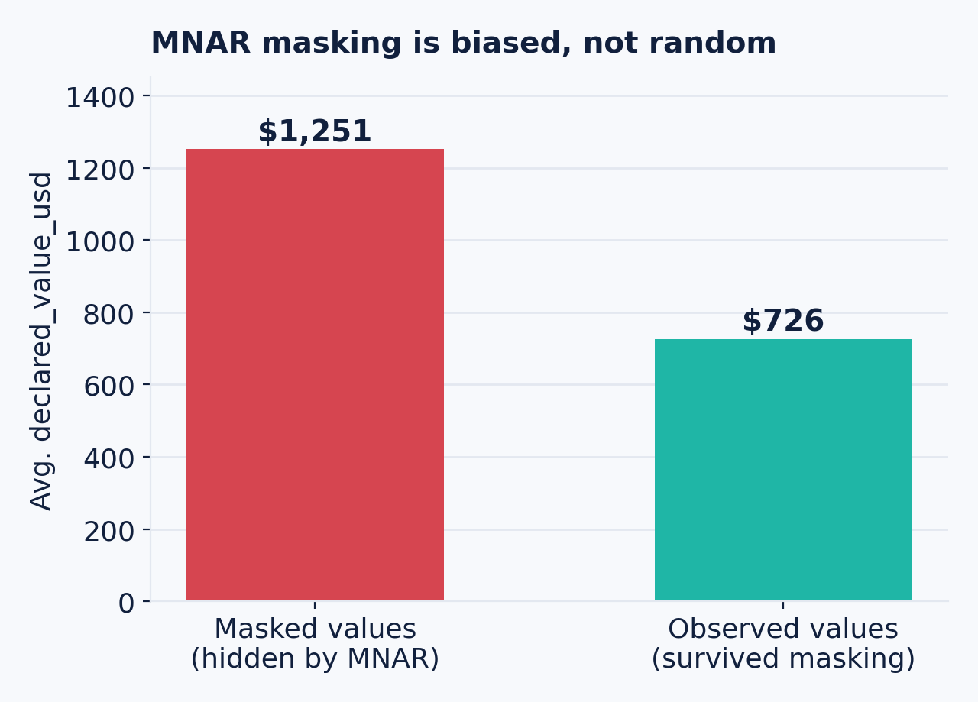
MISSING DATA HANDLING
Three missingness mechanisms, deliberately different
Mechanism | Probability depends on | Example rule
MCAR | Nothing | orders.package_weight_kg masked at 5%, independent of any value
MAR | An observed column | orders.actual_delivery_ts masked depending on status
MNAR | The hidden value itself | orders.declared_value_usd — high values are hidden more often
18 rules ship by default. Achieved rates track configured targets to within 0.6 percentage points. Every masked cell is written to ground_truth/ with its true value, so imputation strategies can be scored, not guessed at.
MNAR bias is real and measurable: naive mean-imputation on declared_value_usd would understate true values by roughly 42% — exactly the failure mode this mechanism is built to expose.
THE DATA FOUNDATION
11

Slide 13
MISSING DATA HANDLING
15 anomaly classes, every one labelled
Operational disruptions
Data-quality defects
Demand spikes & extreme weather events
Traffic gridlock
Vehicle breakdowns — delay + cost spike + possible failure
Driver no-shows
Warehouse stockouts
Regional fuel-price shocks
Address errors
Fraudulent orders
GPS jumps — position teleports with impossible implied speed
GPS flatlines
Sensor drift
Duplicate orders (-DUP suffix)
Negative durations
Order-of-magnitude cost outliers
Every anomaly is tagged in the affected table's anomaly_flags column, so detection models have labelled ground truth to train and score against.
THE DATA FOUNDATION
12

Slide 14
The Intelligence Layer
Machine learning, deep learning, optimization and explainability — seven stages, one config-driven platform.
THE INTELLIGENCE LAYER
13

Slide 15




MACHINE LEARNING
Seven stages, run from one configuration file
Preprocessing
EDA
Supervised
Unsupervised
Deep learning
Optimization
Explainability
Preprocessing splits temporally (train ≤ Oct 6, test from Nov 6) because predicting SLA breaches is forecasting — a random split would let the model read the future.
Every heavy dependency is optional: XGBoost, LightGBM, CatBoost, OR-Tools, SHAP, LIME, UMAP, PyTorch, FastAPI all degrade gracefully and report their status via `logisticsml.cli deps`.
This run: 50,150 orders, 137 engineered features, nine supervised model families benchmarked on one split.
THE INTELLIGENCE LAYER
14

Slide 16

MACHINE LEARNING
137 features — and a leakage bug we caught ourselves
Temporal features (including cyclical sin/cos encodings), geospatial, package, resource, environmental, rolling-history and efficiency features, denormalised from orders against every dimension table.
Rolling aggregates are leakage-aware: every historical feature is computed with .shift(1), so a row never sees its own outcome.
ml_clean applies imputation, outlier clipping, ordinal encoding, missing indicators and constant-column dropping — every decision logged to preprocessing_metadata.json so the transform can be replayed.
Found in verification, not by the user
First run: ROC-AUC 1.000. That's leakage, not skill.
ml_features still carried is_late, delay_minutes and realised costs — the model was scoring its own answer key.
Fixed with an explicit 25-column leakage guard (data.leakage_columns), applied after the target is extracted.
Honest result: 0.998 — genuinely high, because delay is a deterministic function of distance, traffic, weather and SLA, all of which remain legitimate features. The model's top drivers (sla_hours, lead_time_hours, congestion_index) match the generator's own causal logic.
THE INTELLIGENCE LAYER
15

Slide 17
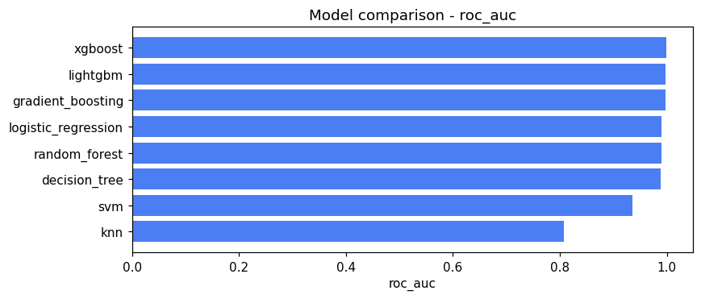
CLASSIFICATION MODELS
Nine model families, one held-out split
Model | ROC-AUC | Precision | Recall | F1
XGBoost | 0.998 | 0.960 | 0.939 | 0.949
LightGBM | 0.998 | 0.979 | 0.925 | 0.951
Gradient Boosting | 0.997 | 0.934 | 0.921 | 0.927
Random Forest | 0.990 | 0.878 | 0.821 | 0.849
Late-delivery-at-dispatch task, temporal split, 137 features, 50,150 orders. Full nine-model table (incl. SVM, KNN, Decision Tree, Logistic Regression) in the ML platform report.
THE INTELLIGENCE LAYER
16

Slide 18
CLASSIFICATION MODELS
Two honest framings of the same question
At dispatch
At order entry (pre-dispatch)
0.998
0.960
ROC-AUC
ROC-AUC
lead_time_hours is known once a vehicle and driver are assigned — the model can use it, and it's the single strongest predictor available.
Strips lead_time_hours and everything else known only after assignment. Use this task if you want to quote a delivery promise the moment the order is placed.
The 0.038 gap between the two is the measured value of knowing vehicle/driver assignment before predicting — not a modelling artifact.
THE INTELLIGENCE LAYER
17

Slide 19
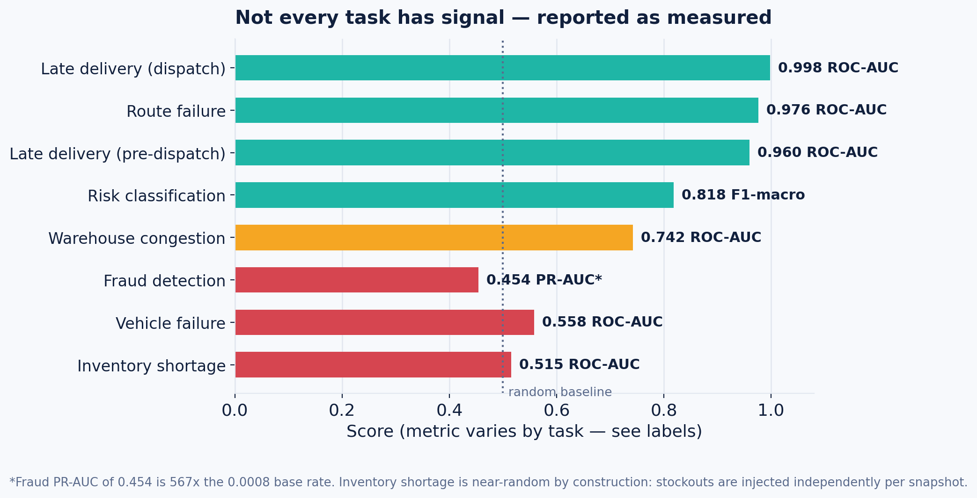
CLASSIFICATION MODELS
Not every task has signal — and the platform says so
THE INTELLIGENCE LAYER
18

Slide 20

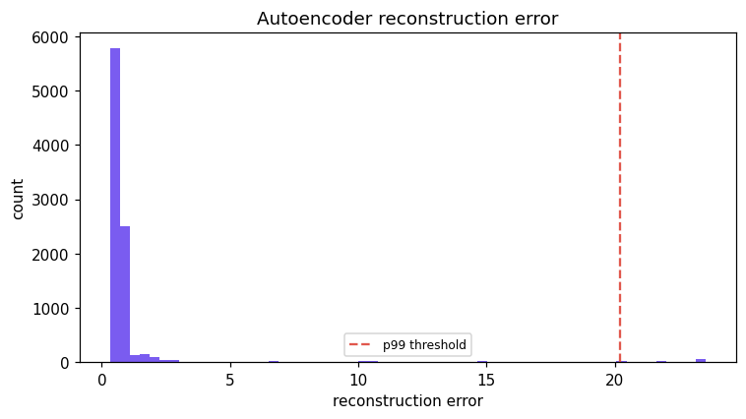
DEEP LEARNING
Five architectures, native PyTorch, labelled honestly
MLP
Autoencoder
LSTM
Transformer-style
TabNet (sparsemax)
All five implemented natively in PyTorch (deep_torch.py) — MLP and autoencoder classics, an LSTM for sequence structure, an FT-Transformer-style model with attention over feature tokens, and TabNet with a from-scratch sparsemax feature-selection layer.
This sandbox had no GPU/torch runtime available (network and disk constraints) — every deep-learning result on this slide runs through scikit-learn stand-ins, explicitly labelled APPROXIMATION in every table and report.
The full PyTorch path ships ready to run on a machine with torch installed; nothing here is placeholder code.
THE INTELLIGENCE LAYER
19

Slide 21




OPTIMIZATION ALGORITHMS
Eight solvers across four problem families
VRP / CVRP / VRPTW
Driver scheduling
Fleet allocation
Warehouse allocation
OR-Tools RoutingModel, with a nearest-neighbour + 2-opt fallback
CP-SAT model over shift coverage and labour cost
CP-SAT assignment with soft subcontracting
Capacitated facility location, CP-SAT, vs a proper greedy baseline
Inventory (EOQ)
Genetic algorithm
Simulated annealing
Particle swarm
Closed-form economic order quantity with safety stock
From-scratch, benchmarked on the same instance as OR-Tools
From-scratch — 0.7% off exact, in 1/90th the time
From-scratch, fastest wall-clock of the four methods
THE INTELLIGENCE LAYER
20

Slide 22
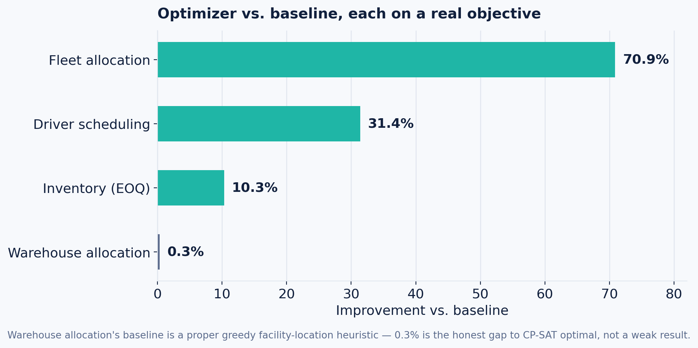
OPTIMIZATION ALGORITHMS
Every result measured against a real baseline
Problem | Objective | Baseline
Driver scheduling | $6,028 | $8,782
Fleet allocation | $3,640 | $12,519
Warehouse allocation | 48,935 | 49,073
Inventory (EOQ) | $9.38M/yr | $10.45M/yr
Warehouse allocation improves only 0.3% — and that's the honest number. Its baseline is greedy facility location, which is provably near-optimal here. An earlier version compared against an “open every site” baseline and reported a meaningless 66%.
THE INTELLIGENCE LAYER
21

Slide 23
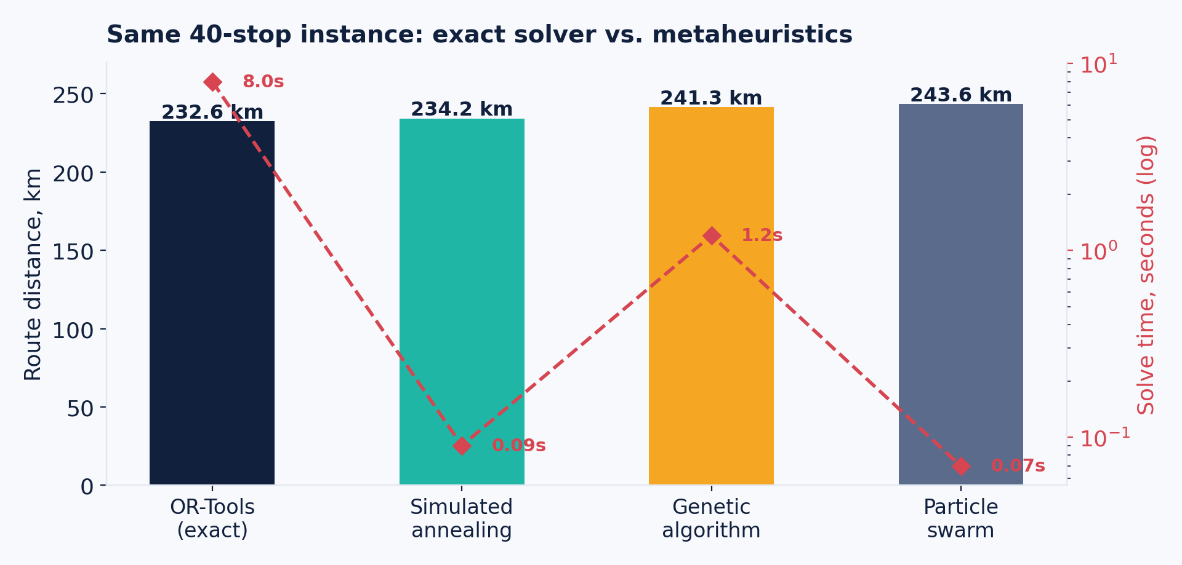
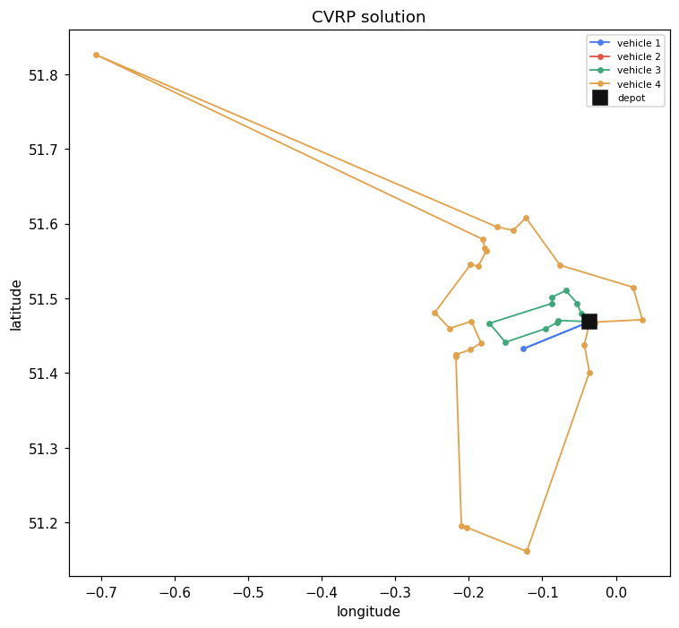
OPTIMIZATION ALGORITHMS
The same 40-stop instance, four ways
Simulated annealing lands within 0.7% of the exact solver in 1/90th of the time — the trade-off is the point of running them head-to-head, not a contest to declare a single winner.
THE INTELLIGENCE LAYER
22

Slide 24
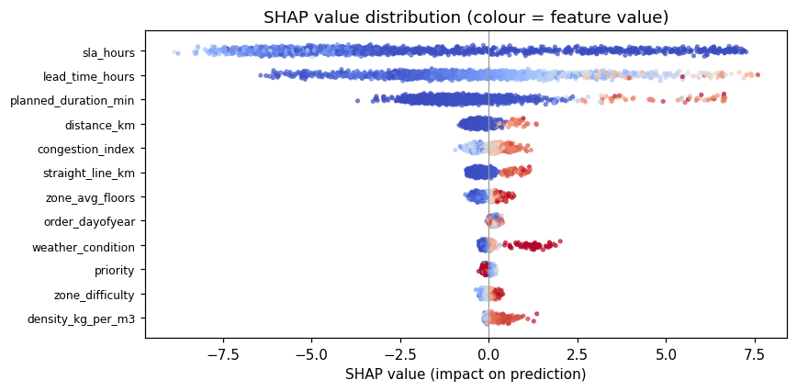

EXPLAINABILITY
SHAP attribution, computed natively
A packaging bug, not a modelling one
The released shap package fails against XGBoost 3.x — it can't parse the JSON-encoded base_score.
The platform calls XGBoost's and LightGBM's native TreeSHAP directly instead — the same exact Shapley values, from the library that owns the tree structure.
Top attribution: sla_hours (39%), lead_time_hours (22%), planned_duration_min, congestion_index, distance_km.
THE INTELLIGENCE LAYER
23

Slide 25
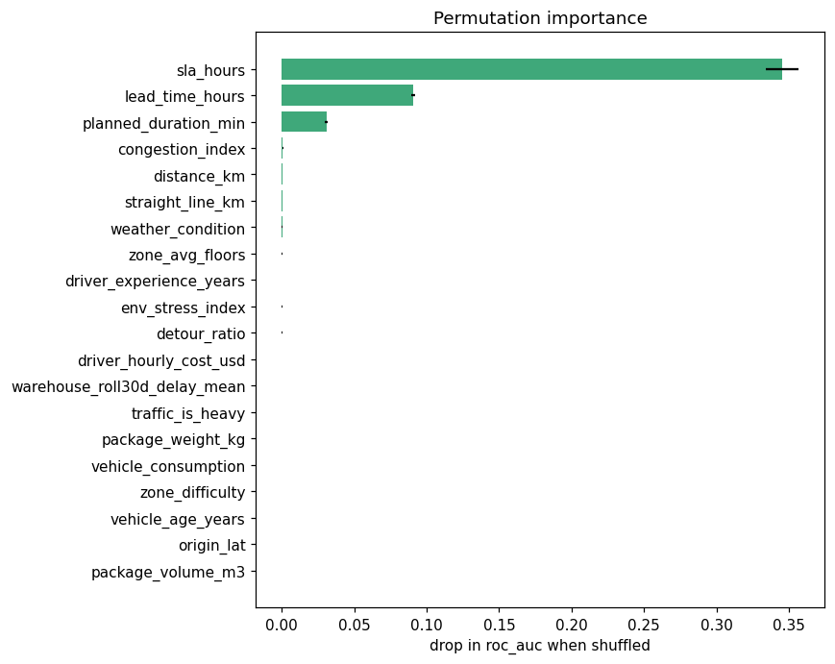
EXPLAINABILITY
Two methods, cross-checked — and wired into governance
SHAP vs. permutation importance rank correlation: 0.61 — sharp disagreement would flag correlated features or an unstable model; this level says the two methods broadly agree.
LIME (in-house weighted-ridge surrogate) and partial dependence available per-instance and per-feature.
Governance is built in, not bolted on: the model registry versions every run, promotion and rollback are one command, and the prediction API enforces a feature contract — reordering input columns cannot change a prediction. That invariant is covered by a test.
THE INTELLIGENCE LAYER
24

Slide 26
The Product
A nine-module executive dashboard — one self-contained file, live filters, and an honest empty state when data is missing.
THE PRODUCT
25

Slide 27



DASHBOARD
Nine modules, one page
Executive Dashboard
Operations Center
Fleet Management
Revenue, cost, margin, on-time rate, MoM movement
Demand heatmap, hourly reliability, congestion profile
Composition, age, energy mix, utilisation, maintenance
Warehouse Analytics
Delivery Monitoring
Demand Forecast
Throughput vs. capacity, automation, stockout exposure
Interactive map, 7 layers, SLA outcome by priority
30-day projection, 95% interval, seasonality decomposition
Optimization Simulator
AI Recommendations
Explainable AI
8 what-if levers, live cost & service recomputation
9 ranked, quantified actions, each with its evidence
SHAP, leaderboard, agreement check, partial dependence
THE PRODUCT
26

Slide 28
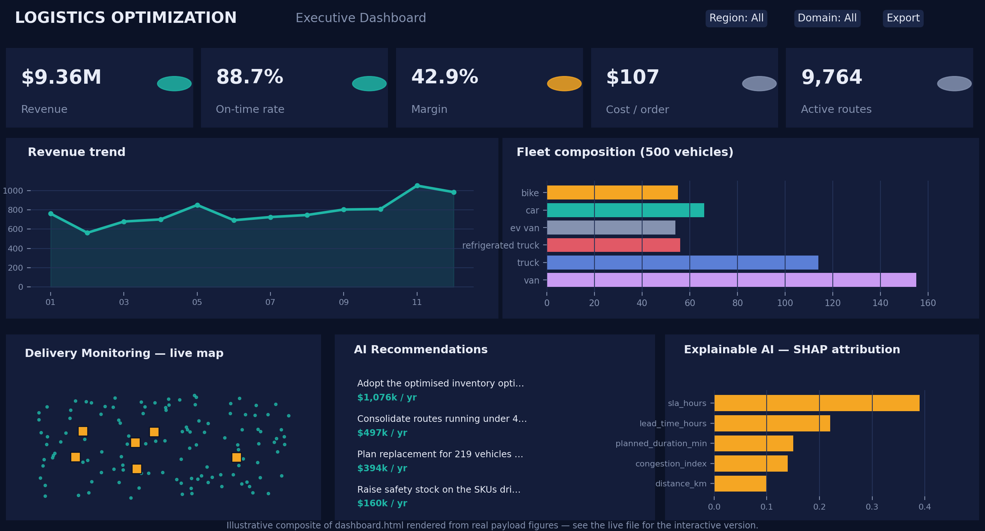
DASHBOARD
A composite you can trust, not a slide of hopes
Filters actually filter.
A 432-row region × domain × month cube lets the browser genuinely re-aggregate the executive figures — not just swap a label.
The simulator is calibrated, not invented.
Congestion and weather elasticities are measured late-rate gaps from this dataset; vehicles and drivers are modelled Cobb-Douglas (85/15) toward whichever is scarcer.
Forecast accuracy is reported out-of-sample.
16.97% MAPE held out, vs. 7.04% in-sample — the flattering number is not the one we lead with.
43 / 43 validation checks
in a headless harness: every KPI reconciles to the payload, every chart container renders or shows an honest empty state.
dashboard.html is one self-contained file (0.72 MB) — opens by double-click, no server. This image is an illustrative composite built from the same payload, for a slide that has to work without a browser.
THE PRODUCT
27

Slide 29

Business Impact
Three worked examples from this dataset, and a quantified — explicitly illustrative — ROI estimate.
BUSINESS IMPACT
28

Slide 30
CASE STUDY 1
Predicting, explaining, and pricing for late deliveries
Predict
Explain
Confirm
Act
The dispatch-time model flags at-risk orders at ROC-AUC 0.998, using features known the moment a vehicle and driver are assigned.
SHAP shows sla_hours alone accounts for 39% of attribution — the model leans on the same lever a planner would.
Adverse weather deliveries run 13.0% late vs. 11.0% in clear conditions — a measured +2.0pp across 7,236 deliveries, not a modelling artifact.
Recommendation: extend promised windows automatically once severity crosses a threshold — quantified impact $27,854/yr at this sample's scale.
BUSINESS IMPACT
29

Slide 31
CASE STUDIES 2 & 3
A fleet that's under-loaded, and a stock policy already priced
Fleet consolidation
Inventory policy
77% of routes run under 40% of vehicle capacity; median load is just 7%.
Recommended: raise the minimum load threshold before dispatch — $496,688/yr identified at this sample's scale.
Separately, the fleet-allocation CP-SAT solver already beats a real assignment baseline by 70.9% on its own cost objective — the two levers are complementary.
EOQ with safety stock reaches $9.38M/yr against a $10.45M/yr baseline — 10.3%, or $1.076M/yr.
The single largest lever identified anywhere in this platform, and it's closed-form: no solver required, just the right formula applied consistently.
Paired with a targeted safety-stock raise on the SKUs driving the 1.36% stockout rate ($160,274/yr).
BUSINESS IMPACT
30

Slide 32
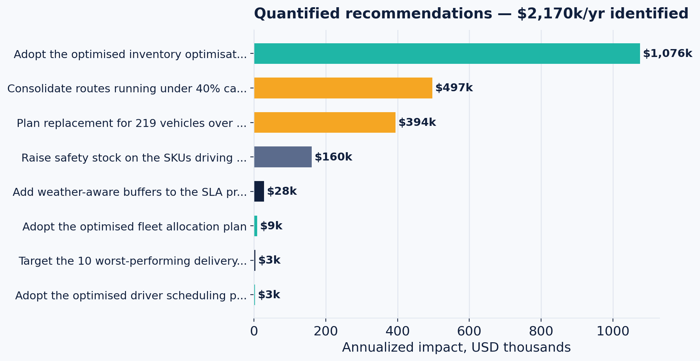
ROI
$2.17M/yr in quantified opportunity, at this sample's scale
$9.36M
Annual revenue
$5.35M
Annual cost
42.9%
Margin
$2.17M
Identified opportunity
BUSINESS IMPACT
31

Slide 33
ROI
Read every number on the last two slides as a method demonstration
These figures are illustrative estimates computed on the generated synthetic sample (50,150 orders). They demonstrate the methodology — how a recommendation is derived and priced — not a guaranteed outcome. Real-world impact depends on data quality, integration depth, organizational adoption, and how closely this dataset's physics match your actual operations.
Data quality: production data is messier than a calibrated generator — expect the first pass to find data problems before it finds savings.
Integration depth: the impact estimates assume recommendations are actually operationalised into planning, not just reported.
Scale: these dollar figures scale with order volume; a network 10x this size should expect roughly 10x the opportunity, not 10x the confidence.
Change management: the largest single lever (EOQ inventory, $1.076M/yr) requires zero new technology — only the discipline to run the existing formula consistently.
BUSINESS IMPACT
32

Slide 34

Getting to Production
Architecture, security, cloud deployment, and an honest roadmap for the gap between this build and a production rollout.
GETTING TO PRODUCTION
33

Slide 35
ARCHITECTURE
Four layers, entirely open-source
Data layer
pandas, NumPy, PyArrow — Parquet, SQLite, DuckDB
Intelligence layer
scikit-learn, XGBoost, LightGBM, CatBoost, PyTorch, OR-Tools
Serving layer
File-backed model registry — versioned, promotable, rollback-able; FastAPI or stdlib HTTP
Presentation layer
Single-file HTML, Tailwind, Plotly, Leaflet — no server to run
Every optional dependency degrades gracefully rather than aborting the run — a design property, not just a library list.
GETTING TO PRODUCTION
34

Slide 36
SECURITY
Governance is real today; production hardening is the next step
Already built
Needed before production
Versioned model registry — every run stores estimator, preprocessor, exact feature order and provenance.
Explicit promotion and one-command rollback; the production version is never pruned.
Prediction API enforces a feature contract — reordering input columns cannot change a prediction, and that invariant is covered by a test.
Encryption at rest and in transit for real (non-synthetic) customer, driver and location data.
Role-based access control on both the dashboard and the prediction API.
PII minimisation and masking — this dataset is synthetic and contains none, but a real deployment will.
Audit logging, and vetting of every optional ML dependency before it reaches production.
GETTING TO PRODUCTION
35

Slide 37


CLOUD DEPLOYMENT
A cloud-agnostic reference architecture
Object storage
Containerized pipeline
Registry & API
Dashboard on CDN
Tables & artifacts — S3 / GCS / Blob
Generator + ML platform, batch or orchestrated
Model store behind a managed load balancer, autoscaled
Static file, cached at the edge, no server to run
No proprietary service is required to reproduce this deck: the entire pipeline above already runs, identically, inside a local sandbox.
Swapping in a managed queue, warehouse, or orchestrator (Airflow, Step Functions, Cloud Composer) is additive, not a rewrite.
GETTING TO PRODUCTION
36

Slide 38
ROADMAP
An illustrative path from this build to production
0–2 months
Pilot
Swap in one real data feed for one region; keep the dashboard read-only while the model's predictions are shadow-scored.
2–4 months
Productionize
Wire the registry and API into CI; add authentication and role-based access.
4–6 months
Expand
Add task coverage; put a human in the loop on the low-signal tasks (inventory shortage, vehicle failure) rather than automating them prematurely.
6+ months
Scale
Cloud deployment, security hardening, continuous retraining and monitoring against drift.
Illustrative sequencing, not a committed delivery plan — durations depend on data access, integration scope and organizational readiness.
GETTING TO PRODUCTION
37

Slide 39

Questions?
Four repositories, one connected system.
logistics_datagen
logistics_ml
logistics_dashboard
This deck
20 tables · 26 checks passing
7 stages · 27 checks passing
9 modules · 43 checks passing
19 topics · every figure sourced
chuvardynskyi@yahoo.com

