Slide 1
MedGPT: Advancing Conversational Medical Diagnostics
- DSAN5800 Project
Yifan Bian, Chuyuan Zhong, Donglin Jiang

Slide 2

Content
Introduction
Motivation
Data Overview
Method
Section 1: Dialogue Part
Section 2: Transform dialogues to Structured Data
Limitation and Improvements
Local Demo Showcase

Slide 3
Introduction
Overview
MedGPT is an AI-powered conversational chatbot designed to assist in medical diagnosis.
It leverages advanced natural language (HuggingFace, OpenAI) processing to understand and respond to medical inquiries.
Purpose
Aims to support healthcare professionals by providing quick, preliminary diagnosis suggestions based on patient symptoms.
Enhances patient engagement and preliminary care.

Slide 4

Motivation
Addressing the need for instant medical assistance
Improving preliminary diagnosis accuracy
Reducing workload on healthcare professionals
Accessible healthcare support for remote areas
We hope to help patients determine if their symptoms require urgent care, suggest possible diagnoses for them to investigate further, and guide them in knowing what questions to ask their doctor.

Slide 5
Data Overview
We used two datasets, MedDialogue and GenMedGPT, from Kaggle.
They all contain JSON-formatted dialogues between patients and doctors.
Each dialogue contains an instruction specifying how to answer medical questions as a doctor, the patient's symptom input text, and the doctor's diagnostic response text.
For example:
{
  "instruction": "If you are a doctor, please answer the medical questions based on the patient's description.",
  "input": "Doctor, I have been experiencing sudden and frequent panic attacks. I don't know what to do.",
  "output": "Well, based on what you're telling me, it sounds like you may be suffering from panic disorder. The best course of action is to start with psychotherapy and mental health counseling. Additionally, we should conduct an electrocardiogram to make sure that there are no physical issues causing your panic attacks. We will also need to perform a depression screen and a toxicology screen to rule out any other underlying causes. Finally, I would recommend a comprehensive psychological and psychiatric evaluation and therapy to help manage your symptoms. "
  }

Slide 6
Data Overview
GenMedGPT and MedDialogue contain 5452 and 1024 medical conversations, respectively. The symptoms span a wide range of conditions across medical domains such as gastrointestinal, neurological, respiratory, and more.
The semi-structured dialogue format (JSON)
Appropriate for training conversational diagnosis models

Slide 7
Method
Our conversational diagnosis chatbot MedGPT used a retrieve-and-generate framework to provide intelligent responses to patient symptom queries.
First, a dense vector index is constructed from the MedDialogue dataset to enable quick semantic search. Patient input is encoded into an embedding vector and compared against the index to find the most relevant matching dialogues.
These retrieved medical conversations provide context for our generative model to then produce a diagnosis response. We used a 7B parameter LLM called MedLLaMa on doctor-patient dialogues to power the generation.

Slide 8
Section 1: Dialogue Part

Slide 9
Embedding and Vectorstore
Create embeddings with Sentence Transformer from Huggingface
Building a searchable database with FAISS
Specifically, the sentences are encoded by a BAAI BGE-small embedding model. We used the FAISS library for efficient approximate nearest neighbor search through vector indexes to find the most similar questions and return the question-answer pairs.

Slide 10
Retrieval stage
1. Indexing flow
Ingest medical conversation datasets
Encode dialogues into vectors with BAAI BGE
Index vectors in FAISS for fast retrieval
2. Retrieval Steps (RAG)
Encode user symptom input into vector with BAAI BGE (same as indexing)
Search vector through FAISS index for top 5 most similar dialogues
Extract those snippets into one context string (rag)
This rag context string is then provided to the generator model later to prime it to continue the medical conversation where the retrievals left off

Slide 11
Retrieval benefits
Grounds generation in real conversations
Allows responding relevantly to specifics of user's case
Makes diagnoses more accurate to symptoms

Slide 12
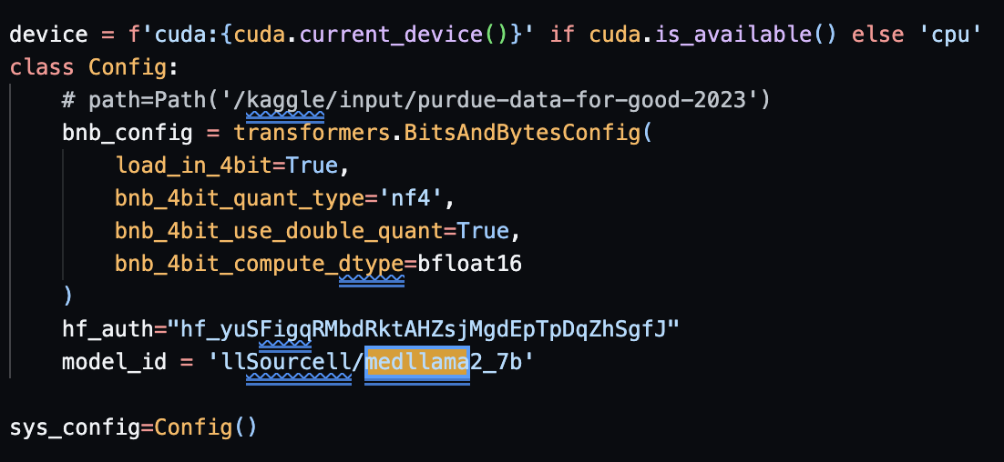
Model
Architecture
Model ID: llSourcell/medllama2_7b
Base: transformer model pre-trained on scientific text
Size: 7 billion parameters
This model, developed by Siraj Raval, is a Llama 2-based model and has been specifically fine-tuned on the MedQA dataset to provide accurate and comprehensive answers to medical questions. While not intended to replace medical professionals or provide official medical advice, MedLlama2_7b serves as an initial reference tool to help point people to valuable medical information. With its training on real anonymized medical conversations and medical journals, it can understand complex health-related questions and provide detailed responses drawing from reliable sources.

Slide 13
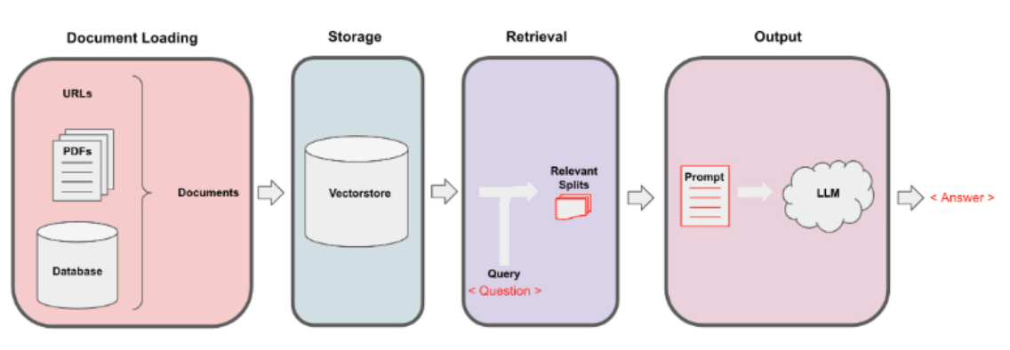
Model
Workflow
Patient enters symptom query
Retrieve relevant dialogues
Concatenate as context string
Feed context to MedLLaMa model
Model generates conversational response
  Temperature: 1e-5
  Max tokens: 512
  Repetition penalty: 1.1
Output continues diagnosis dialogue

Slide 14
Section 2: Transform dialogues to Structured Data

Slide 15
Introduction
Purpose: Extract information from medical treatment texts
Data: Medical records (name, age, condition, medication)
Evaluation Metric: Word Error Rate (WER) = (S+D+I)/N (Substitution, Deletion, Insertion)
Challenges: generalization, multilingual, unsupervised

Slide 16
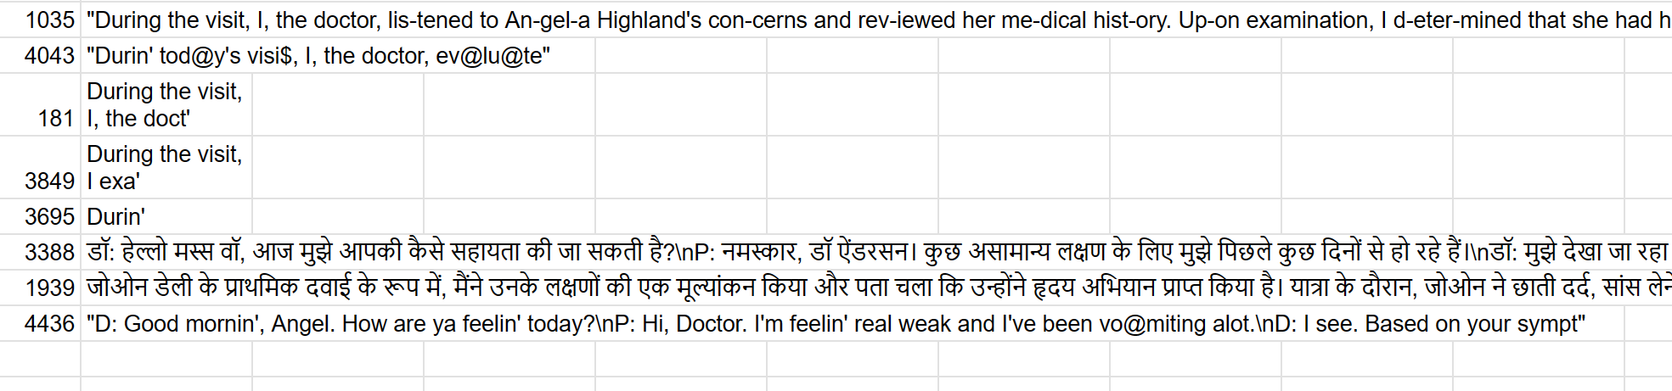
Development Process
Mini-Batch Testing: Test a specific model on a small batch to identify error scenarios.
Investigate and optimize based on identified errors.
Evaluate the model: Understand the model's strengths in extracting specific information.
Based on the combined results mentioned above.
Failed cases （for Llama2 - 7b）

Slide 17
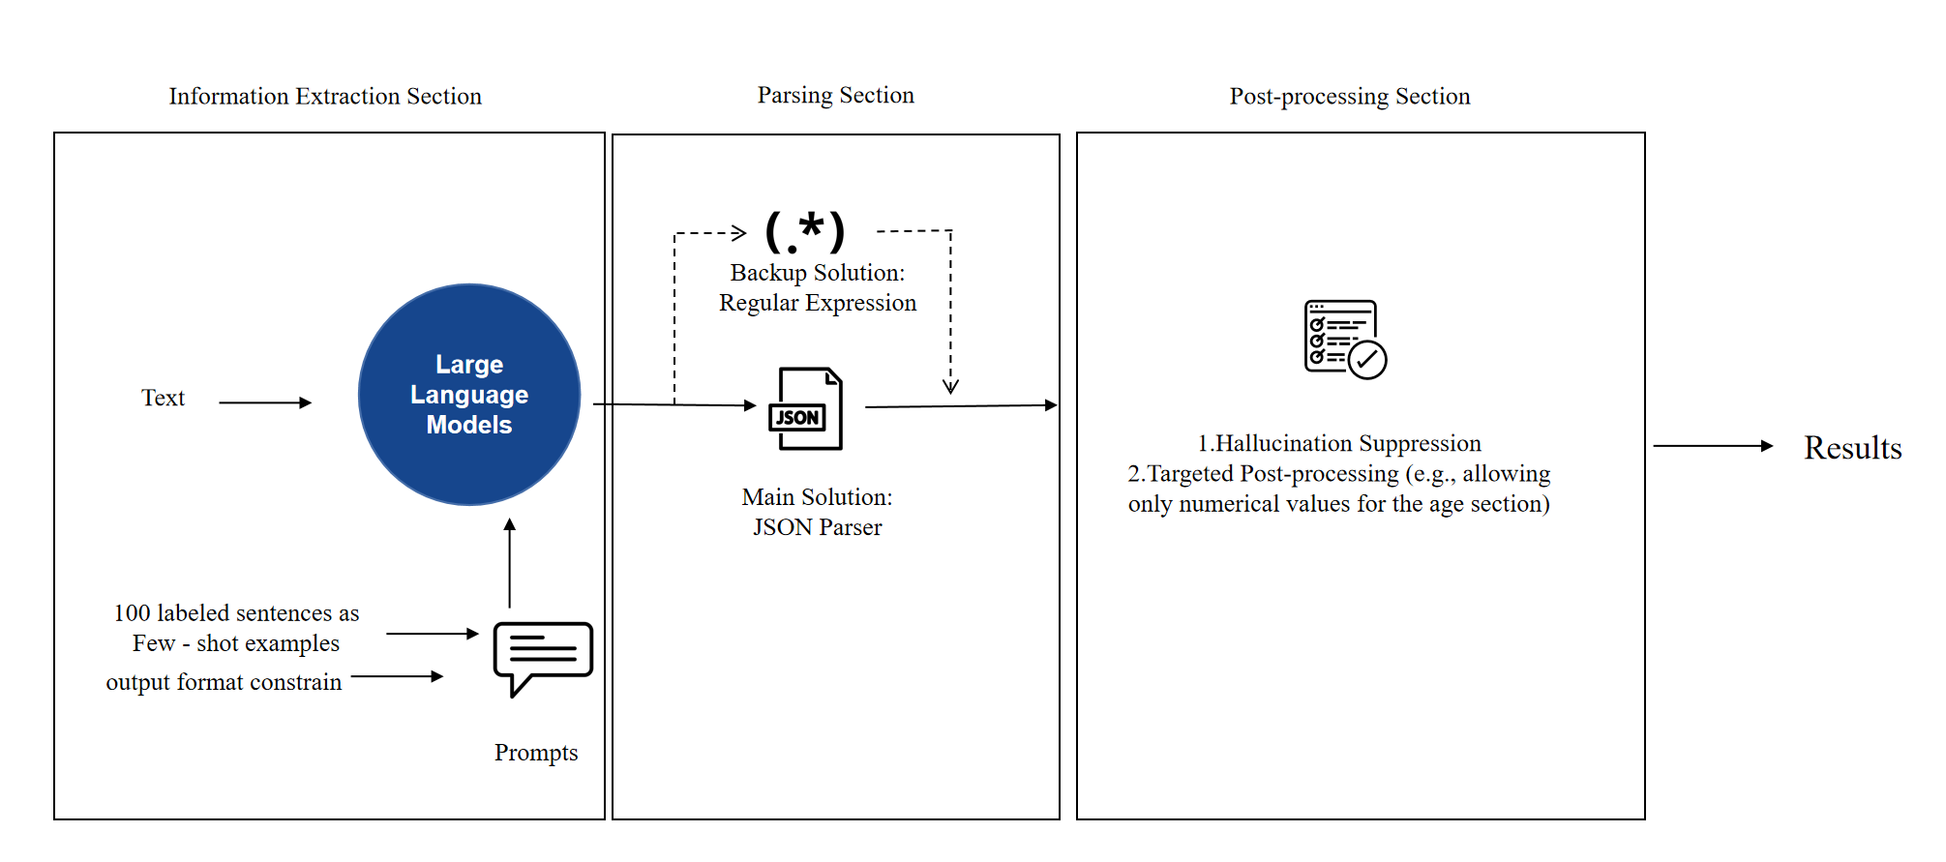
Solution - Single Model

Slide 18

Solution - Whole Process
Age
Name
Condition
Symptom
Precaution
Drug
Llama 2-7B
Yes
English?
MedLlama 2-7B
No
Translate to English
(GPT excels in English translation ability)
Post-processing
Parallel Computing

Slide 19
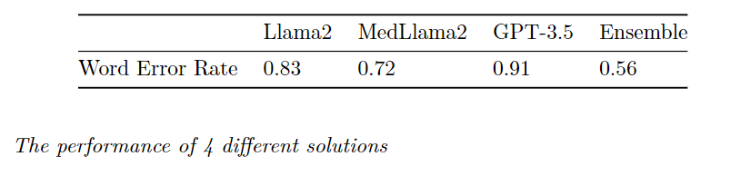
Evaluation
Assessed 4 language models on performance using Word Error Rate (WER)
Lower WER = better performance
Results:
Key Takeaways:
Ensemble approach substantially reduced errors
MedLlama2 strong for medical language tasks

Slide 20
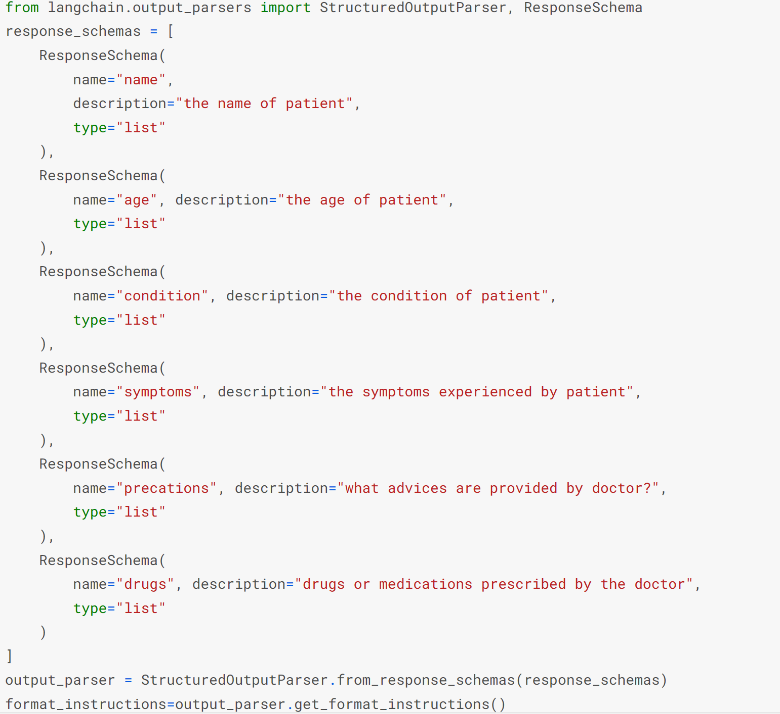
Sample Code - Prompt

Slide 21
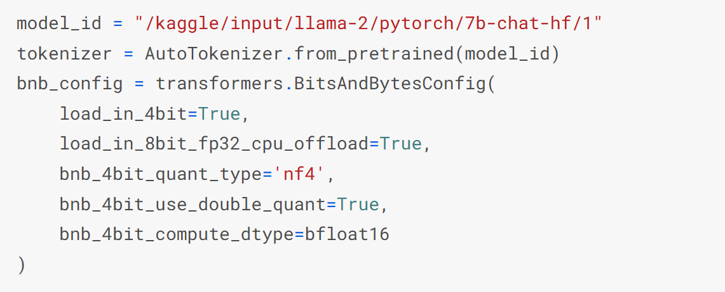
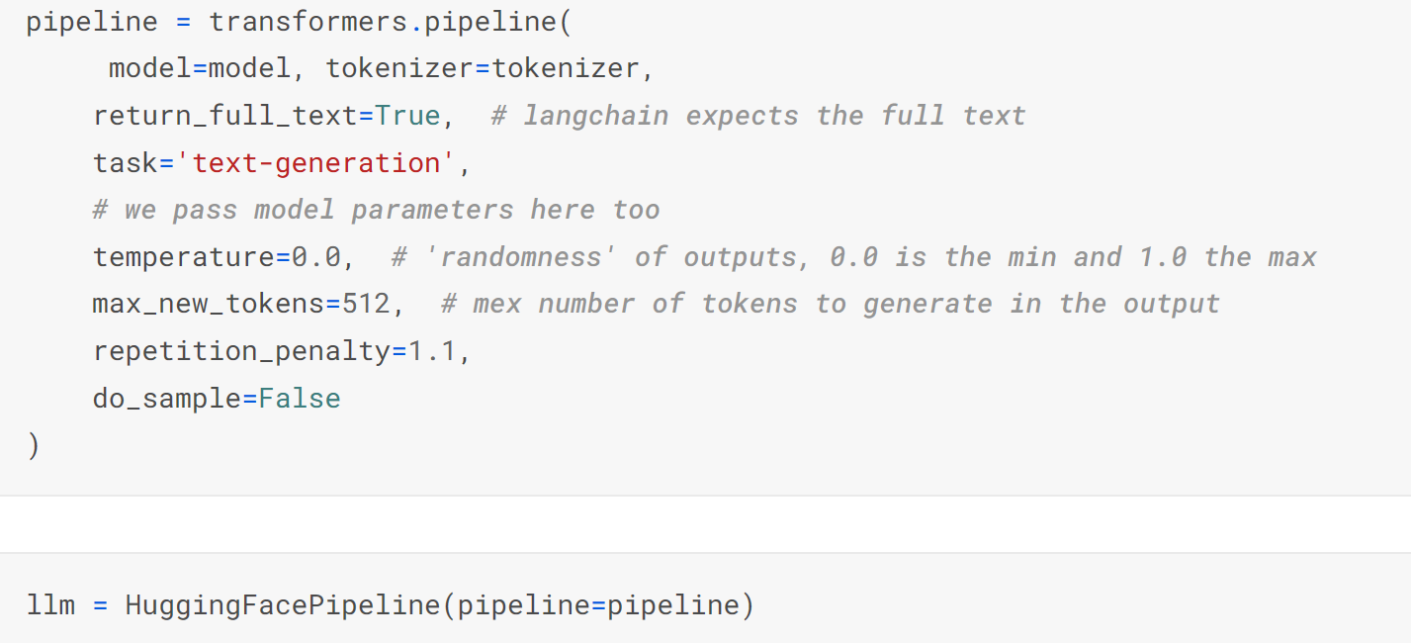
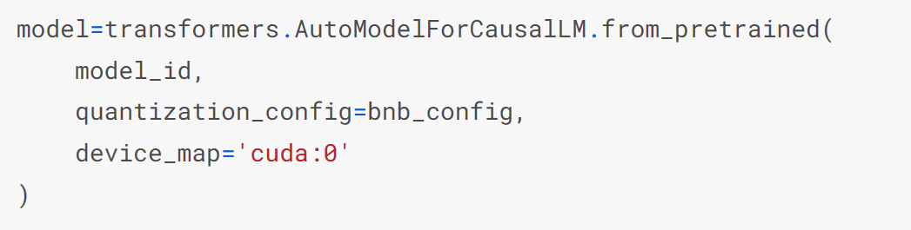
Sample Code - Model Deployment

Slide 22
Limitation and Improvement
Limitations
Enforcing output format constraints hinders the effectiveness of CoT (Multiple layers of input-output chains?)
Evaluation Metric: Does WER measurement lead to overfitting? (Highly influenced by validation set format)
Improvements
Generalization/specificity trade-off (prompt/fine-tuning)
Few-shot learning (potentially effective in large batches)
RAG (Retrieval-Augmented Generation) for recalling domain-specific knowledge

Slide 23
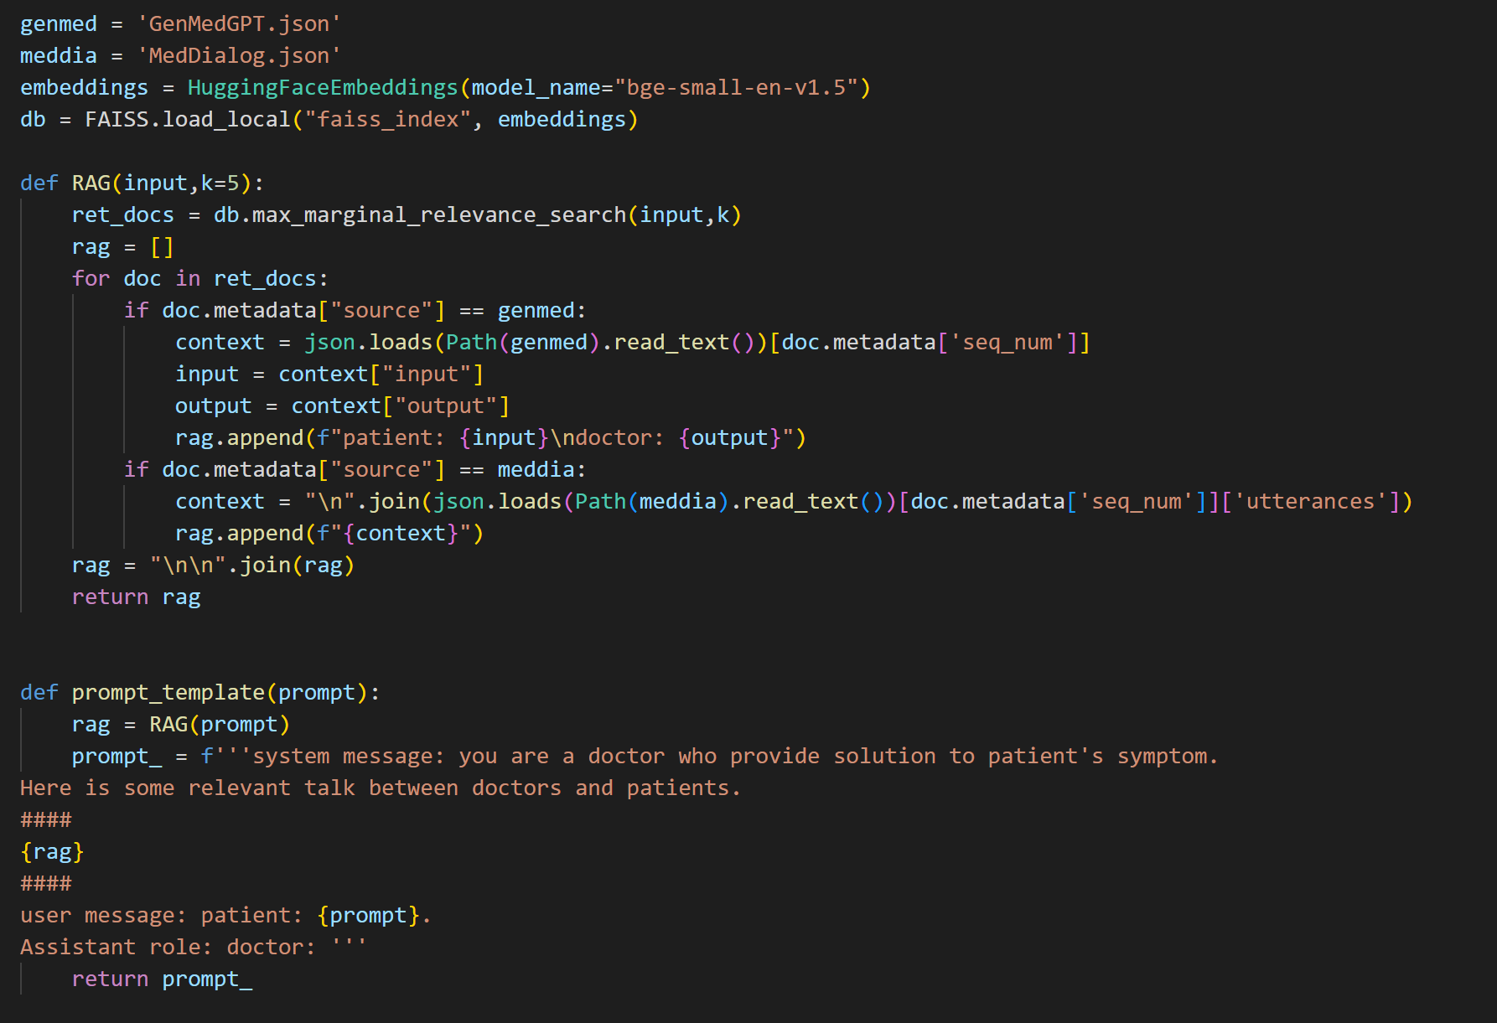
A Streamlit Server Demo
Faiss for Vectorbase
GPT-3.5 for LLM
Langchain for Memory
Streamlit for Front End

