Slide 1







Carpooling Match: A way to save life-time from long daily commute
Chuyi Wang. Xingnuo Duan
Dec, 2019

Slide 2




Agenda
Backgrounds
Introduction
Research
Conclusion
-Introduction to the project
-Problem Statement
-Key Entity & Attributes
-Monte Carlo Simulation
to generate random
samples
-Matching Algorithm
-Summary of Findings
-Concluding Remarks
-Q&A

Slide 3
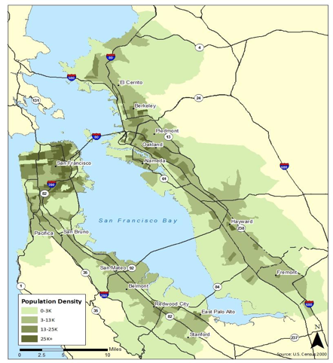



Backgrounds
•People in big cities are suffering from long time commute and serious traffic on daily basis.
•Vehicles with multiple passengers could take the carpool lanes with less traffic.
•There are some obvious patterns about people’s commute.
•For example:
Residence Location:
Fremont(37.548271, -121.988571)
(Computer & Mathematical Occupations: 17.8%, 30648 by 2018)
Work Locations:
Redwood City(37.487846, -122.236115)
Palo Alto(37.468319, -122.143936);
Mountain View (37.386051, -122.083855);

Slide 4
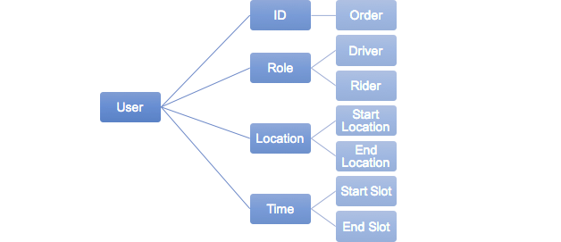
Users’ Attributes
Goal:
Find the all matched pairs of drivers and riders based on their time windows and locations.
Hypothesis:
The match rates is above 95%.
The promotion of the percent of 3 slots help increase the match rate.

Slide 5
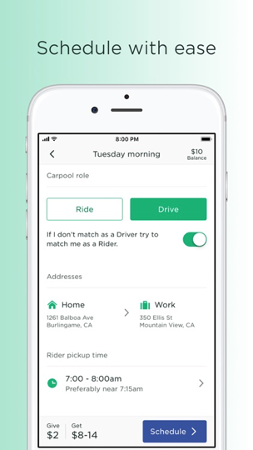
Users’ Attributes
Locations: Coordinations.
Time: A time window ranging from 6:30 to 9:30, while have been divided into 12 slots, that is the time range of a lot is 15 minutes.

Slide 6
Parameter Generating
Role
randomRole(d_num, obs)
Time Slots
randomSlots(slotDict, numDict, obs)
subsetLObs(slotDict, length, obsL, subset)
Locations
start location
end location
randomSandD(obs, source_list, des_list)
randomCenter(indexes, source_list, des_list)
randomLoc(Latlon, radius)
File Output
outTxt(obs, d_num, source_list, des_list, slotDict, numDict, iterId)
dynamicOut(obs, d_num, source_list, des_list, slotDict, numDict, iterNum)

Slide 7
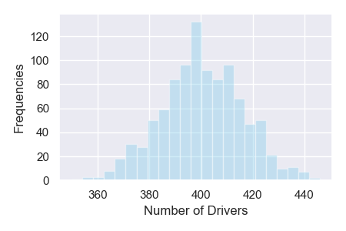
Parameter Generating - Role
1000 trails with 1000 observations in each trail
use 0.4 as driver rate according to material

Slide 8
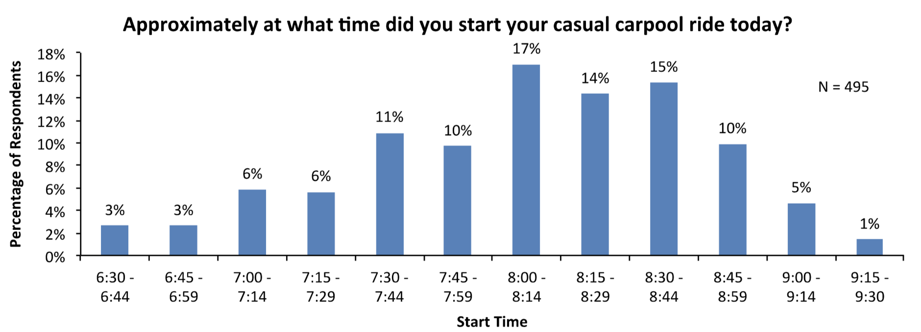
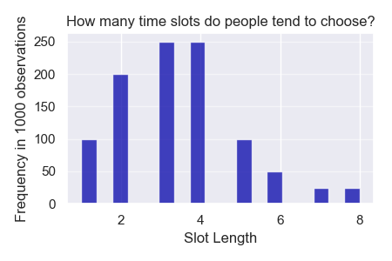
Parameter Generating - Time Slots
source: researchGate
In scoop, people can choose from 6:30 to 9:30, then we use these 12 slots to generate the slotDict which has slot id as the keys and the possibility of this slot as value.
Then we use our experience to specify the preference of how many time slots people choose, with 3 and 4 time slots spanning from 45 mins to 1 hour being the most frequent. Then we get numDict which has number of slot as the keys and the possibilities of slots of this length being chosen.

Slide 9
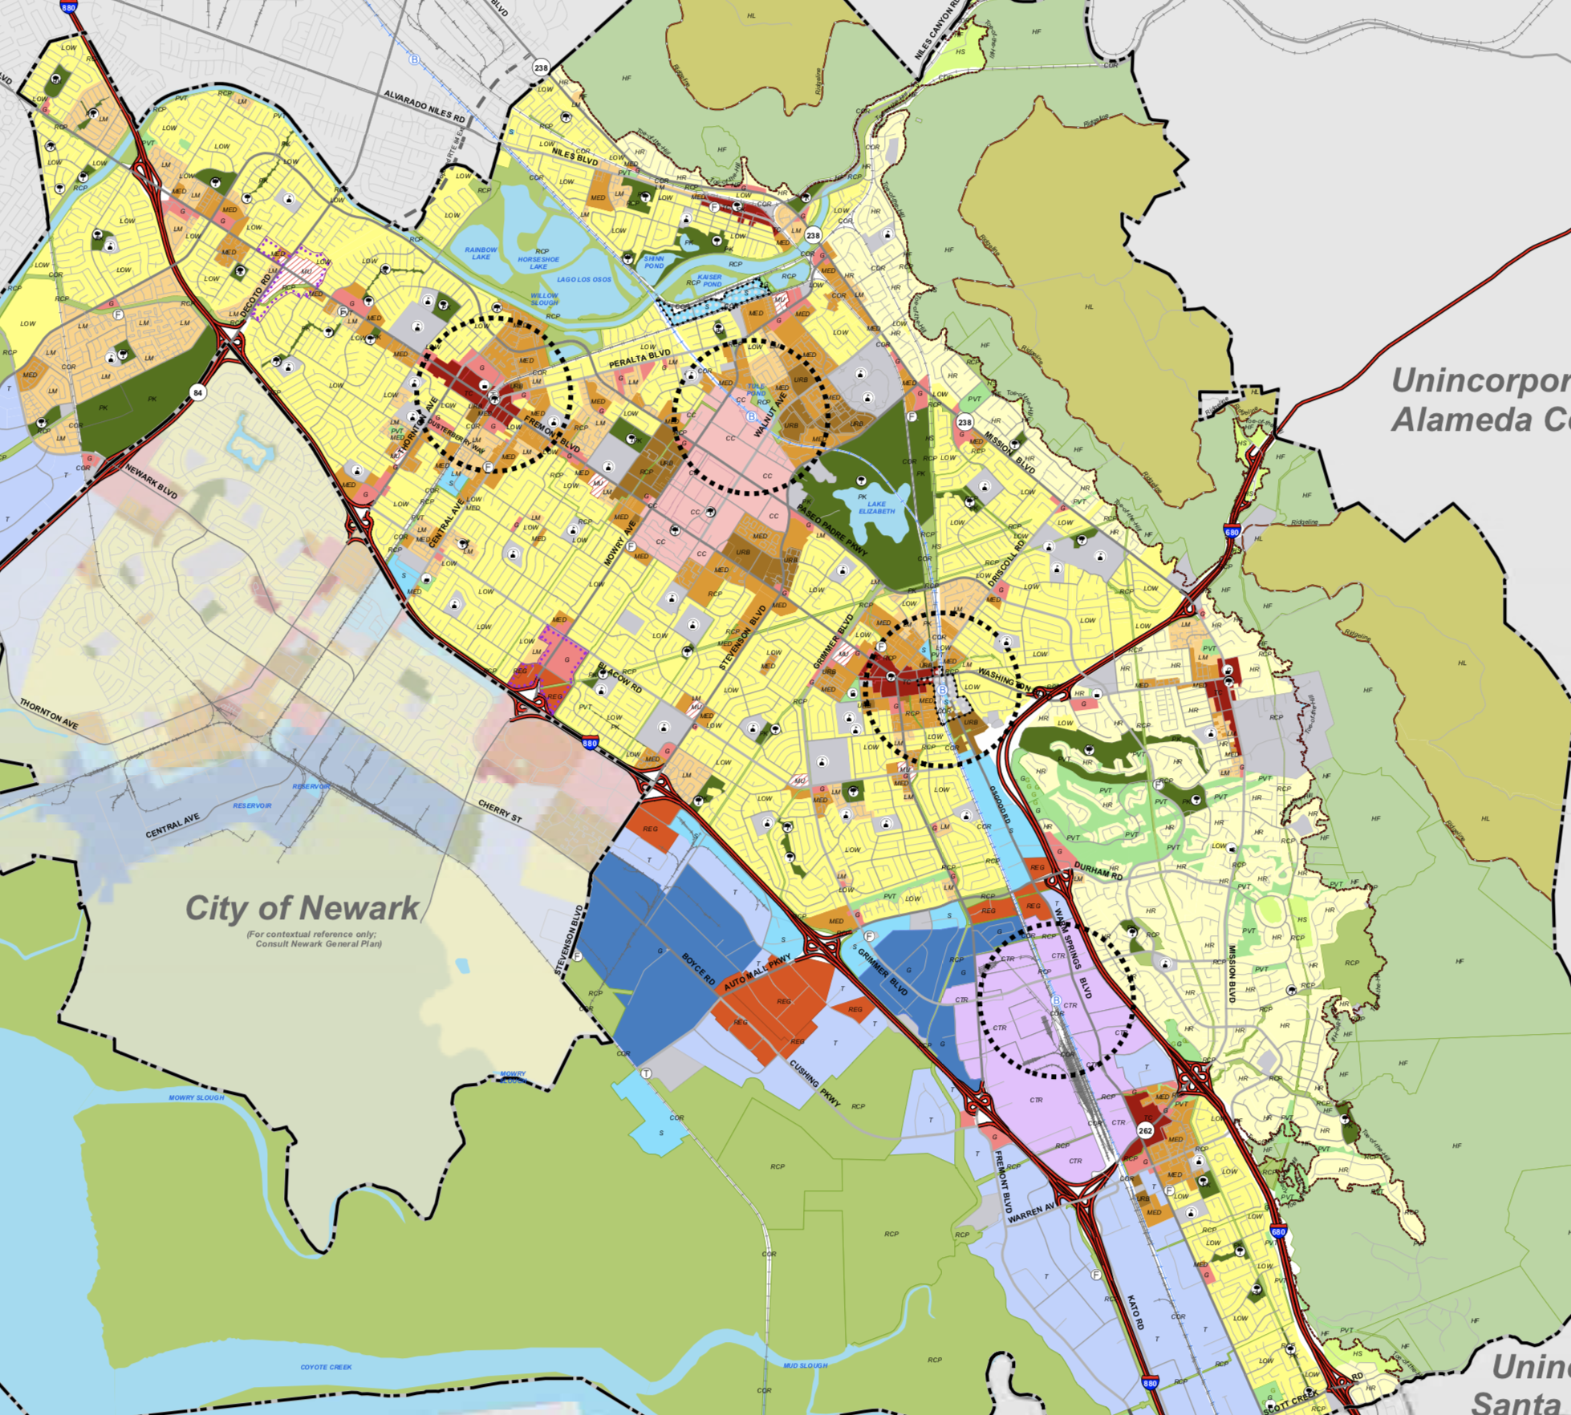
Parameter Generating - Locations
Sources:
(37.558153, -122.006811)
(37.557710, -121.977105)
(37.532314, -121.953163)
(37.501887, -121.939521)
radius = 0.5 miles
Destinations:
Palo Alto(37.468319, -122.143936)
Mountain View (37.386051, -122.083855)
Redwood City(37.487846, -122.236115)
radius = 3 miles
source: Fermont Planning Division

Slide 10
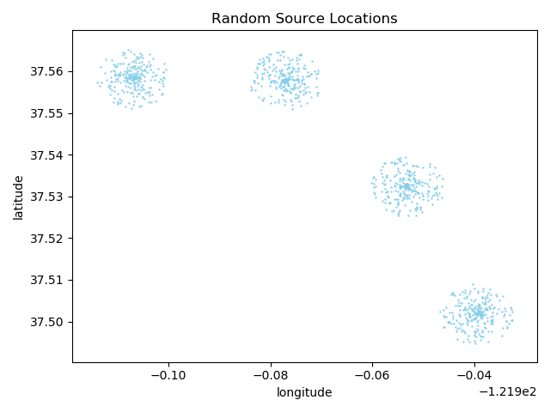
Parameter Generating - Source Locations
Sources:
(37.558153, -122.006811)
(37.557710, -121.977105)
(37.532314, -121.953163)
(37.501887, -121.939521)
radius = 0.5 miles

Slide 11
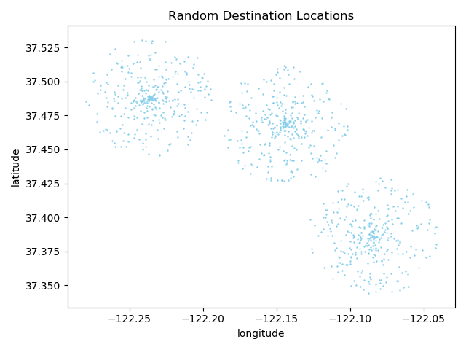
Parameter Generating - Destination Locations
Destinations:
Palo Alto(37.468319, -122.143936)
Mountain View (37.386051, -122.083855)
Redwood City(37.487846, -122.236115)
radius = 3 miles

Slide 12
Matching Process
•User Object
•Lists: Matches, Unmatched_drivers, Unmatched_riders
•Procedure:
1. Process 1 user each time;
2. Match the user with the unmatched lists of the other role
If it is a driver, the match it with each unmatched rides in
“Unmatched_riders”.
3. If it has been successfully matched with an previous
unmatched case, add both of them to the matches, and
remove the unmatched user from its list.
Else if it has been not matched with any cases in unmatched
list, add it to the unmatched list of its role
•Complexity: [O(n), O(n^2)]
It is much more faster than the worst case O(n^2), considering match rate is very high in real.
Matching rules:
1. The driver’s chosen ending time plus the pick-up time is no earlier than a rider’s chosen starting time.
2. The driver’s chosen starting time plus the pick-up time is no later than a rider’s chosen ending time.
3. The total extra time increased because of pick-up and drop-off is no bigger than the driver’s preference.
i.e. if a rider’s slots window is from 8:00 - 8:30

Slide 13
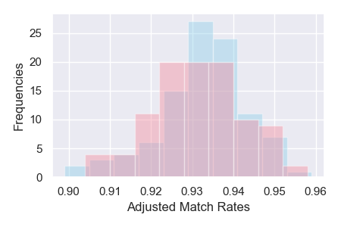
Hypothesis Test
Hypothesis 1:
Null Hypothesis: The match rate is above 95%.
T-test (one tail): t=-16.686, p=0.000
Conclusion: we reject the null Hypothesis.
Hypothesis 2:
Null Hypothesis: The promotion of the percentage of 3 slots does not affect the match rate.
T-test (two tails): t=0.844, p=0.401
Conclusion: we can’t reject the null Hypothesis.

Slide 14
Questions and Comments

