Slide 1
Reproductibility
Sierro Romain & Favre Lenny & Khalil Mohamed
Github:
https://github.com/Chxresubles/m05_miniprojects

Slide 2
Content Table
Data and Workflow Management
Version Control with Git
Code Sharing with GitHub
Unit Testing and Continuous Integration
Code Documentation and Scientific Reports
Packaging, Deployment and Licensing
Conclusion

Slide 3
Data and Workflow Management
Dataset → secondary source
Wine quality: 2 sub-datasets (Red wine, White wine)
Boston House Prices: 13 features per house and their price
Workflow
Load Data
Preprocessing
Training
Evaluation

Slide 4
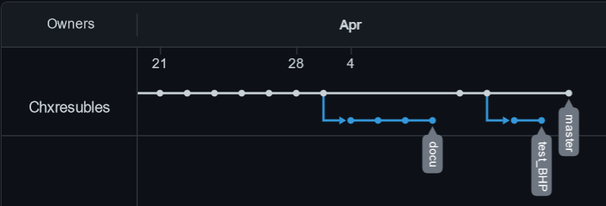
Version Control with Git
How we worked ?
Never work on branch «master»
New development branch for every new functionnality
Commits with clear messages
Once a branch is ready, has been tested and reviewed:
Squash and merge to the master
Delete the development branch

Slide 5
Code Sharing with GitHub
GitHub repo structure:
«.github/workflows/» : GitHub workflow files for CI
«docs» : Contains the package documentation
«m05/utils/» : Common Python modules
«m05/boston_house_prices/» + «m05/wine_quality/» : Project specific Python modules + a copy of Data in «dataset/»
«test/» : Unit tests for all Python modules
«READMD.md» : README file
«requirements.txt» : List of required Python packages

Slide 6

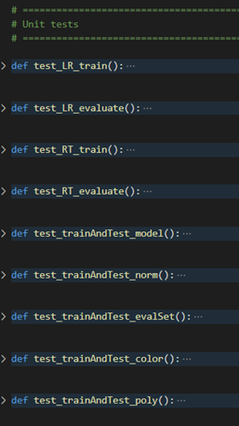
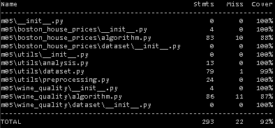
Unit Testing and Continuous Integration
The Pytest runner is used
One file of test per module
92% of code coverage
Main with argparse untested

Slide 7
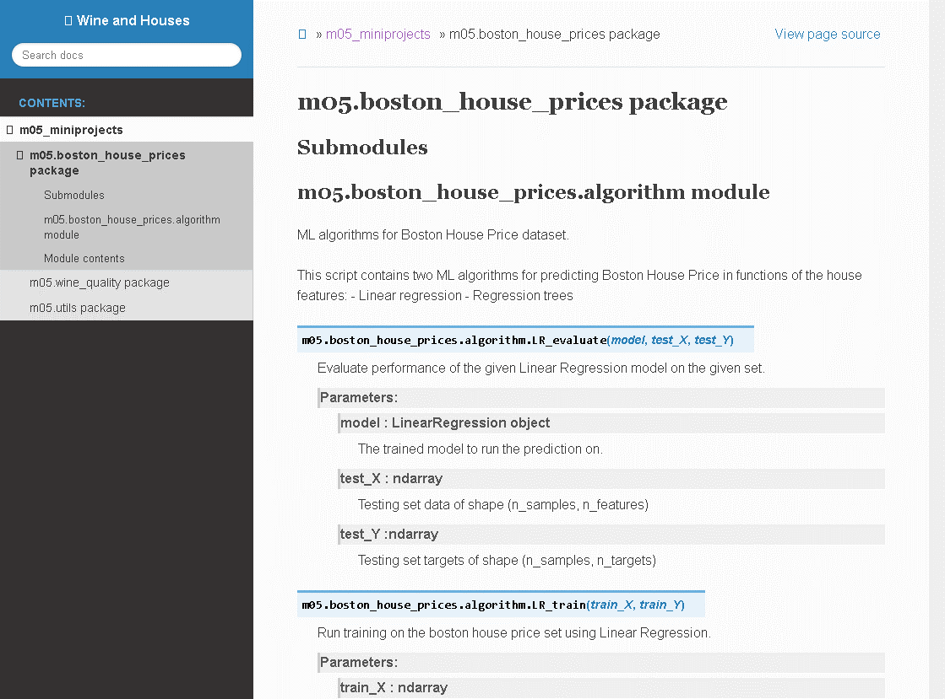
Code Documentation and Scientific Reports
Documentation created with Sphinx in HTML format.
Module documentation from docstrings.
README.md file created for the GitHub repository.

Slide 8
Packaging and Deployment
Can be easily installed and run from GitHub clone
«m05» as Python package containing both wine_quality and boston_house_prices projects
Datasets included in the package
CLI entry points for both projects

Slide 9
Licensing
BSD 2 clause
Zero compliance cost
Allows inclusion in both open source and commercial software
Why ?
It is commonly used for python packages
It fits all our needs
Contained in LICENSE.txt

