Slide 1

G4T2 OBJECT-ORIENTED PROGRAMMING PROJECT PRESENTATION
Jun Hao, Marcus, Kannappan, Sophie, Shao Xuan, Shane, Wei Lun

Slide 2
TABLE OF CONTENTS
Object-oriented design principles used
System architecture diagram
System design and application layers
Open-source libraries used
Application Demonstration

Slide 3
OBJECT-ORIENTED DESIGN PRINCIPLES USED
1
SINGLE RESPONSIBILITY PRINCIPLE (SRP)
USING THE Java Springboot Framework, we separated the classes of our application based on:
Entity layer - for managing relationship mapping between objects, and translates business objects from and to database rows.
Repository layer - to handle database interactions
Service layer - to handle business logic
Controllers - handle HTTP requests and act as API endpoints for frontend use

Slide 4
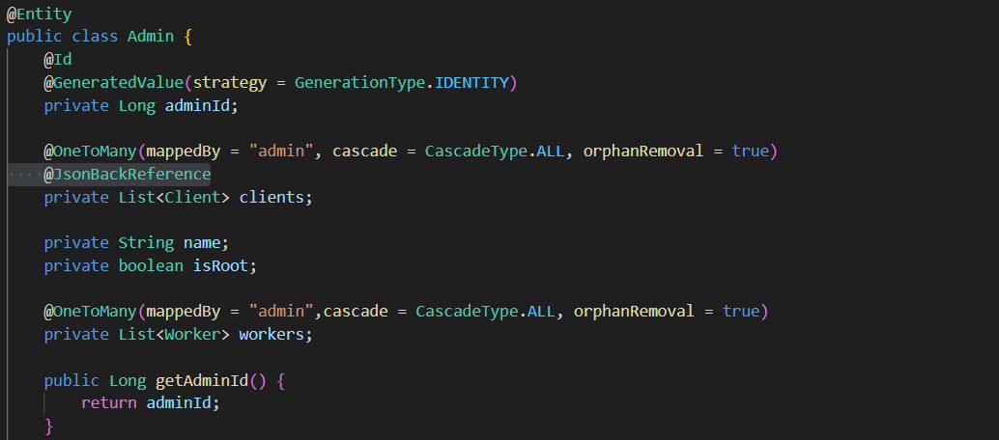
OBJECT-ORIENTED DESIGN PRINCIPLES USED
1
ENCAPSULATION
Entity layer
Entities have private fields and public getter/setter methods
Admin entity class

Slide 5
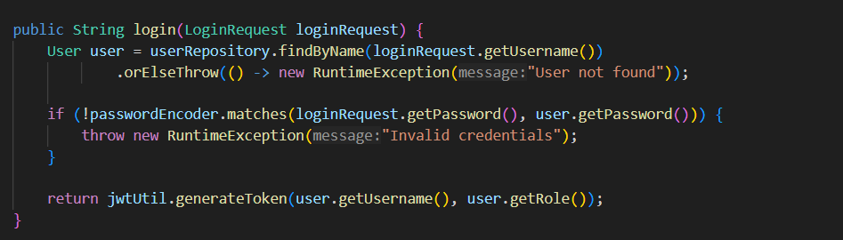
OBJECT-ORIENTED DESIGN PRINCIPLES USED
1
Service layer
Service classes don’t directly expose the repository but rather encapsulate repository calls within meaningful methods
ENCAPSULATION
Login method in UserService class

Slide 6
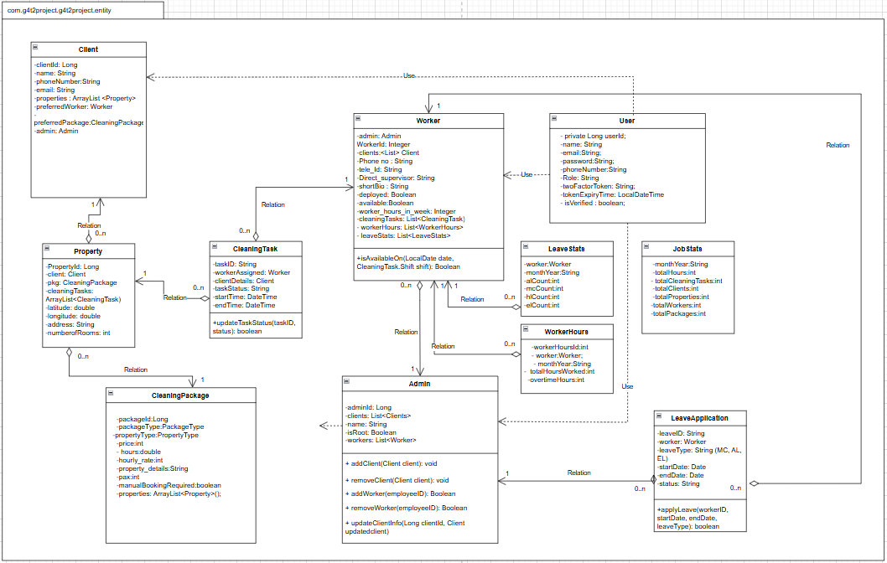
RELATIONSHIP MAPPING(ENTITIES)
2

Slide 7


2
SYSTEM ARCHITECTURE (BACKEND SPRINGBOOT APPLICATION)
Client
Controller
Service
Repository (CRUD operations)
Function calls
Dependency injections
HTTP request
DTO (Data transfer objects)
Spring JPA
Entity

Slide 8
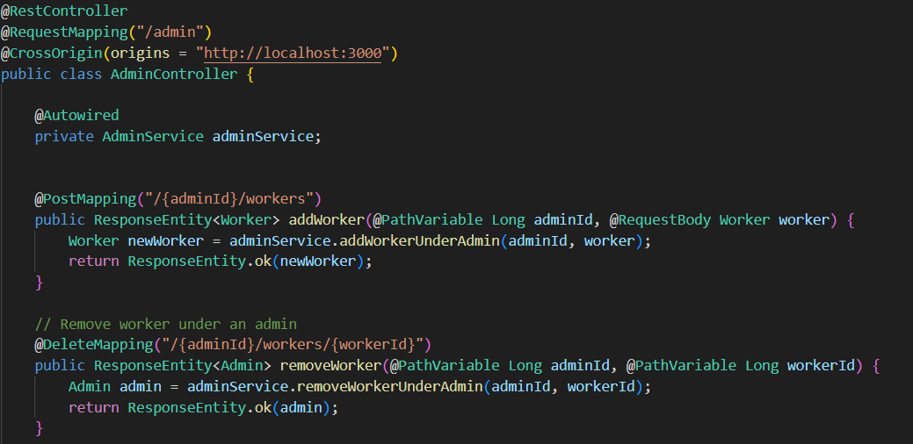
SYSTEM DESIGN AND APPLICATION LAYERS
3
Controller layer (Presentation layer)
Handles HTTP requests and responses
Maps incoming requests to specific functions, calls appropriate service methods, and returns data or views
Includes request validation, error handling, and response formatting

Slide 9
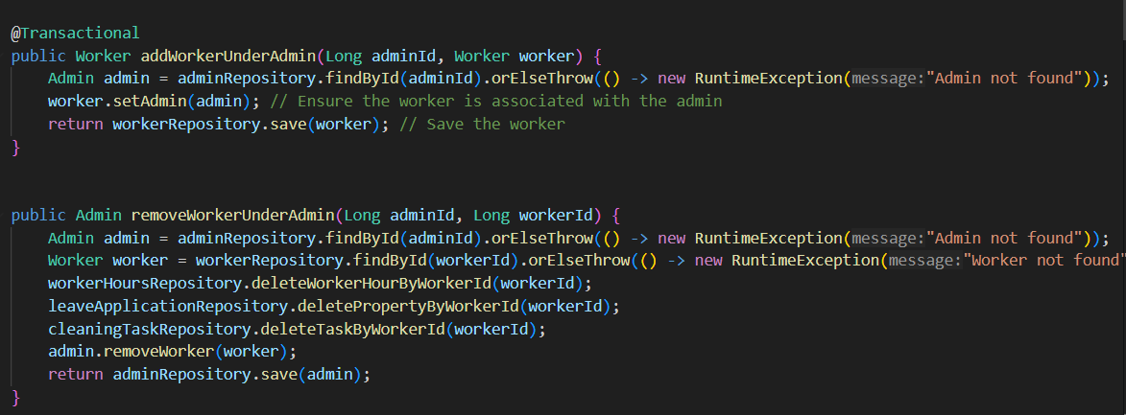
SYSTEM DESIGN AND APPLICATION LAYERS
3
Service Layer (Business logic layer)
Contains core business logic and processes
Encapsulates the application’s business logic and rules, calling repository methods to interact with the database if needed
Includes data transfer objects to combat problems such as circular referencing

Slide 10
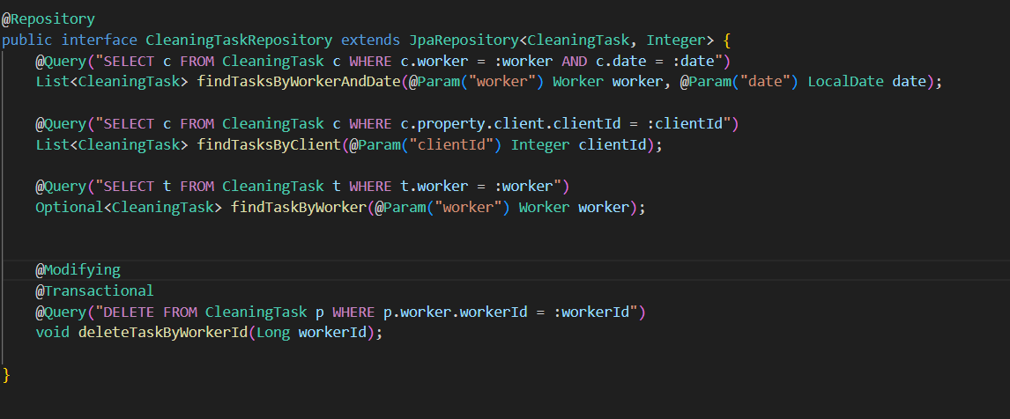
SYSTEM DESIGN AND APPLICATION LAYERS
3
Repository layer (Data access layer)
Provides an abstraction layer over the database
Manages database operations like CRUD (Create, Read, Update, Delete) operations, and interacts directly with the database, enabling data retrieval and storage.

Slide 11
SYSTEM DESIGN AND APPLICATION LAYERS
3
Entity layer(Domain model layer)
Represents the core data and business objects
Defines data structure for objects and includes entity relationships, validation rules, and encapsulated logic within the domain model itself.

Slide 12
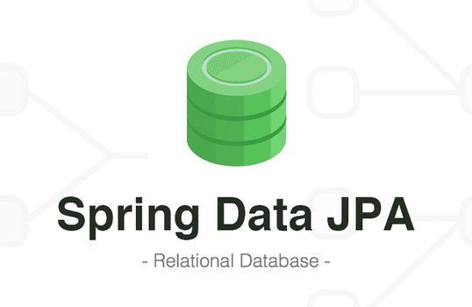
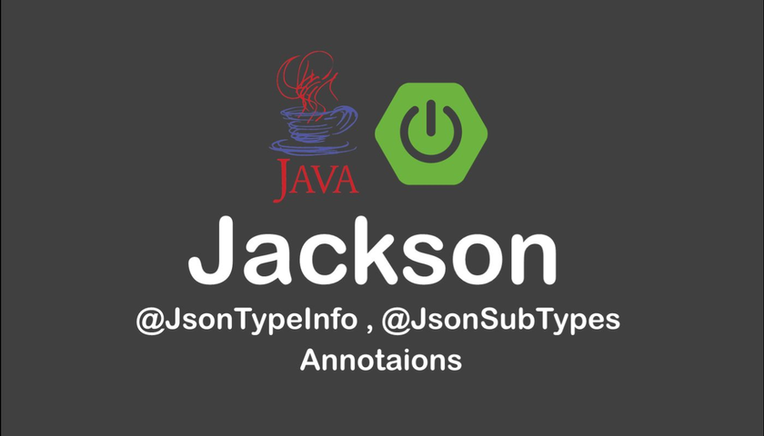









OPEN-SOURCE LIBRARIES USED
4
Notes:
google maps API

Slide 13
5
APPLICATION DEMONSTRATION

Slide 14
THANK YOU

