Slide 1

Detection of Brain Tumour MRI Images using Convolutional Neural Networks and Traditional Machine Learning Algorithms
A Project in Machine Learning in Synthetic Biology
Chigozie Nkwocha

Slide 2
Introduction
Brain Tumours
Cell growth and death imbalance
Detection and Diagnosis
Computational techniques

Slide 3
Aim
To classify brain tumour MRI scan images into four classes using traditional and modern machine learning (CNN) models

Slide 4
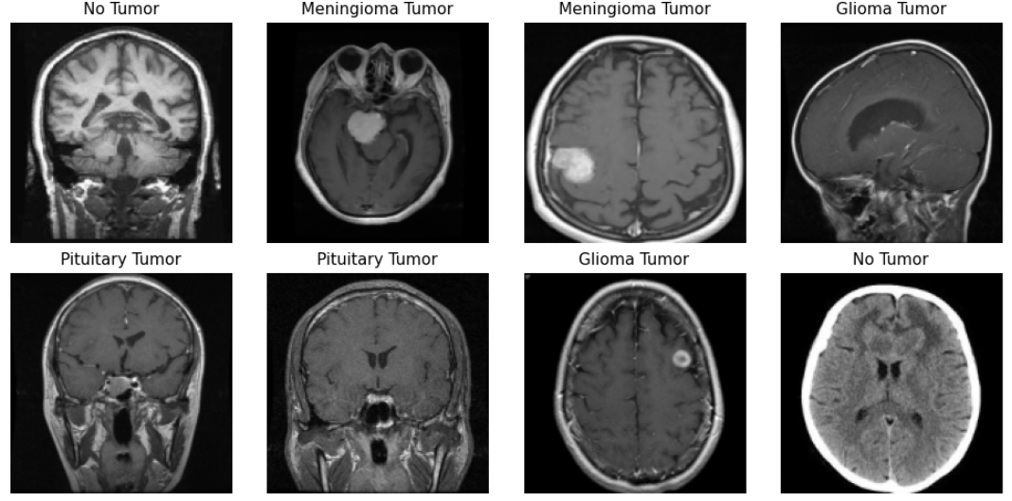
Dataset
3,624 brain MRI scans
Healthy brains (500)
Glioma tumours (926)
Meningioma tumours (937)
Pituitary Tumours (901)

Slide 5
Methodology
Data Preparation and Model Development
Rescaling to 0,1 range
Resizing into 150 by 150 size
Image data augmentation
Splitting into train (0.9) and test data (0.1)
Feature Extraction
PCA dimensionality reduction for ML models
Model Development and Evaluation
Models
Logistic Regression
K-Nearest Neighbours
Convolutional Neural Network

Slide 6
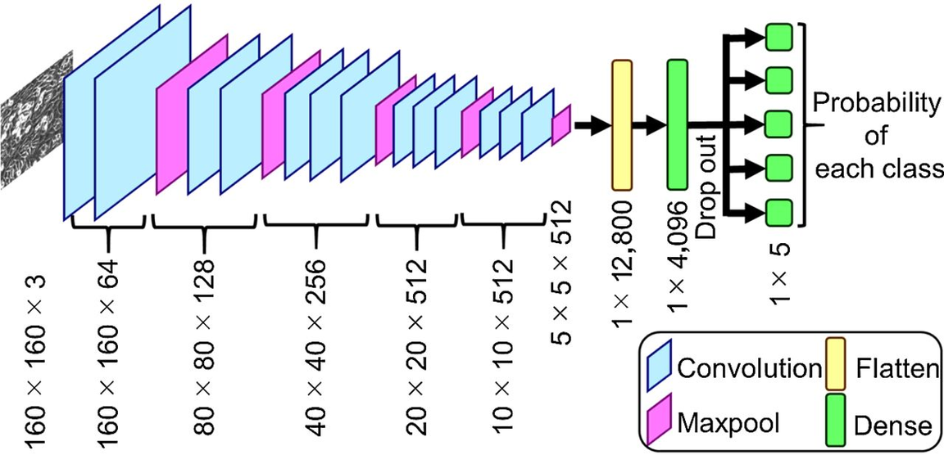
Model Architecture (CNN)
Four CNN layers
Rectified linear unit (relu)
32, 64, 128, 512 filters with 3x3 kernel size
Max pooling layers with pool size of 2
Flatten layer
Dense layer
1,028 neurons
Relu activation function
Dropout layer
Output layer
Softmax activation function
Figure 1: A CNN Model Architecture

Slide 7
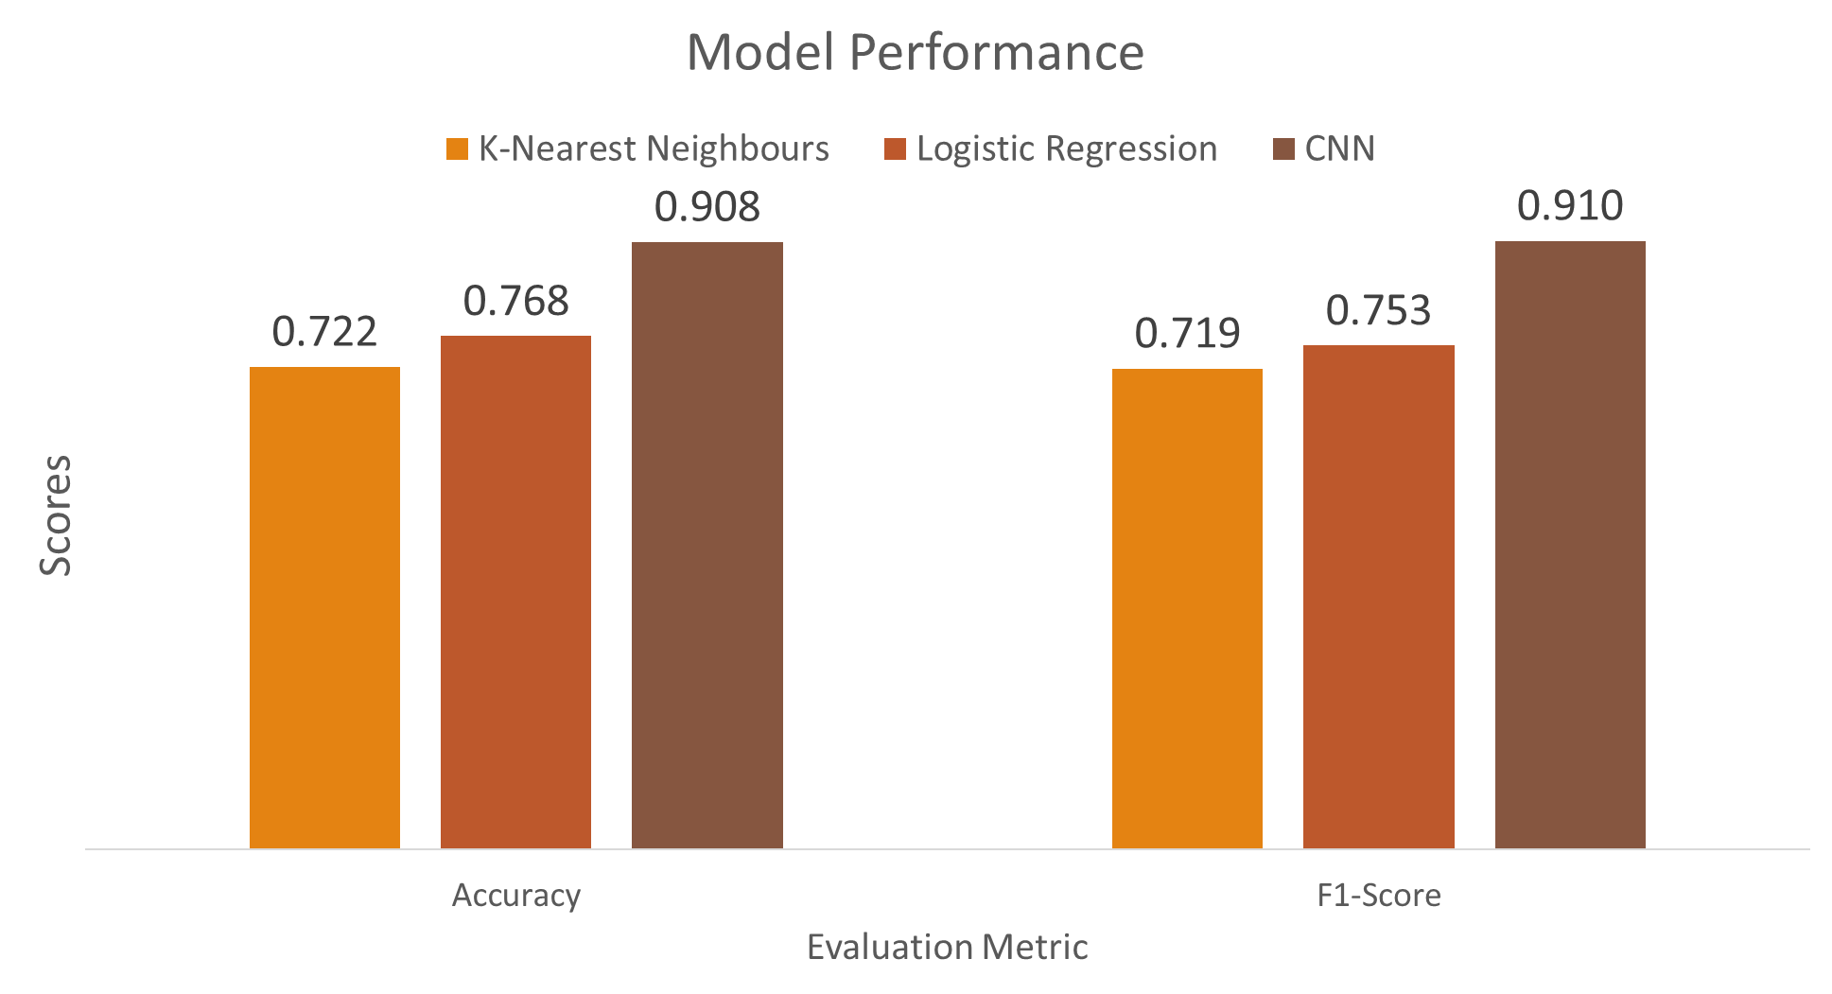
Results
Figure 2: Model Performance (Accuracy and F1-score)

Slide 8
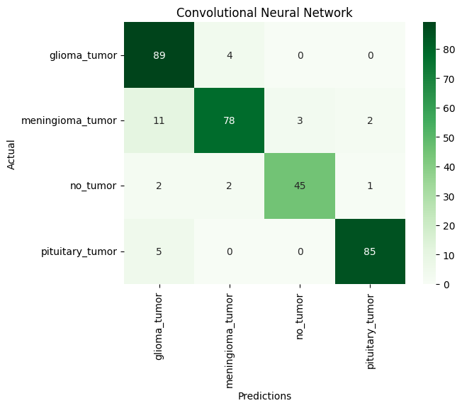
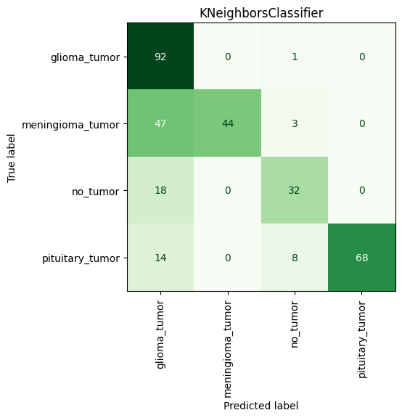
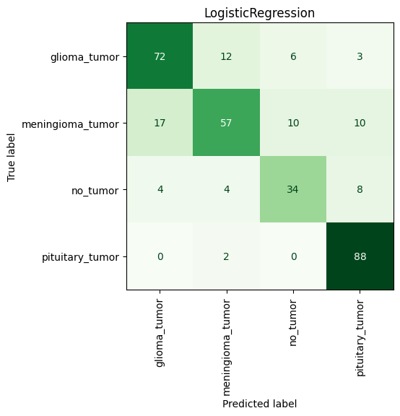
Results
Figure 3: Confusion Matrix for all models

Slide 9
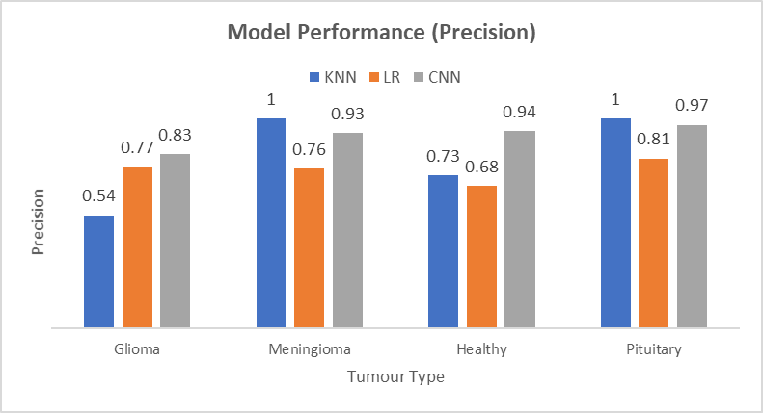
Results
Figure 4: Model Performance for each class (Precision)

Slide 10
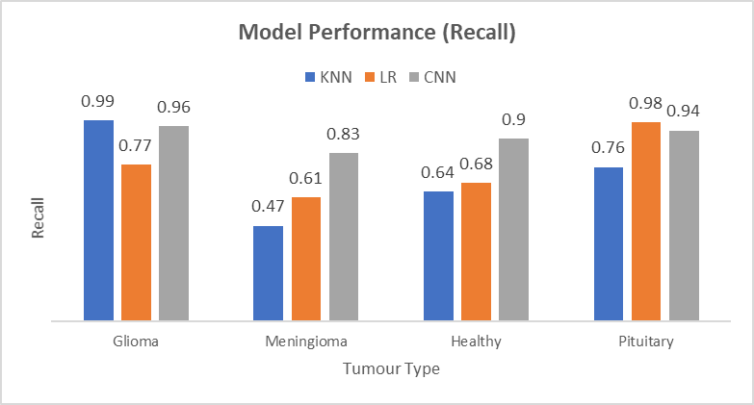
Results
Figure 5: Model Performance for each class (Recall)

Slide 11
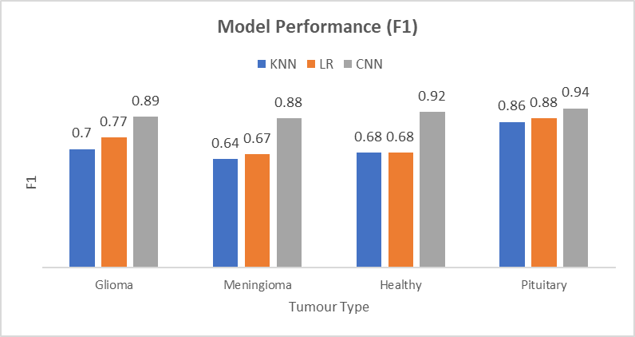
Results
Figure 6: Model Performance for each class (F1)

Slide 12
Thank You for Your Attention
Questions ??

