Slide 1
Implementation of Machine learning on Predicting Flight Completion Booking

Slide 2
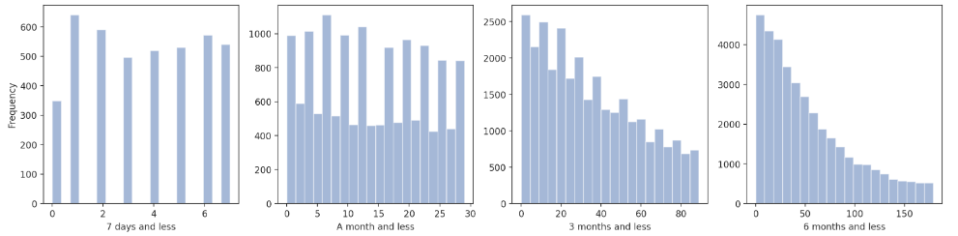
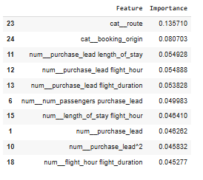
While most customers are lone travellers, a significant portion of passengers tend to book closer to their travel dates.
Regardless of the traveller segment, Monday is considered the busiest day of travels.
By route, the Penang - Taipee route appear to be most popular for the last minute customers and New Zealand - Malaysia route for the long planned travellers.
Random forest, GradientBoosting, Naives Bayes and KNN classifier models were inplemented
GradientBoost is the best performing model in this case closely followed by Random forest.
Going by the feature_importance function in Random forest, Route variable shows that it a relevant feature that influneces the prediction of the dependent variable.

