Slide 1
PropFlow ZW
Screens Overview — Dark & Light Mode
7 approved screens · desktop & mobile · dark theme (primary) and light theme (complete)

Slide 2
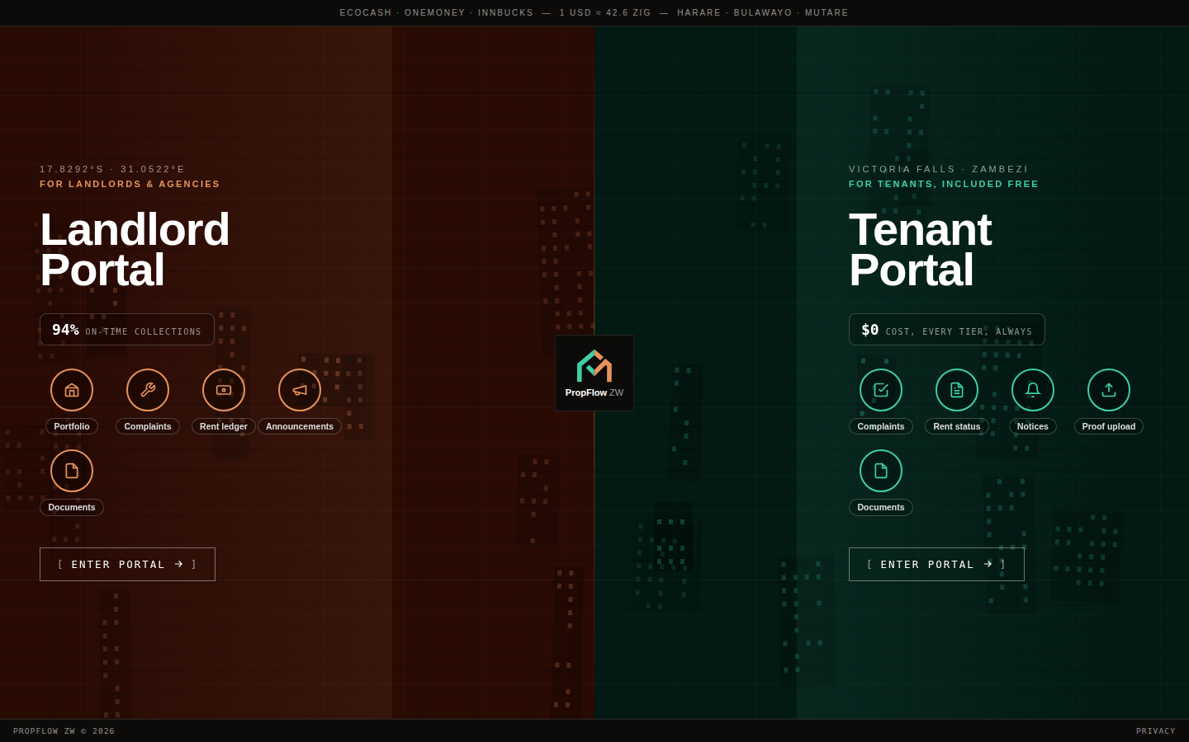
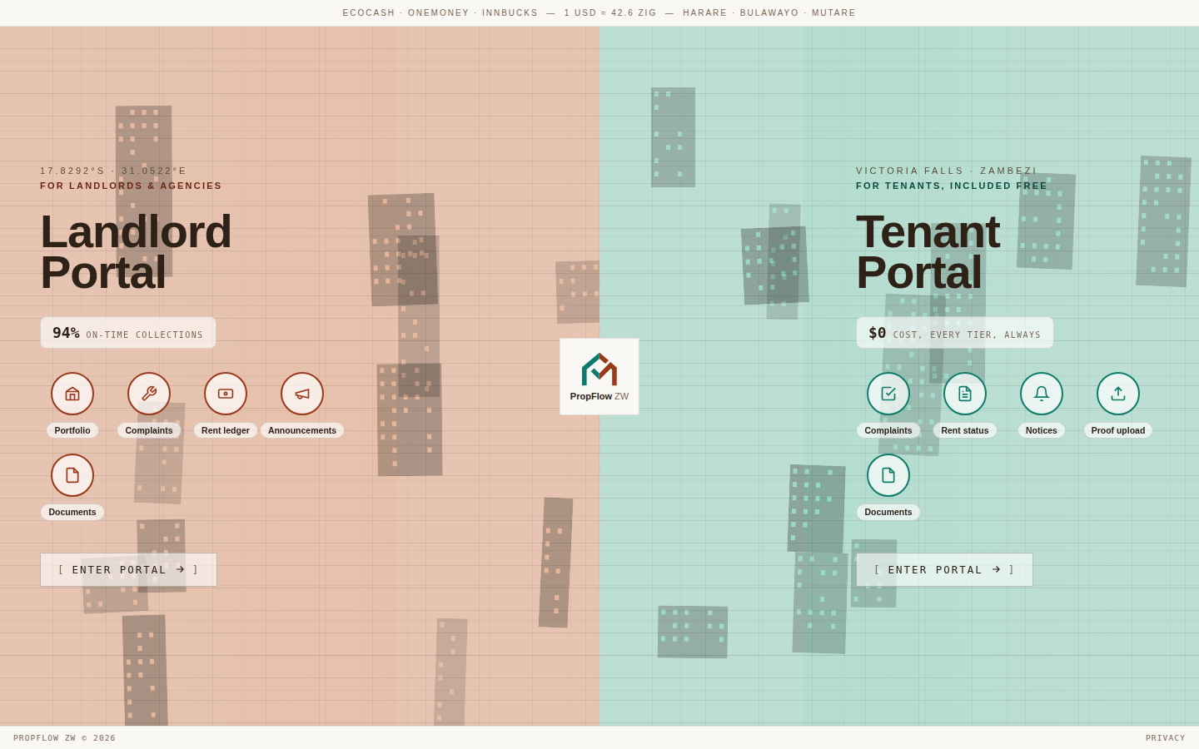
Portal Landing
Desktop · The split first impression — landlords and tenants choose their side from the same door.
Dark mode
Light mode
PropFlow ZW · Portal Landing

Slide 3
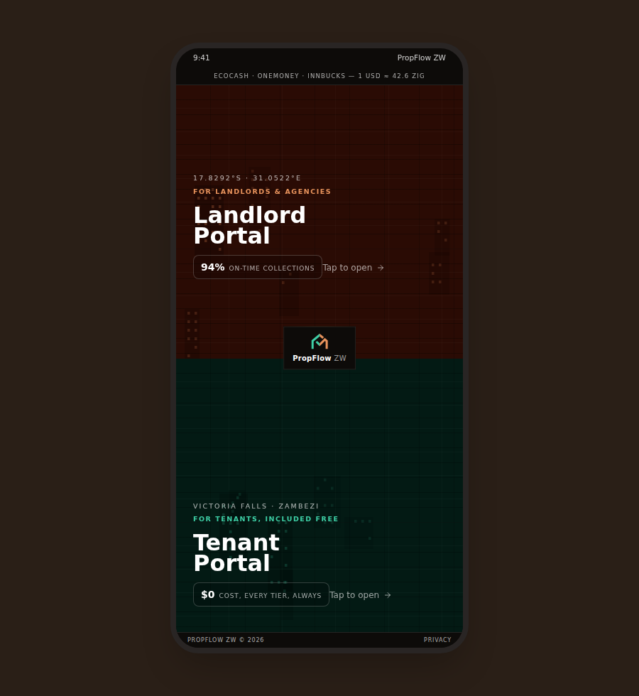
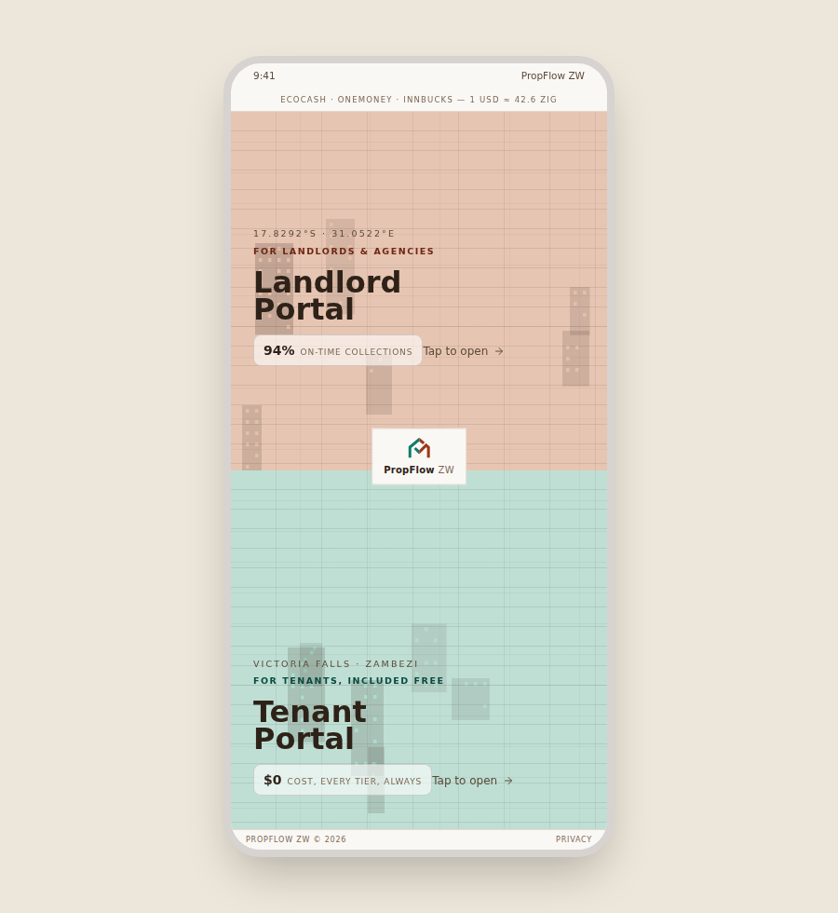
Portal Landing
Mobile · The split first impression — landlords and tenants choose their side from the same door.
Dark mode
Light mode
PropFlow ZW · Portal Landing

Slide 4
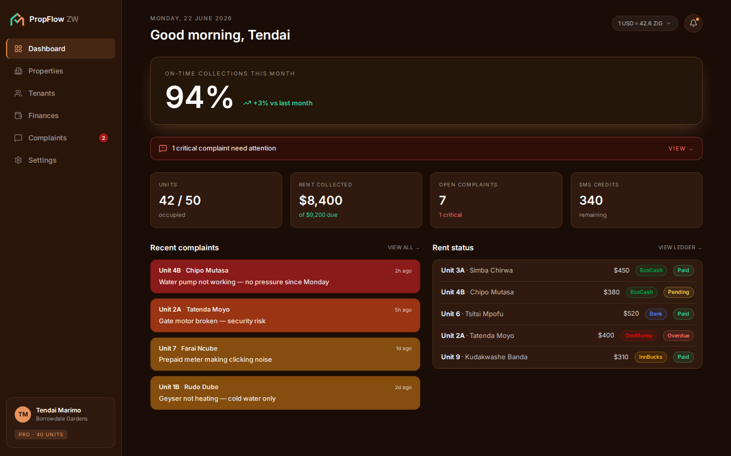
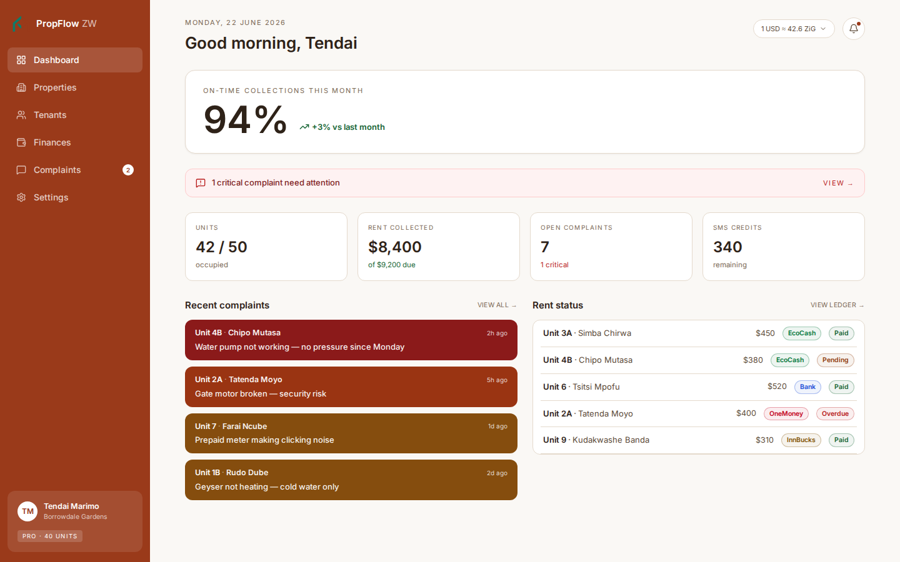
Landlord Dashboard
Desktop · Daily home base — on-time collections hero stat, critical alerts, complaints and rent status.
Dark mode
Light mode
PropFlow ZW · Landlord Dashboard

Slide 5
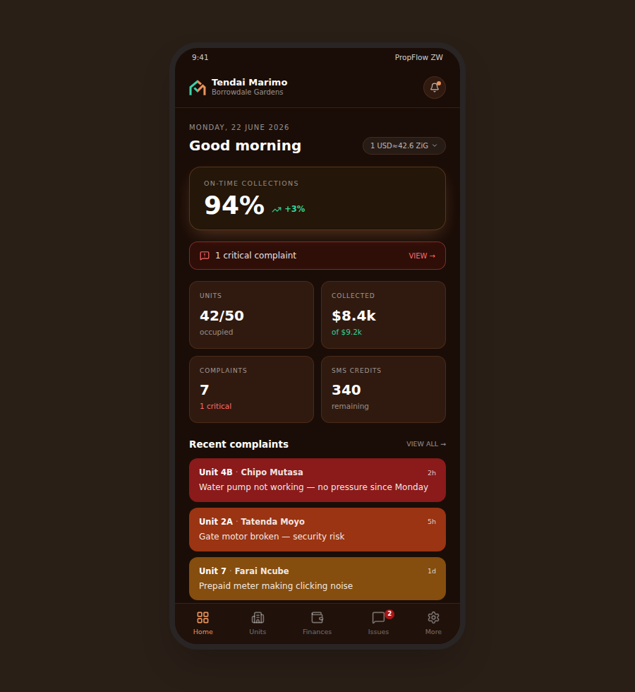
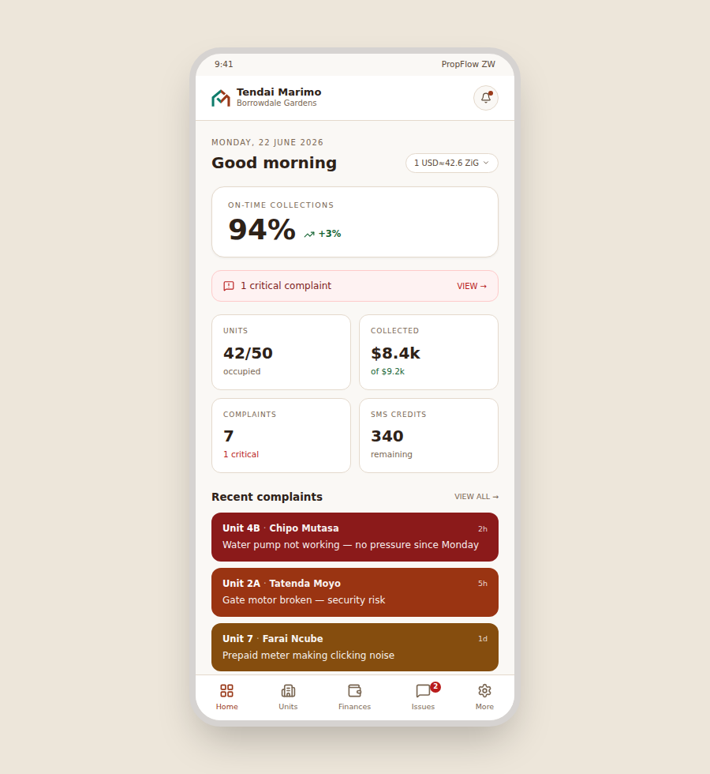
Landlord Dashboard
Mobile · Daily home base — on-time collections hero stat, critical alerts, complaints and rent status.
Dark mode
Light mode
PropFlow ZW · Landlord Dashboard

Slide 6
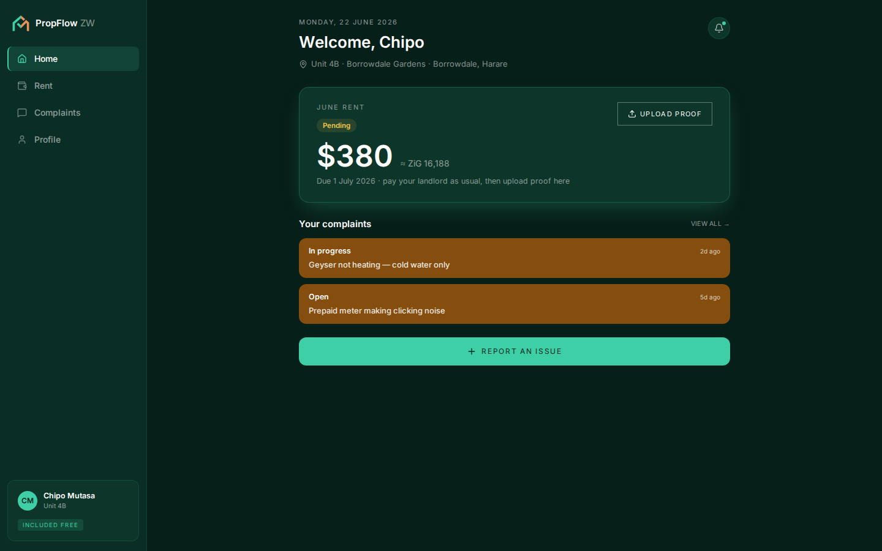
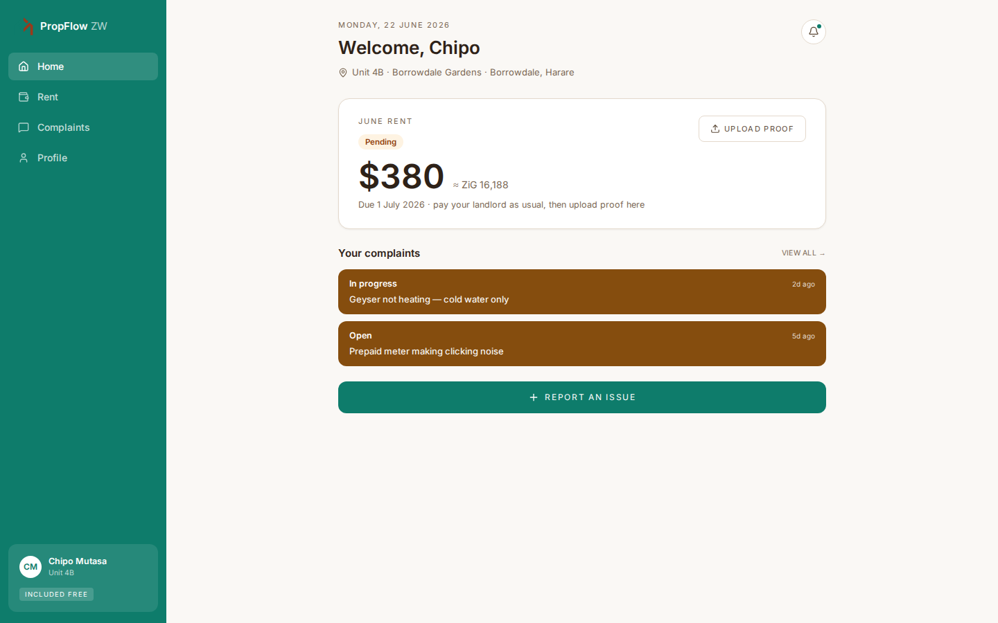
Tenant Home
Desktop · The tenant's flagship screen — rent status, open complaints, and a one-tap issue report.
Dark mode
Light mode
PropFlow ZW · Tenant Home

Slide 7
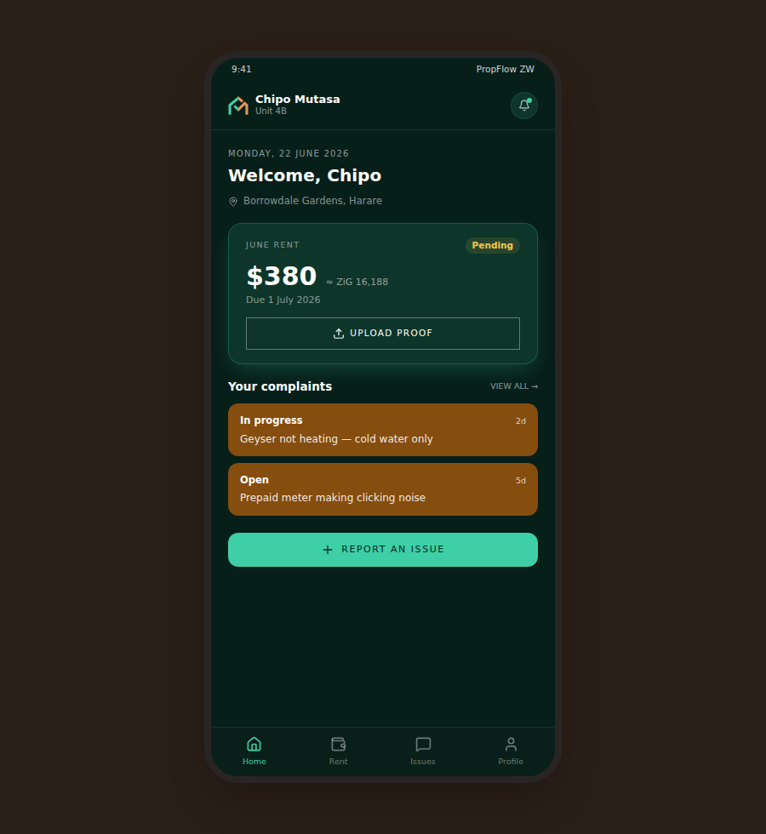
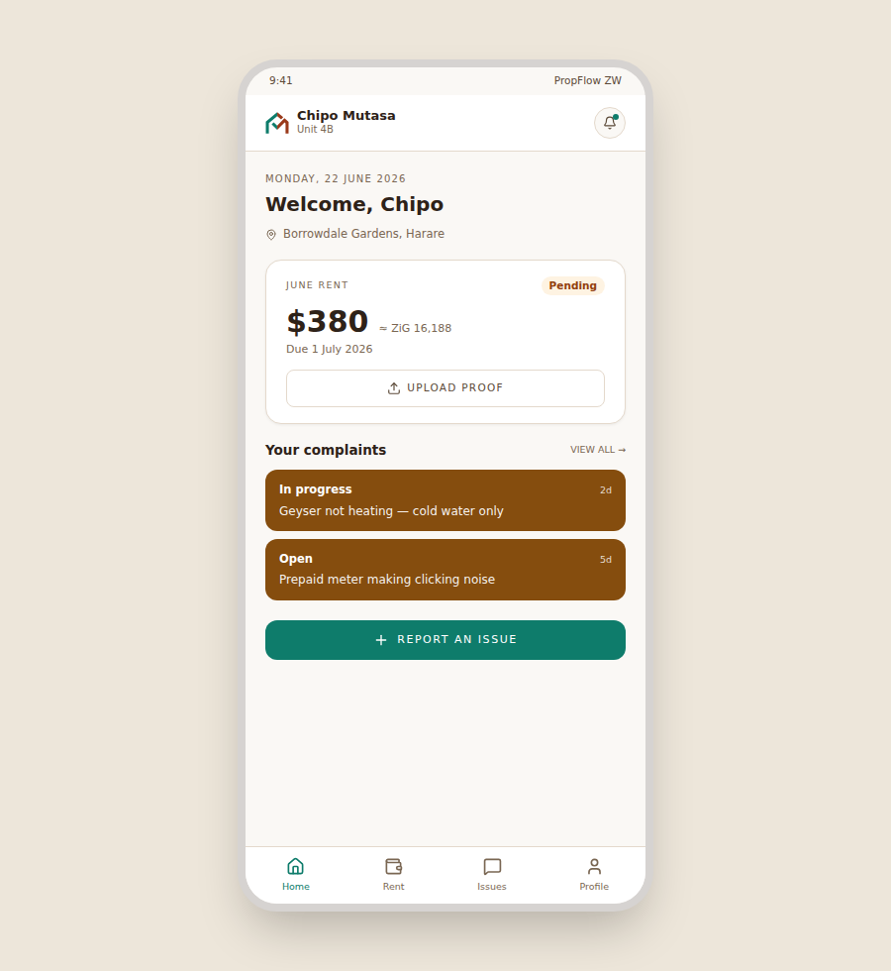
Tenant Home
Mobile · The tenant's flagship screen — rent status, open complaints, and a one-tap issue report.
Dark mode
Light mode
PropFlow ZW · Tenant Home

Slide 8
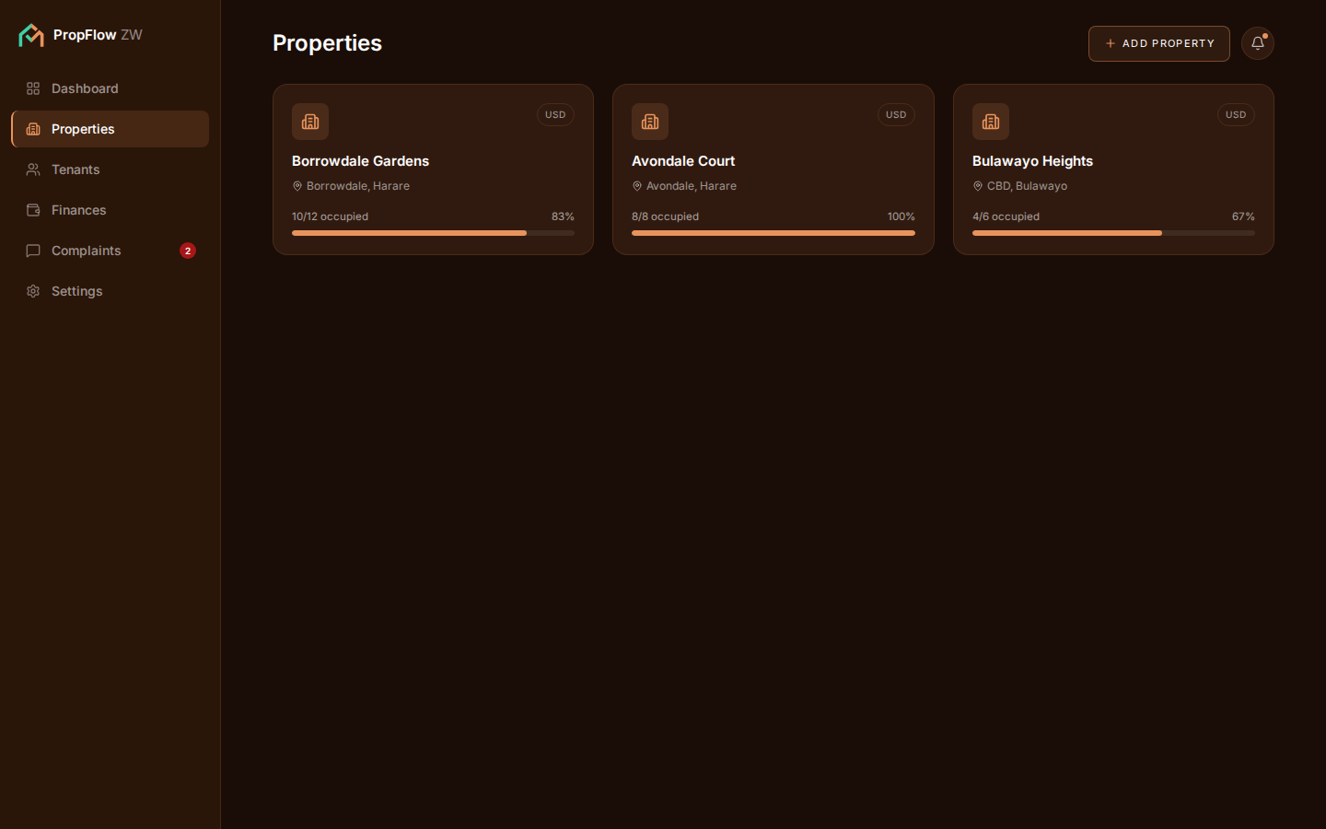
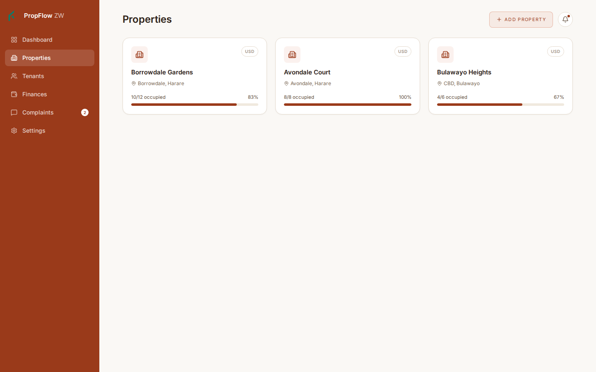
Properties & Units
Desktop · The workhorse data screen — occupancy at a glance, unit-by-unit management.
Dark mode
Light mode
PropFlow ZW · Properties & Units

Slide 9
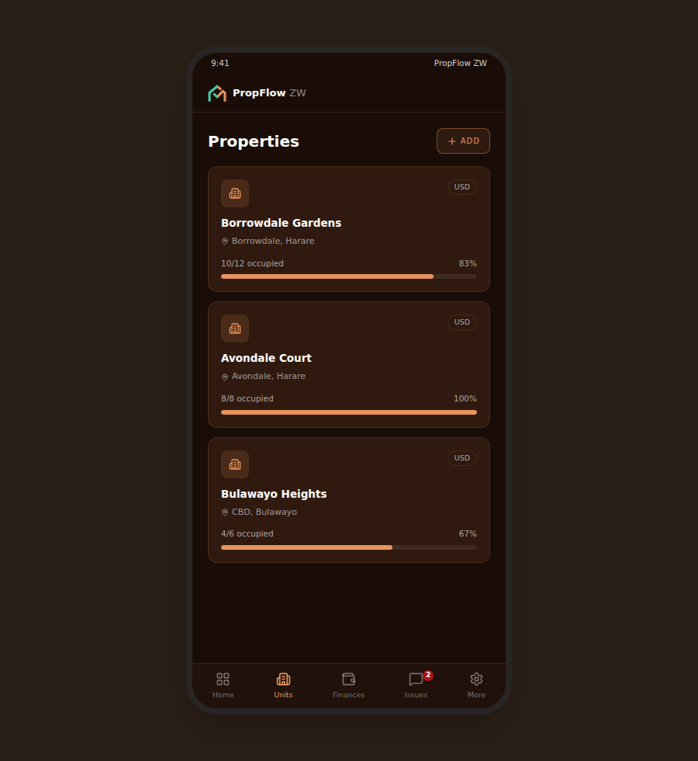
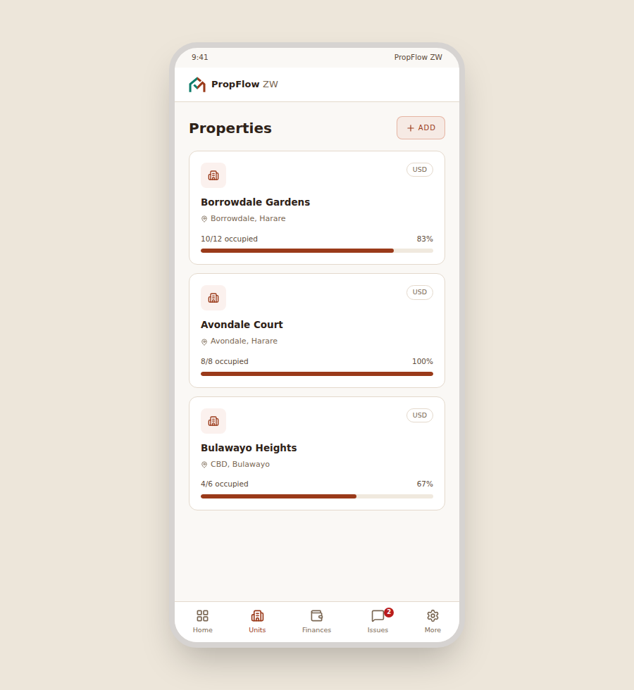
Properties & Units
Mobile · The workhorse data screen — occupancy at a glance, unit-by-unit management.
Dark mode
Light mode
PropFlow ZW · Properties & Units

Slide 10
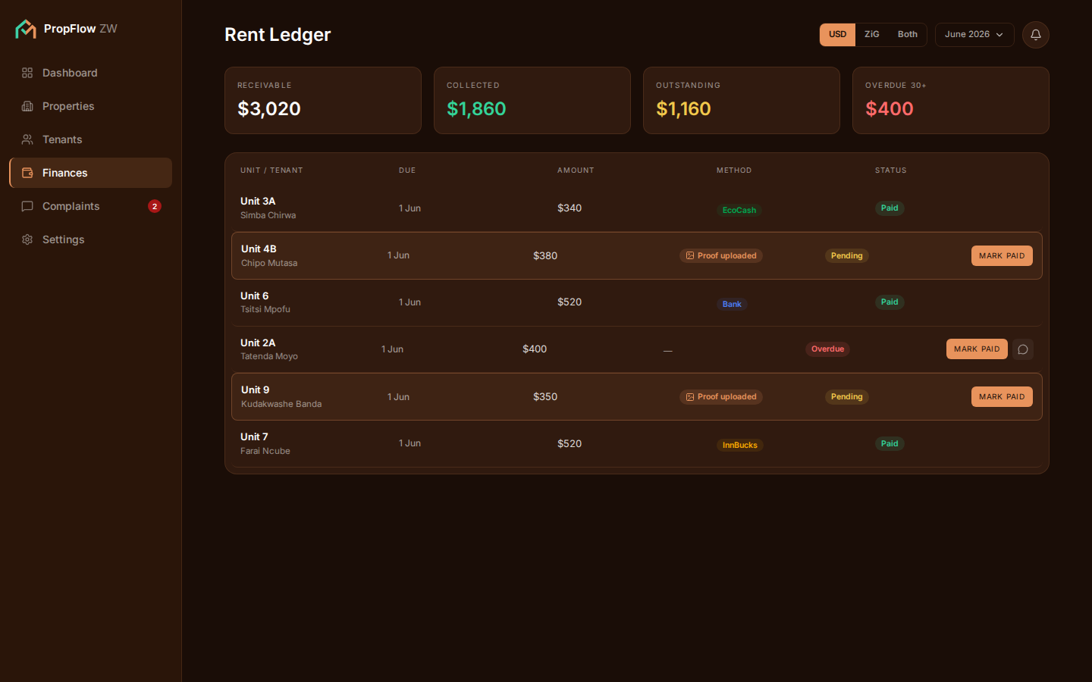
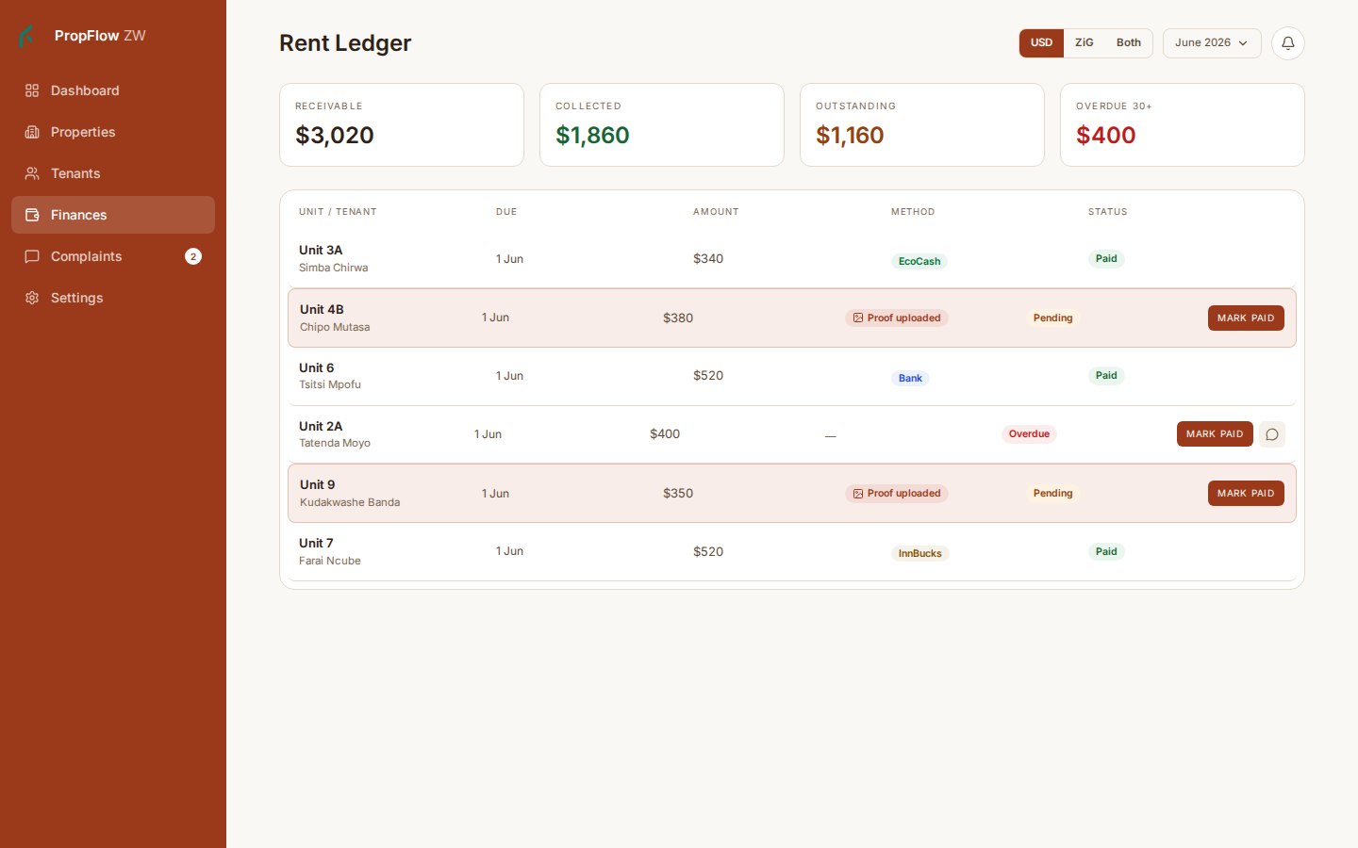
Rent Ledger
Desktop · Every unit's rent for the month, with proof-pending rows visibly highlighted.
Dark mode
Light mode
PropFlow ZW · Rent Ledger

Slide 11
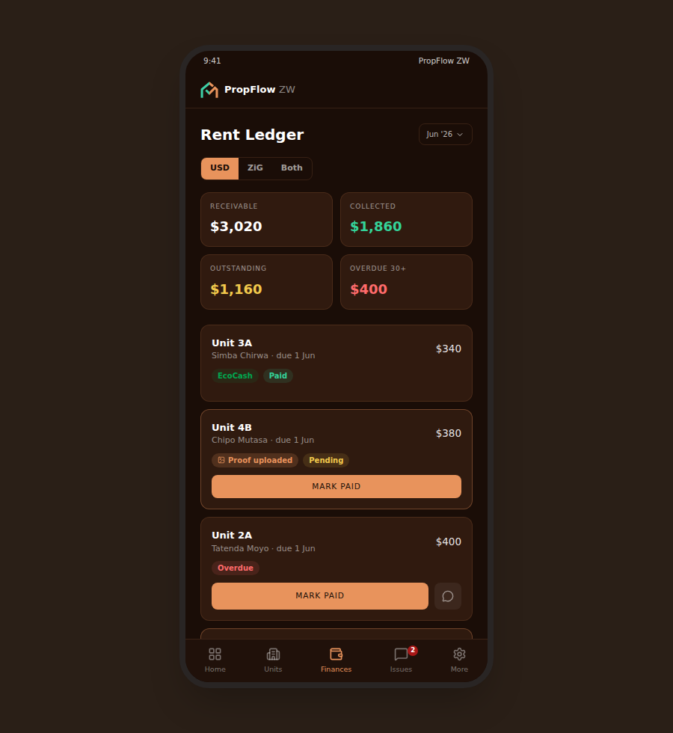
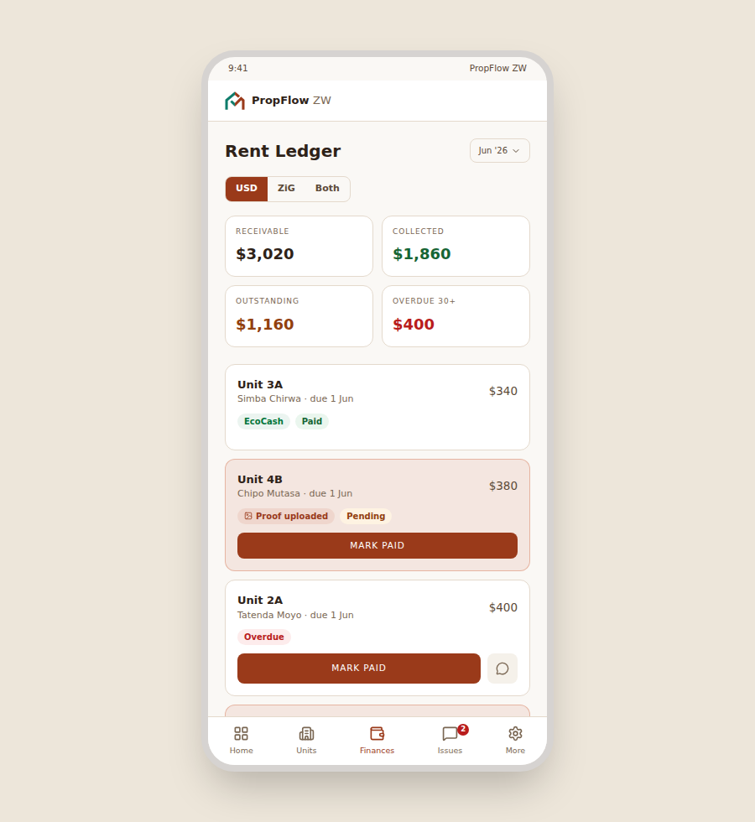
Rent Ledger
Mobile · Every unit's rent for the month, with proof-pending rows visibly highlighted.
Dark mode
Light mode
PropFlow ZW · Rent Ledger

Slide 12
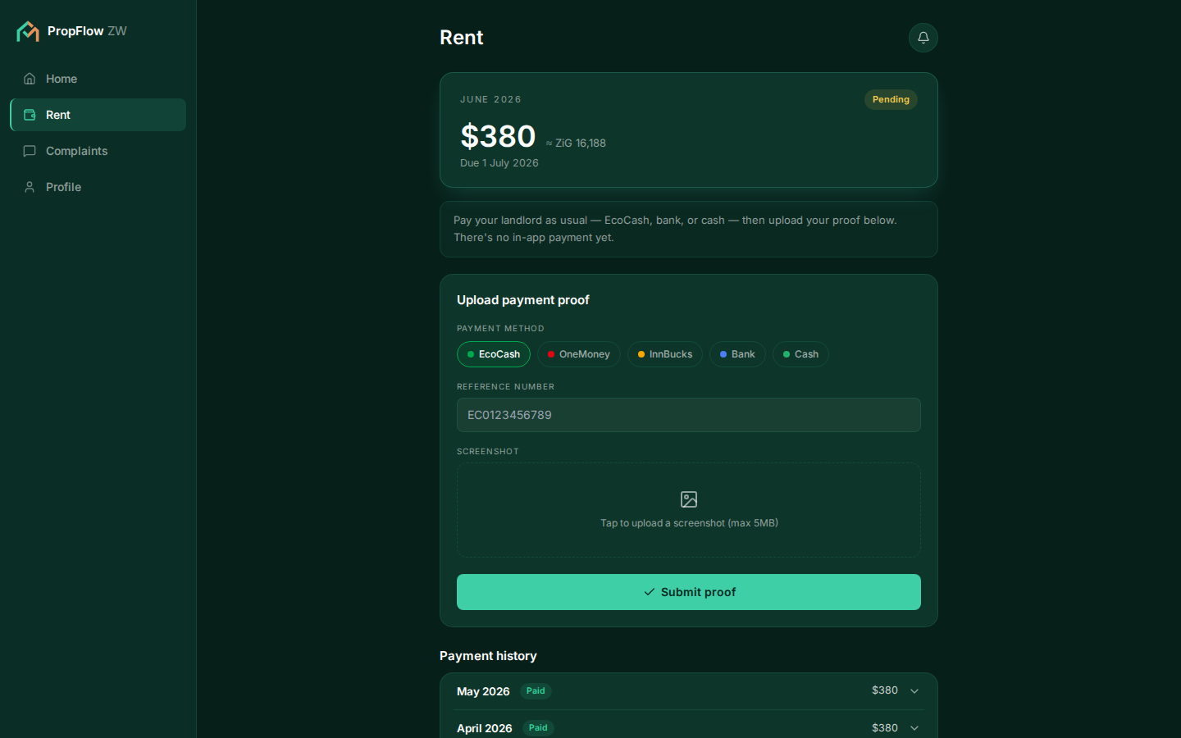
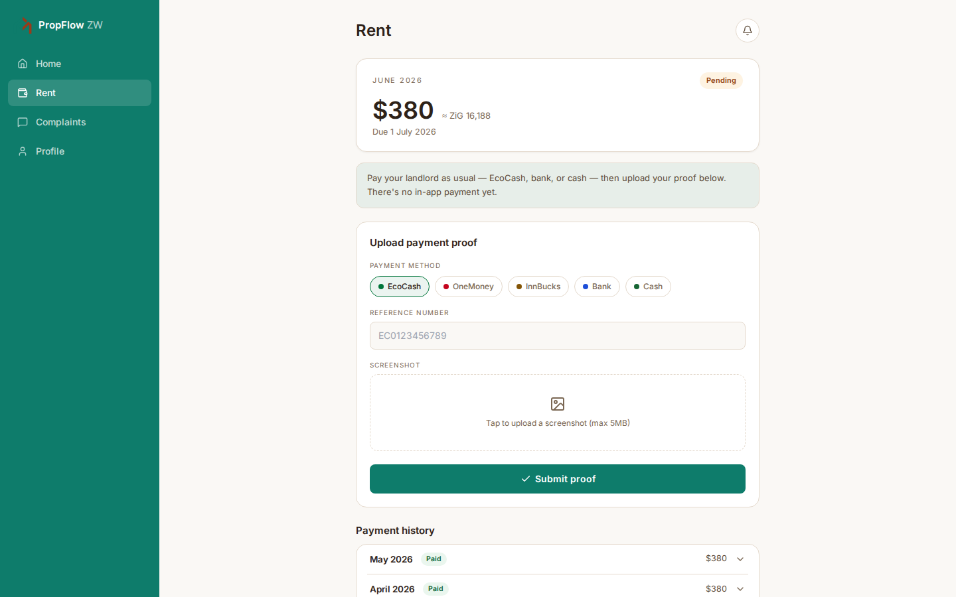
Tenant Rent & Proof Upload
Desktop · Pay your landlord as usual, then upload proof here — plus 12 months of history.
Dark mode
Light mode
PropFlow ZW · Tenant Rent & Proof Upload

Slide 13
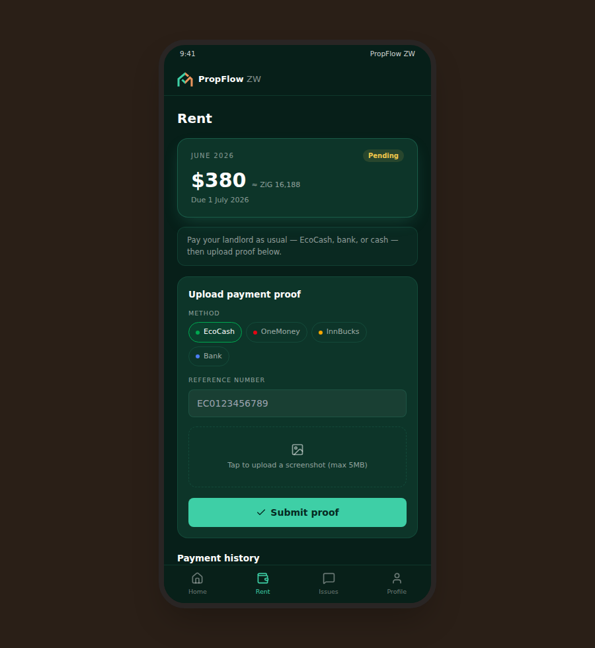
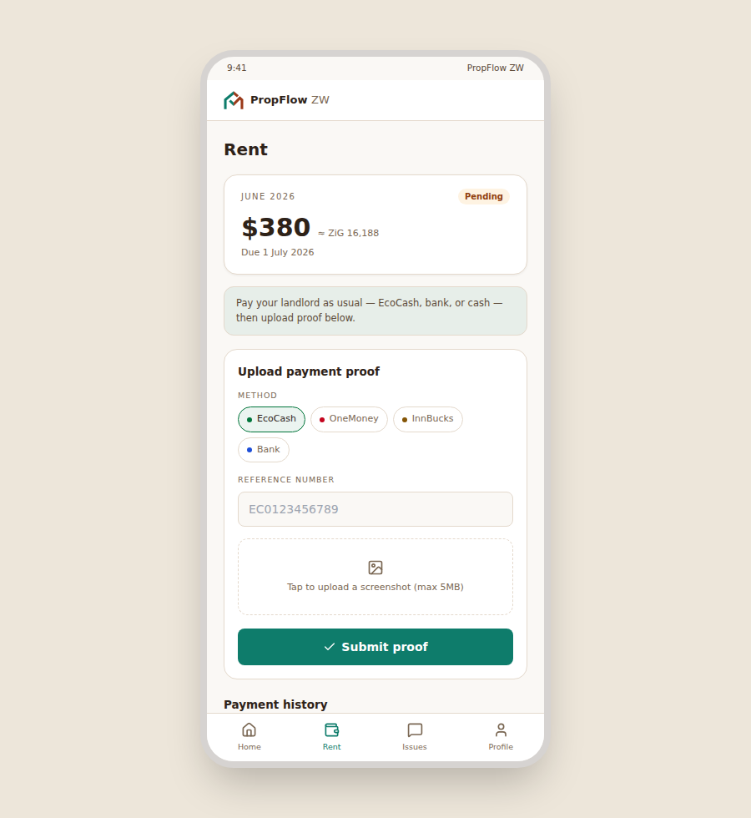
Tenant Rent & Proof Upload
Mobile · Pay your landlord as usual, then upload proof here — plus 12 months of history.
Dark mode
Light mode
PropFlow ZW · Tenant Rent & Proof Upload

Slide 14
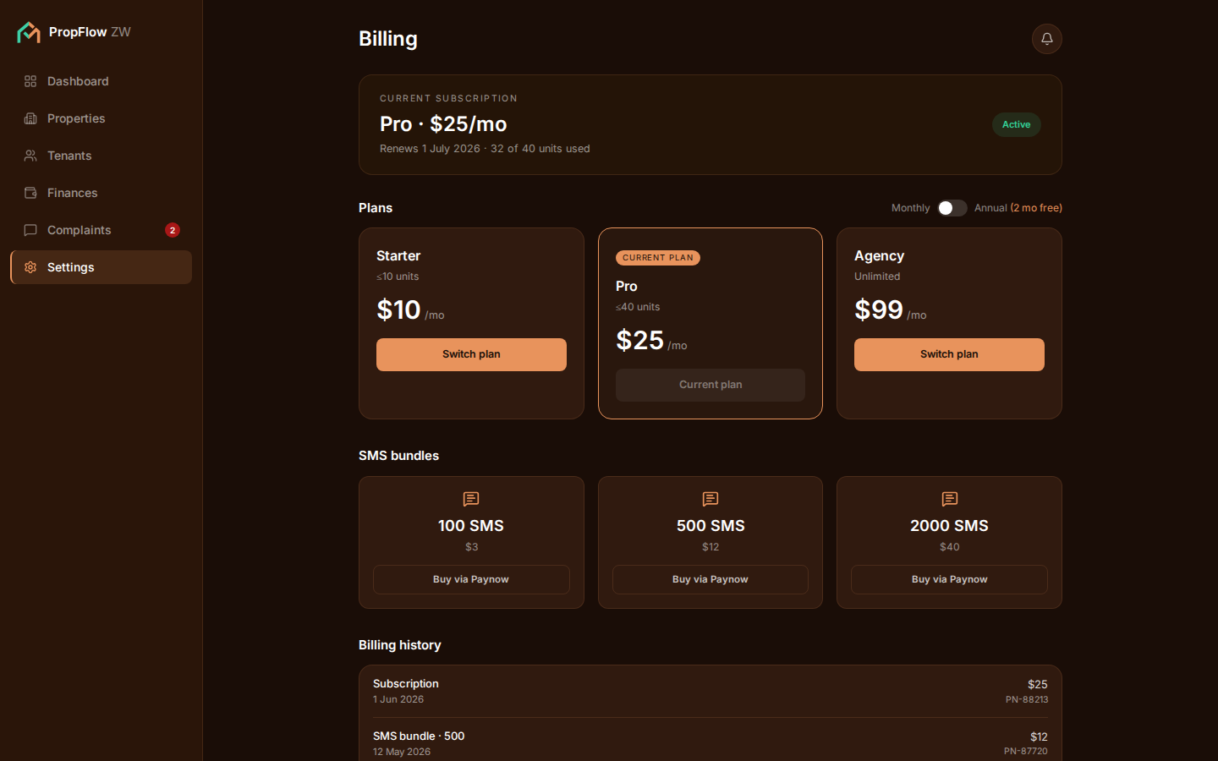
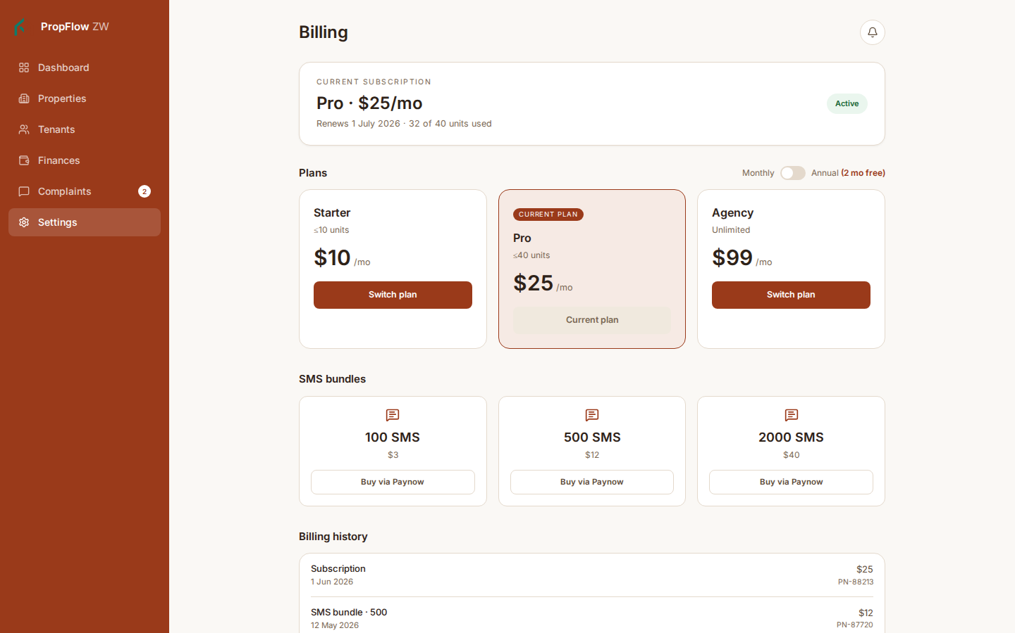
Settings → Billing
Desktop · PropFlow's own subscription, billed the same way landlords collect rent.
Dark mode
Light mode
PropFlow ZW · Settings → Billing

Slide 15
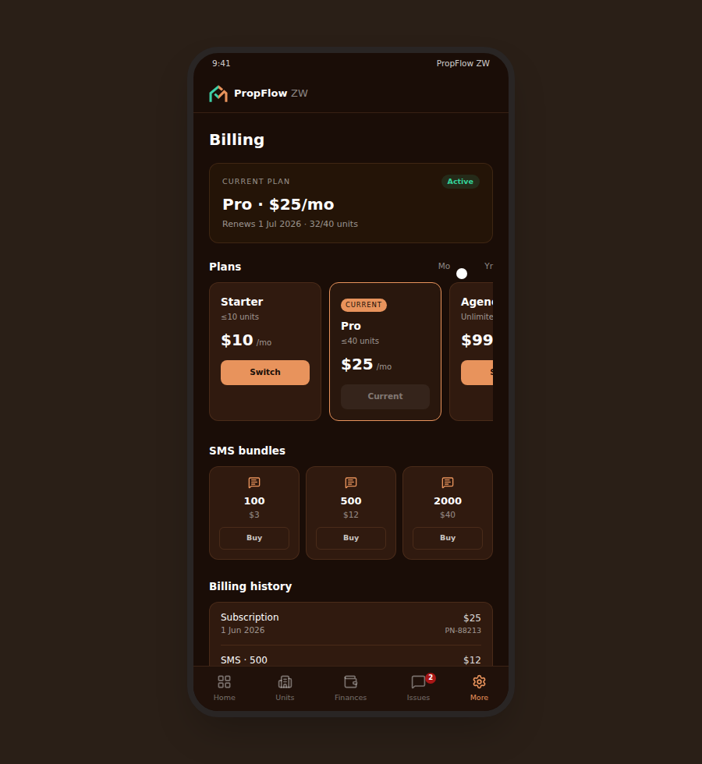
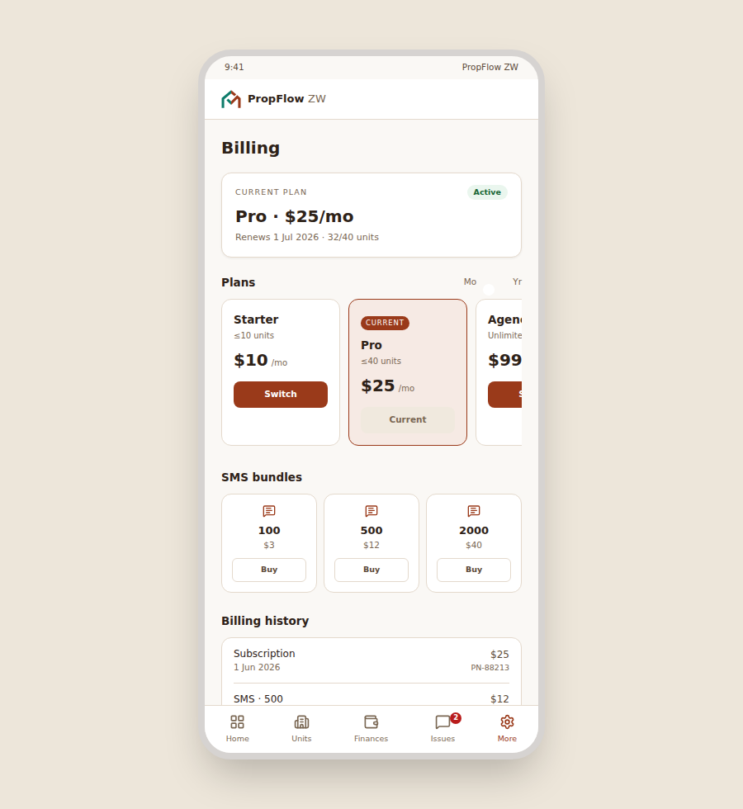
Settings → Billing
Mobile · PropFlow's own subscription, billed the same way landlords collect rent.
Dark mode
Light mode
PropFlow ZW · Settings → Billing

Slide 16
More to come
Light mode conversion is complete for all 7 screens. Next: Auth pages review, and continued design iteration.

